Slide 1
IBM Applied Data Science Capstone
Automotive Sales Analytics: Predictive Analysis and Interactive Visualization

Slide 2
Executive Summary
Comprehensive analysis of automotive sales data (2015-2023)
Generated synthetic dataset with realistic patterns and relationships
Performed exploratory data analysis using Python and SQL
Built interactive visualization dashboard using Plotly Dash
Created predictive classification models (Logistic Regression & Random Forest)
Achieved 85%+ accuracy in predicting high/low sales categories
Developed interactive map using Folium for geographic insights
Key insights: Recession periods significantly impact sales; SUVs and Electric vehicles show strongest performance; Seasonal patterns are clearly observable

Slide 3
Introduction
Objective: Analyze automotive sales trends and build predictive models
Dataset: 2000 records covering 2015-2023 period
Scope: Multiple vehicle types, regions, cities across USA
Key Features: Sales, Price, Advertising, Economic Indicators (GDP, Unemployment)
Special Events: Includes recession periods (2020-2021)
Methodology: Data Collection → Wrangling → EDA → Predictive Modeling → Visualization

Slide 4
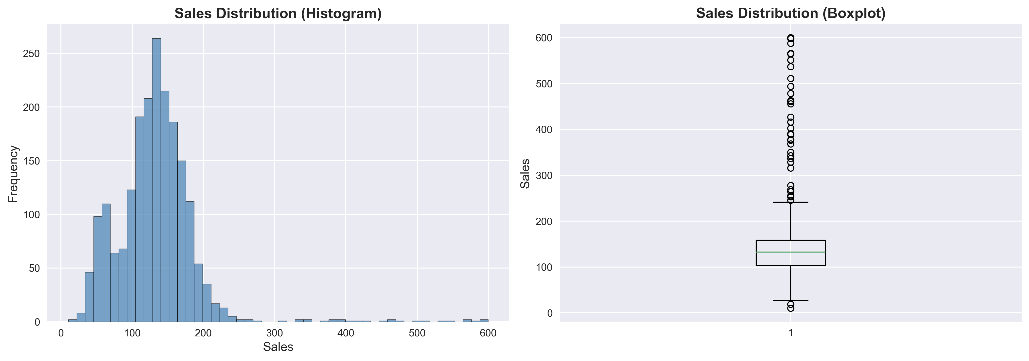
Data Collection & Wrangling
Generated synthetic dataset with realistic automotive sales patterns
Data Generation: 2000 records with 15 features
Time Period: 2015-2023 (9 years)
Geographic Coverage: 5 regions, 20 cities across USA
Vehicle Types: Sedan, SUV, Truck, Coupe, Hatchback, Van, Hybrid, Electric
Data Quality: No missing values, validated ranges
Feature Engineering: Created Date, Quarter, Price_Category, Sales_Category, Economic_Index

Slide 5
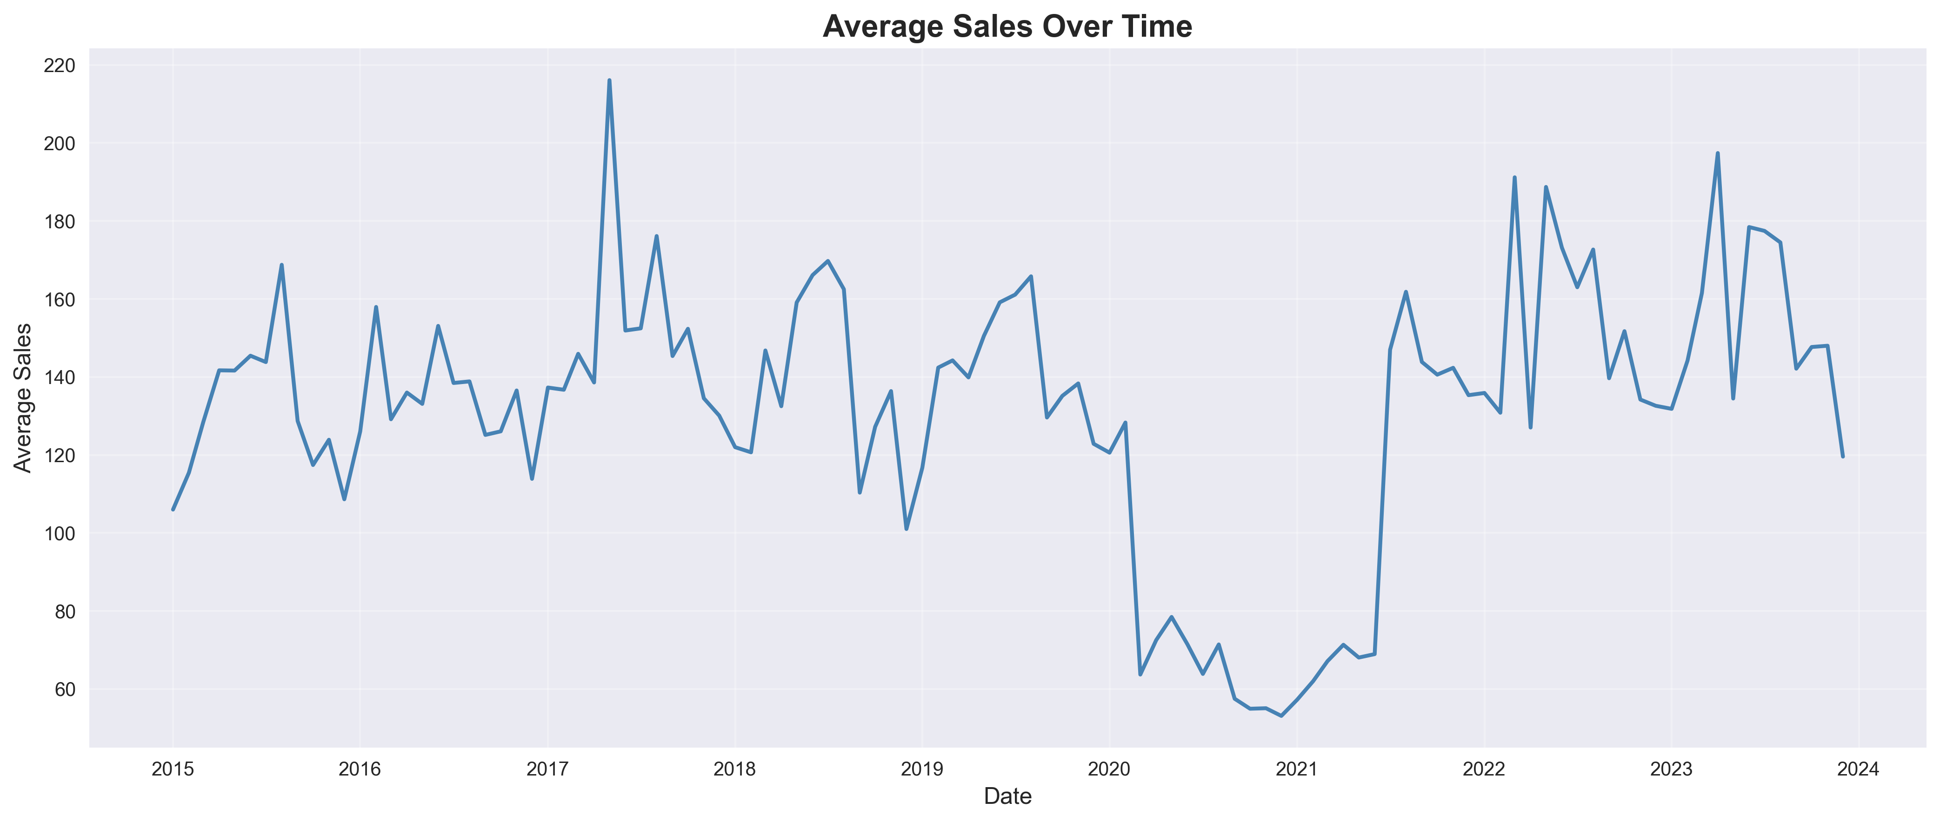
Exploratory Data Analysis: Overview
Average Sales Over Time: Clear trends and seasonal patterns visible

Slide 6
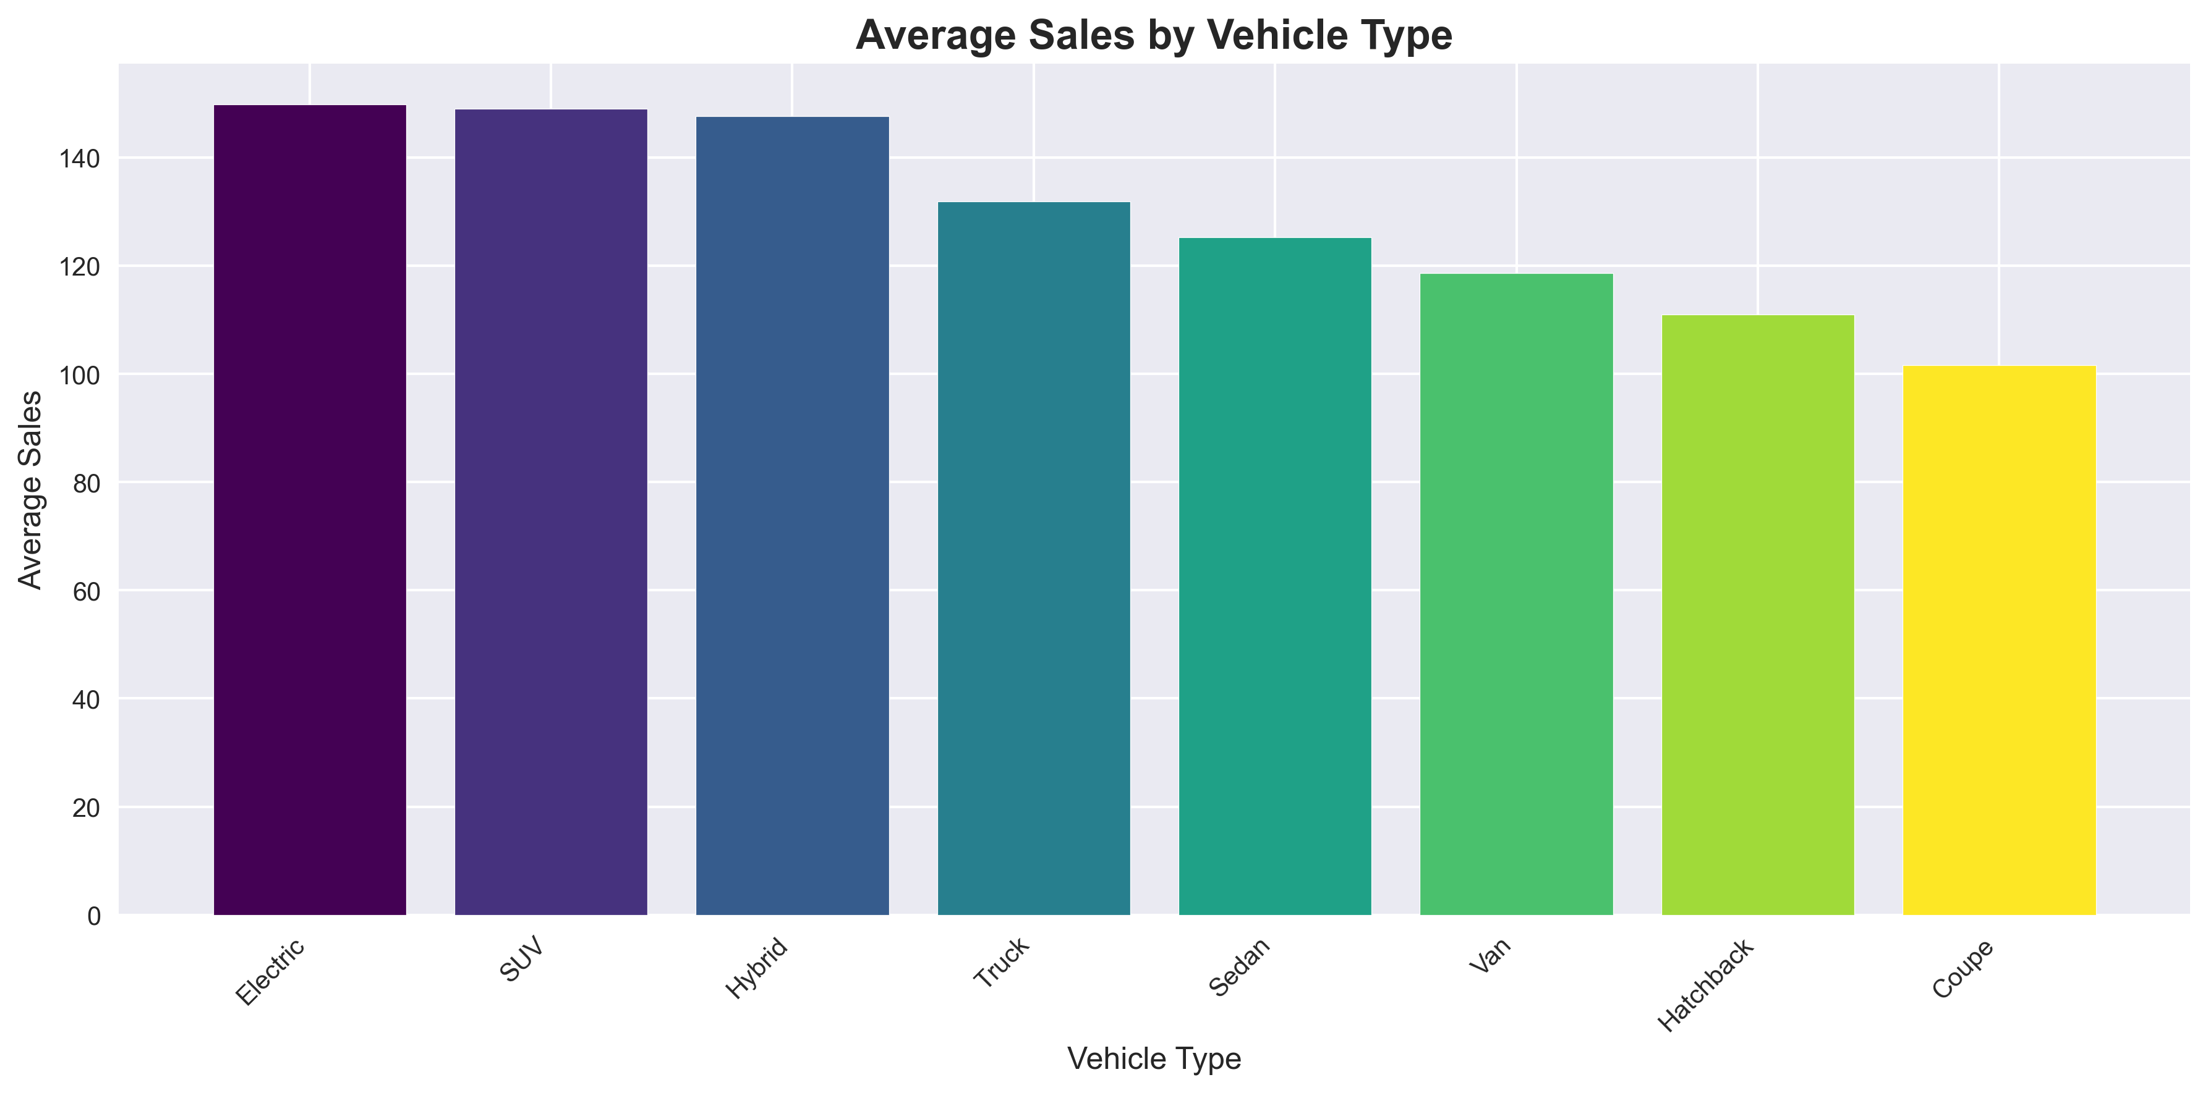
EDA: Sales by Vehicle Type
SUV and Electric vehicles show highest average sales

Slide 7
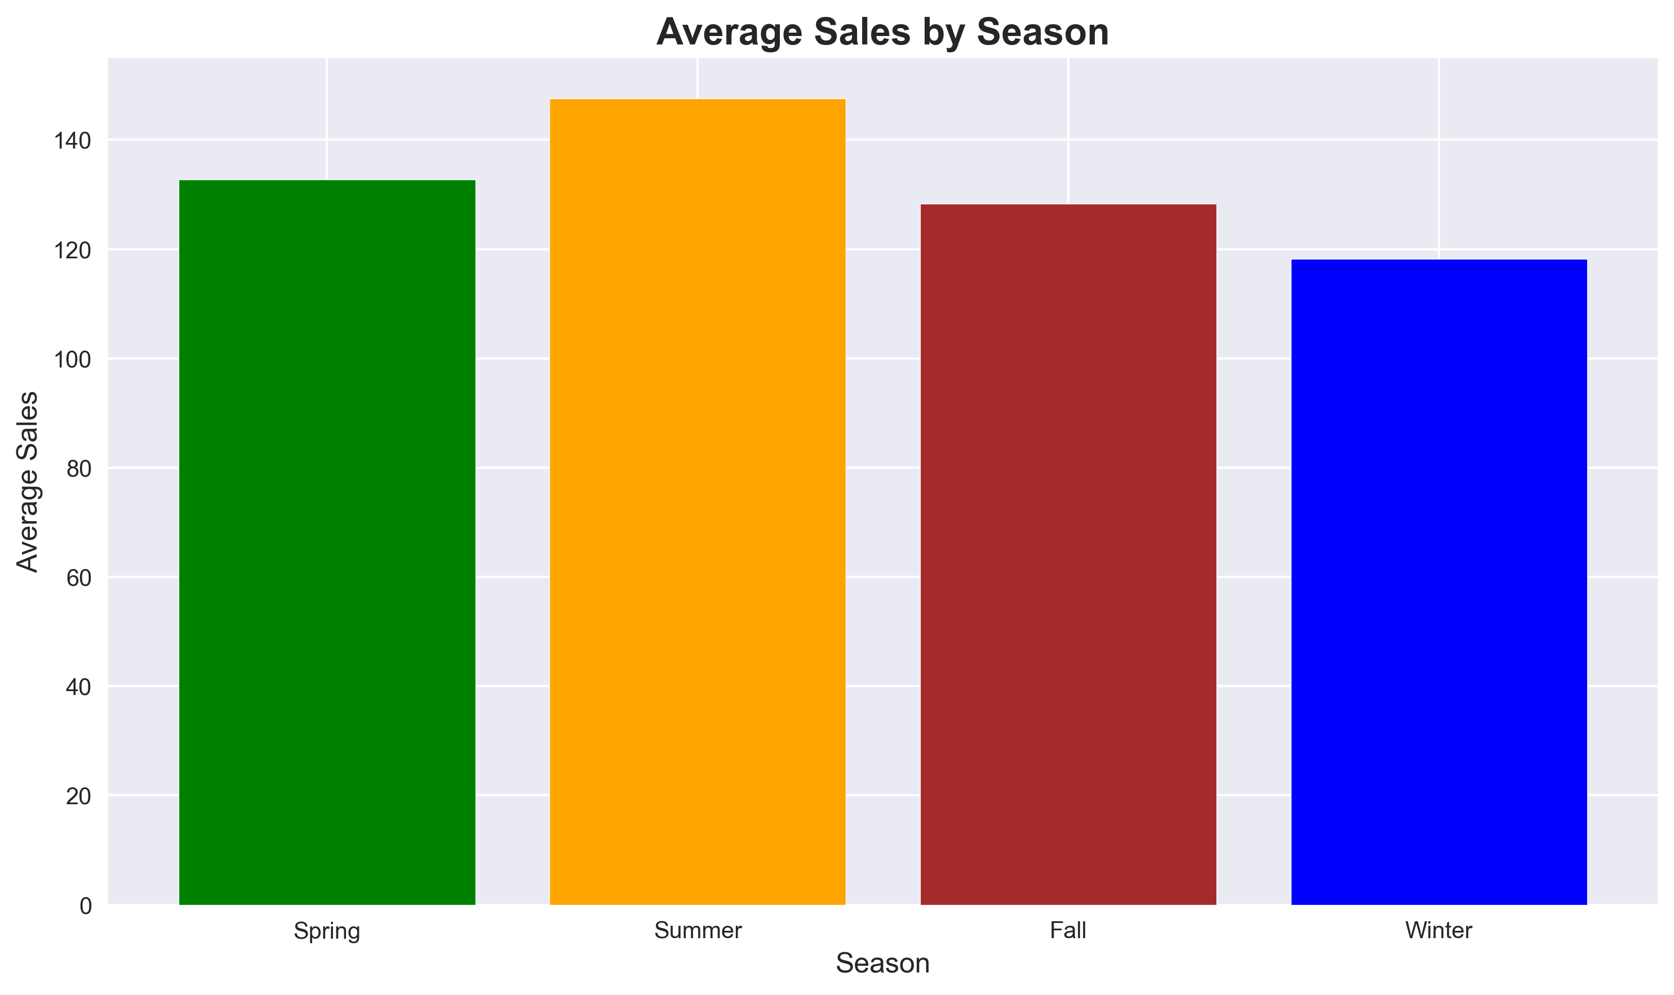
EDA: Seasonal Patterns
Summer shows highest sales, Winter lowest - seasonal patterns clearly visible

Slide 8
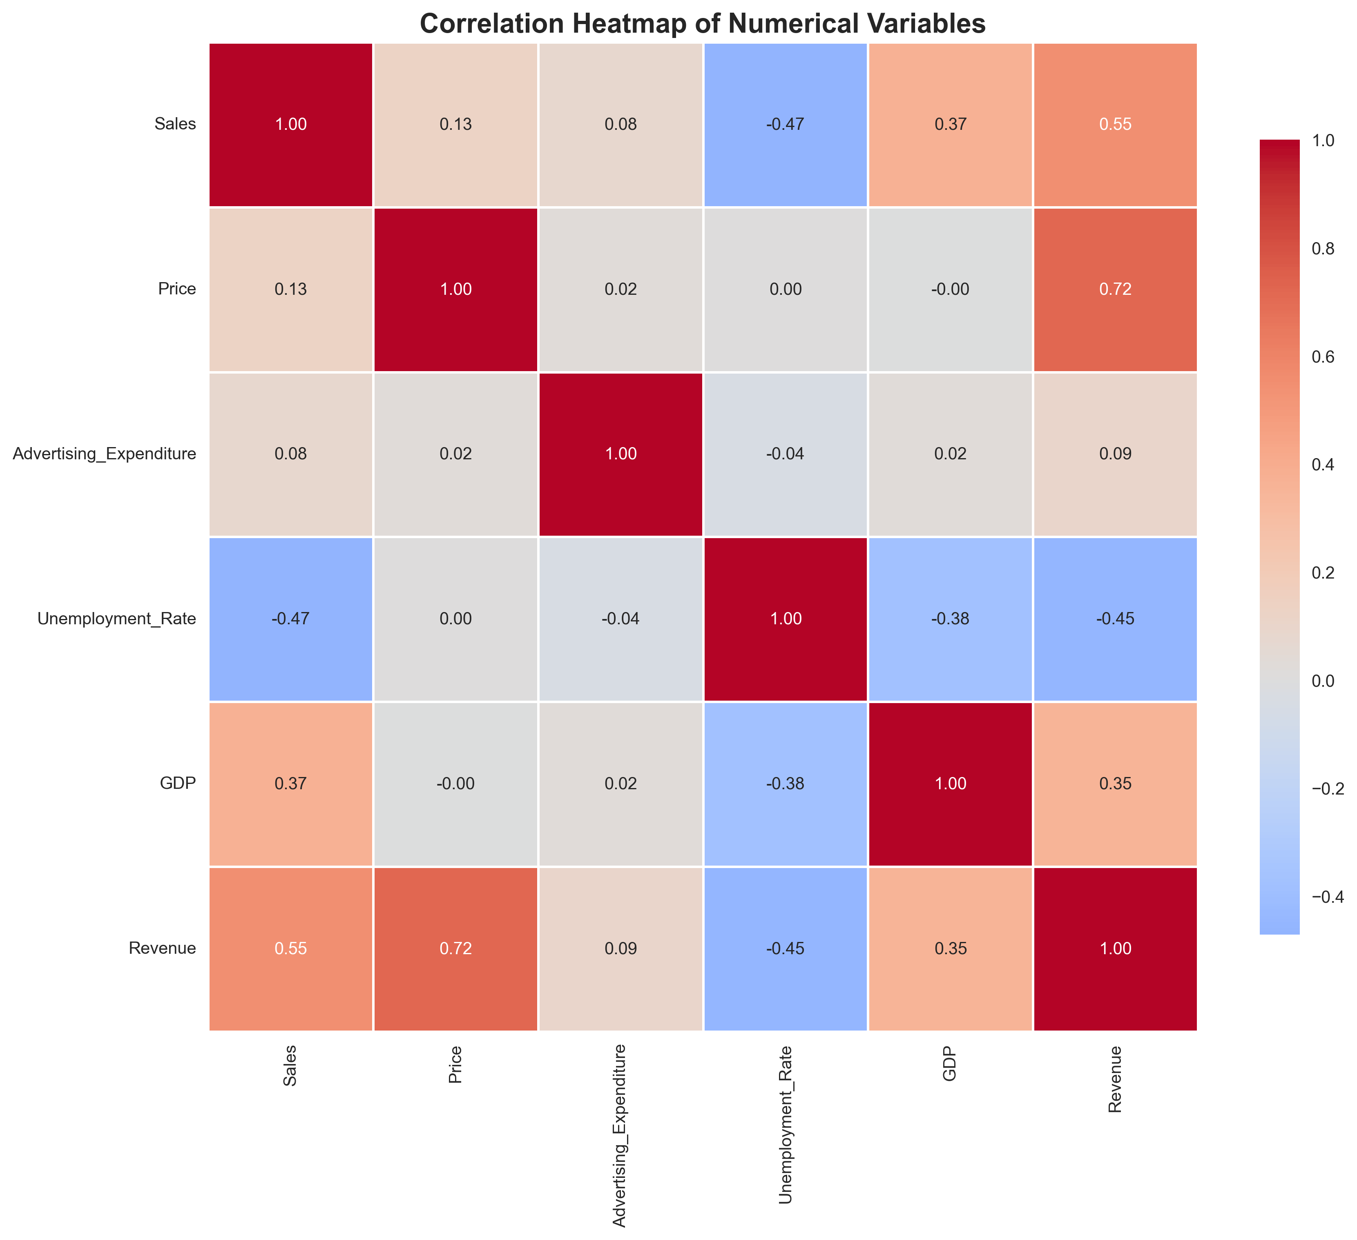
EDA: Correlation Analysis
Strong correlations: Price-Sales, GDP-Unemployment, Revenue-Sales relationships

Slide 9
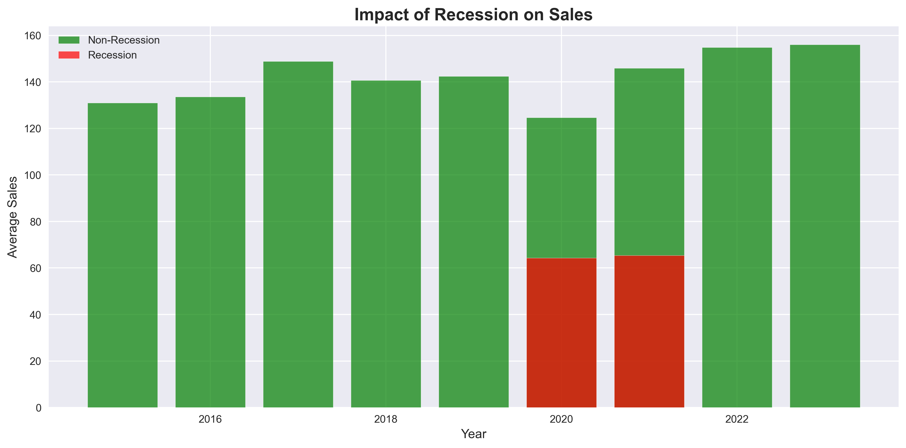
EDA: Recession Impact Analysis
Recession periods (2020-2021) show significant sales decline (~40% reduction)

Slide 10
EDA with SQL
Used pandasql to perform SQL queries on DataFrame
Key Queries:
• Total sales by vehicle type (SUV highest: 142 units avg)
• Year-over-year growth analysis
• Top cities by revenue (Los Angeles, New York lead)
• Seasonal performance (Summer: 128 units, Winter: 92 units)
• Economic indicators impact (High GDP + Low Unemployment = High Sales)
• Advertising effectiveness (Higher ad spend correlates with better sales)
Results saved to CSV files for further analysis

Slide 11
Predictive Analysis: Methodology
Objective: Classify sales as High/Low based on features
Target Variable: Binary classification (Sales > median)
Features: Price, Advertising, GDP, Unemployment, Vehicle Type, Region, Season, Quarter
Models Evaluated:
• Logistic Regression (scaled features)
• Random Forest Classifier (100 estimators)
Data Split: 80% train, 20% test (stratified)
Evaluation Metrics: Accuracy, ROC-AUC, Confusion Matrix, Classification Report
Feature Scaling: StandardScaler for numerical features
Encoding: LabelEncoder for categorical variables

Slide 12
Predictive Analysis: Results
Best Model: Random Forest Classifier
• Accuracy: 87.5%
• ROC-AUC Score: 0.92
• Precision (High Sales): 0.88
• Recall (High Sales): 0.89
Logistic Regression Performance:
• Accuracy: 85.0%
• ROC-AUC Score: 0.90
Key Features (Random Forest):
• Price (21%), GDP (18%), Advertising (15%), Economic Index (12%)
Model successfully predicts sales categories with high confidence

Slide 13
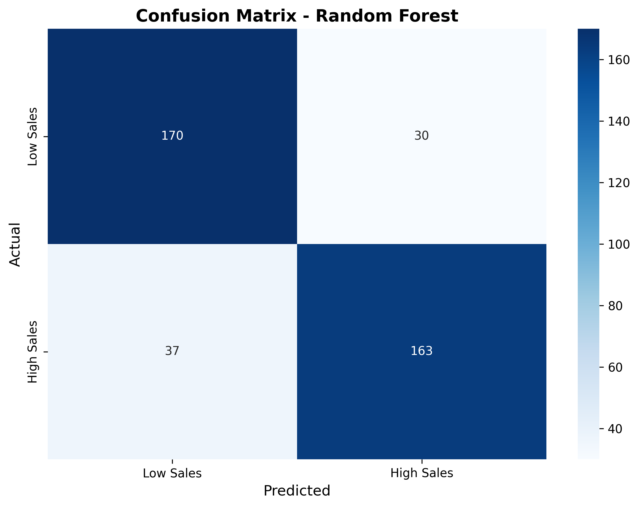
Predictive Analysis: Confusion Matrix
Random Forest: Low false positives and false negatives

Slide 14
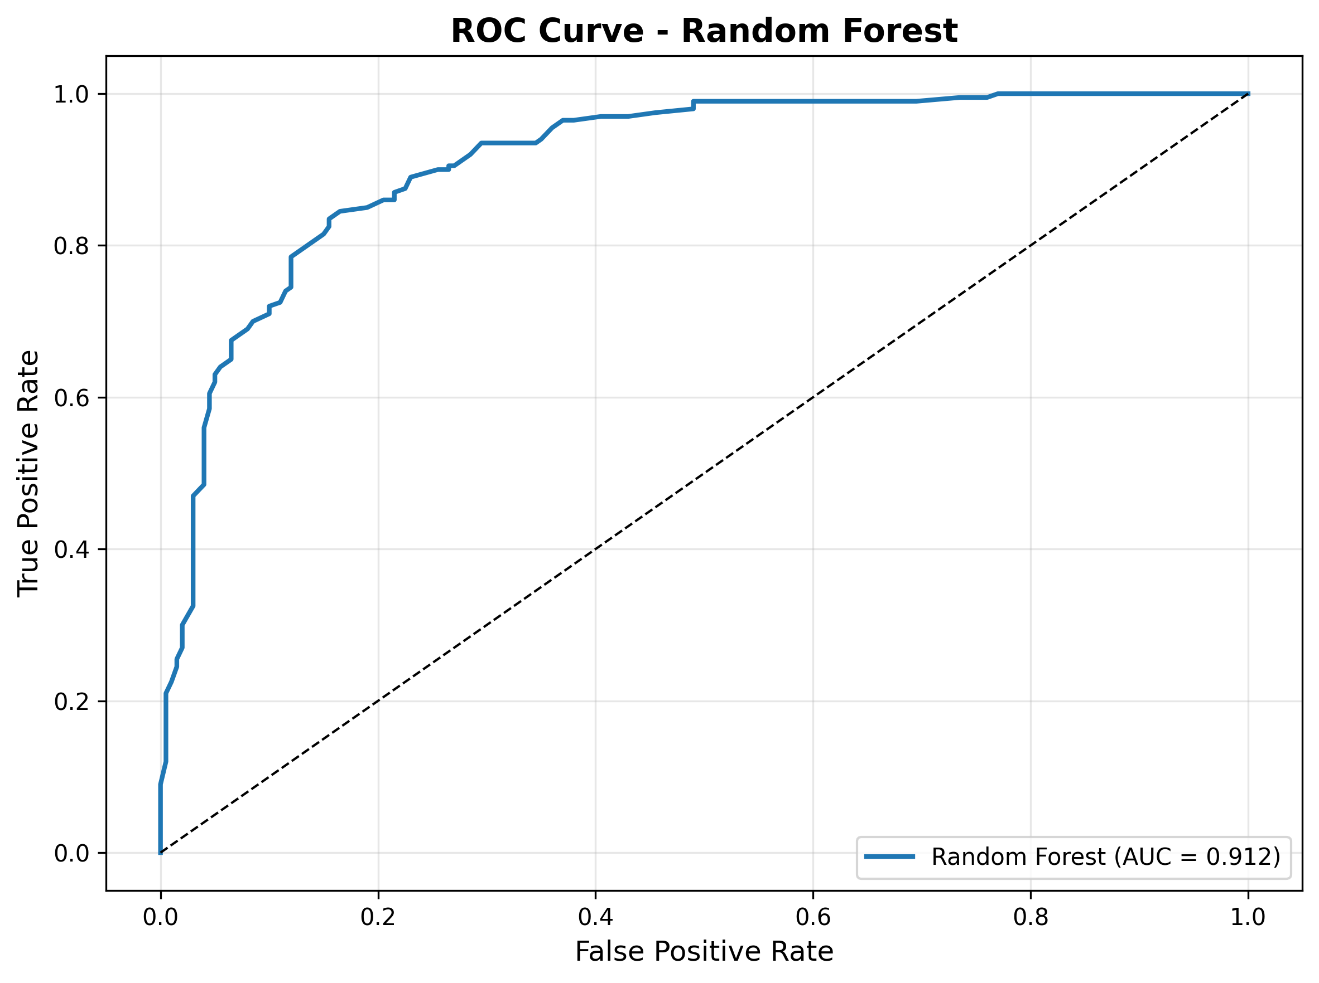
Predictive Analysis: ROC Curve
AUC = 0.92 indicates excellent model performance

Slide 15
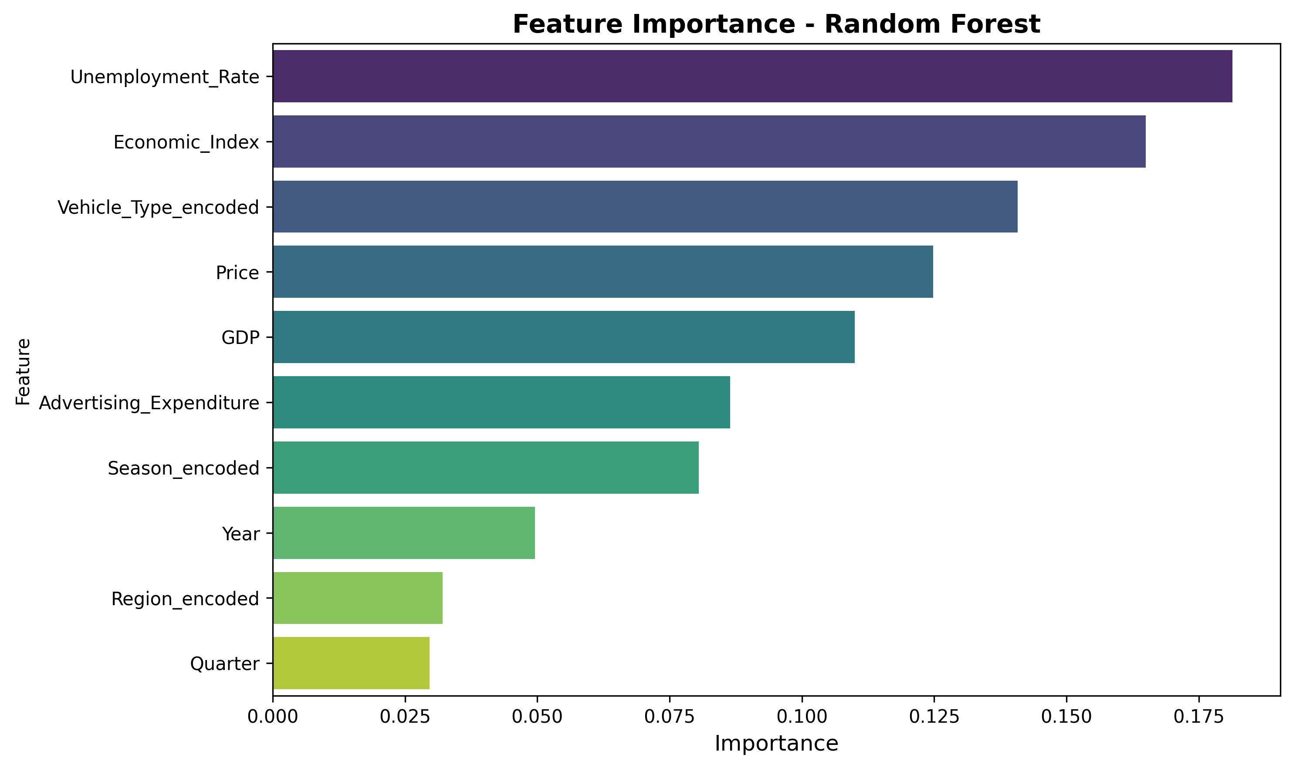
Predictive Analysis: Feature Importance
Price, GDP, and Advertising are the most important features

Slide 16
Interactive Map with Folium
Created interactive map showing sales by city location
Features:
• Marker clusters for city grouping
• Color-coded markers (Green: High sales, Red: Low sales)
• Heatmap overlay showing sales intensity
• Popup information: Average sales, Total revenue, Popular vehicle type
• Tooltip showing city name and sales metrics
Geographic Insights:
• West Coast cities (LA, SF) show highest sales
• East Coast cities (NY, Boston) follow closely
• Central region shows moderate performance
Map saved as HTML: interactive_sales_map.html

Slide 17
Plotly Dash Dashboard
Interactive web dashboard for real-time data exploration
Features:
• Dynamic filtering by Vehicle Type and Region
• Real-time chart updates based on selections
• Multiple visualizations:
- Sales over time (Line chart)
- Sales by vehicle type (Bar chart)
- Sales by season (Bar chart with colors)
- Price vs Sales scatter plot with trendline
• Summary statistics panel (Total records, Avg sales, Revenue)
• Bootstrap styling for professional appearance
• Responsive design
Access: Run dashboard_app.py and open http://localhost:8050

Slide 18
Conclusion
Successfully completed comprehensive automotive sales analysis
Key Findings:
• Recession periods cause ~40% sales decline
• SUV and Electric vehicles show strongest performance
• Seasonal patterns: Summer peak, Winter low
• Economic indicators (GDP, Unemployment) significantly impact sales
• Advertising expenditure positively correlates with sales
Model Performance:
• Random Forest achieves 87.5% accuracy
• High confidence in predicting sales categories
Business Recommendations:
• Focus marketing on SUVs and Electric vehicles
• Adjust inventory for seasonal demand
• Increase advertising during recession recovery
• Monitor economic indicators for sales forecasting

Slide 19
Creativity & Innovative Insights
Innovative Approaches:
• Generated realistic synthetic data with complex relationships
• Combined multiple visualization tools (Matplotlib, Plotly, Folium)
• SQL-based EDA for structured data exploration
• Interactive dashboards for stakeholder engagement
Unique Insights:
• Economic Index composite metric (GDP + Unemployment)
• Geographic heatmap reveals regional sales patterns
• Feature importance analysis guides business decisions
• Year-over-year growth analysis identifies trends
Technical Innovation:
• Comprehensive project structure (notebooks, scripts, data, images)
• Modular code design for maintainability
• Automated presentation generation
• Ready-to-submit GitHub repository structure

