Slide 1
Who performs the specific step in the Project Locations update workflow
Who develops & maintains the data model/ tool/ platform needed for the specific step
PIA/ external consultant
ZDV (Team DAI)
KfW operations (PM/ PA)
Specific responsibilities vary by team
IDV (Geodata-Desk)
IDV (Geodata-Desk)

Slide 2
COLLECT (Project Locations Model)
VALIDATE (online validator)
Project-level locations
(multi-geometry)
Validated Project-level Locations
GeoJson format with timestamp + unique filename
Excel or GeoJson format
VISUAL PLAUSIBILITY CHECK (online validator)
UPLOAD DATA (Open Data Platform)
AGGREGATE DATA
(Python script)
CREATE MAP (Open Data Platform)
Project-level Locations
Departmental-level Project Locations
Portfolio map
ODP data resource
ODP data resource
ODP map resource

Slide 3
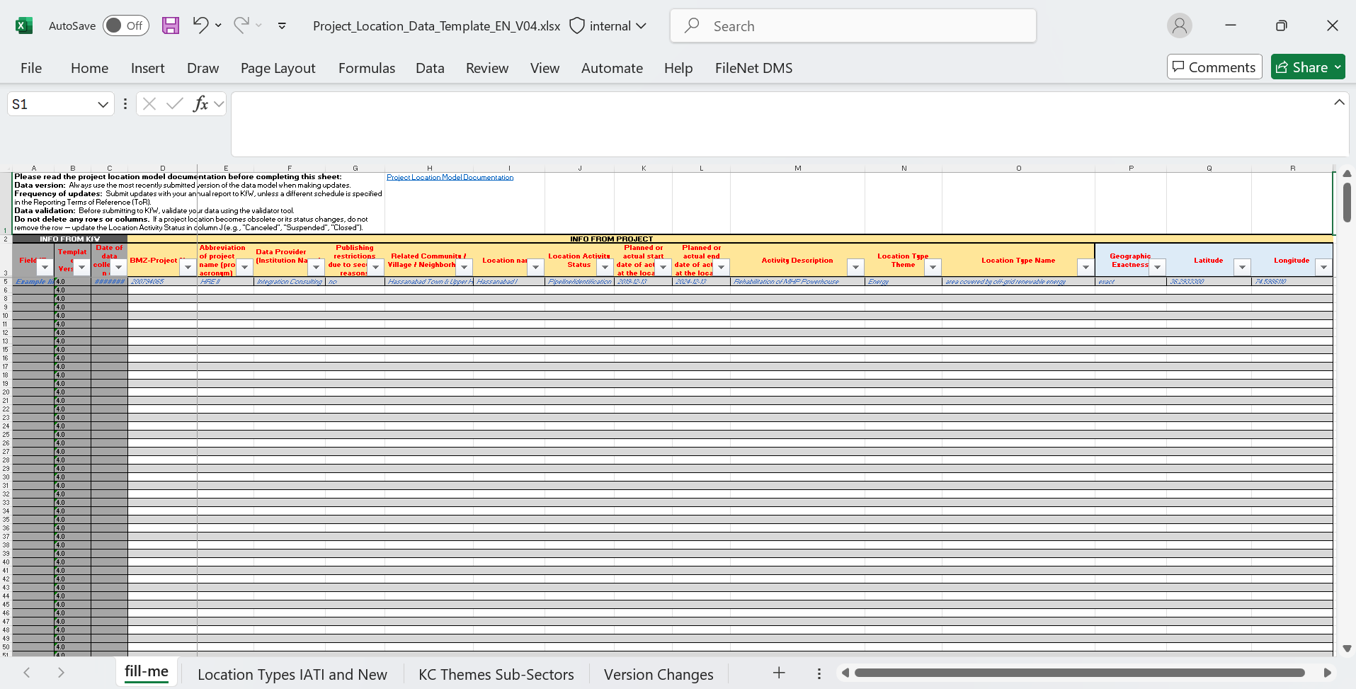
Project Locations Model (PLM) - v4
link

Slide 4



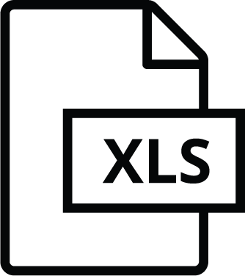
Points-based Project Locations
Geometry-based Project Locations/ Tutorial
Required: Project Locations Model (PLM) with point coordinates filled
Required: Project Locations Model (PLM) joint to GeoJSON geometry file based on a common column of data
Latitude and Longitude columns
XLSX
XLSX
At least 1 common column in both files
GeoJSON

Slide 5
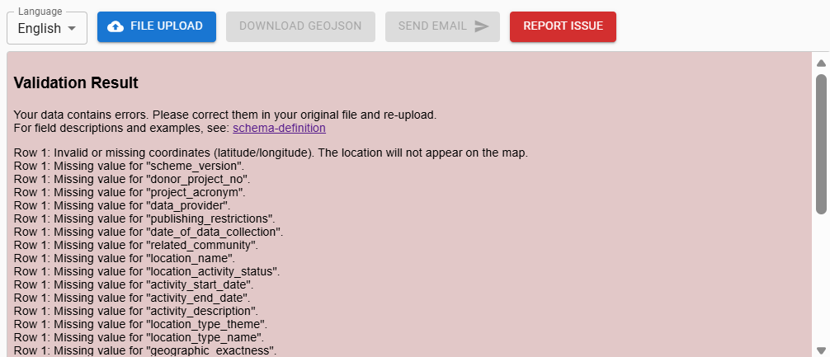
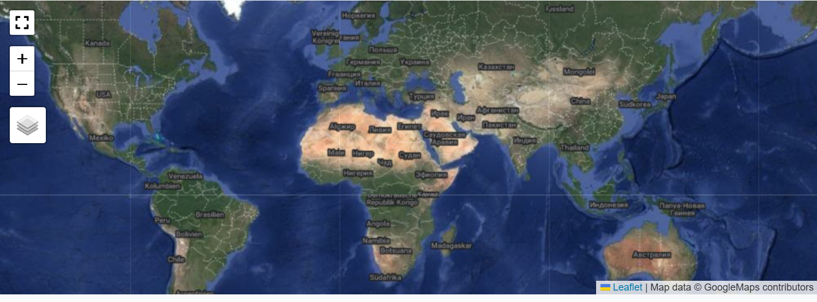
Online validator/ Link
Example of errors in validation result
GeoJSON will not be generated
No Project Locations displayed

Slide 6
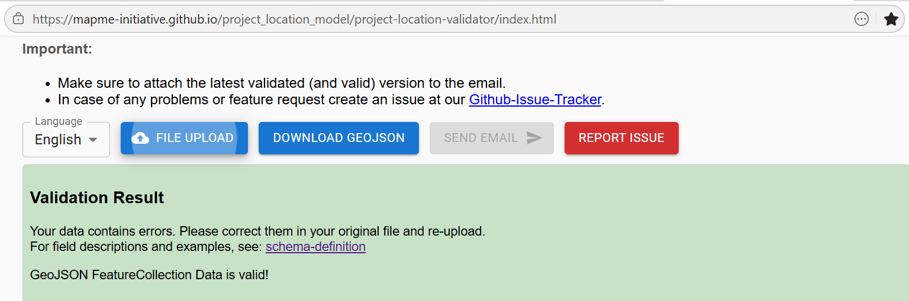
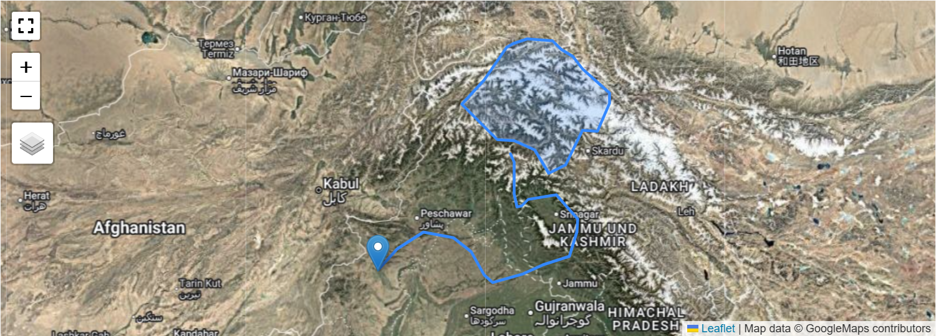
Online validator/ Link
Example error-free validation result
GeoJSON of validated file is generated and can be downloaded
No Project Locations displayed
Multi-geometry Project Locations displayed

Slide 7
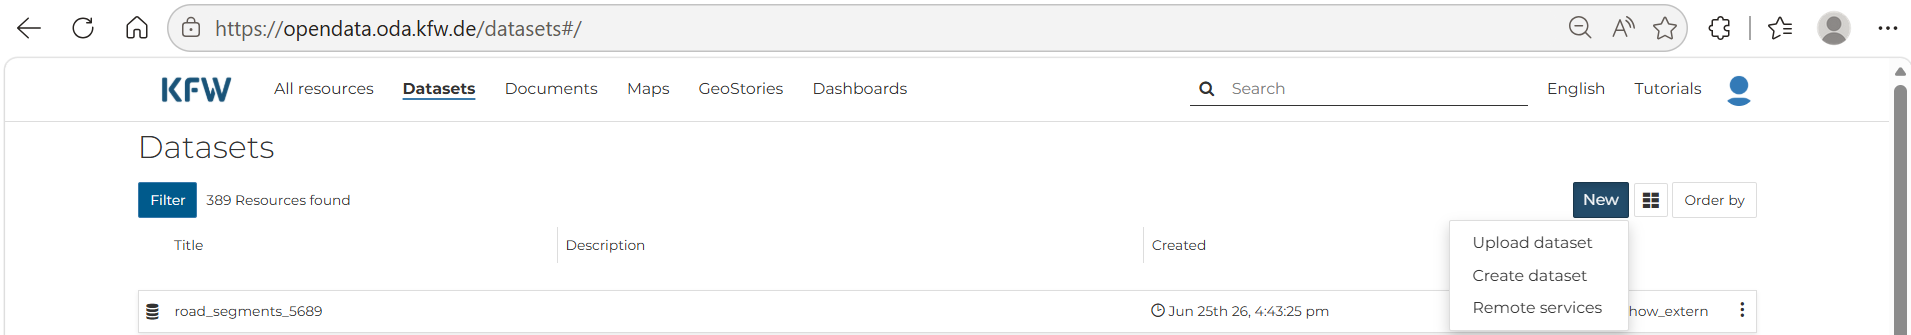
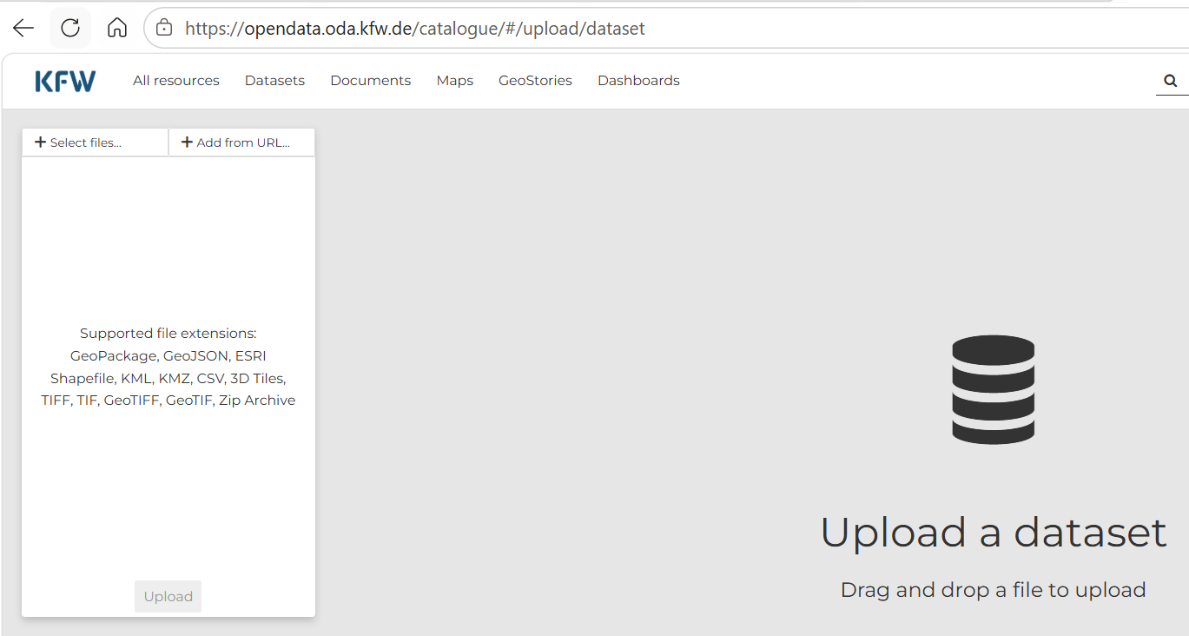
Upload validated GeoJSON to Open Data Platform (ODP)/ Tutorial

