Slide 1
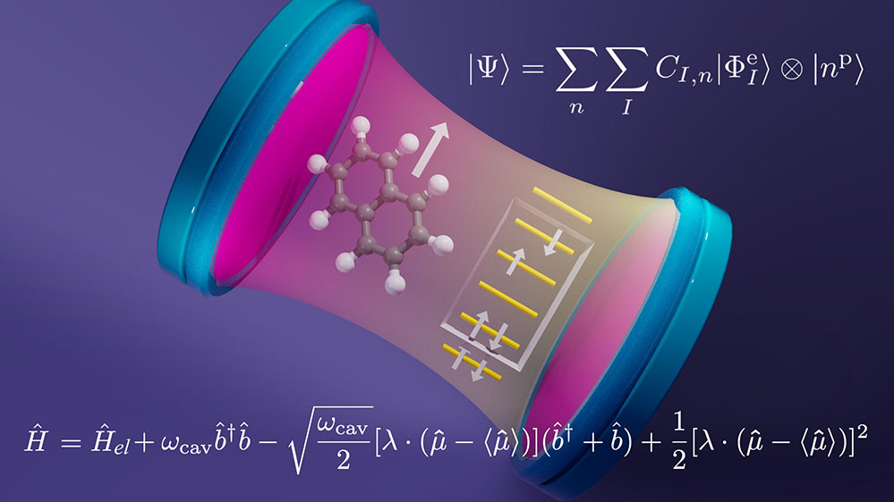


Cavity Quantum Electrodynamics Complete Active Space Configuration Interaction Theory
Scientific Achievement
Molecules strongly interacting with nanoconfined light require theoretical advances that enable both electrons and photons to be treated on equal quantum mechanical footing. We have developed a tractable and accurate approach that provides a balanced approach to capture strong correlation effects between the electronic and photonic degrees of freedom.
Significance and Impact
The strong interaction between molecules and light can dramatically alter structure, reactivity, and dynamics in these systems, offering new ways to control chemistry and to prepare composite quantum states or polaritons involving light and matter.
Research Details
A theoretical methodology termed Cavity Quantum Electrodynamics Complete Active Space Configuration Interaction Theory (QED-CASCI) was developed to find the low-energy eigenstates of a Hamiltonian that rigorously captures the interaction between electron and photon degrees of freedom
A robust iterative eigensolver was adapted for this theory and demonstrated on systems with millions of electronic configurations and 100 photon occupation states
Cavity-driven singlet-triplet inversion was studied with unprecedented theoretical resolution
Figure illustrating electronic states of the naphthalene molecule strongly coupled to a photon mode in an optical cavity. The QED-CASCI ansatz is shown above the cavity, and the Hamiltonian of the coupled system is shown below.
The work was performed at UNC Charlotte and Pacific Northwest National Laboratory. Nam Vu, Daniel Mejia-Rodriguez, Nicholas P. Bauman, Ajay Panyala, Erdal Mutlu, Niranjan Govind, Jonathan J. Foley IV. Cavity Quantum Electrodynamics Complete Active Space Configuration Interaction Theory, JCTC, https://doi.org/10.1021/acs.jctc.3c01207
Notes:
200 Word Summary: Polariton chemistry has attracted great attention as a potential route to modify chemical structure, properties, and reactivity through strong interactions among molecular degrees of freedom and one or more quantized photons. A rigorous theoretical treatment of molecular polaritons requires the treatment of matter and photon degrees of freedom on equal quantum mechanical footing. In the limit of molecular electronic strong or ultrastrong coupling to one or a few molecules, it is desirable to treat the molecular electronic degrees of freedom using the tools of ab initio quantum chemistry. The MAPOL team is developing such theoretical and computational methods within the framework they call ab initio cavity quantum electrodynamics. In recent work, they introduced a method called Cavity Quantum Electrodynamics Complete Active Space Configuration Interaction theory to provide ground- and excited-state polaritonic surfaces with a balanced description of strong correlation effects among electronic and photonic degrees of freedom. This method provides a platform for ab initio cavity quantum electrodynamics when both strong electron correlation and strong light–matter coupling are important and is an important step toward computational approaches that yield multiple polaritonic potential energy surfaces and couplings that can be leveraged for ab initio molecular dynamics simulations of polariton chemistry.
The authors acknowledge support from the Center for Many-Body Methods, Spectroscopies, and Dynamics for Molecular Polaritonic Systems (MAPOL) under FWP 79715, which is funded as part of the Computational Chemical Sciences (CCS) program by the U.S. Department of Energy, Office of Science, Office of Basic Energy Sciences, Division of Chemical Sciences, Geosciences and Biosciences at Pacific Northwest National Laboratory (PNNL). PNNL is a multi-program national laboratory operated by Battelle Memorial Institute for the United States Department of Energy under DOE contract number DE-AC05-76RL1830.

