Slide 1
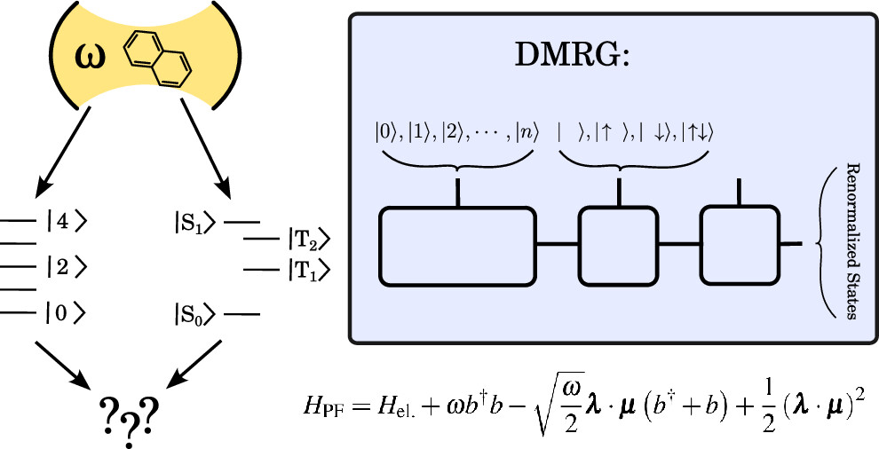



Polaritonic Chemistry with the Density Matrix Renormalization Group Method
Scientific Achievement
To understand and control the properties of molecules strongly interacting with light at the nanoscale, we need theoretical developments that allow for an equal quantum mechanical treatment of both electrons and photons. We have created an accurate and scalable theoretical method that effectively addresses the strong correlation between electronic and photonic degrees of freedom.
Significance and Impact
Entangling molecules with quantized light can profoundly impact the structure, reactivity, and dynamics of these systems, opening up exciting possibilities for manipulating chemical processes and creating novel quantum states with potential applications for quantum information science. Our approach will enable predictive simulations of these complex quantum systems
Figure illustrating electronic states of the naphthalene molecule strongly coupled to a photon mode in an optical cavity. The QED-CASCI ansatz is shown above the cavity, and the Hamiltonian of the coupled system is shown below.
Research Details
A new theoretical approach called Quantum Electrodynamics Density Matrix Renormalization Group (QED-DMRG) method was developed
A robust parallel implementation of DMRG was adapted for this theory and demonstrated on strongly correlated systems with trillions of configurations, which are out of reach of most current computational methods.
We explicitly demonstrated the ability of DMRG to effectively remove irrelevant degrees of freedom, thus massively saving computational power.
Cavity effects were studied on acene chains of increasing lengths.
The work was performed at JH-Inst Prague, UNC Charlotte and Pacific Northwest National Laboratory. Mikuláš Matoušek, Nam Vu, Niranjan Govind, Jonathan J. Foley IV, and Libor Veis, JCTC, https://doi.org/10.1021/acs.jctc.4c00986
Notes:
The authors acknowledge support from the Center for Many-Body Methods, Spectroscopies, and Dynamics for Molecular Polaritonic Systems (MAPOL) under FWP 79715, which is funded as part of the Computational Chemical Sciences (CCS) program by the U.S. Department of Energy, Office of Science, Office of Basic Energy Sciences, Division of Chemical Sciences, Geosciences and Biosciences at Pacific Northwest National Laboratory (PNNL). PNNL is a multi-program national laboratory operated by Battelle Memorial Institute for the United States Department of Energy under DOE contract number DE-AC05-76RL1830.

