Slide 1
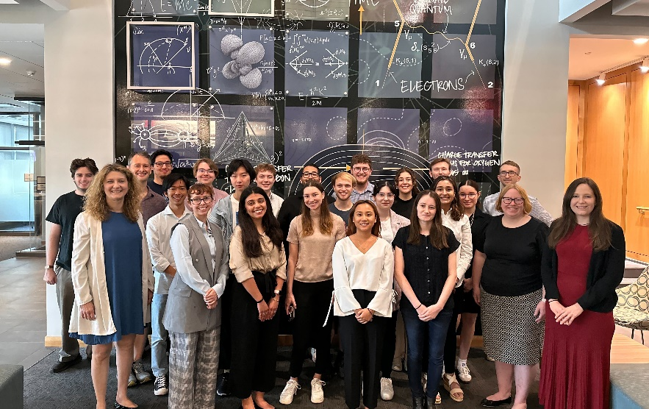
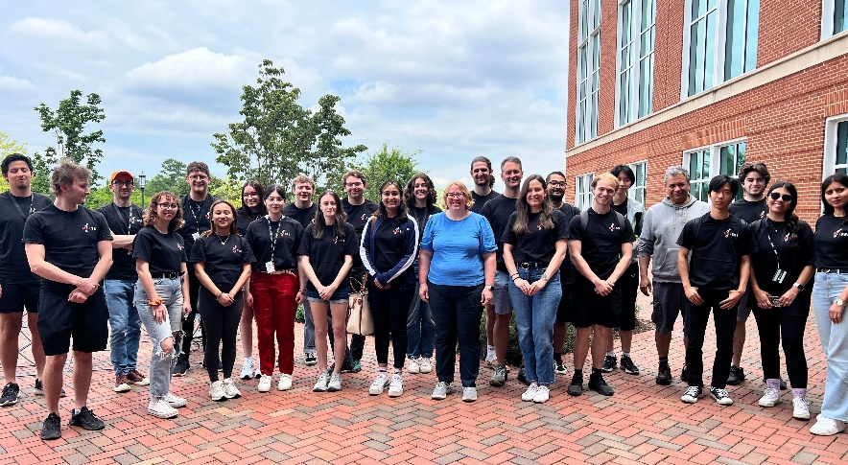

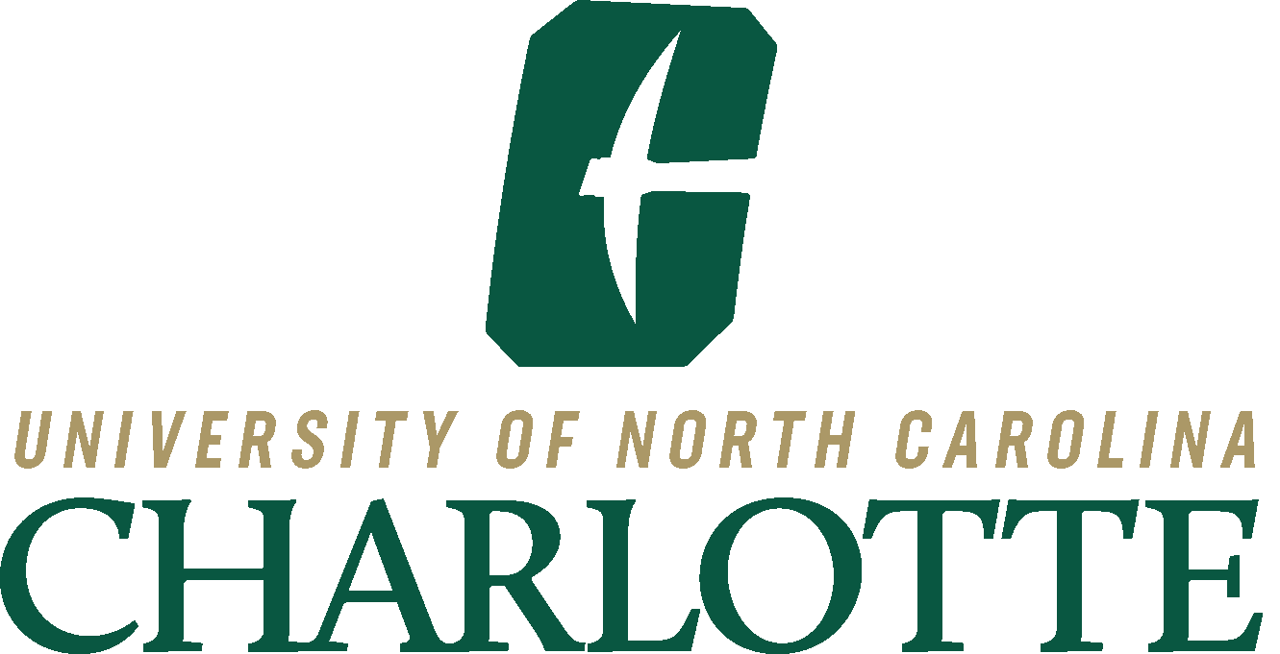
MolSSI-MAPOL-Charlotte Computational Molecular Science Workshop
Achievement
The Center for Many-Body Methods, Spectroscopies, and Dynamics for Molecular Polaritonic Systems (MAPOL), the Molecular Science Software Institute (MolSSI), and the Department of Chemistry at the University of North Carolina at Charlotte (UNC Charlotte) jointly hosted a weeklong workshop on computational chemistry.
Significance and Impact
Computation and programming are widely used in chemistry research. Learning these skills can enhance problem solving in science courses more broadly. However, instruction in computation and programming is not widely integrated into the curriculum of chemistry programs, especially at minority serving institutions and primarily undergraduate institutions. The workshop gave students a hands-on instruction on scientific programming in the Python programming language, introduced them to basic quantum chemical tools, and helped them apply these tools to model strong light-matter coupling in polariton chemistry.
Details
The workshop was held from June 3 – 7th at UNC Charlotte and workshop included 19 students: 16 undergraduates and three graduate students. 12 participants identified as female and/or from a group historically excluded from STEM. Students came from 15 different institutions, nine of which are primarily undergraduate, and eight different states. Two of the represented institutions are designated minority serving institutions. Financial support was provided to students for travel and room and board. The support included bringing instructors and speakers from across the U.S. to engage with participants.
Students and workshop instructors at UNC Charlotte in June 2024
This work was supported by FWP 79715
Notes:
1-2 paragraph description of highlight – The Center for Many-Body Methods, Spectroscopies, and Dynamics for Molecular Polaritonic Systems (MAPOL), along with the Molecular Science Software Institute (MolSSI) and the Department of Chemistry at the University of North Carolina at Charlotte (UNC Charlotte), hosted a free workshop on computational chemistry. This 1-week intensive workshop targeting undergraduates in the physical sciences and engineering was held between June 3-7 2024 at UNC Charlotte. It included several days introducing basic programming skills in Python and several days developing and applying a computer model of nanoscale systems known as molecular polaritons. The financial support of MAPOL and MolSSI covered room and board for all participants and enabled the planning team to bring instructors and expert speakers from across the country to participate in the workshop.
Acknowledgements – The organizers of this workshop acknowledge support from the Center for Many-Body Methods, Spectroscopies, and Dynamics for Molecular Polaritonic Systems (MAPOL) under FWP 79715, which is funded as part of the Computational Chemical Sciences (CCS) program by the U.S. Department of Energy, Office of Science, Office of Basic Energy Sciences, Division of Chemical Sciences, Geosciences and Biosciences at Pacific Northwest National Laboratory (PNNL). PNNL is a multi-program national laboratory operated by Battelle Memorial Institute for the United States Department of Energy under DOE contract number DE-AC05-76RL1830.

