Slide 1
Internationalization in MapOSMatic
Or how to crowd source your i18n effort ;-)
David Mentré and Hakan Tandoğan
MapOSMatic team <contact@maposmatic.org>
DevCamp #12 – Cantine Rennaise – 2013-11-13

Slide 2
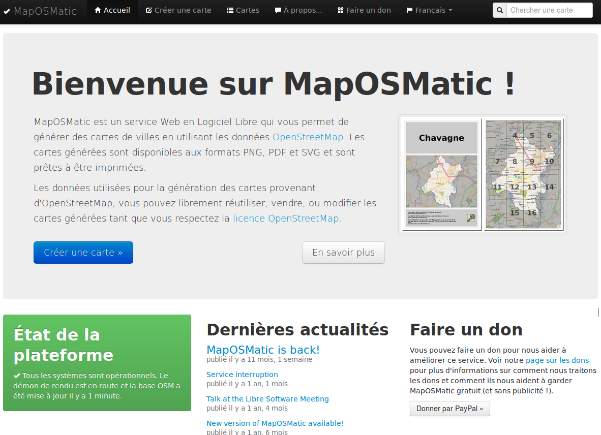
Bienvenue sur MapOSMatic!

Slide 3
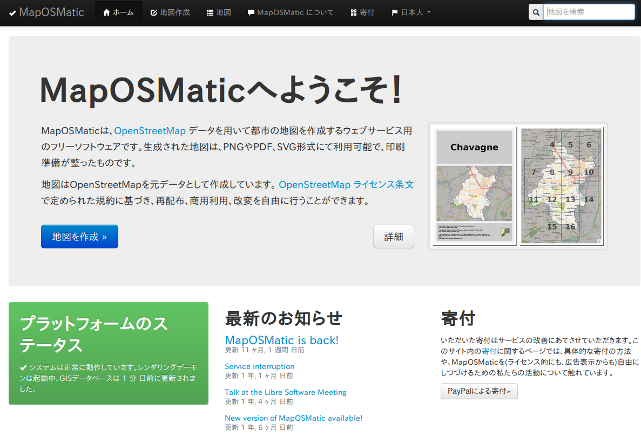
MapOSMaticへようこそ！

Slide 4
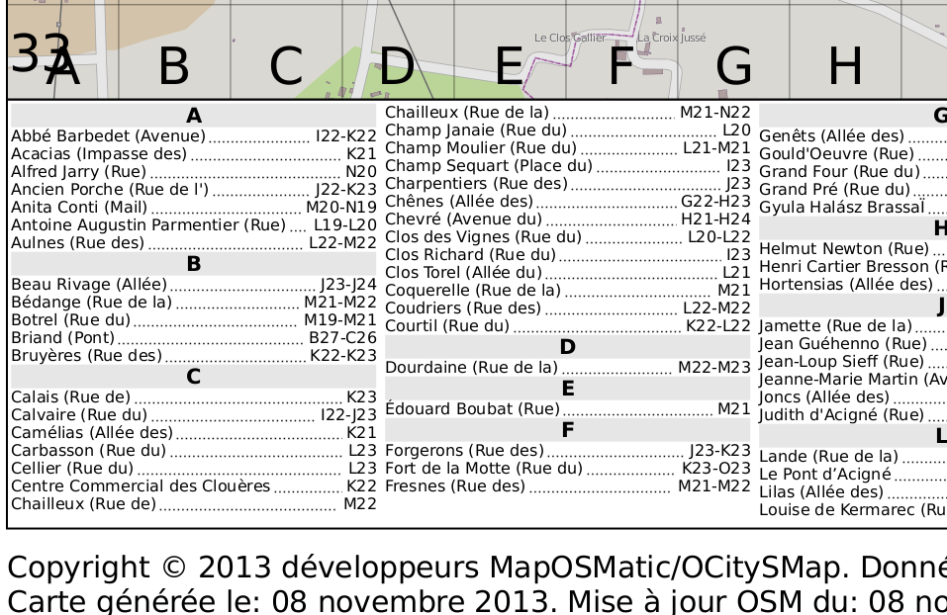
A map in French

Slide 5
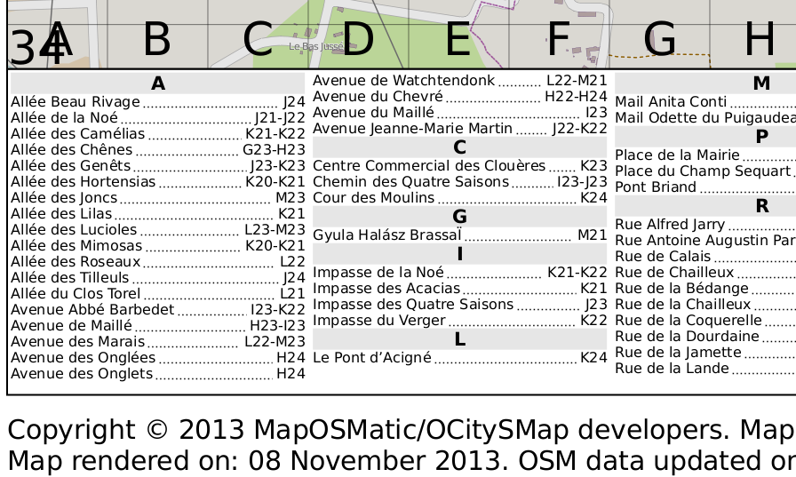
Same map in English

Slide 6
MapOSMatic architecture
Two modules
  maposmatic: web front-end / Python Django
  ocitysmap: back-end / pure Python
What needs to be translated?
  Web front end (strings)
  Map attribution and index categories (strings)
  Index sorting: Python specific code

Slide 7
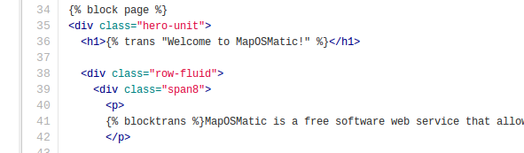
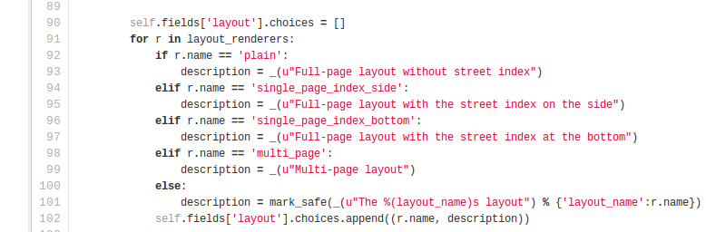
Translated strings marks
In Django templates
  %trans and
  %blocktrans
  markers
In Python code
  Usual _( )
  marker

Slide 8
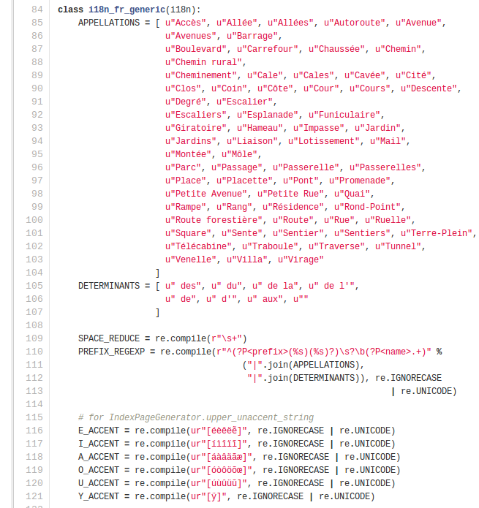
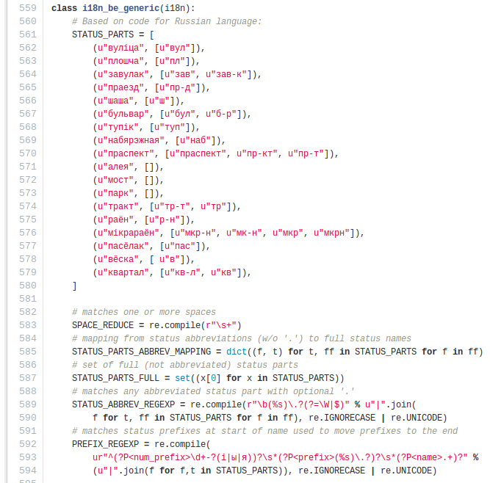
Index: specific code in Python

Slide 9
How text strings are translated?
Home made i18n.py script extracts strings (auto)
  Hide call complexity of xgettext, msgmerge, msgformat, ...
  Manage POT (language template), PO (translated language) and MO (compiled strings) files
Resulting PO file pushed to Transifex (auto)
Translated files are downloaded and if changed, committed to dev git on savannah (auto)
Sometimes, dev git merge into production git, a.k.a. www.maposmatic.org
(auto): done automatically on a private Jenkins instance
  in Turkey, thanks Hakan ;-)

Slide 10
Some statistics
33 languages translated
  12 at more than 90%
    English, Belarusian, Greek, Dutch, Esperanto, French, German, Japanese, Portuguese (Brazil), Catalan, Italian, Portuguese (Portugal)
Web site: 190 strings with 1627 words overall
Generated maps: 19 strings with 109 words overall

Slide 11
Transifex effect: crowd-translation
Transifex: web service for crowd-translation
  Free for free software
Before switching to Transifex
  Web front-end: 16 supported languages
  Back-end: 18 supported languages
  33 now!

Slide 12
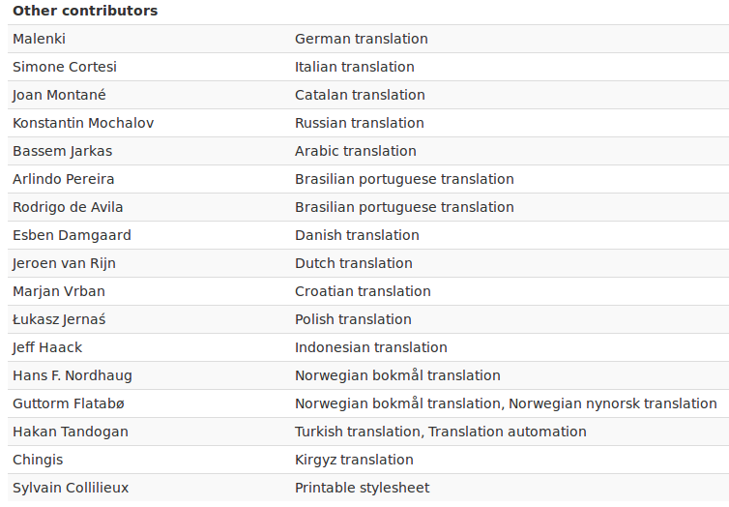
In short: thanks!

Slide 13
In summary
Need to deploy i18n infrastructure
  Annotate code, scripts, Transifex account, translation workflow, documentation, ...
Translators come automagically... well, after some advertising
  Answer to translation requests, point to documentation (wiki)
Crowd-translation does help!
All source code and scripts
  https://savannah.nongnu.org/projects/maposmatic/
Any question?

