Slide 1
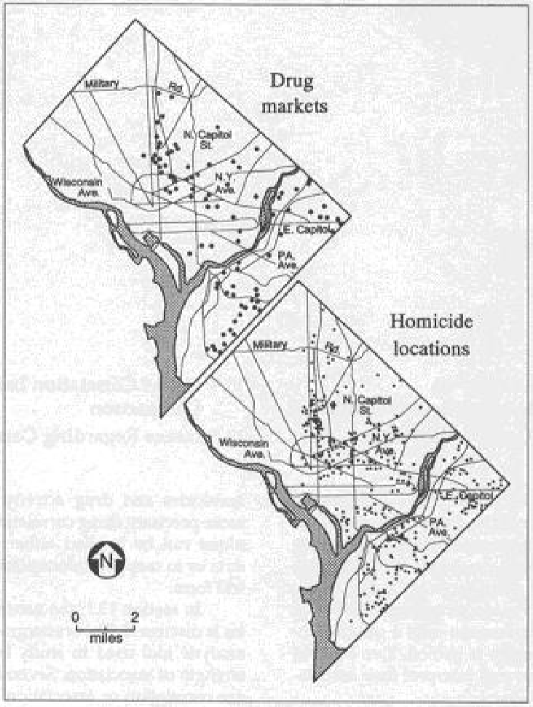
HOMICIDES AND DRUG SALE POINTS IN WASHINGTON, D.C.

Slide 2
CORRELATION ANALYSIS
Quantitative set of statistical methods to measure both direction and strength of associate between a pair of (spatial) variables
Scatterplot – graphical representation
Positive – larger value of one variable corresponds to a larger value of a second variable, smaller with smaller
Ex. Central Place Theory: population and retail services
Negative – larger value of one variable corresponds to a smaller value of a second variable, smaller with larger
Ex. Distance Decay: Pollution decreases downwind from point source
Random (neutral) – little or no association between variables

Slide 3
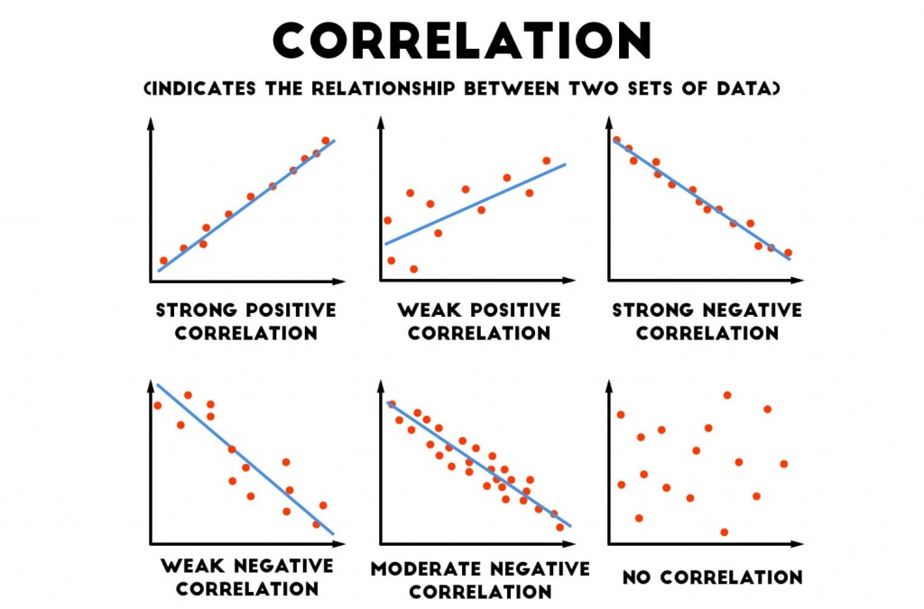

Slide 4
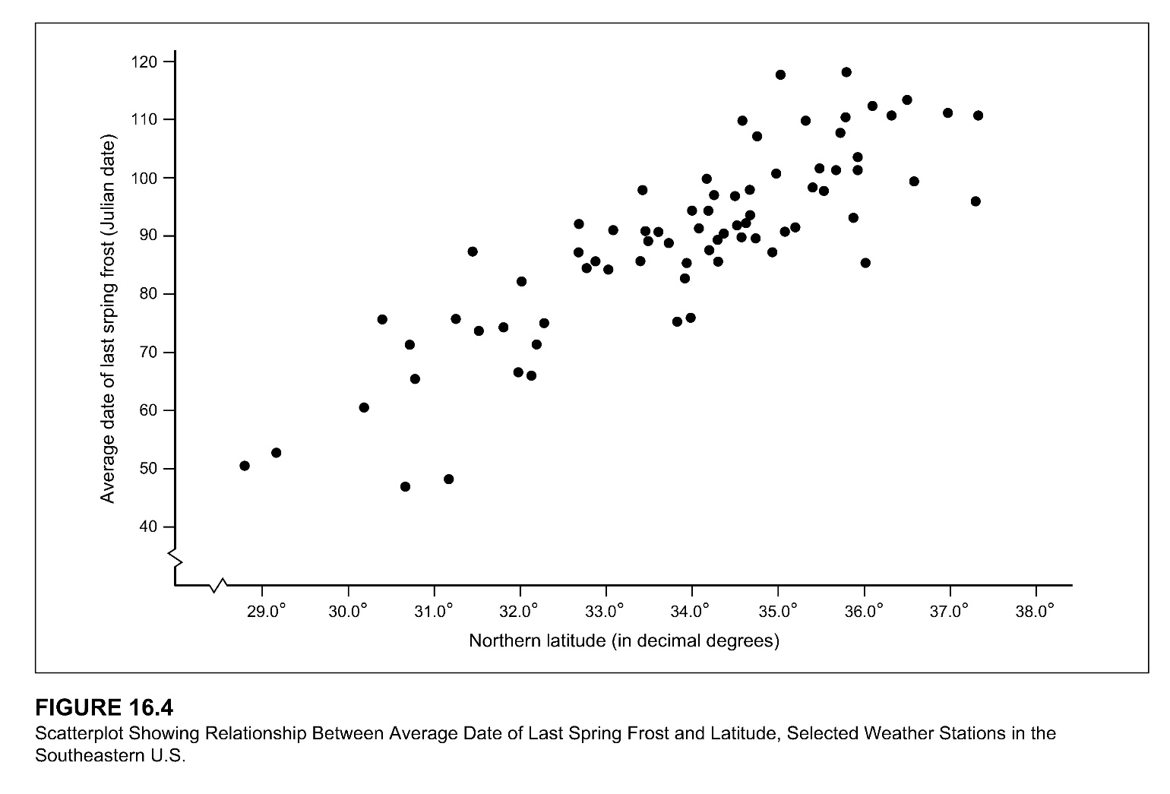
CORRELATION ANALYSIS
However, there may be relationship….
Response (dependent) variable – variable of interest that you hope to explain
Y-axis (effect)
Explanatory, predictor (or independent) variable - variable used to account for, “explain” or “predict” variation in Y variable
X-axis (causal)

Slide 5
CORRELATION COEFFICIENTS
Index to measure direction and strength of relationships
+1.0 – maximum value
-1.0 – minimum value
0.0 – total lack of relationship

Slide 6
PEARSON’S PRODUCT-MOMENT CORRELATION COEFFICIENT
Ratio between the covariance in X and Y to the product of the standard deviations of the two variables = r
Ranges from -1 to 1 with 0 indicating no relationship

Slide 7
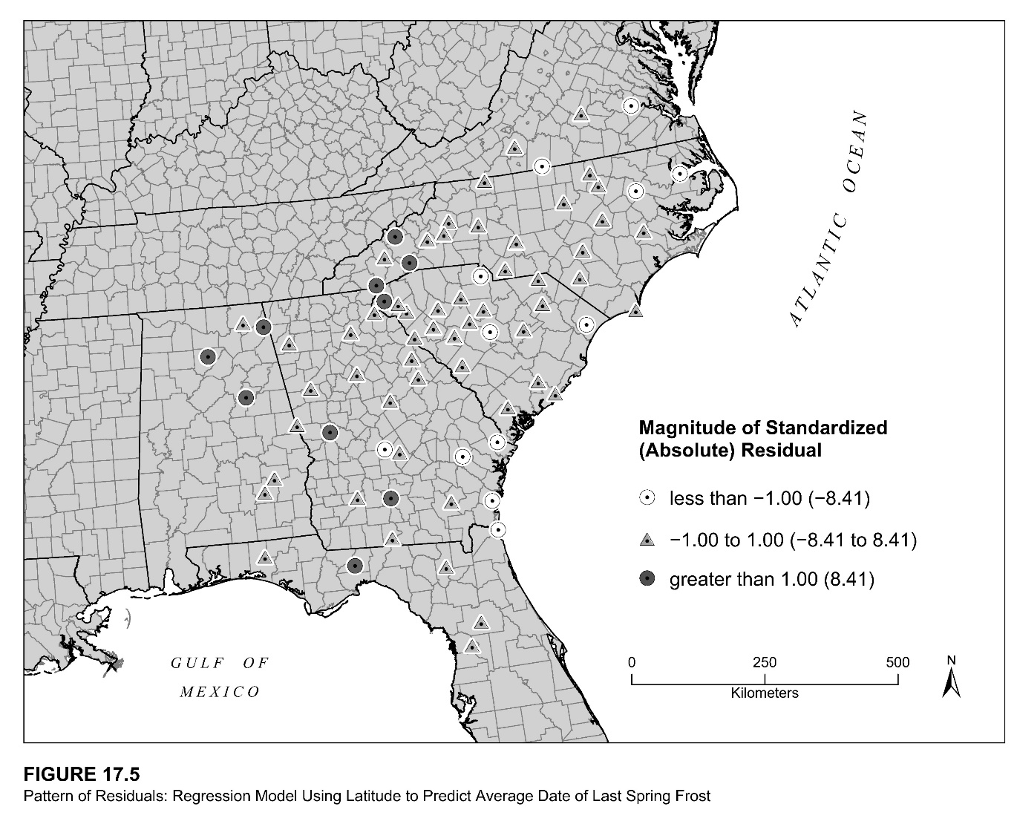
PEARSON’S PRODUCT-MOMENT CORRELATION COEFFICIENT: EXAMPLE
Last Spring Frost in SE US
Hypothesis: Weather stations with a more northerly latitude have average last frost dates later in the spring than weather stations with less northerly latitudes

Slide 8
CORRELATION COEFFICIENT: EXAMPLE

Slide 9
Regression analysis terms and concepts
Dependent variable (y):
This is the variable representing the process you are trying to predict or understand (residential burglary, foreclosure, rainfall).
Independent/Explanatory variables (X):
These are the variables used to model or to predict the dependent variable values. In the regression equation, they appear on the right side of the equal sign and are often referred to as explanatory variables.
Regression coefficients (β):
Coefficients are computed by the regression tool. They are values, one for each explanatory variable, that represent the strength and the type of relationship the explanatory variable has to the dependent variable.

Slide 10
Regression analysis terms and concepts
R²/R-squared:
Multiple R-squared and adjusted R-squared are both statistics derived from the regression equation to quantify model performance. The value of R-squared ranges from 0 to 100 percent. If your model fits the observed dependent variable values perfectly, R-squared is 1.0
Residuals:
These are the unexplained portion of the dependent variable, represented in the regression equation as the random error term ε.
P-values:
Regression methods perform a statistical test to compute a probability, called a p-value, for the coefficients associated with each independent variable. The null hypothesis for this statistical test states that a coefficient is not significantly different from zero (in other words, for all intents and purposes, the coefficient is zero and the associated explanatory variable is not helping your model). Small p-values reflect small probabilities and suggest that the coefficient is, indeed, important to your model with a value that is significantly different from zero (in other words, a small p-value indicates the coefficient is not zero).

Slide 11
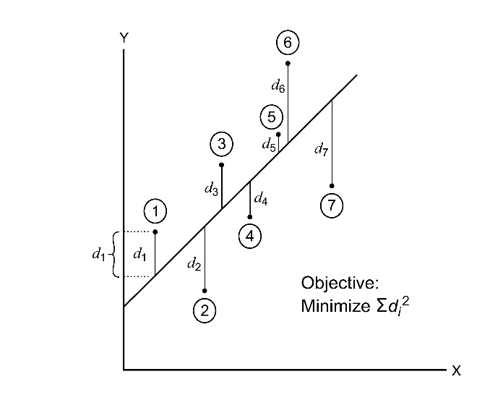
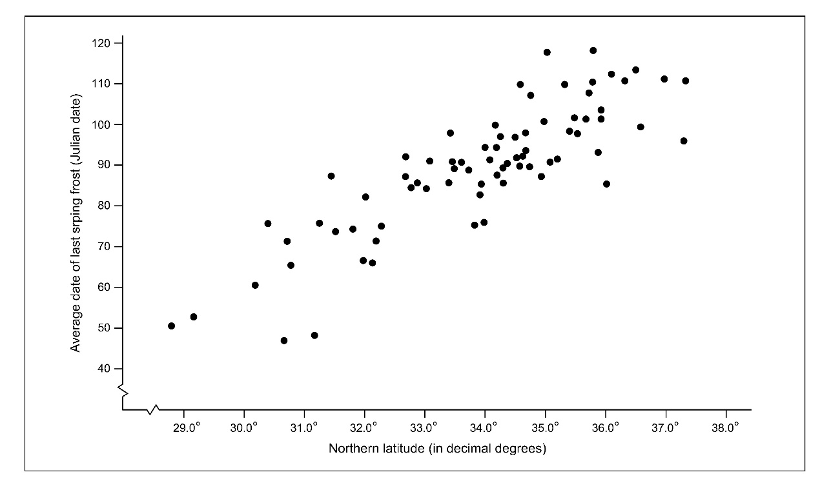
SIMPLE LINEAR REGRESSION
Least-squares regression line: the unique line that minimizes the sum of squared vertical distances between each data point and the line
Best estimate of relationship between the explanatory variable (X) and the response variable (Y)
Predictive model – select X value, determine resultant Y

Slide 12
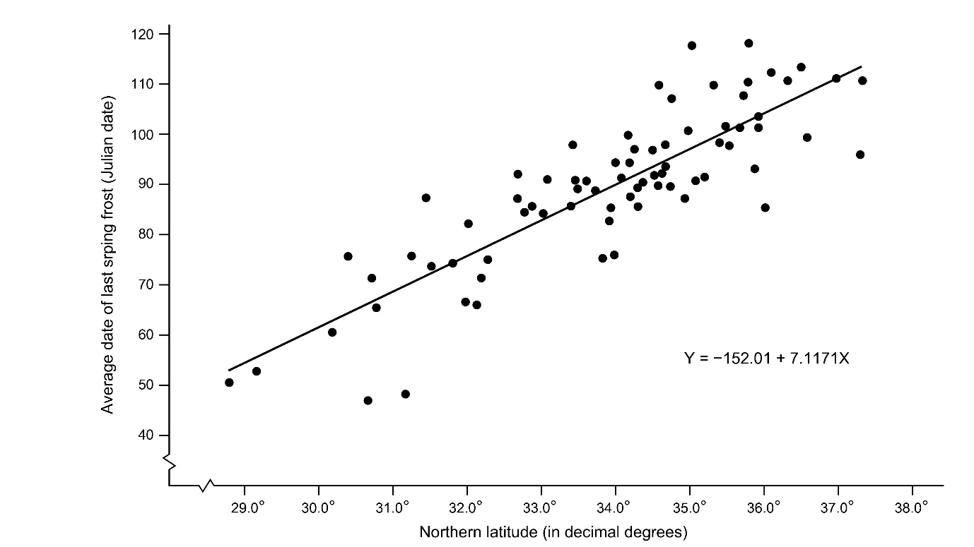
SIMPLE LINEAR REGRESSION: LAST SPRING FROST
Two parameters
a: Y-intercept
Constant: Y value when X = 0
-152.01????
Domain of X
SE US: 29° to 37°
b: slope
Regression coefficient: absolute change of the line in Y direction associated with an increase of 1 in X direction

Slide 13
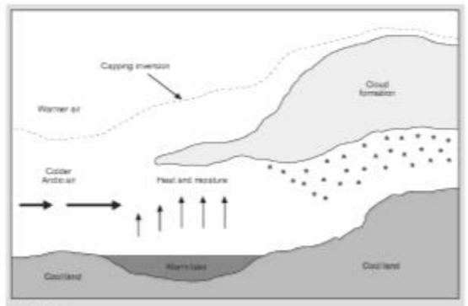
Another SIMPLE LINEAR REGRESSION EXAMPLE
Lake Effect Snow in NE Ohio
Presence of nearby large water body influences precipitation
Does distance from the lake impact snowfall amounts?

Slide 14
