Slide 1
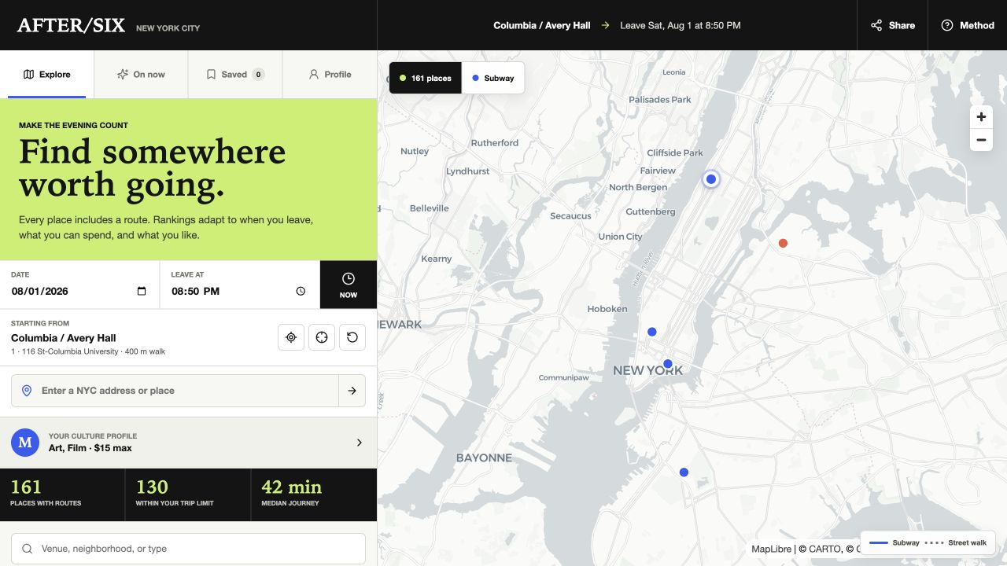
MAPPING SYSTEMS · FINAL PROJECT
AFTER / SIX
NYC
When the day ends, what culture is actually reachable?
Meredith Cui · Networks expanded into a public cultural-access tool
Notes:
My final project expands the Networks assignment into a public cultural-access planner. It begins with a practical question I often have after class or work: a place may look close on a map, but can I realistically get there tonight? After Six NYC combines route distance with departure time, opening hours, price, mobility access, and personal interest.
[Sources]
- Project-generated application screenshot.
- https://data.cityofnewyork.us/Recreation/DCLA-Cultural-Organizations/u35m-9t32
- https://data.ny.gov/Transportation/MTA-General-Transit-Feed-Specification-GTFS-Static/fgm6-ccue
- https://www.openstreetmap.org/copyright

Slide 2
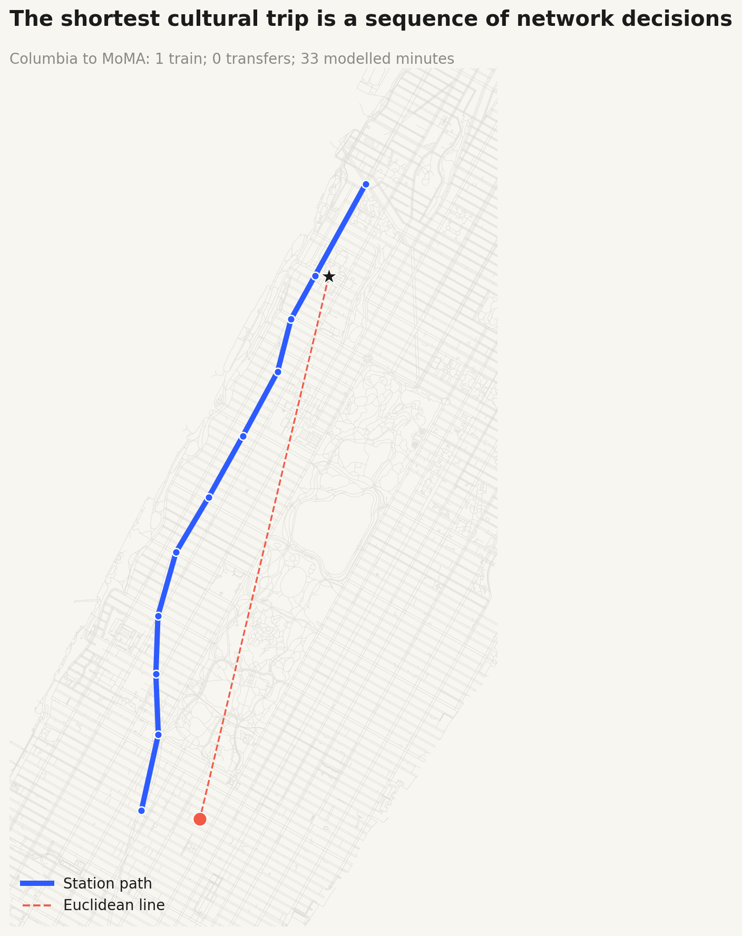
RESEARCH STATEMENT
Near is not the same as accessible
EUCLIDEAN DISTANCE
measures separation
NETWORK JOURNEY
measures decisions
Experienced access also changes with
WHEN
Will it still be open?
COST
Can this visitor afford it?
MOBILITY
Is a step-free station nearby?
INTEREST
Is it worth the trip for me?
AFTER / SIX NYC
02
Notes:
My research statement is that geographic proximity is not the same as experienced cultural access. Euclidean distance only measures the separation between coordinates. A real trip includes walking, station choice, line changes, transfers, and the final walk. Even after that journey is calculated, availability still depends on time, cost, mobility, and personal interest.
[Sources]
- https://data.ny.gov/Transportation/MTA-General-Transit-Feed-Specification-GTFS-Static/fgm6-ccue
- https://data.ny.gov/Transportation/MTA-Subway-Stations/39hk-dx4f
- https://www.openstreetmap.org/copyright
- https://www.nyc.gov/site/dcla/resources/free-and-suggested-admission.page

Slide 3
PROJECT DIAGRAM
The Networks exercise became a public decision tool
01 · INPUT
02 · MODEL
03 · OUTPUT
PUBLIC PLACES
Schedule-weighted graph
A route-aware
evening planner
venue · hours · admission
current programs
best of 8 destination stations
walking + wait + ride + transfer + exit
score by time, cost, opening, access, interest
ranked places
route + travel time + arrival
open when I arrive
TRANSIT NETWORK
161
106
16
1,002
4,337
screened places
weekly schedules
current programs
station-line nodes
weighted edges
Typical weekday model, not live MTA service
AFTER / SIX NYC
03
Notes:
This diagram shows how the Networks exercise became a working product. I curated 161 public cultural places, including 106 structured weekly schedules and 16 date-checked current programs. I connected those records to a schedule-weighted subway graph with 1,002 station-line nodes and 4,337 weighted edges. For every place, the model compares eight destination stations, calculates an arrival, and sends a transparent result to the interface.
[Sources]
- https://data.cityofnewyork.us/Recreation/DCLA-Cultural-Organizations/u35m-9t32
- https://data.ny.gov/Transportation/MTA-General-Transit-Feed-Specification-GTFS-Static/fgm6-ccue
- https://data.ny.gov/Transportation/MTA-Subway-Stations/39hk-dx4f
- https://www.openstreetmap.org/copyright

Slide 4
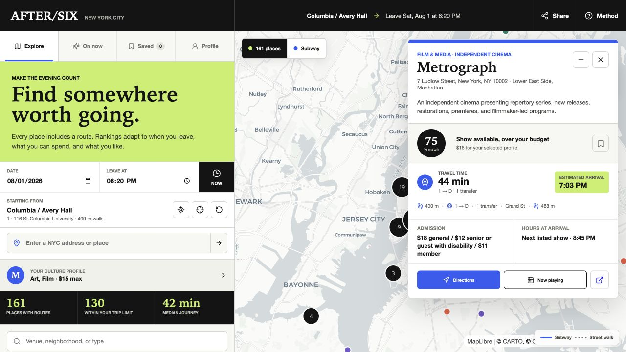
INTERACTIVE PRODUCT
The interface lets each user change the question
01
ANY ORIGIN
Search an NYC address or choose a point.
02
OPEN AT ARRIVAL
Every destination gets its own arrival time.
03
PERSONAL PROFILE
Interests, budget, trip limit, and mobility.
04
ON NOW
Date-checked programs link to official pages.
Prototype profiles and saved places stay in the browser; no login is required.
AFTER / SIX NYC
04
Notes:
The model becomes useful through interaction. A user can search any New York starting address, set a real departure time, filter for places that will still be open at the computed arrival, and inspect the full trip. The profile changes interest, budget, trip length, and mobility priorities. On Now adds current programs with official event links. For this class prototype, profiles and saved places are stored locally, so personalization does not require collecting personal data.
[Sources]
- Project-generated application screenshots.

Slide 5
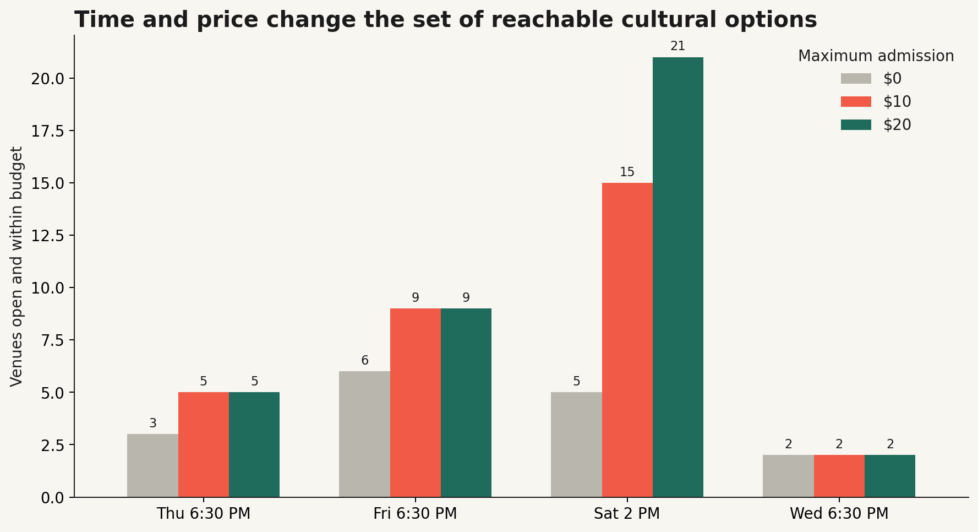
WHAT THE MODEL REVEALS
Time and price change the evening choice set
9
open + within $15
Friday 6:30 PM
6
free at that moment
39 min
median modeled journey
Controlled analytical sample: 25 detailed admission profiles.
The closest option can disappear because it closes, exceeds budget, or takes longer through the network.
AFTER / SIX NYC
05
Notes:
This controlled 25-profile analysis shows why a static map is not enough. At Friday 6:30 PM, for a New York student with a 15-dollar maximum, only nine places are both open and within budget. Six are free at that moment, and the median modeled journey is 39 minutes. The available set changes again on Thursday, Saturday afternoon, or Wednesday evening. Cultural access is temporal and economic as well as spatial.
[Sources]
- https://www.nyc.gov/site/dcla/resources/free-and-suggested-admission.page
- https://data.ny.gov/Transportation/MTA-General-Transit-Feed-Specification-GTFS-Static/fgm6-ccue
- Project-generated analysis.

Slide 6
REFLECTION + NEXT SEMESTER
Good cultural maps show their assumptions.
WORKING NOW
CURRENT LIMITS
NEXT SEMESTER
161 screened public places
Route and arrival for every place
106 weekly schedules
16 date-checked programs
Static, not live, GTFS
No delay or elevator outage feed
No sellout or interior-access data
Cannot calculate whether a place feels welcoming
Live transit and elevator feeds
Automated official event updates
Optional cross-device profiles
User testing + deeper equity analysis
Access is a relationship between a person, a place, a time, and a network.
AFTER / SIX NYC
06
Notes:
The current result is a usable 161-place prototype, but its limits are part of the conclusion. It uses a typical weekday schedule rather than live service, and it cannot know elevator outages, sold-out events, venue interiors, or whether a space feels welcoming to a particular person. In future semesters I would connect live transit and elevator feeds, automate official event updates, add optional account sync, and test the tool with real users. The broader research question is how cultural access differs across communities, not simply where venues are located.
[Sources]
- https://data.ny.gov/Transportation/MTA-General-Transit-Feed-Specification-GTFS-Static/fgm6-ccue
- https://data.ny.gov/Transportation/MTA-Subway-Stations/39hk-dx4f
- https://data.cityofnewyork.us/Recreation/DCLA-Cultural-Organizations/u35m-9t32

