Slide 1








OPTIMIZING HAZARDOUS WASTE MANAGEMENT FACILITIES IN THE PHILIPPINES:
ADDRESSING REGIONAL DISPARITIES
Ensuring sustainable hazardous waste management
BY: RELATIVO, Muffle P.
BSCPE III-IE
This project aims to analyze the total hazardous waste generated by various regions in the country and compare it with the number of registered Treatment, Storage, and Disposal (TSD) facilities. By examining this relationship, we can determine whether there is a complementary balance between waste generation and facility availability. This analysis will highlight potential gaps and inconsistencies in hazardous waste management across the Philippines, guiding strategies for enhancement and sustainability.

Slide 2



LIST OF CONTENTS
Problem Statement & Explanation
Processed Data
Machine Learning Model
Interactive Map
Report and Presentation
Conclusion

Slide 3


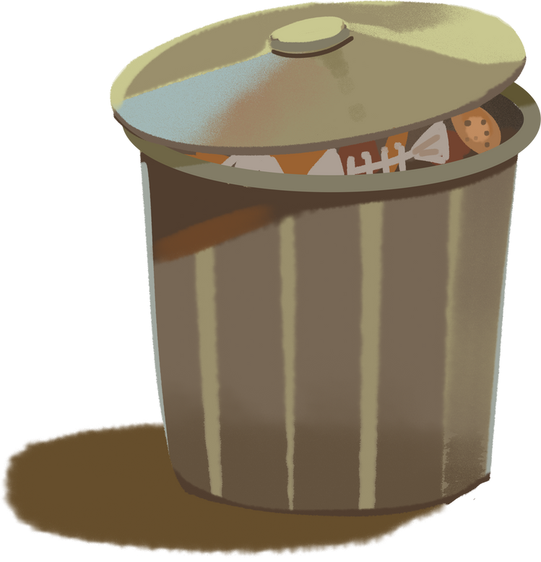

PROBLEM STATEMENT
The Philippines faces challenges in managing hazardous waste effectively due to an unequal distribution and limited number of facilities across different regions. The rapid growth of industries and cities, combined with a lack of proper infrastructure, has worsened the situation, causing environmental damage and health risks in areas with insufficient services. Most facilities are located in a few regions, leaving many parts of the country without adequate waste treatment and disposal options. To solve this problem, there is a need to optimize the placement of facilities to ensure fair access and reduce environmental and health hazards.

Slide 4
WHAT IS HAZARDOUS WASTE?
Hazardous waste includes materials that are dangerous to people and the environment due to their toxic, flammable, corrosive, or reactive nature. Examples include industrial chemicals, stabilized wastes, oil, wastes with inorganic chemicals, and organic chemicals. These substances can cause harm if not handled and disposed of properly.

Slide 5
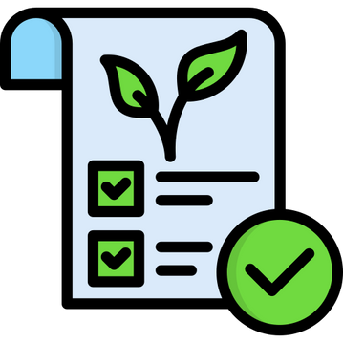




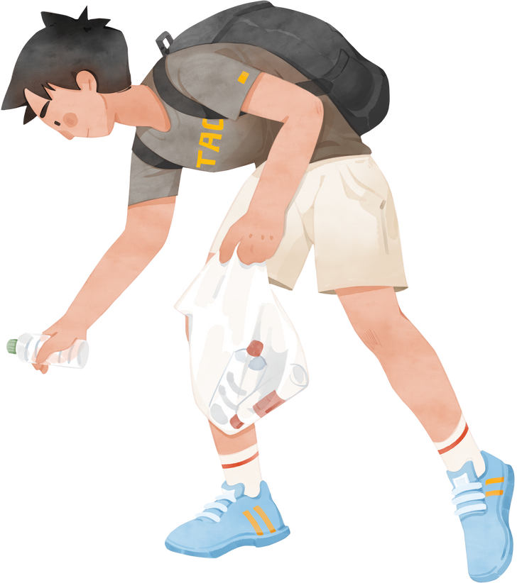
WHY THIS PROBLEM SHOULD BE FOCUSED ON?
Addressing hazardous waste is crucial for a healthier environment, safer communities, and a sustainable future.
Environmental
Impact
Public Health
Risks
Economic
Costs
Global
Inequality

Slide 6
WHY THIS PROBLEM SHOULD BE FOCUSED ON?
Improper disposal of hazardous waste can pollute the air, water, and soil, harming ecosystems and wildlife. For instance, toxic chemicals can leak into rivers and lakes, disrupting aquatic life and contaminating the food chain.
Exposure to hazardous waste can cause serious health problems, including respiratory issues, skin disorders, and even life-threatening illnesses like cancer. People who work with or live near hazardous waste sites are particularly at risk.
Cleaning up polluted areas is expensive and often takes years. Poor management of hazardous waste also leads to increased healthcare costs due to the diseases it causes.
Wealthier countries often ship hazardous waste to poorer nations with fewer regulations, putting vulnerable communities at greater risk. This creates a global justice issue that demands attention.

Slide 7

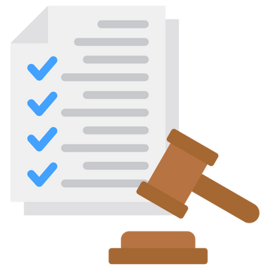
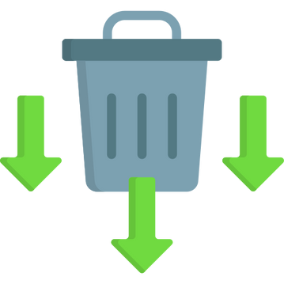

HOW CAN WE ADDRESS THIS ISSUE?
Promote sustainable practices, advanced recycling methods, education, and strict regulations to minimize hazardous waste and ensure safe disposal.
Reduce Waste
Recycle and Treat
Raise Awareness
Strengthen Regulations

Slide 8
HOW CAN WE ADDRESS THIS ISSUE?
Adopt sustainable practices to create less hazardous waste.
Find safer ways to recycle or neutralize harmful substances.
Teach people and industries how to handle and dispose of hazardous waste responsibly.
Enforce stricter rules to prevent improper disposal and illegal dumping.

Slide 9

One of the significant solution is:
IMPROVING OR INCREASING TSD (TREATMENT, STORAGE, AND DISPOSAL) FACILITIES
Increasing TSD (Treatment, Storage, and Disposal) facilities is crucial for effective hazardous waste management. By enabling treatment and disposal closer to waste sources, these facilities reduce transportation needs, costs, and risks. Expanding TSD capacity helps regions manage their growing waste generation and prevents waste accumulation. Enhanced facilities ensure safe handling of hazardous materials, improving community safety and compliance with regulations. Lastly, more TSD facilities promote recycling, raise public awareness about hazardous waste issues, and protect the environment and public health.

Slide 10
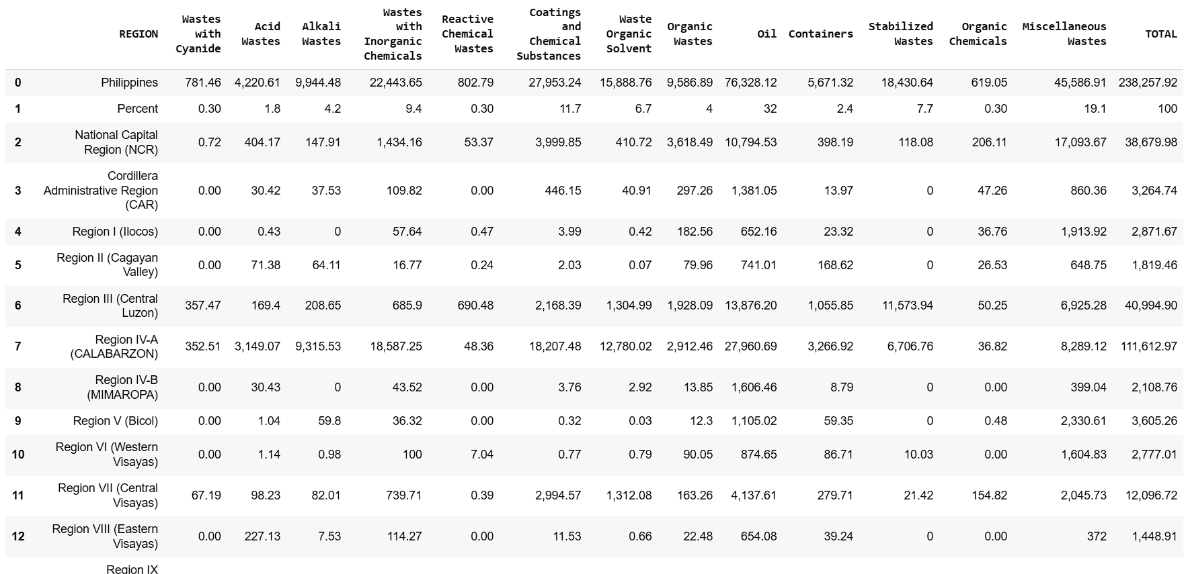
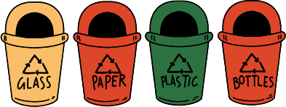
DATASET OF THE AMOUNT OF GENERATED HAZARDOUS WASTE BY REGION IN 2023
Environmental sustainability includes:

Slide 11
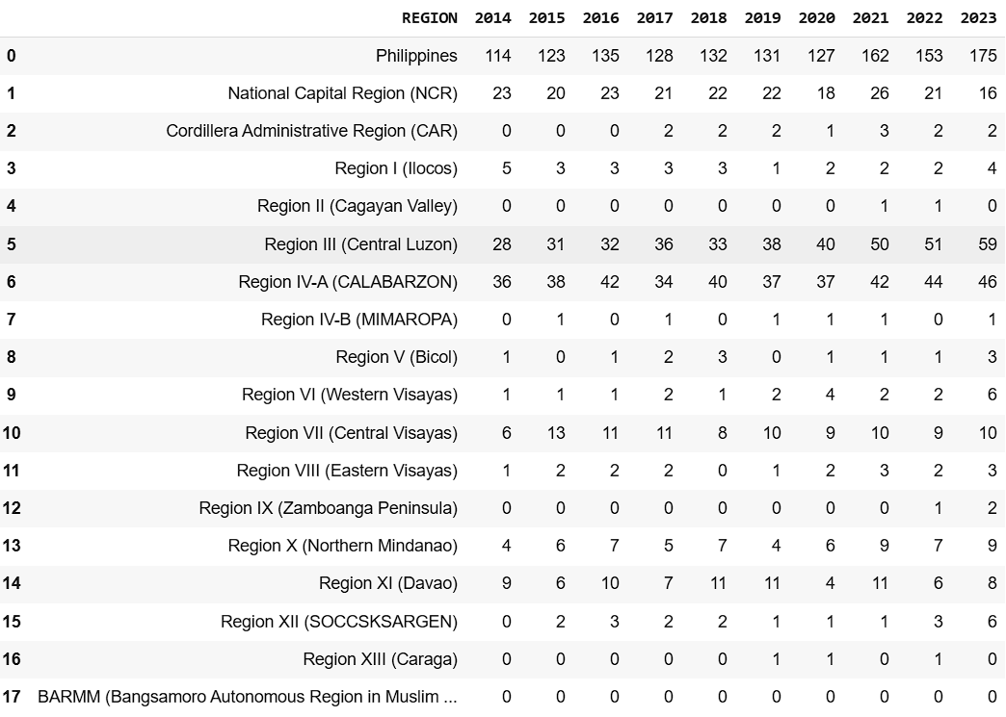
DATASET OF THE NUMBER OF REGISTERED TSD FACILITIES BY REGION 2014-2023

Slide 12
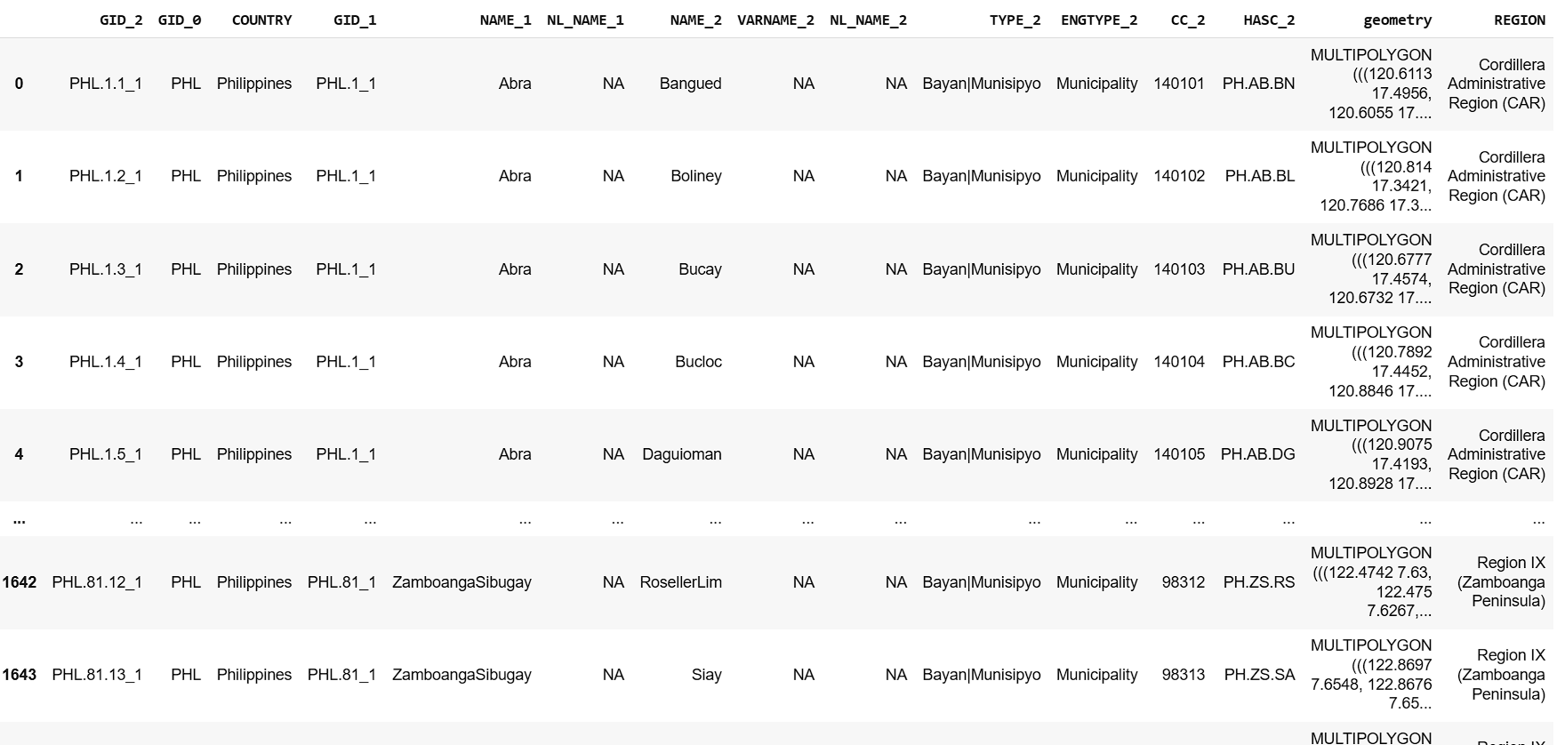
DATASET OF THE PHILIPPINE MAP WITH GEOMETRY AND REGIONAL DIVISIONS ADDED

Slide 13
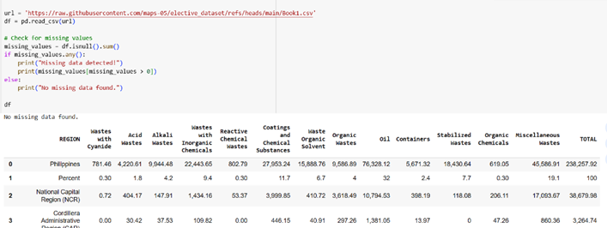
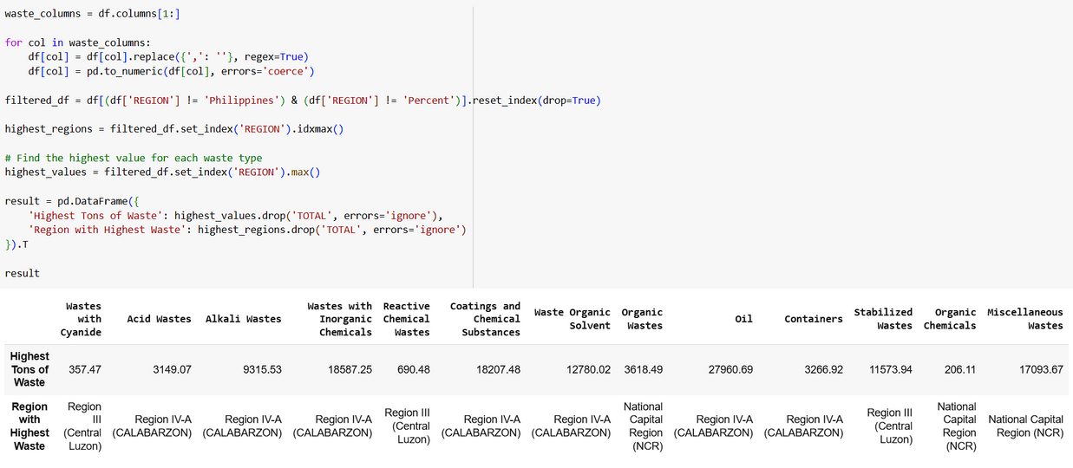
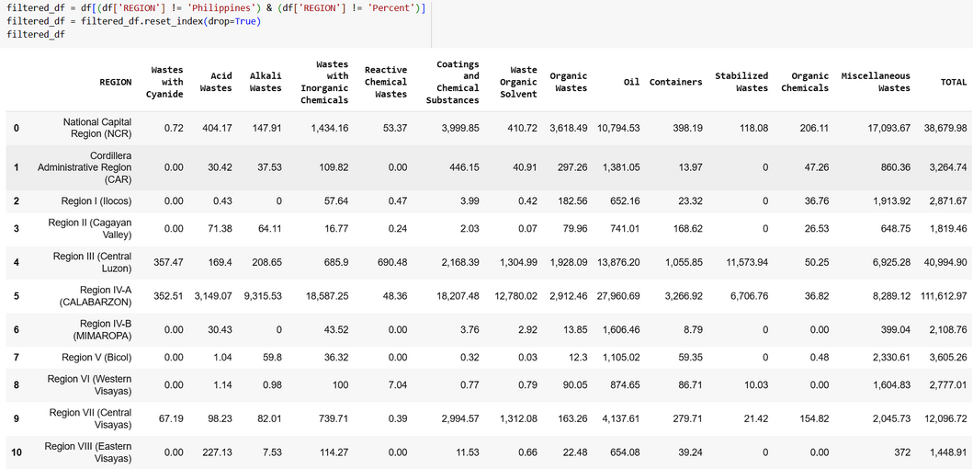
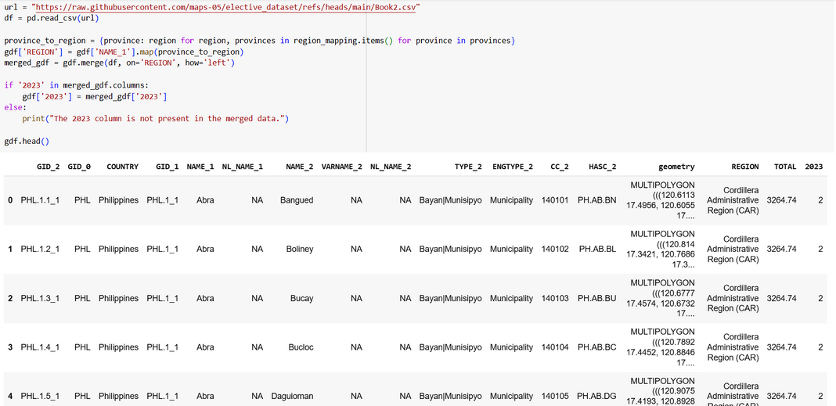
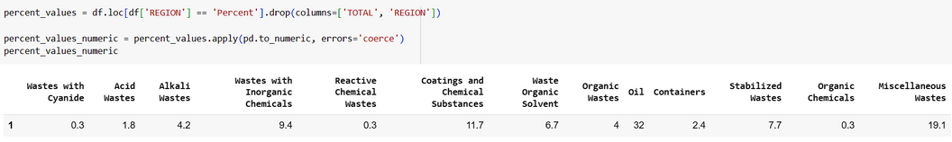
FILTERED AND MERGED DATASET

Slide 14
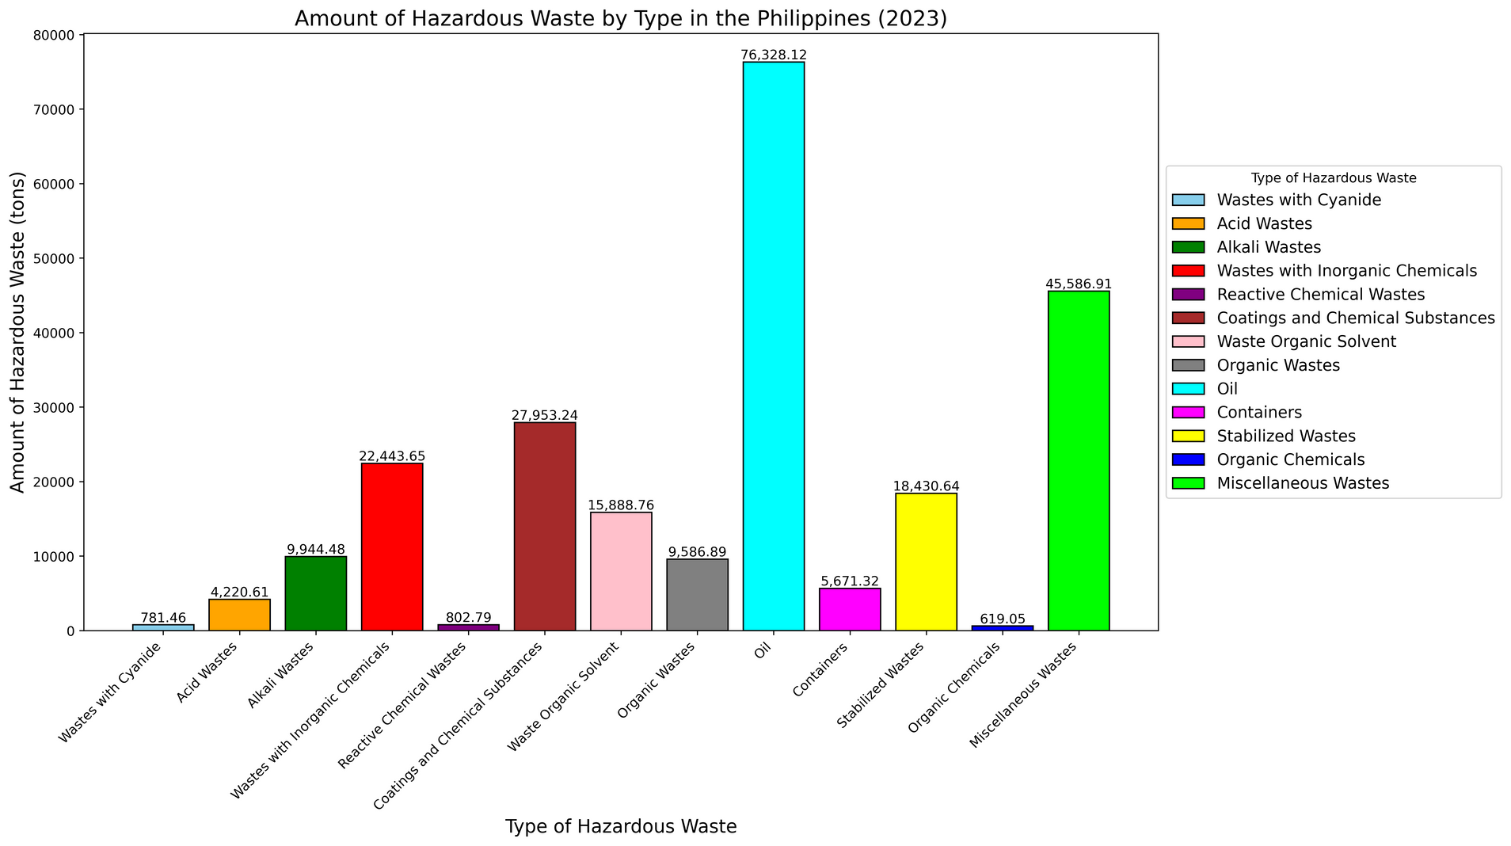
TOTAL AMOUNT OF HAZARDOUS WASTE BY TYPE (2023)
The amount of hazardous waste generated in the Philippines in 2023, categorized by type depicts the waste category with the highest amount is Oil, with a total of 76,328.12 tons, followed by Miscellaneous Wastes (45,586.91 tons). The waste category with the lowest amount is Organic Chemicals, with only 619.05 tons. The data suggests that the majority of hazardous waste generated in the Philippines comes from industrial activities, particularly those related to oil and gas extraction, manufacturing, and construction.

Slide 15
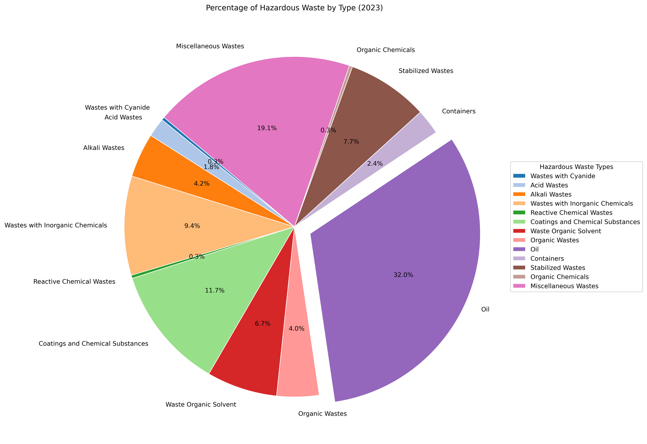
PERCENTAGE OF HARZARDOUS WASTE BY TYPE (2023)
The hazardous waste percentage breakdown reveals that Oil constitutes the highest percentage of hazardous waste generated, accounting for 32.0%. Conversely, Organic chemicals, Wastes with cyanide, and Reactive chemical wastes represent the lowest percentage, contributing only 0.3% to the total hazardous waste. This data is consistent with the information presented in the accompanying bar graph.

Slide 16
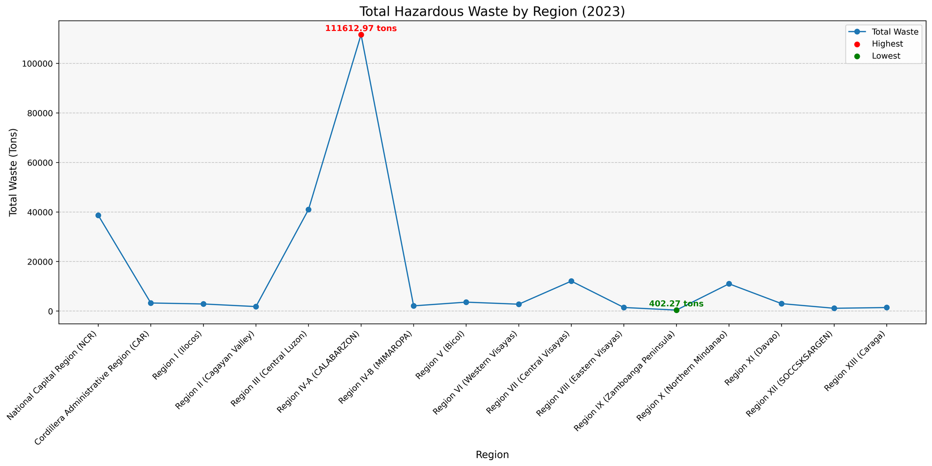
TOTAL HAZARDOUS WASTE BY REGION IN THE PHILIPPINES (2023)
The highest amount of hazardous waste is found in Region IV-A (CALABARZON), with a total of 111612.97 tons. This is significantly higher than other regions. The lowest amount of hazardous waste is found in Region X (Northern Mindanao), with a total of 402.27 tons. This indicates a considerable disparity in the generation and management of hazardous waste across the different regions.

Slide 17
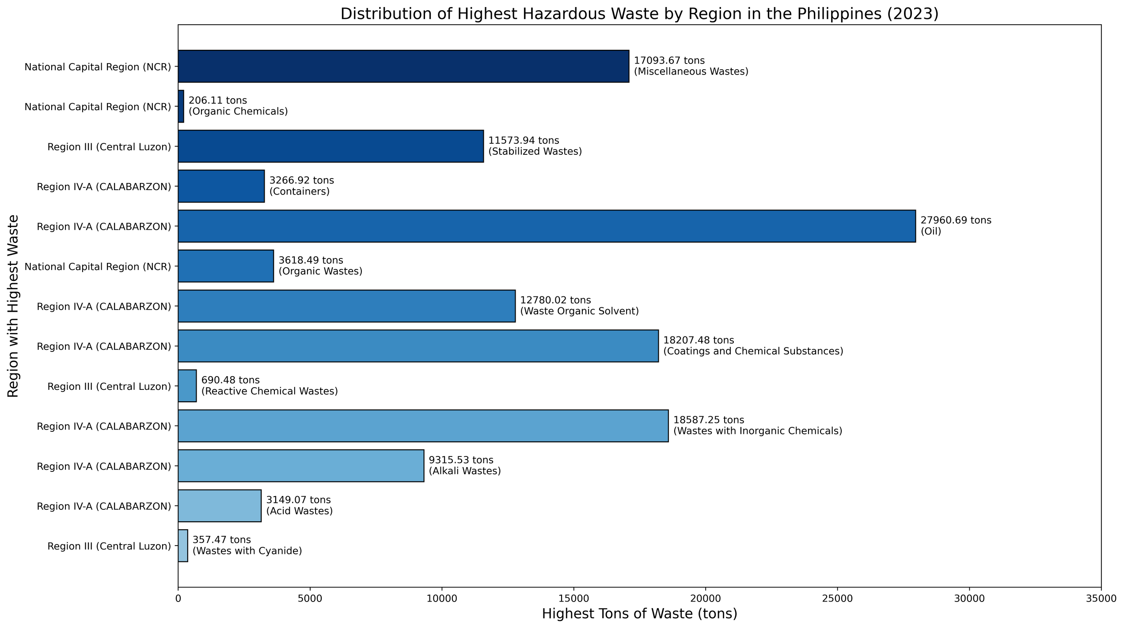
DISTRIBUTION OF HIGHEST HAZARDOUS WASTE BY REGION (2023)

Slide 18
Region IV-A (CALABARZON)
This region has the highest amount of hazardous waste, with a total of 67,272.42 tons.
The most common type of hazardous waste is oil, followed by coatings and chemical substances.
National Capital Region (NCR)
The region has a high concentration of hazardous waste, with a total of 17,299.78 tons.
The most common type of hazardous waste is miscellaneous wastes, followed by stabilized wastes.
Region III (Central Luzon)
The region has a relatively low amount of hazardous waste, with a total of 12,242.23 tons.
The most common type of hazardous waste is reactive chemical wastes, followed by wastes with cyanide.
Significant Finding:
The majority of hazardous waste in the Philippines is concentrated in three regions: NCR, Region IV-A, and Region III. This suggests that there is a need for stronger regulations and waste management systems in these regions.

Slide 19

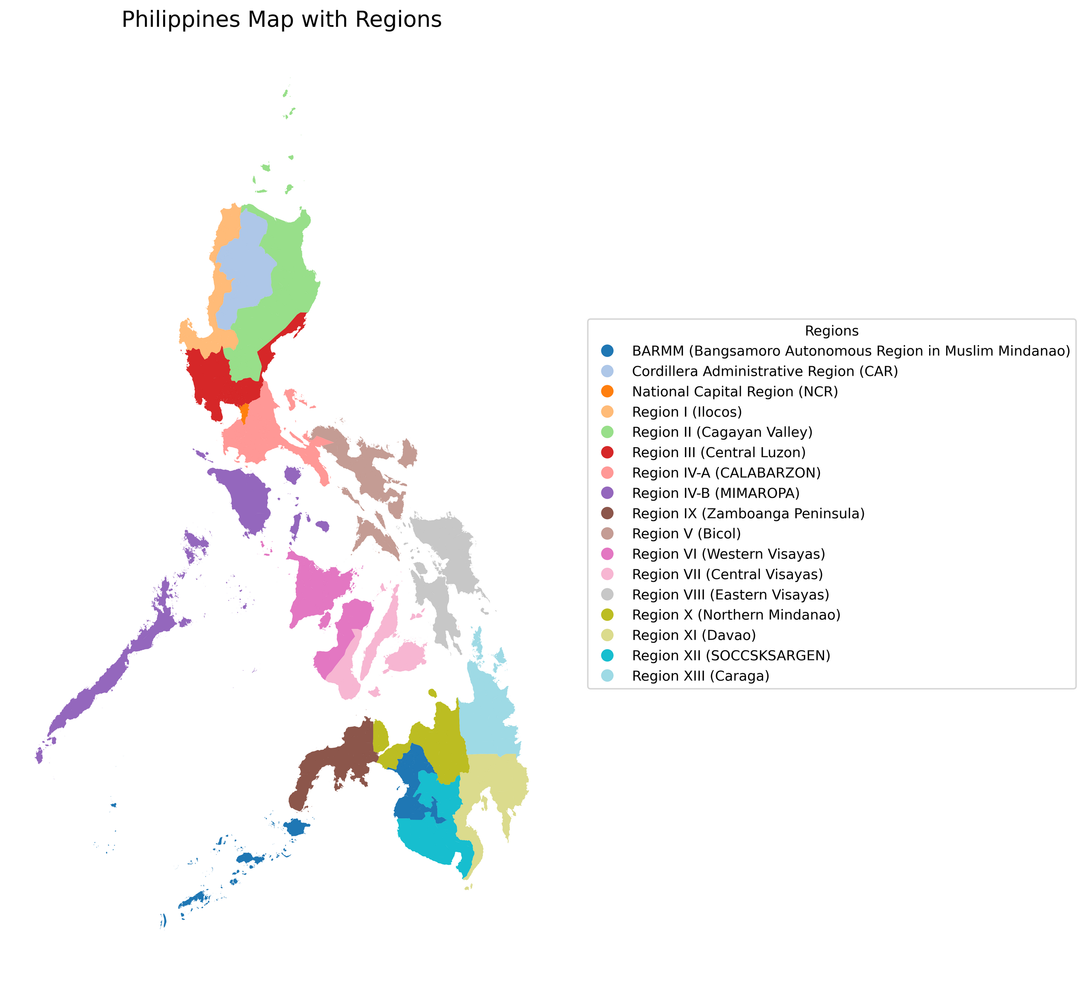



DIVIDING THE PHILIPPINES BY REGION

Slide 20
DIVIDING THE PHILIPPINES BY REGION

Slide 21
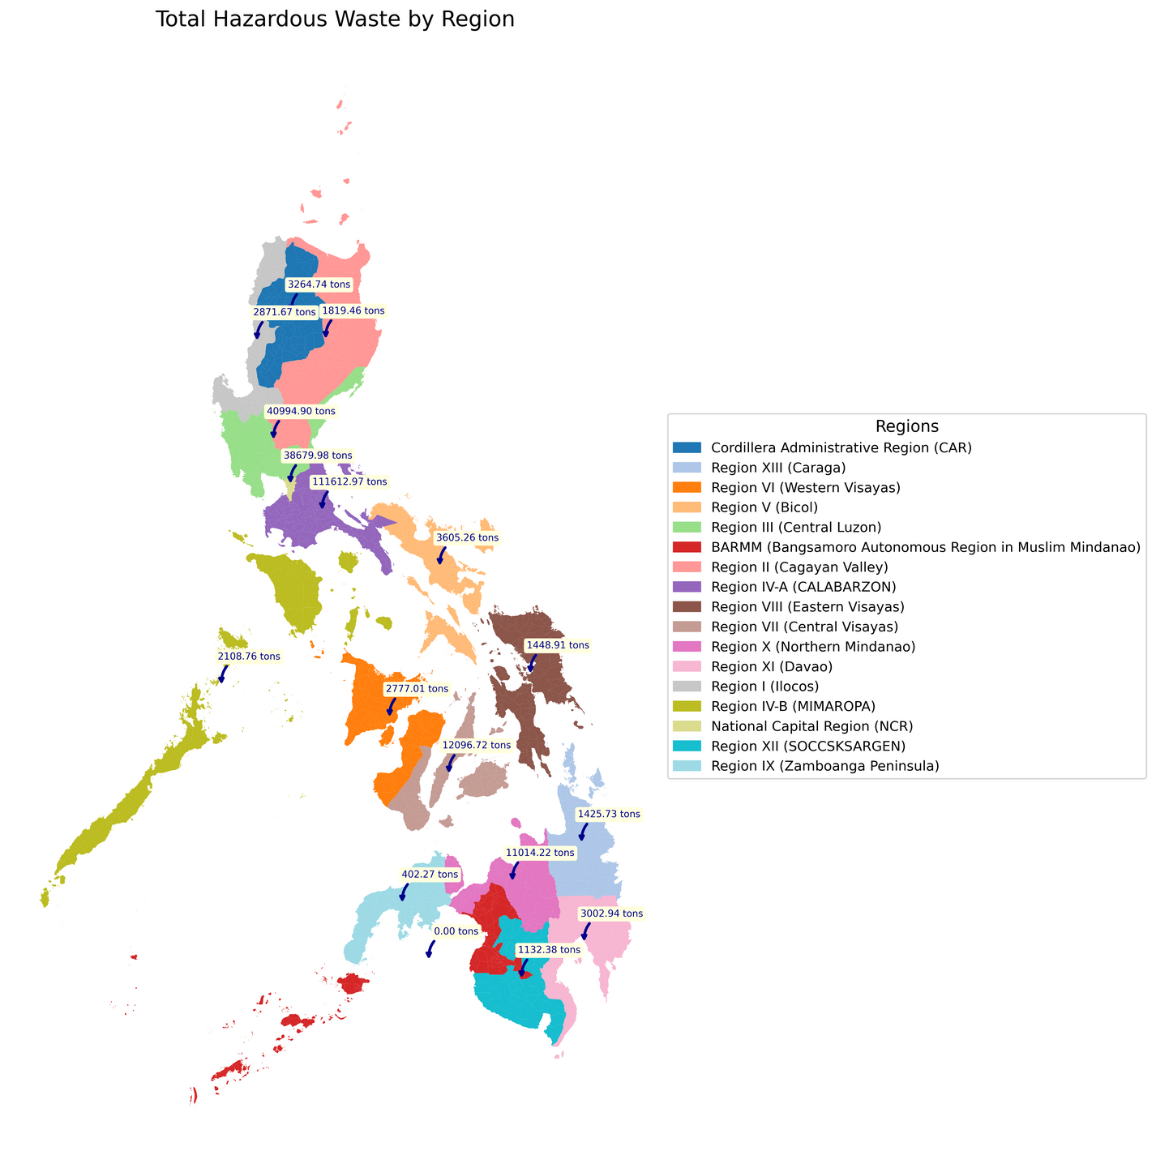
TOTAL HAZARDOUS WASTE BY REGION USING GEOPANDA
This map illustrates the total hazardous waste generated by each region in the Philippines, measured in tons. Each region is color-coded and labeled with its corresponding hazardous waste total, providing a clear visualization of the distribution. Notably, Region IV-A (CALABARZON) has the highest hazardous waste amount at 40,994.90 tons, followed by other regions like NCR and Region III with significant totals. In contrast, some regions, such as a part of Region IX and MIMAROPA, report low hazardous waste. This visualization highlights areas with higher waste generation, offering insights for targeted waste management and environmental planning.

Slide 22
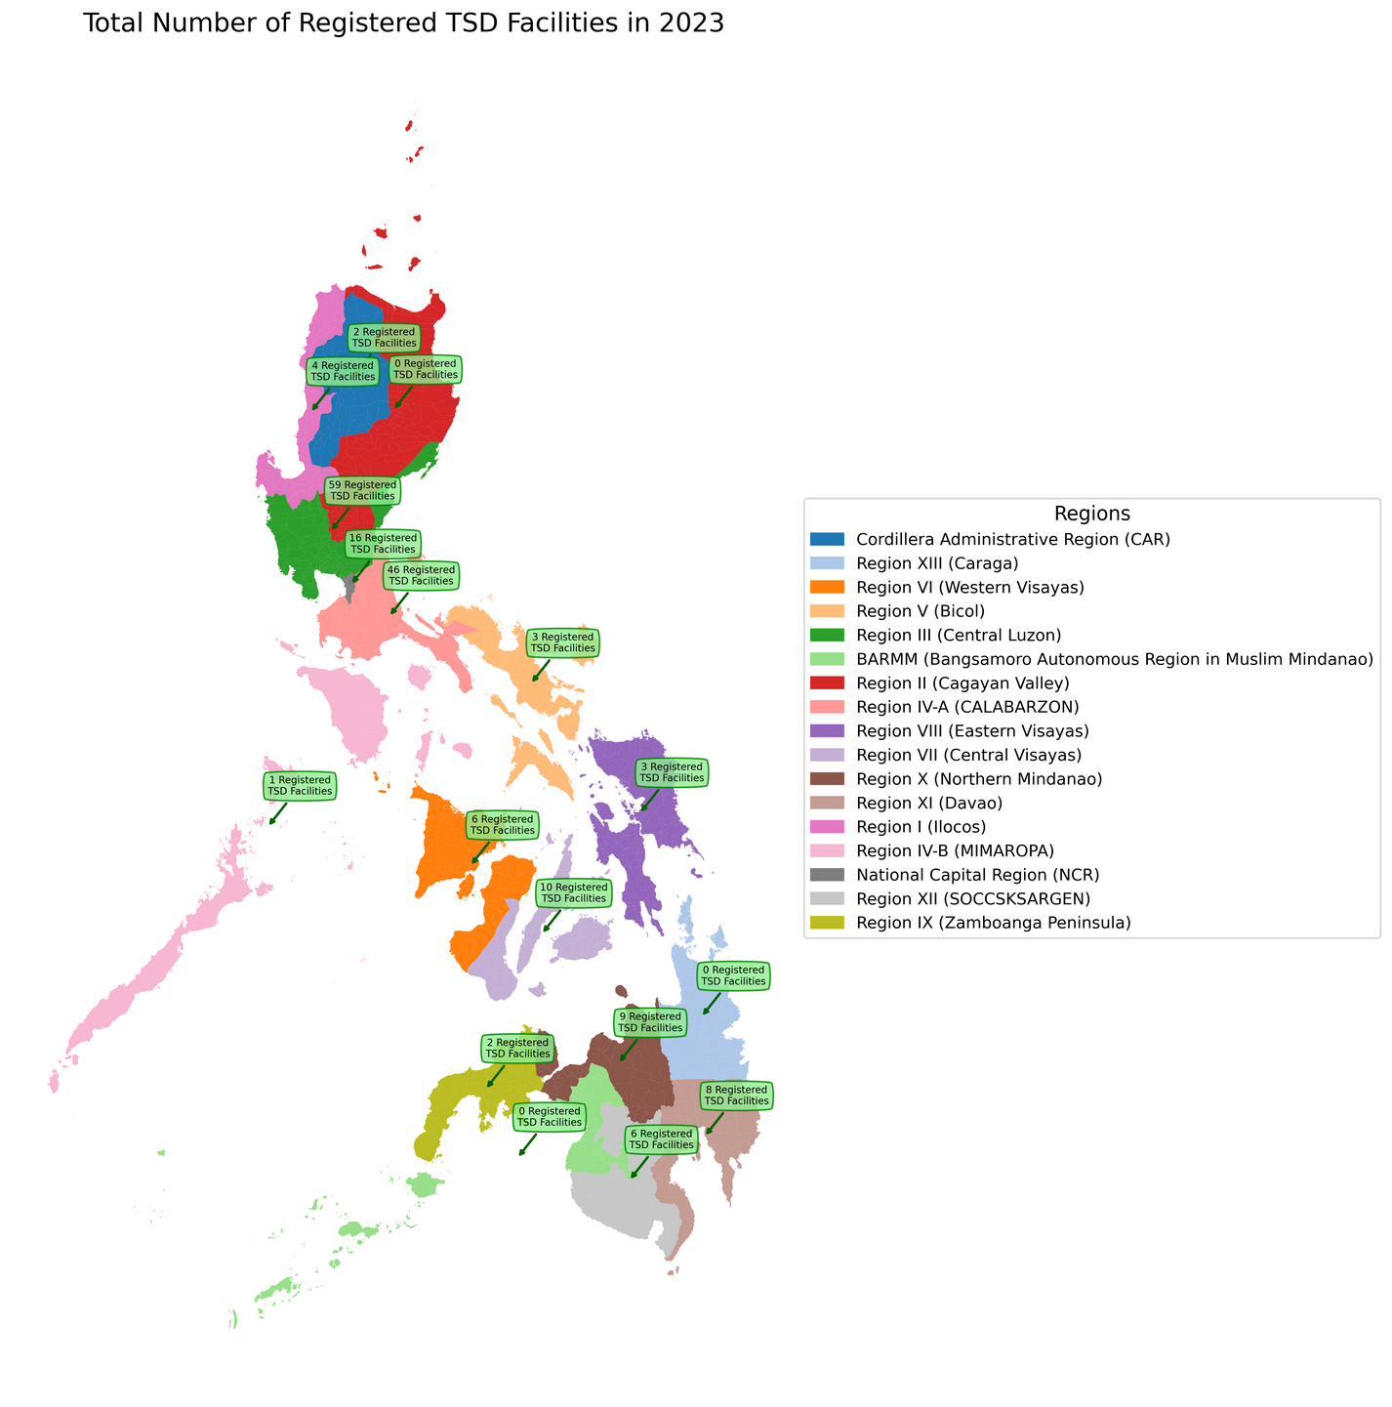
TOTAL NUMBER OF REGISTERED TSD FACILITIES IN 2023 USING GEOPANDA
This map shows the total number of registered TSD (Treatment, Storage, and Disposal) facilities in each region of the Philippines for 2023. Each region is color-coded and labeled with its corresponding facility count. Region III (Central Luzon) has the highest number of registered facilities, totaling 59 facilities, followed by the
Region IV-A (CALABARZON) with 46 facilities. Some regions, such as BARMM and Region XIII (Caraga), report 0 registered facilities. The total number of registered TSD facilities in the Philippines is resulted to 175. This visualization highlights regions with better waste management infrastructure and areas that may require further development.

Slide 23
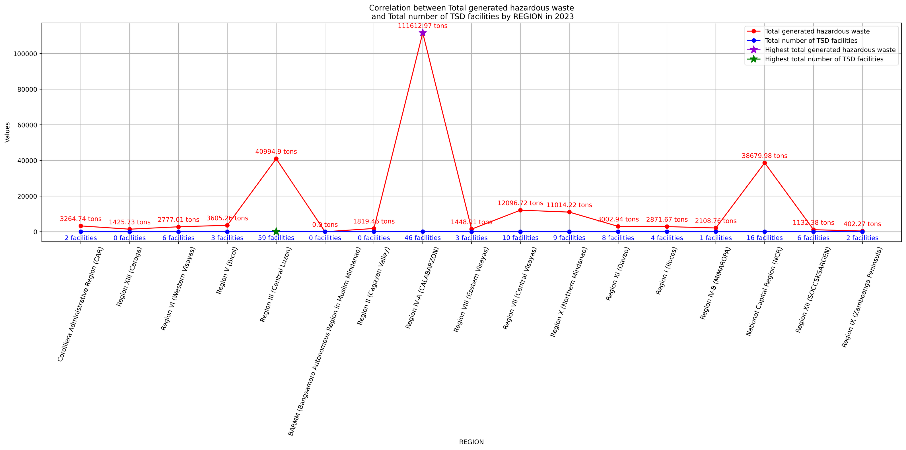



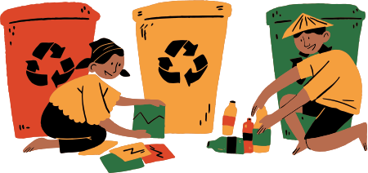
CORRELATION BETWEEN TOTAL GENERATED HAZARDOUS WASTE AND TOTAL NUMBER OF TSD FACILITIES BY REGION IN 2023

Slide 24
This analysis highlights the necessity for strategically distributing TSD facilities, particularly in areas with increasing waste generation but insufficient infrastructure, to ensure effective and sustainable hazardous waste management.

Slide 25
SIGNIFICANT FINDINGS
Regions of Note
CALABARZON (Region IV-A) generates the highest amount of hazardous waste, totaling 111,612.97 tons, and has a significant number of TSD facilities (46). This suggests that the region is well-equipped to manage a large portion of its waste locally.
Central Luzon (Region III) produces 40,994.9 tons of hazardous waste and boasts the most TSD facilities (59). The high facility count suggests the region has strong infrastructure for managing its hazardous waste output.
Discrepancies in Waste Generation and Facility Availability
Certain regions, like the National Capital Region (NCR), which generates 38,679.98 tons of hazardous waste, have fewer TSD facilities (16) compared to Region III. This disparity may result in logistical challenges for local waste management.
Regions such as BARMM, Caraga, and Cagayan Valley have not registered any TSD facilities despite generating hazardous waste, leading to significant environmental and logistical concerns.

Slide 26
SIGNIFICANT FINDINGS
Low Waste Generation Regions with Facilities
Regions like MIMAROPA (Region IV-B) and SOCCSKSARGEN (Region XII) have relatively low hazardous waste outputs (2,108.76 tons and 1,132.38 tons, respectively) but still maintain registered TSD facilities. This indicates a level of preparedness to manage waste, even at lower generation levels.
Critical Gaps in Waste Management
Regions lacking TSD facilities, such as BARMM and Caraga, may depend heavily on neighboring regions for waste management, which increases transportation risks and costs.

Slide 27
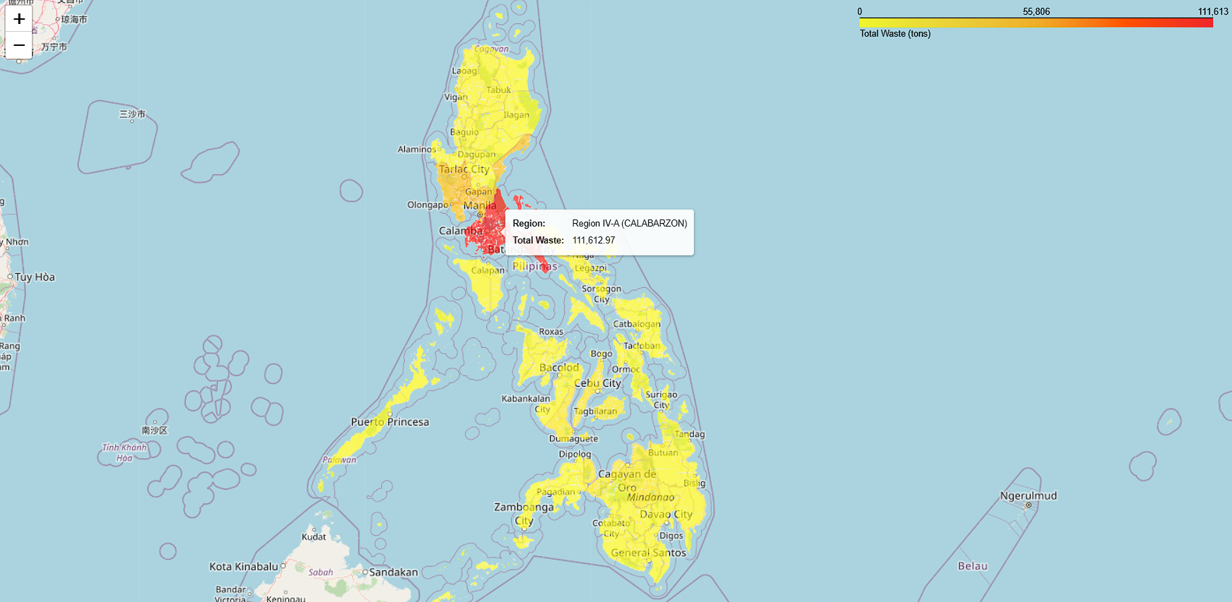
TOTAL HAZARDOUS WASTE GENERATED BY REGION IN THE PHILIPPINES, VISUALIZED WITH A COLOR MAP AND TOOLTIPS USING FOLIUM
download_folium_maps.com

Slide 28
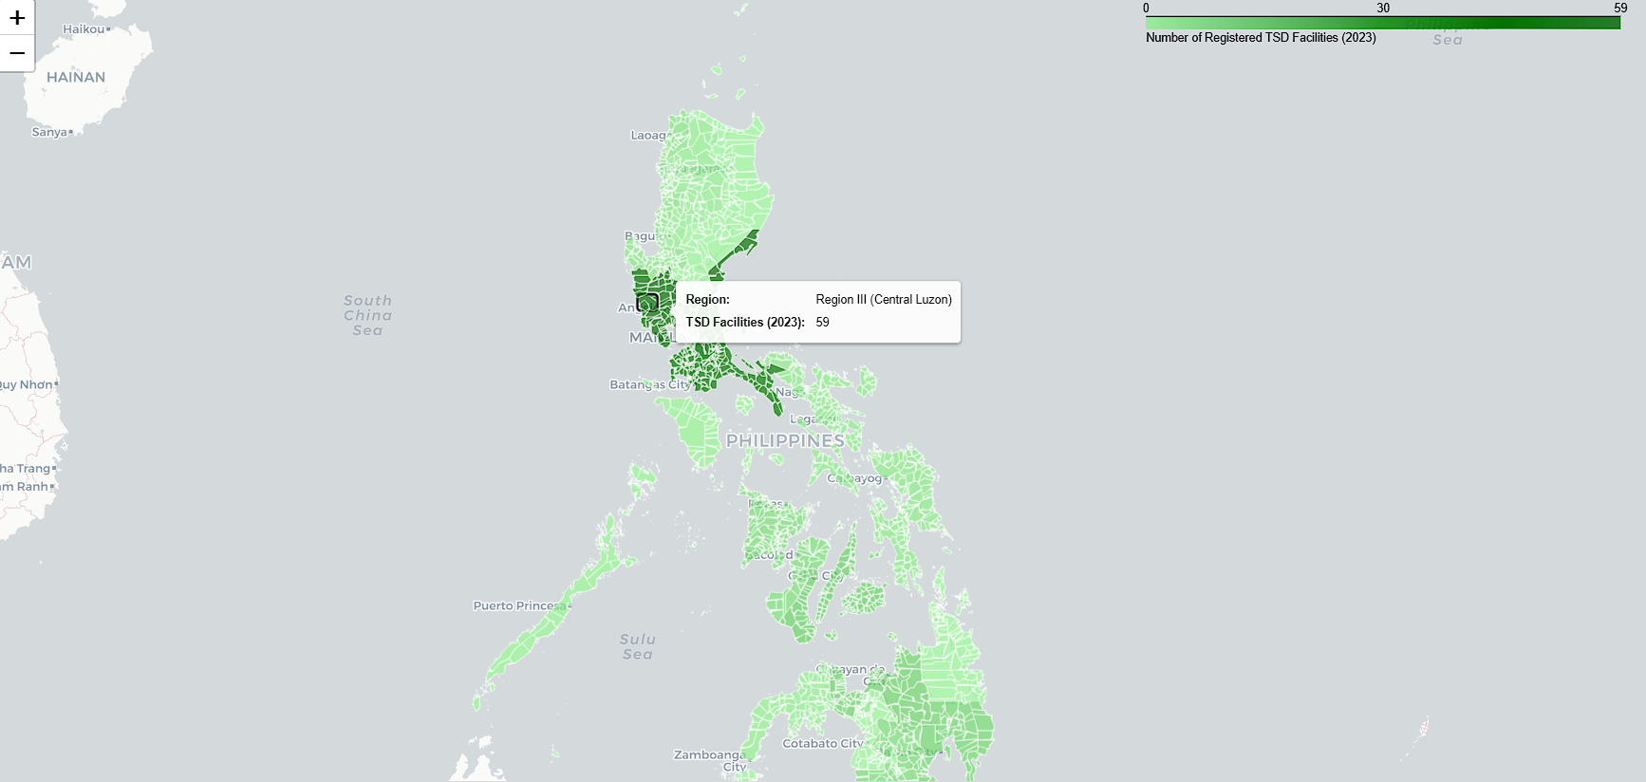
download_folium_maps.com
TOTAL NUMBER OF REGISTERED TSD FACILITIES BY REGION IN THE PHILIPPINES, VISUALIZED WITH A COLOR MAP AND TOOLTIPS USING FOLIUM

Slide 29
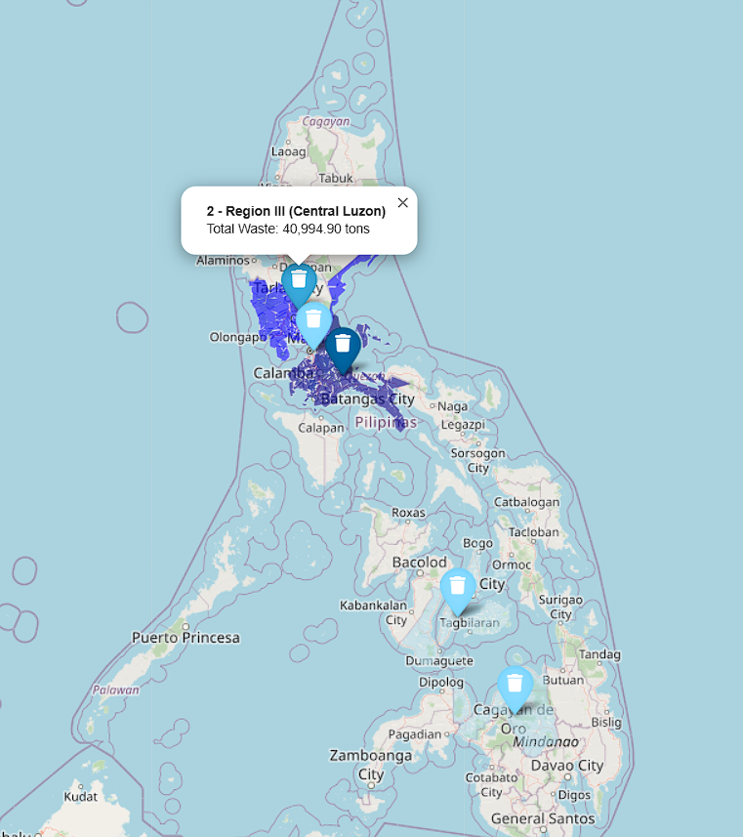
download_folium_maps.com
TOTAL HAZARDOUS WASTE GENERATED BY REGION IN THE PHILIPPINES, VISUALIZED WITH A TOOLTIP AND MARKER (TOP 5) USING FOLIUM

Slide 30
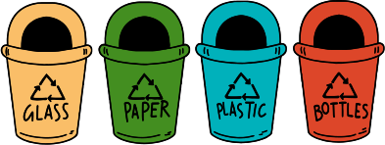
CONCLUSION
In summary, the analysis of hazardous waste generation and TSD facility distribution in the Philippines highlights significant regional disparities. CALABARZON and Central Luzon are noted for their high levels of hazardous waste and the availability of TSD facilities, reflecting strong local waste management capabilities. In contrast, regions like NCR and BARMM face challenges due to high waste generation and a lack of sufficient facilities, which can lead to environmental risks. Additionally, regions with lower waste outputs, such as MIMAROPA and SOCCSKSARGEN, show preparedness through their TSD facilities, underscoring the importance of readiness in waste management.
The findings call for a more equitable distribution of TSD facilities, particularly in areas with increasing hazardous waste, to improve the Philippines' capacity for sustainable waste management and protect public health and the environment.

Slide 31



THANK YOU
REFERENCES
csv_and_folium.com
colab_link.com

