Slide 1
Income Prediction using machine learning
Presented By:
Akanksha Madhukar Pawar
Dr D Y Patil Institute of Technology
Department of Artificial Intelligence and Data Science

Slide 2
OUTLINE
Problem Statement (Should not include solution)
Proposed System/Solution
System Development Approach (Technology Used)
Algorithm & Deployment
Result
Conclusion
Future Scope
References

Slide 3
Problem Statement
Develop a machine learning model for income prediction based on a given dataset that includes various socio-economic factors. The goal is to identify and analyze the significant factors influencing an individual's income and build a predictive model using the Random Forest Classifier. The project involves data preprocessing tasks, such as converting relevant column values into binary (0 or 1), removing unnecessary columns, and retaining essential columns in their original form. The objective is to create an efficient model that accurately predicts income levels based on the selected features, contributing to a better understanding of the socio-economic determinants affecting income.

Slide 4
Proposed Solution
The project aims to predict what factors affect an individual’s income. The solution will consist of the following components:
Data Collection:
Using a Dataset from Kaggle. Link: https://www.kaggle.com/datasets/wenruliu/adult-income-dataset
Data Preprocessing:
Data preprocessing for this project is done by combining one-hot encoding, filtering, and correlation analysis for making the dataset suitable for the machine learning model.
Machine Learning Algorithm:
The machine learning algorithm used in this project is Random Forest Classifier.
Deployment:
The project can be deployed using API integration, security measures, monitoring strategies, and user-friendly documentation for seamless real-world applications.
Evaluation:
Evaluate the Random Forest Classifier's income prediction model through hyperparameter tuning and feature importance insights for effective real-world applicability.
Result: One of the factors ‘Never worked before’ is shown as a least concerning factor for an higher income by the ML model but that is because the values present in the dataset indicate only few individuals who have never worked before hence the output is given.

Slide 5
System Approach
System Requirements:
No specific system requirement is needed for the device except for Internet connection.
The project is made on Google Colaboratory so an google account is needed.
Library Required to build the Model:
The project is programmed is Python language.
The libraries used are:
Pandas
Matplotlib
Seaborn
Sklearn

Slide 6
Algorithm & Deployment
Algorithm Selection:
I chose the Random Forest Classifier for income prediction due to the presence of categorical columns like occupation, workclass, marital-status, relationship, and race with numerous unique values.
I transformed these specific values into binary format, enhancing compatibility with the Random Forest algorithm, known for its effectiveness with binary-encoded features.
Data Input:
Dataset from Kaggle. Link: https://www.kaggle.com/datasets/wenruliu/adult-income-dataset
Training Process:
The training process includes hyperparameter tuning and feature importances.
Later an optimal classifier with proper parameters are given by GridSearchCV.
Prediction Process:
The dataset is cleaned and pre-processed for training.
The data is trained with algorithm.
The factors that affect the income for an individual is found using feature importance insights.

Slide 7
Result
Visualization
Heatmap. (Fig 1.1)
Heatmap after removing columns that are not correlated with the column ‘income. (Fig 1.2)
Importances (factors by which the income is affected)
Using Random Forest Classifier. (Fig 2.1)
Using Random Forest Classifier after setting parameters. (Fig 2.2)

Slide 8
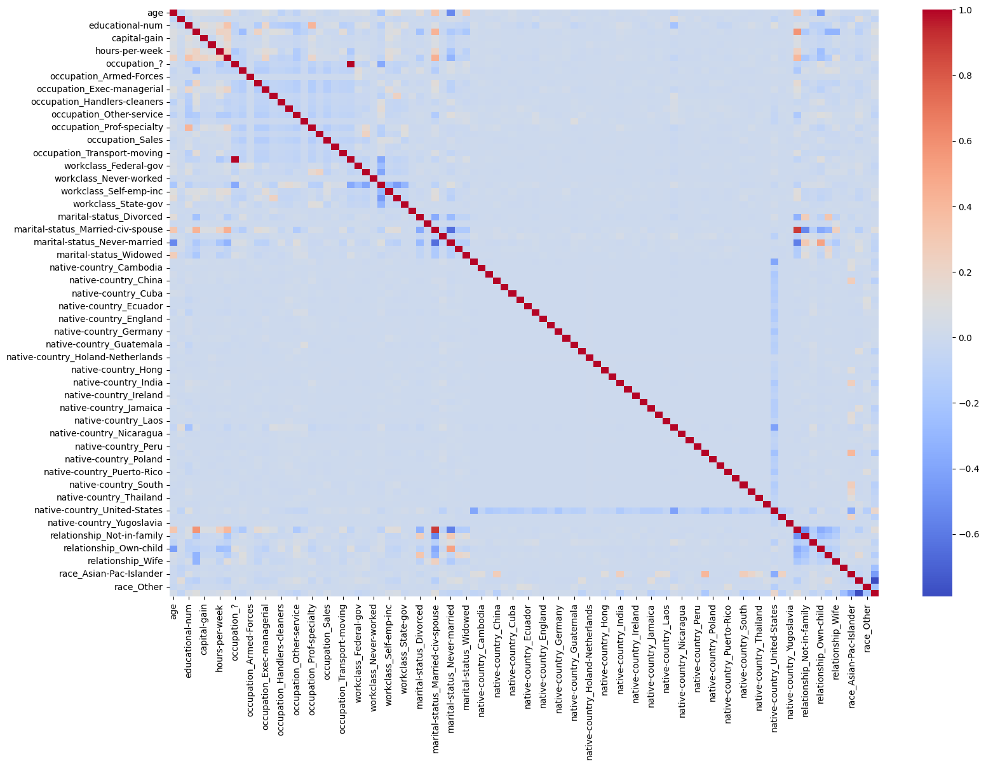
Fig 1.1

Slide 9
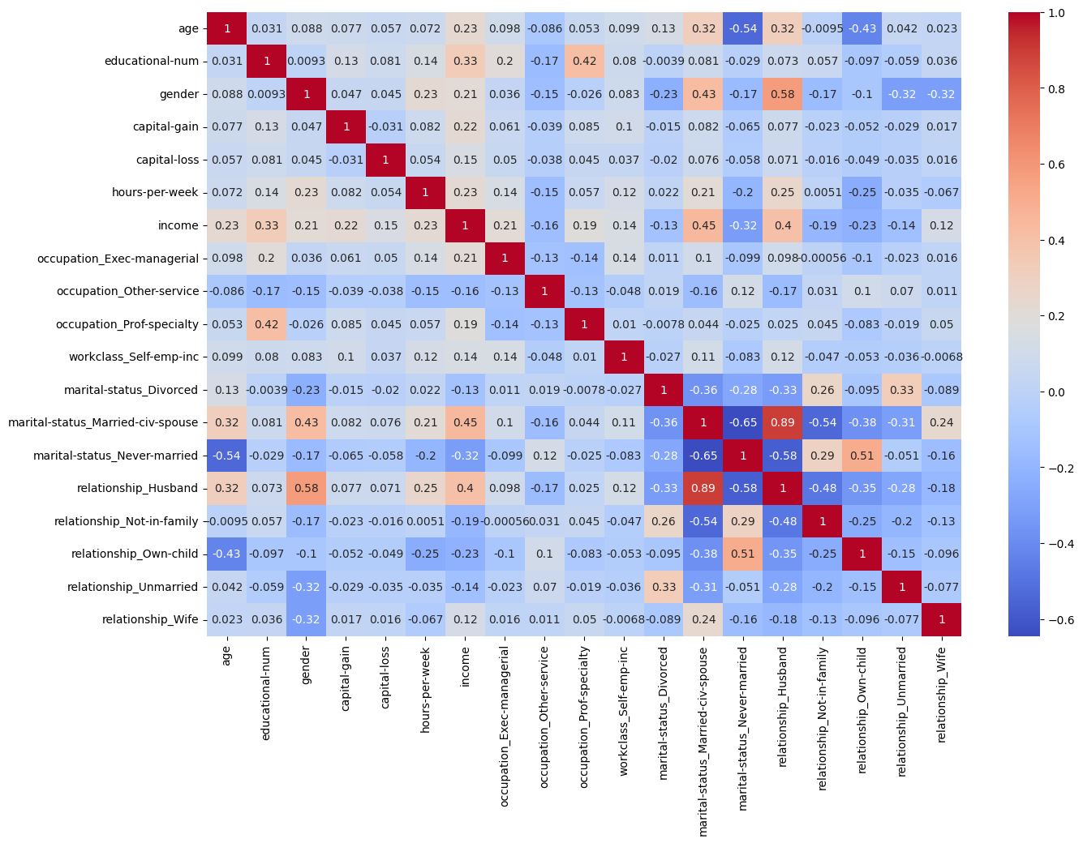
Fig 1.2

Slide 10
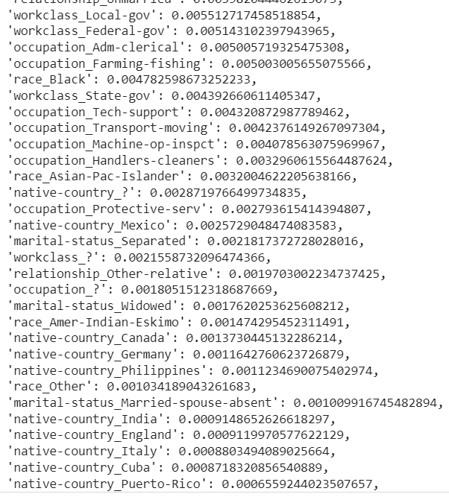
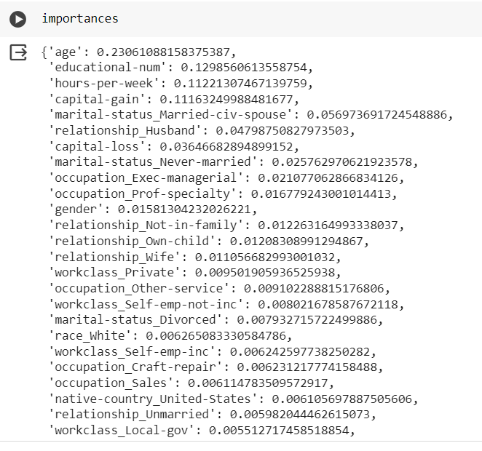
Fig 2.1

Slide 11
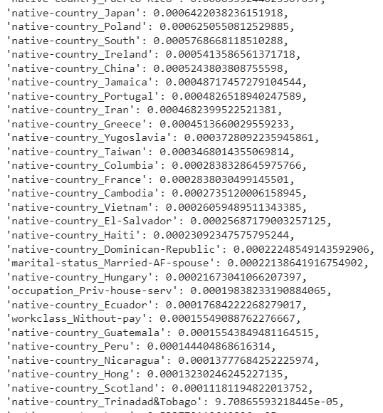
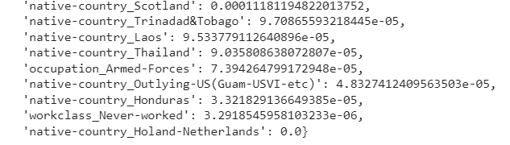

Slide 12
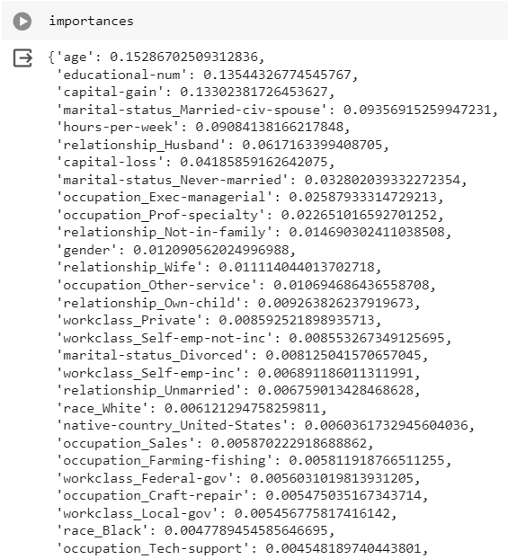
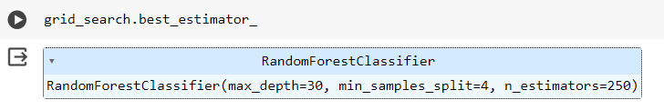
Fig 2.2

Slide 13
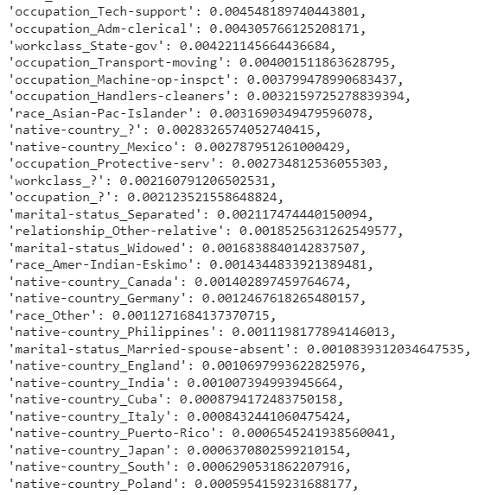
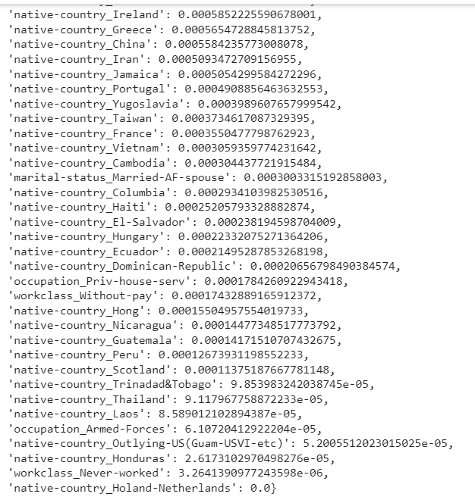

Slide 14
Conclusion
The Random Forest Classifier-based income prediction model, enhanced through preprocessing, successfully identifies significant socio-economic factors influencing income levels. This efficient model contributes valuable insights, deepening our understanding of these determinants.

Slide 15
Future scope
Future enhancements include exploring alternative algorithms, incorporating external data, and optimizing model interpretability. Continuous monitoring, fine-tuning, and real-world deployment will ensure the model's relevance and applicability in evolving socio-economic landscapes.

Slide 16
References
https://www.kdnuggets.com/2023/07/pandas-onehot-encode-data.html
https://www.geeksforgeeks.org/how-to-do-train-test-split-using-sklearn-in-python/
https://www.analyticsvidhya.com/blog/2021/06/tune-hyperparameters-with-gridsearchcv/

Slide 17
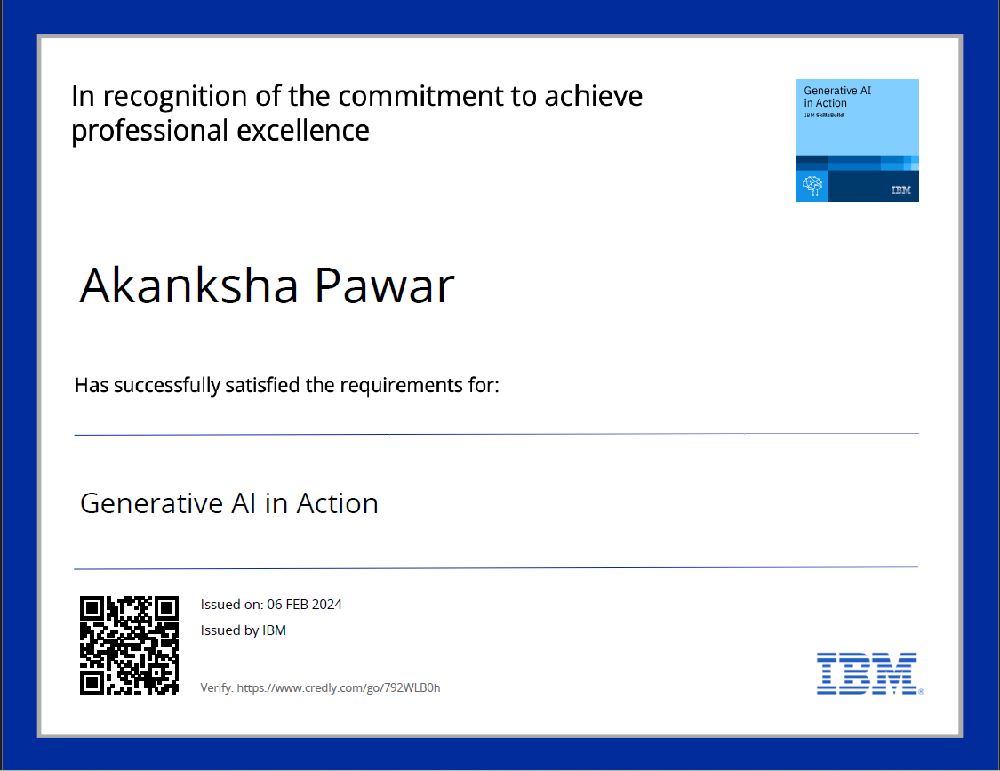
course certificate 1

Slide 18

course certificate 2

Slide 19
COURSE CERTIFICATE LINKS
Verify: https://www.credly.com/go/792WLB0h
Verify: https://www.credly.com/go/VBoCZ4wi
The PPT, code, badges and certificates are in github.
Link: https://github.com/maps51/Edunet

Slide 20
THANK YOU

