Slide 1
Interator and Iterable
Two commonly used interfaces in Java.
And: for-each loop.

Slide 2
Iterator
Problem: how can we access all members of a collection without knowing the structure of the collection?
Solution: each collection (List, Set, Stack, ...) provides an Iterator we can use.
<<interface>>
Iterator
hasNext( ): boolean
next( ): T (Object)
remove(): void

Slide 3
How to Use Iterator
List<String> list =
new ArrayList<String>( );
list.add("apple");
list.add( ... ); // add stuff
Iterator<String> iter = list.iterator();
while ( iter.hasNext() ) {
String s = iter.next( );
// do something with s
}
create a new Iterator for the collection.

Slide 4
Iterator Reduces Dependency
Suppose we have a Purse that contains Coins and a method getContents to show what is in the purse:
// Suppose a purse has a collection of coins
List<Coin> coins = purse.getContents();
for(int k=0; k<coins.size(); k++) {
Coin c = coins.get(k);
//TODO process this coin
}
Now the Purse must always create a List for us, even if the coins are stored is some other kind of collection, or a database.

Slide 5
Iterator Reduces Dependency (2)
If getContents instead just returns an Iterator, then:
// Suppose a purse has a collection of coins
Iterator<Coin> coins = purse.getContents();
while( coins.hasNext() ) {
Coin c = coins.next();
//TODO process this coin
}
The purse is free to internally use any collection it wants, and does not need to create a List for us.

Slide 6
Iterable
Problem: how can we get an Iterator?
Forces:
(1) the collection should create the iterator itself since only the collection knows its own elements.
(2) every collection should provide same interface for getting an Iterator (for polymorphism).
Solution: define an interface for creating iterators.
Make each collection implement
this interface.
<<interface>>
Iterable
iterator( ): Iterator<T>

Slide 7
How to Use Iterable
List<Student> list =
new ArrayList<String>( );
list.add( ... );
list.add( ... );
Iterator<String> iter = list.iterator();
iterator() creates a new Iterator each time.

Slide 8
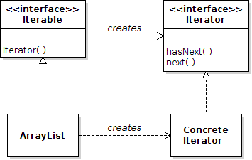
Iterable is a Factory Method
You can eliminate direct dependency between classes by creating an interface for required behavior.
the factory...
the product...
abstract:
the factory method
concrete:

Slide 9
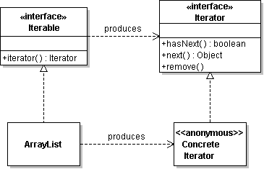
Factory Method
The Pattern
Factory Interface | Iterable
Factory Method | iterator( )
Product | Iterator
Concrete Factory | any collection

Slide 10
for-each loop
List<String> list =
new ArrayList<String>( );
list.add( . . . ); // add things to list
// print the list
for( String s: list ) {
System.out.println(s);
}
"for each String s in list" { . . . }

Slide 11
for-each compared to while
For-each loop. stuff is any Collection or an array.
for( Object x: stuff) {
System.out.println( x );
}
While loop does same thing:
Iterator iterator = stuff.iterator( );
while( iterator.hasNext() ) {
Object x = iterator.next( );
System.out.println( x );
}

Slide 12
for-each in detail
"For each Datatype x in ... do { . . . }"
for( Datatype x: _collection_ ) {
System.out.println(x);
}
Datatype of the elements in _collection_
_collection_ can be:
1) array
2) any Iterable object

Slide 13
for-each with array
Indexed for loop. array[ ] is an array of double
double [] array = . . .;
for(int k=0; k<array.length; k++) {
System.out.println(array[k]);
}
for-each loop to do the same thing:
for( double x: array ) {
System.out.println( x );
}

Slide 14
Error: modifying a collection while using iterator
Iterator throws an exception if the underlying collection is modified while using the iterator.
List<String> words = /* a list of strings */;
Iterator iter = words.iterator( );
System.out.println(iter.next()); // OK
words.add("elephant");
System.out.println(iter.next()); // error
// exception thrown
"for-each" also throws exception if you modify collection while inside loop. (what about for-each with array?)

