Slide 1
Math Foundations for Machine Learning
Section 1: Linear Algebra
Dino de Raad

Slide 2
What is Linear Algebra

Slide 3
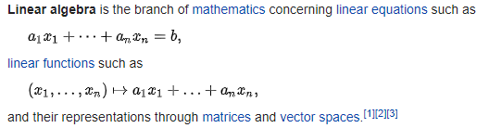
What is Linear Algebra

Slide 4
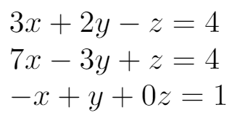
What is Linear Algebra
Systems of linear equations:
Linear Transformations:

Slide 5
What is Linear Algebra
Systems of linear equations:
Linear Transformations:

Slide 6
What is Linear Algebra
Systems of linear equations:
Linear Transformations:

Slide 7
Vectors and Matrices

Slide 8
Vectors
A vector is a multidimensional number
It specifies a point in space, just like a number specifies a point on the line
In a computer, this is a numerical array
0
1
2

Slide 9
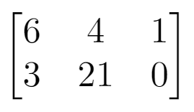
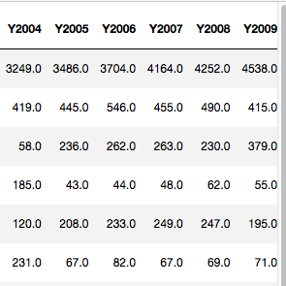
Matrices
Can be thought of as:
A linear transformation on a vector
The coefficients of a system of equations
A multidimensional vector, where the columns are vectors
A dataset where the rows are observations and the columns are attributes
In a computer, this is a rectangular numerical array

Slide 10
Vectors and Matrices: Systems of Equations
Every linear algebra problem boils down to solving Ax = b
A is some matrix, x is an unknown vector, and b is a known vector

Slide 11
Matrix Decomposition

Slide 12
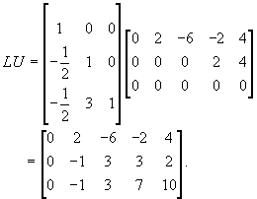
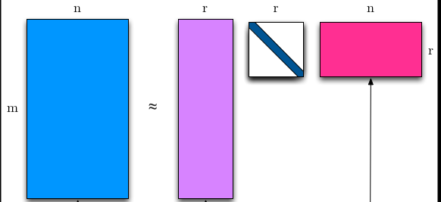
Matrix Decomposition
Matrices can be multiplied, and the result can be either a matrix or a vector
This means a matrix can be written as the product of 2 or more matrices

Slide 13
Eigenvalues and Eigenvectors

