Slide 1
Neural Network Structure
And why it’s Written in Linear Algebra
08/02/2019
Dino de Raad

Slide 2
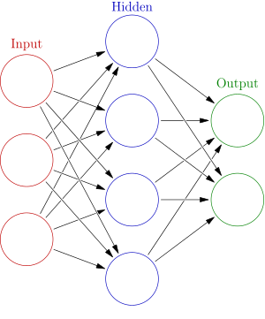
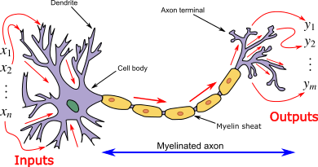
Neural Network Structure
Why should we expect a neural network to work?

