Slide 1
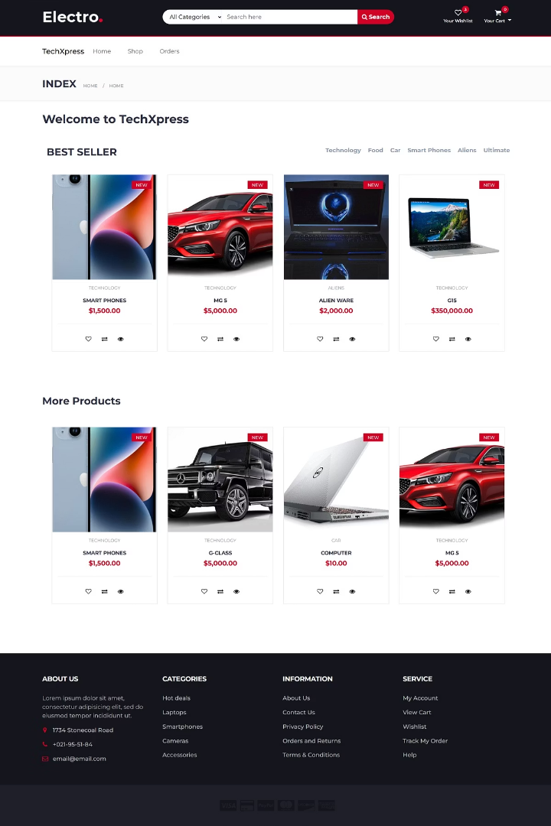

E-commerce Platform Built with .NET Core
TechXpress powers online retail with a modern, scalable, and secure e-commerce solution using .NET Core MVC.
by Mohamed Amin

Slide 2
Website Overview: Homepage Showcase
Homepage features product categories, search bar, and promotional banners.
Highlight seasonal promotions like “Summer Sale - Up to 50% Off!”
User-friendly design ensures intuitive navigation for all visitors.
Engage shoppers with new arrivals and featured collections.

Slide 3
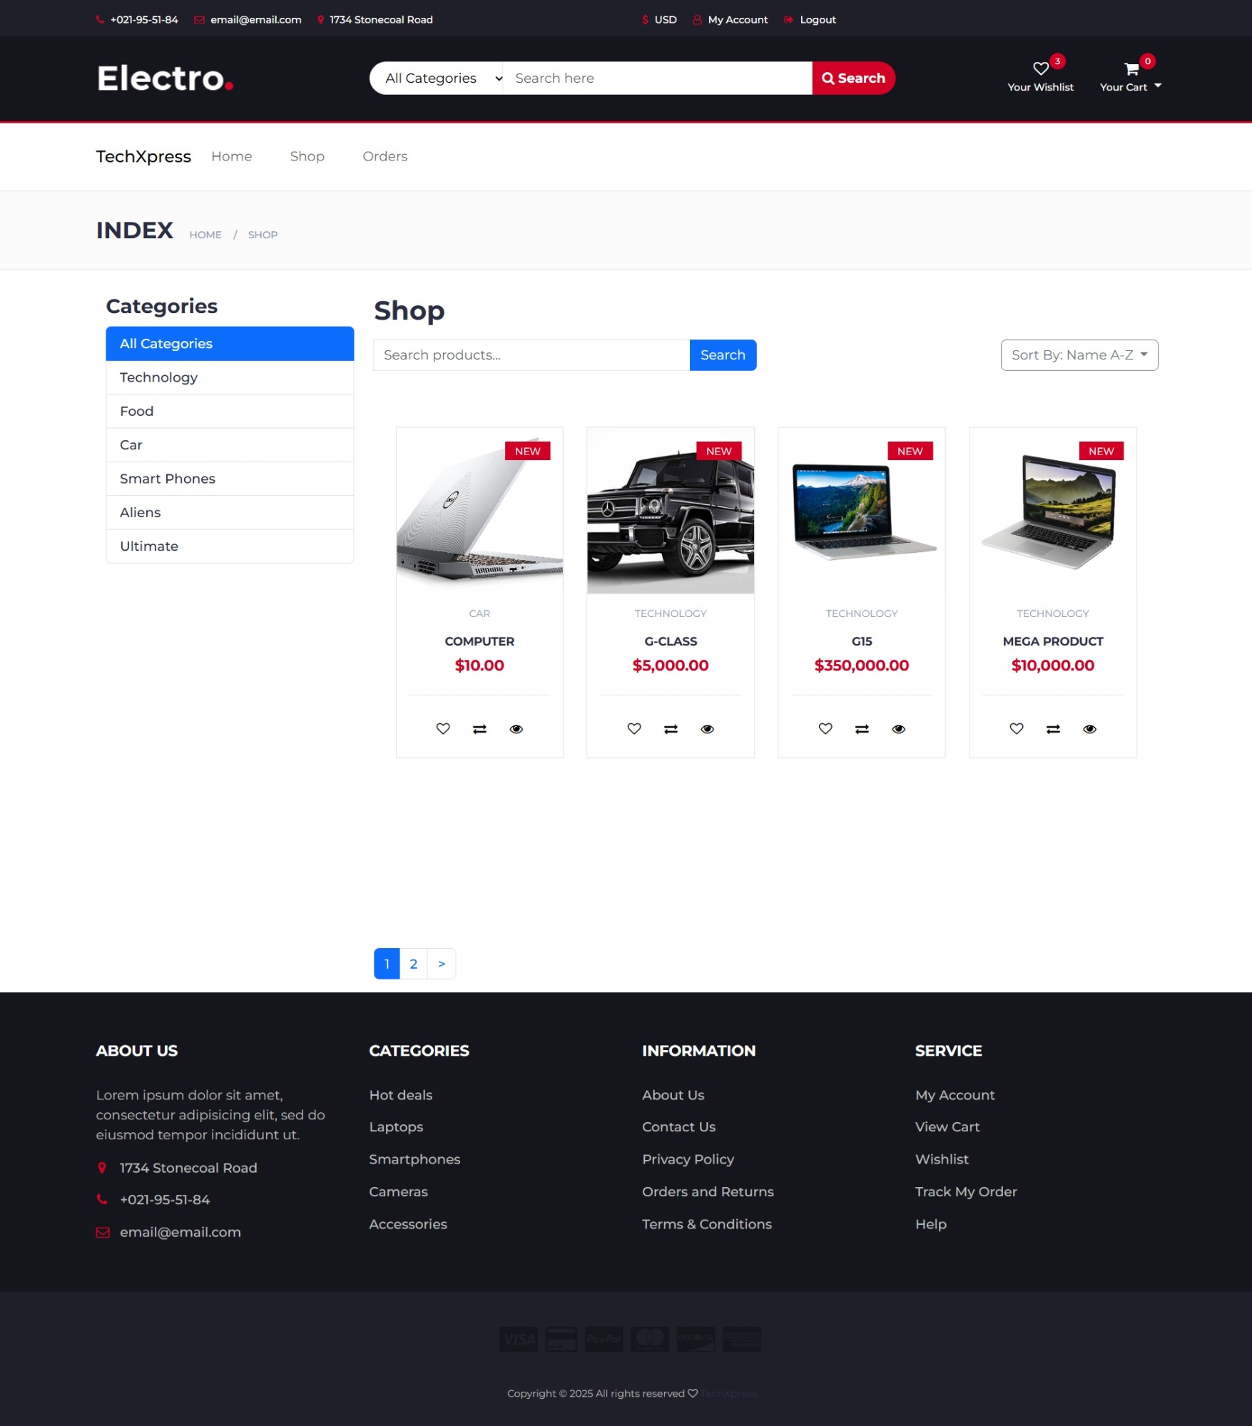
Key Features: Product Catalog & Details
Product Listing
Filtering & Sorting
High-quality images and detailed descriptions showcase products clearly.
Options by price, rating, popularity, and date added enhance browsing.
Detailed Product Page
Multiple images, zoom, add-to-Cart, and add-to-Wishlist buttons.

Slide 4
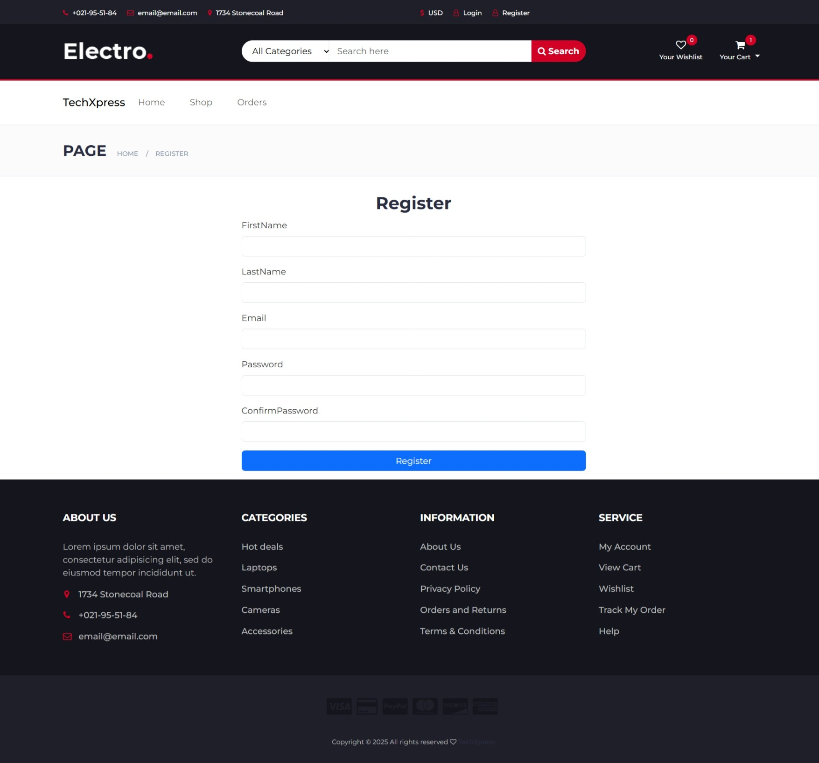
Register

Slide 5
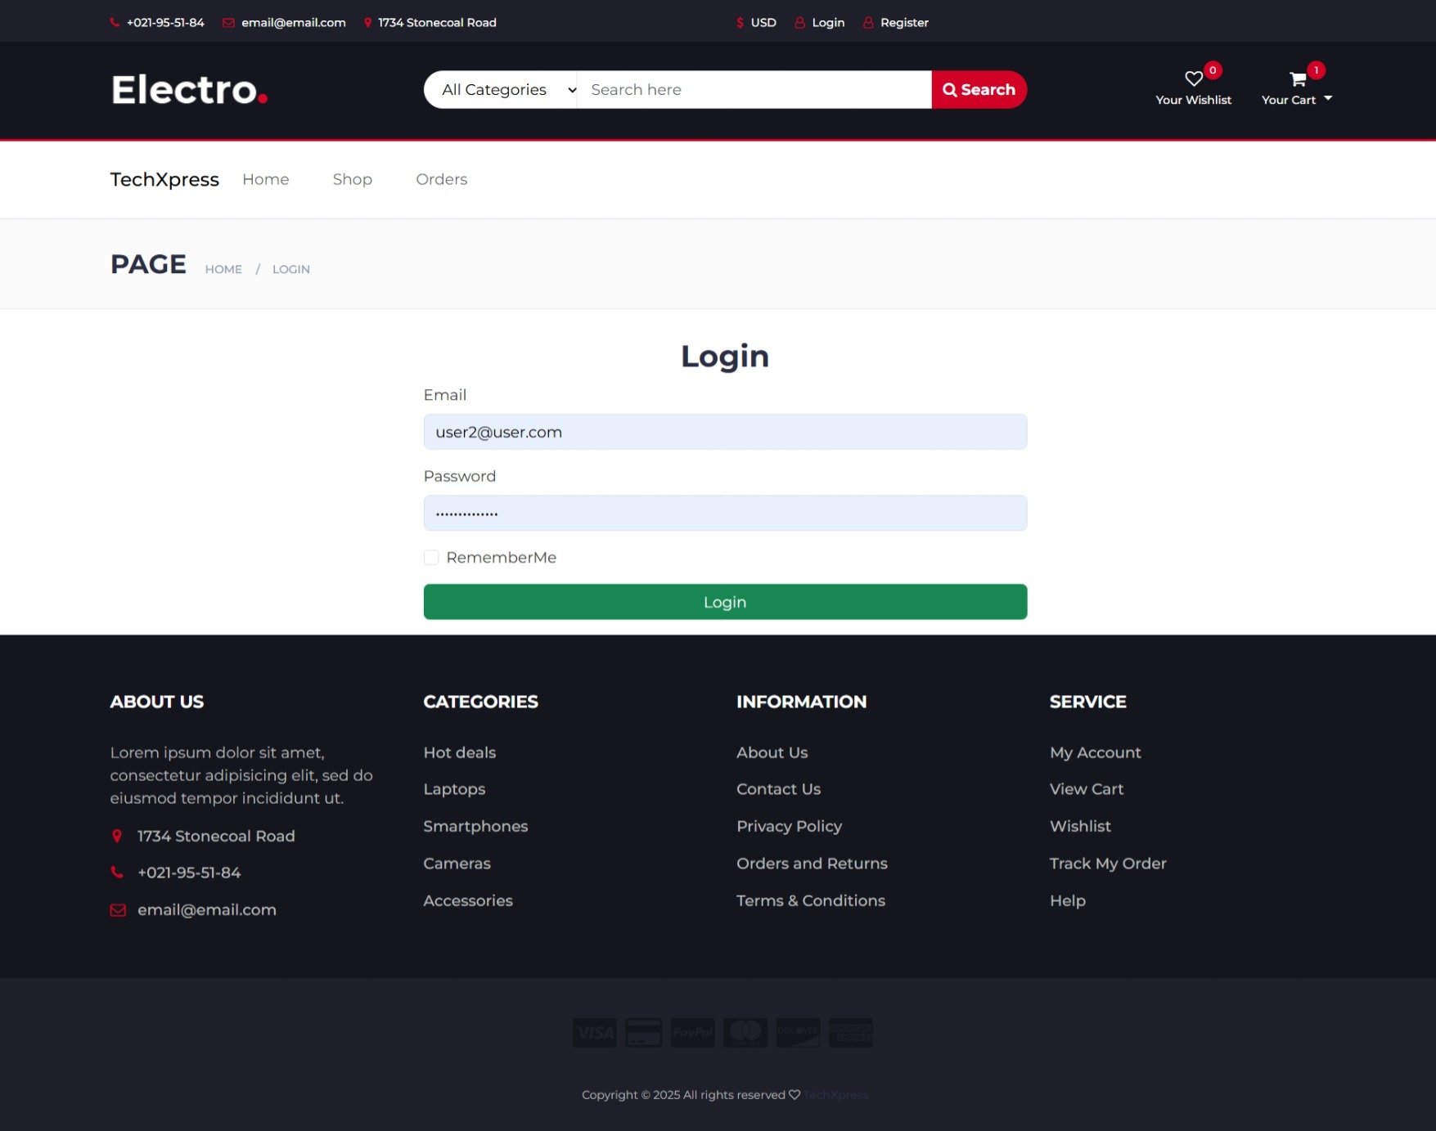
Login

Slide 6
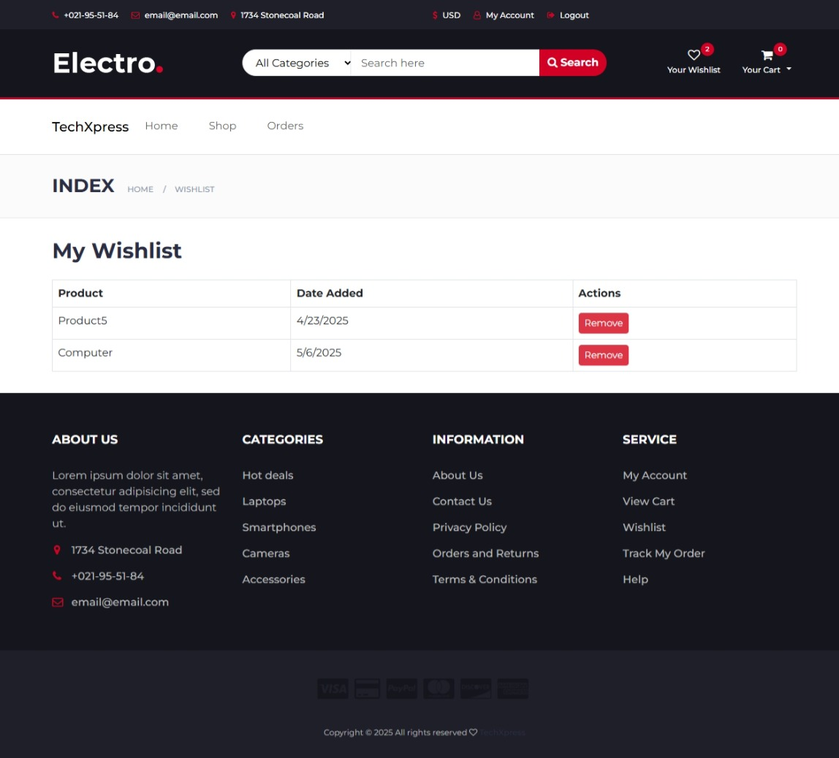
Wishlist

Slide 7
Shopping Cart and Checkout Process
Secure Checkout
Payment Options
Easy Cart Management
Seamless and encrypted process for safe purchases.
Supports Cash on Delivery, PayPal, Stripe for flexibility.
Modify quantities or remove products with a simple interface.

Slide 8
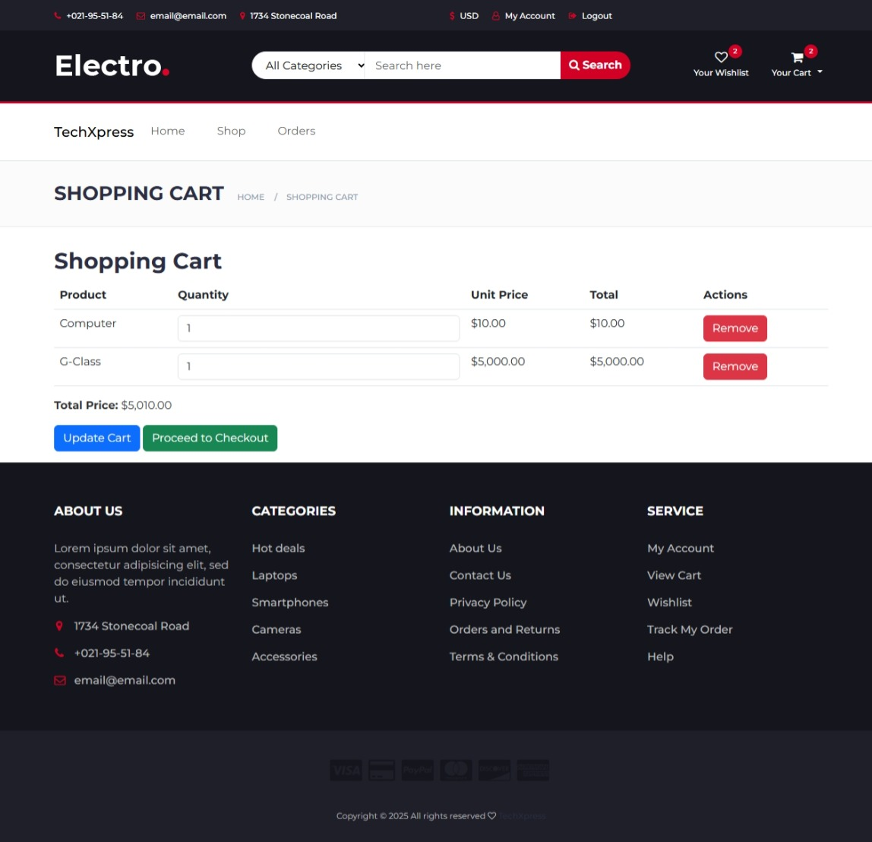
Cart

Slide 9
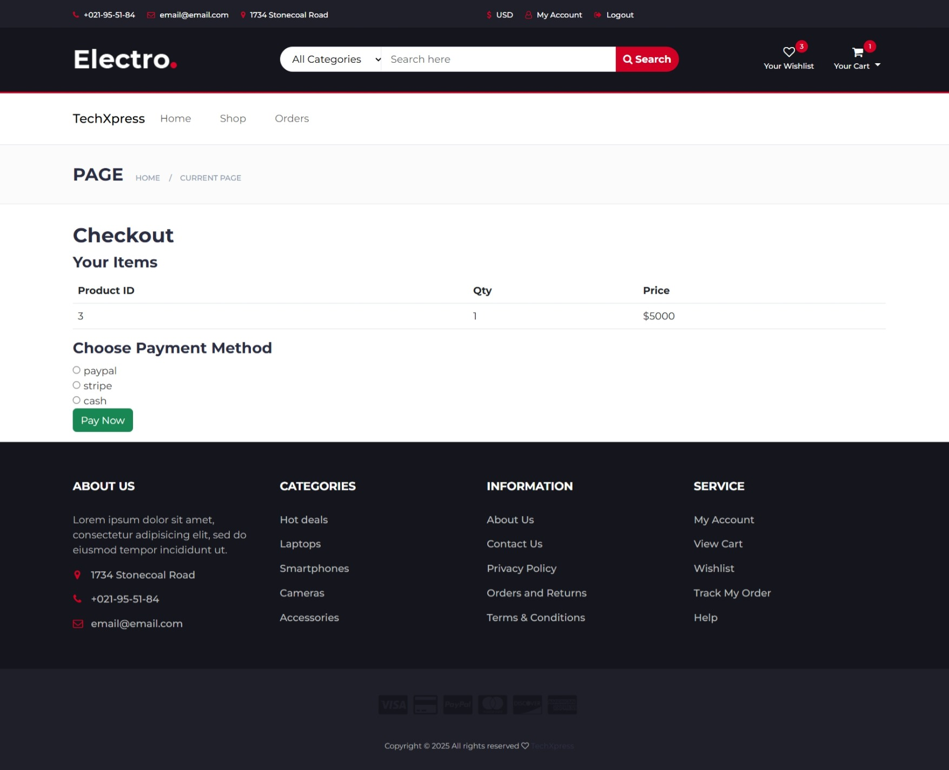
Checkout

Slide 10
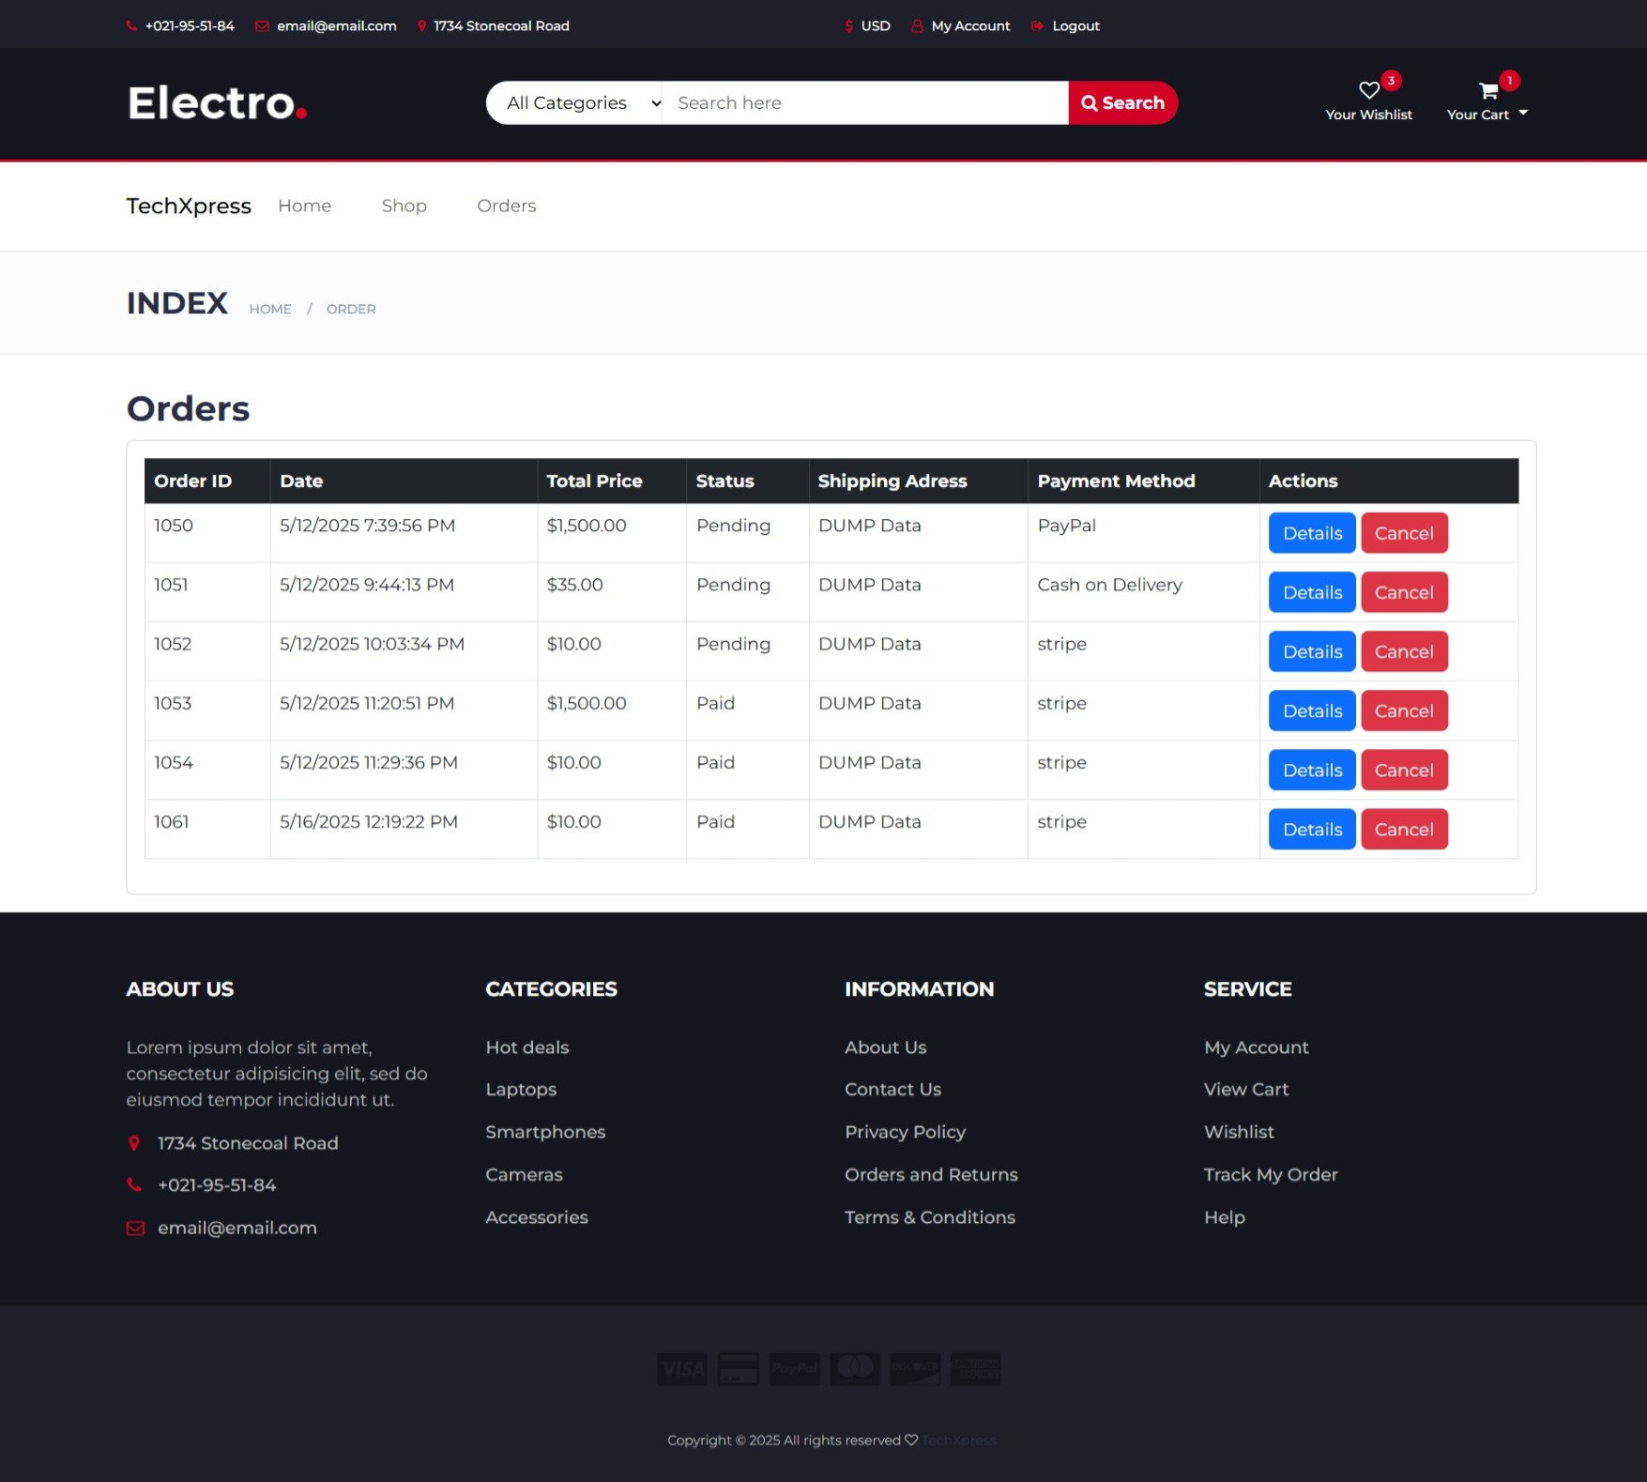
Orders

Slide 11
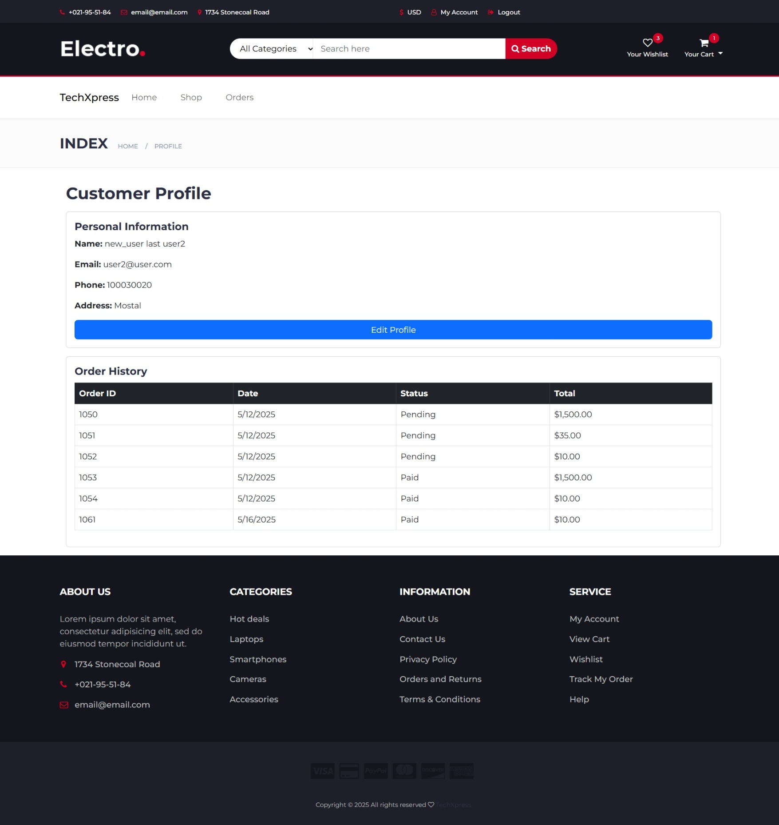
My Account

Slide 12
User Account Management
JWT Secure login and registration protect user data effectively.
Order history and tracking
Saved addresses and payment methods
Loyalty program with reward points
Personalized recommendations boost engagement and sales.

Slide 13
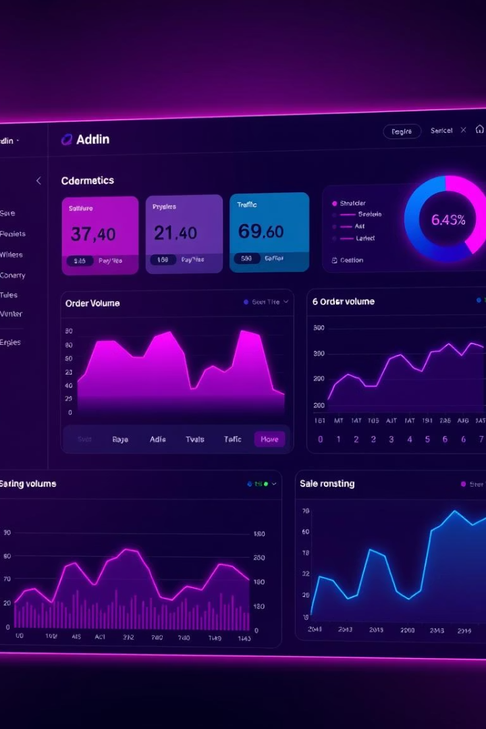
Admin Panel: Dashboard Overview
Sales Revenue
Track real-time revenue with customizable widgets.
Order Volume
Monitor active orders and fulfillment status efficiently.
Website Traffic
Analyze user behavior to optimize marketing strategies.

Slide 14
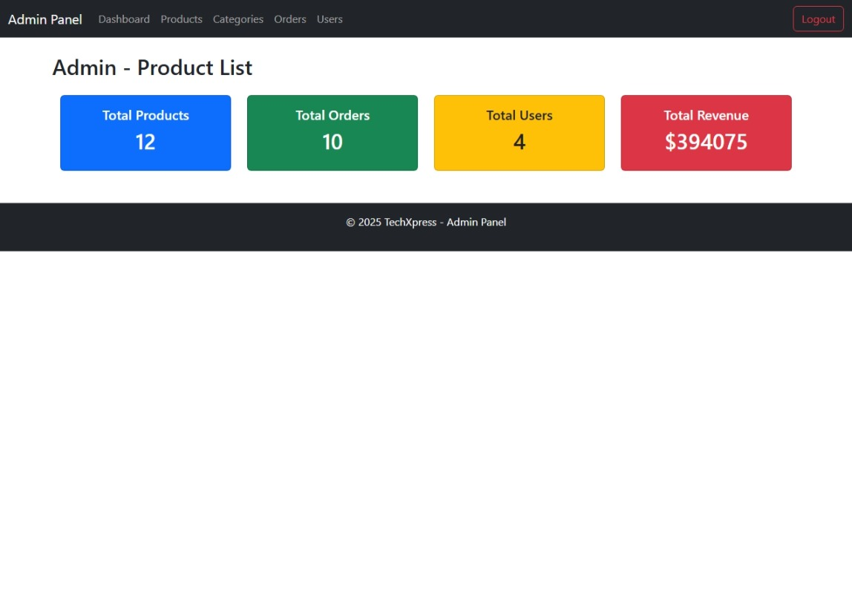



Admin Panel: Product and Order Management
Product Management
Create and edit titles, descriptions, prices, and images easily.
Inventory Tracking
Keep stock updated and avoid overselling issues.
Order Processing
Track shipping and send automated status emails

Slide 15
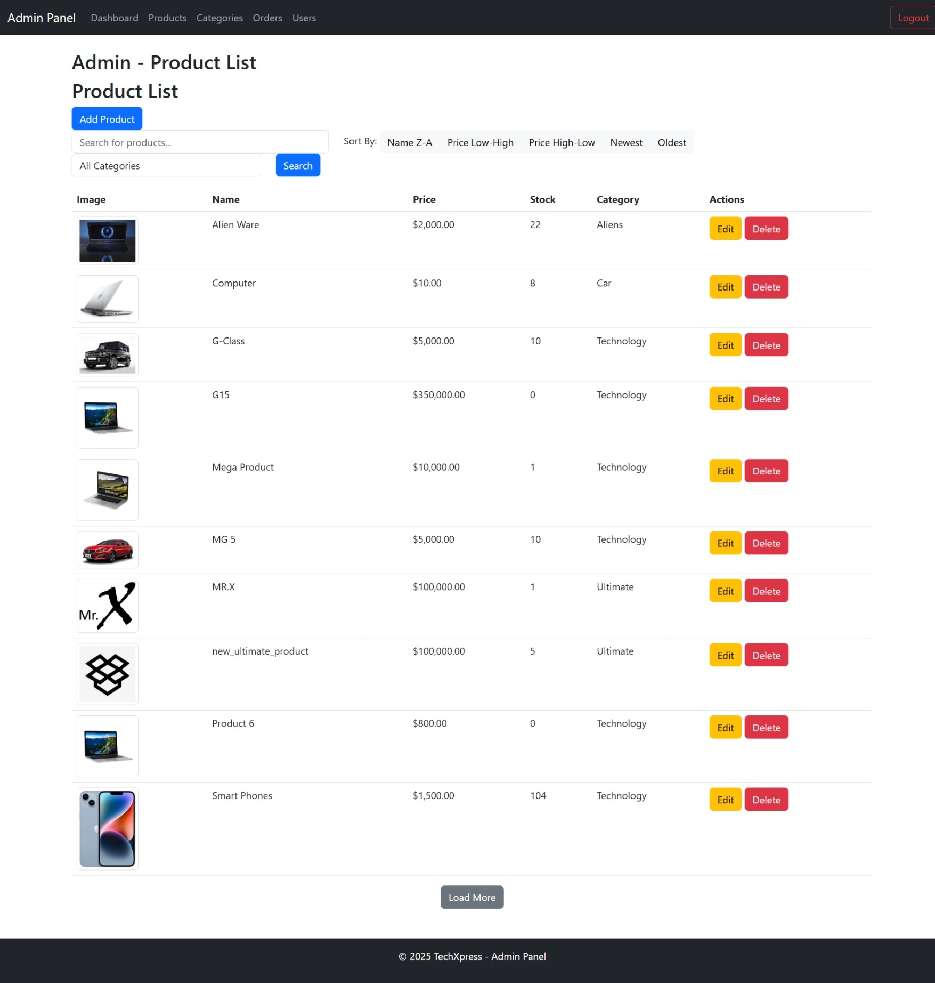
Product

Slide 16
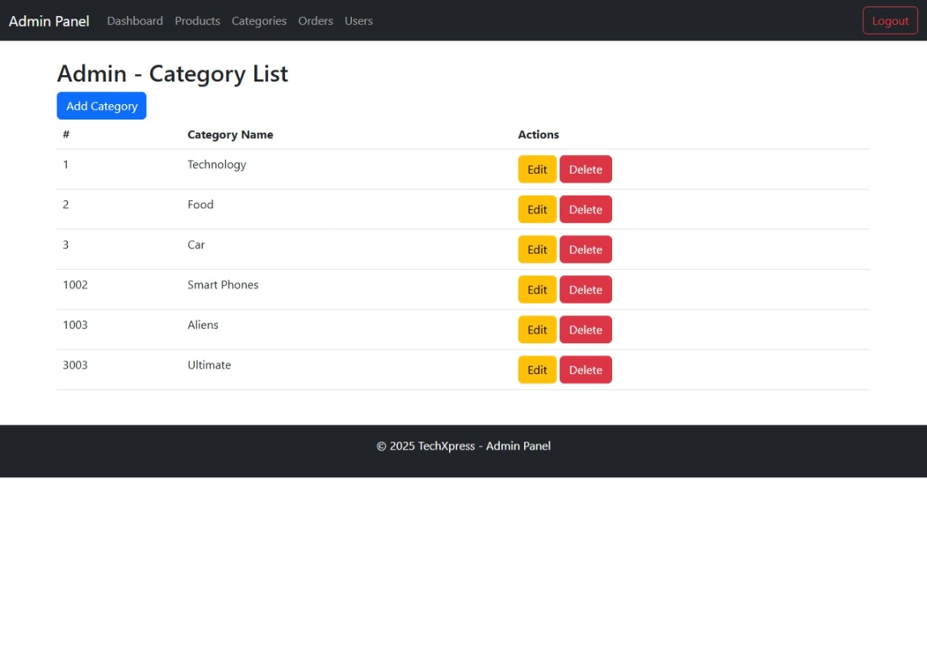
Category

Slide 17
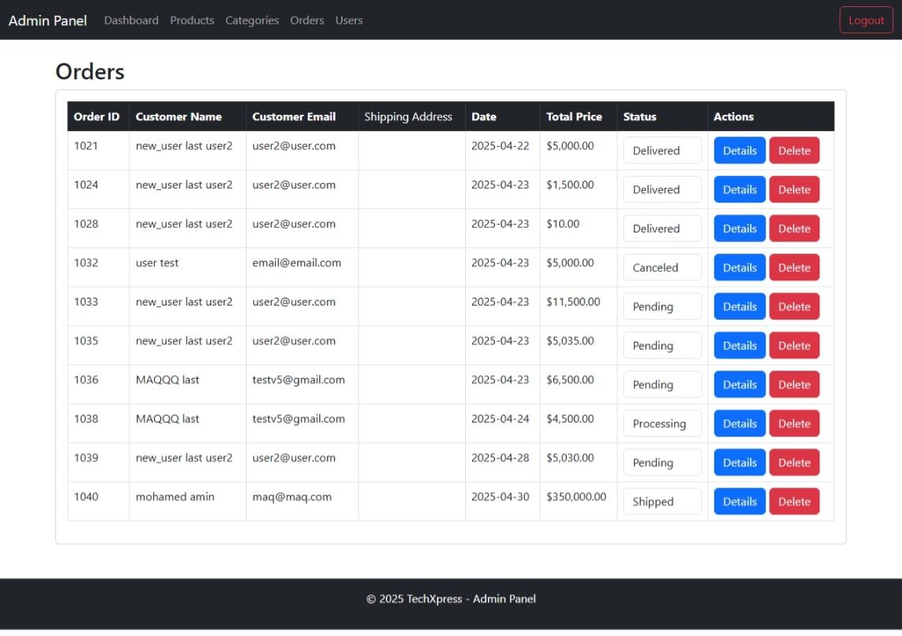
Orders

Slide 18
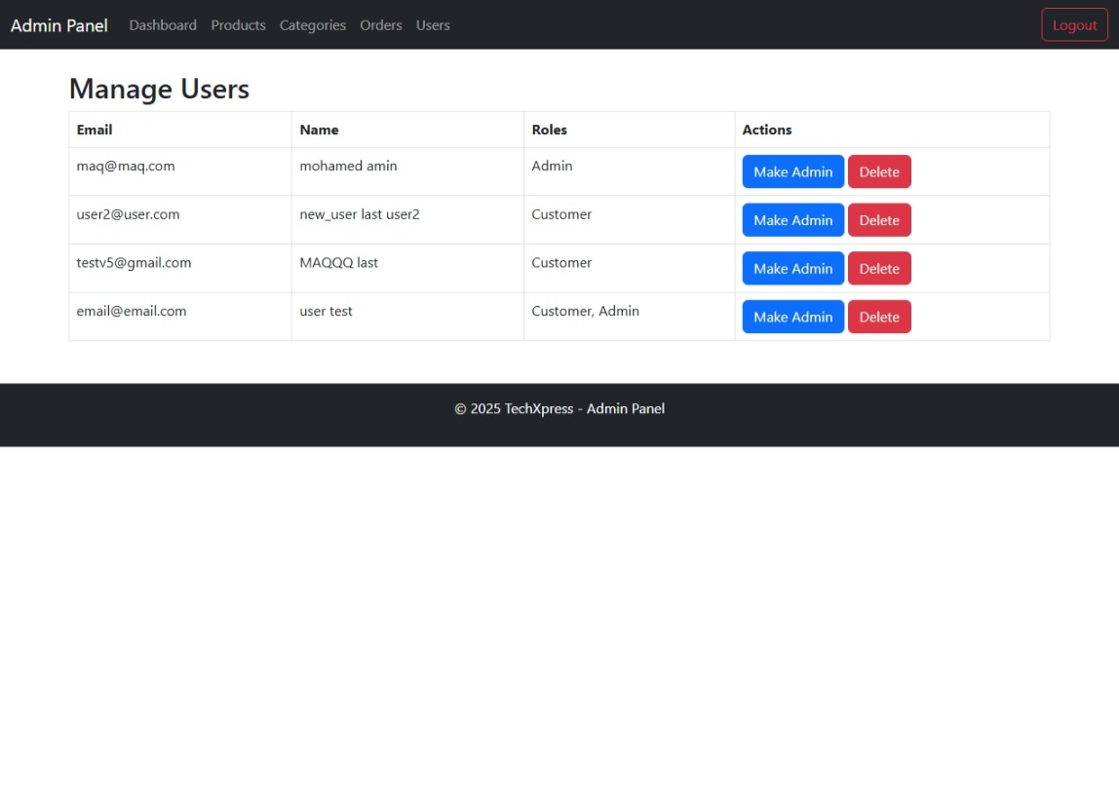
User Management

Slide 19





Technology Stack & Scalability
SQL Server
.NET Core
Reliable relational database management system
High performance and cross-platform compatibility
2
1
Azure Cloud
3
Scalable and highly available hosting environment
Future Improvement
5
4
Security
Mobile app and AI-powered recommendations in development
JWT tokens, SSL encryption, and OWASP compliance

