Slide 1




E-Filing Portal: FSD and two demo videos
COVER LETTER · 19 OCT 2026
To: Faizan Chaudhary, Partner — Vision Vault Solutions, Faisalabad
Dear Sir,
ENCLOSED
With reference to our last meeting about the E-Filing project, I am pleased to share the progress so far. The portal is built and running on our demo site, and this document explains how it works. It supports two ways of working, so every client is covered whether or not they use the internet themselves:
Functional Specification (FSD)
This document · 25 slides · PowerPoint + PDF · DFD level 0 and 1, roles, workflow, controls
Our team files for the client
Video 1
Video 1 · Team-assisted filing
Client shares information by phone, WhatsApp, email or an office visit; our team enters it, attaches documents from WhatsApp and records the client's approval.
VVS_Tax_Return_Full_Process.mp4 · 4 min 32 s
Video 2 · Client journey online
The client files online
Video 2
VVS_Client_Journey_Website_to_Filed.mp4 · 4 min 40 s
Client requests a login on our website, enters their own details and documents, pays the fee and confirms the summary in the portal.
Both routes share the same controls: review, client confirmation, four-eyes approval, and filing only after the IRIS acknowledgment. All figures shown are demo data.
NEEDS YOUR INPUT
I would be glad to arrange a live demonstration. Looking forward to your feedback.
Tax rates, WhatsApp and SMS accounts, email, package prices, payment details, turnaround targets and the TY2026 deadline — listed on the last slide.
Best regards, MicroMax Erp Pvt Ltd
Notes:
Cover letter to the partner. Summarises the two ways of working, lists the enclosures and points to the decisions on the last slide.

Slide 2







Vision Vault Solutions
VVS Consultants · Audit & Taxation
01
Client portal
Sign-up · OTP · documents · confirm
FUNCTIONAL SPECIFICATION DOCUMENT · VERSION 1.1
02
Return workflow
Tax Consultancy Portal
12 states · four-eyes · IRIS evidence
03
Tax engine & simulator
Client portal, staff workspace and CRM for income tax returns on FBR IRIS — functional design, data flow diagrams (level 0 and 1), workflow, controls and live data, on ERPNext v16 with a React front end.
Slabs from rules · what-if scenarios
04
CRM & outreach
Leads · pipeline · WhatsApp · Lead Finder
FIRM
SITE
Vision Vault Solutions, Faisalabad
consultant · ERPNext v16 + React
05
Billing & accounts
Packages · proofs → invoice + payment
PARTNER
DATA AS OF
Faizan Chaudhary — Audit & Taxation
19 Oct 2026 · demo season, live entries
06
Insights & control
Dashboards · reports · roles · audit
Prepared by MicroMax Erp Pvt Ltd · Office P.442/D, Mezzanine Floor, Adjacent to Unze London, Hurrian Wala Chowk, Faisalabad 38000
Notes:
Cover. This FSD documents the VVS Tax Consultancy Portal as built and running on the demo site 'consultant'. Figures come from live records on 19 Oct 2026.

Slide 3
About this document
DOCUMENT CONTROL
Scope, audience and how the specification is organised
Document information
Notation used in the diagrams
Item | Detail
Document | Functional Specification — VVS Tax Portal
Version / date | 1.1 · 19 Oct 2026
System | ERPNext v16 · Frappe CRM · WhatsApp · React
Audience | Partner, admin, consultants, implementers
Data source | Live records, site 'consultant' (fake clients)
3.0
External entity
Process
D4
Data store
Data flow (labelled with what moves)
Contents
Principles the design follows
1
System at a glance
2
Actors & roles
Rates never live in code — slabs, credits and final-tax rates come from rule records
Nothing is shown as filed without an IRIS acknowledgment and receipt
Four-eyes: whoever prepares a return cannot approve it
Calculators and simulators are labelled as estimates
3
DFD level 0 — context
4
DFD level 1 — processes
5
Two ways to file · workflow
6
Onboarding & verification codes
7
CRM & lead generation
8
Documents · tax · simulator
9
Controls · billing · insights
10
Security · next steps

Slide 4
Live volumes on site 'consultant'
SYSTEM AT A GLANCE
Record counts on 19 Oct 2026: a demo filing season (TY2026) walked through the real workflow by the team and the clients
56
55
398
790
Clients
Tax Returns
Tax Documents
Audit Events
Taxpayers with masked identifiers
13 filed · 41 in progress
Checklist items, private files
Every create / move / approve
48
30
43
55
Engagements
Sales Invoices
Site Visits
CRM Leads
Packages sold this season
Posted from verified proofs
Field prospects
Website, WhatsApp, visits, finder
Record | Count | Record | Count | Record | Count | Record | Count
Generated PDFs | 19 | Payment Entries | 30 | WhatsApp Messages | 44 | Document Types | 18
Tax Calculations | 48 | Consultations | 13 | WhatsApp Templates | 4 | Tax Years | 2
Scenarios | 5 | CRM Deals | 9 | Services | 6 | Slab Settings | 8
Payment Proofs | 35 | Lead Prospects | 15 | Packages | 4 | Staff users | 13

Slide 5








Who uses the system — and whose records they see
ACTORS & ROLES
Role decides what kind of access; scope decides which records (enforced on the server for every list and document)
Tax Admin
Tax Consultant
Tax Reviewer
Tax Approver
1 user
2 users
1 user
1 user
Runs the firm: settings, team, payments, every client and return.
Prepares returns for the clients assigned to them.
Checks prepared returns and sends them back or on for approval.
Gives the final approval before filing (never their own work).
All clients
Assigned clients
All clients
All clients
Filing Officer
Field Officer
Data Entry
Client
1 user
1 user
1 user
51 portal logins
Files approved returns on FBR IRIS and records the acknowledgment.
Registers prospects and clients met in the field.
Only enters what the client told us and records the client's approval (every team member can also do this).
A taxpayer using the client portal.
All clients
Own registrations
All clients
Own records only

Slide 6
The portal and everything it exchanges data with
DFD LEVEL 0 · CONTEXT DIAGRAM
One process (the whole system), eight external entities and the data flowing between them
Client (taxpayer)
WhatsApp Cloud API
Firm staff
portal · WhatsApp
Meta
consultant · reviewer · approver · filing · admin
▸ sign-up, answers, documents, fee proof, confirmation
◂ codes, checklist, return summary, IRIS receipt, letters
◂ messages, templates, codes
▸ replies, delivery status
▸ preparation, reviews, approvals, filing
◂ queues, inbox, dashboards, reports
0
Prospect / visitor
▸ enquiry, booking, calculator
◂ estimate, follow-up
VVS Tax Consultancy Portal
◂ approved return figures
▸ acknowledgment no. + receipt
FBR IRIS
website · walk-in
filed manually by the filing officer
▸ business listings
◂ search (type + city)
◂ verification codes (backup)
◂ notices, portal invites, reports
Apify (Google Maps)
SMS gateway
Email server
external service
Twilio / bulk SMS
outgoing SMTP
▸ into the portal ◂ out of the portal
Notes:
Level 0 treats the portal as a single process. Clients and prospects feed it data; staff act on it; FBR IRIS is reached manually by the filing officer; WhatsApp, SMS and email carry messages and verification codes; Apify supplies business prospects.

Slide 7
Inside the portal: nine processes, eight data stores
DFD LEVEL 1 · PROCESSES & DATA STORES
Prospect · Apify
Client (taxpayer)
Firm staff
FBR IRIS
enquiry · listings
sign-up · code
package · fee proof
answers · uploads
line entries
review · approve
ack no. · receipt
1.0
2.0
3.0
4.0
5.0
6.0
7.0
Capture & convert leads
Onboard & verify client
Engage & bill
Collect & verify documents
Prepare return & calculate tax
Review, confirm & approve
File & acknowledge
D2
Leads, deals
D1
Tax clients
D3
Fees, payments
D4
Documents
D6
Tax rules
D5
Returns, calcs
D7
Filing records
every step → D9
8.0
WhatsApp · SMS · Email
9.0
Communicate & notify
D9
Audit trail — every create, move, approval
Analyse & report
dashboards · insights · reports → staff
D8
Messages & conversations
Main line: qualified lead → verified client → engagement → documents verified → calculated return → approved return
Notes:
Level 1 opens process 0. The main line runs left to right: a lead becomes a client, buys a package, uploads documents, the return is prepared and calculated, reviewed, confirmed and approved, then filed. Communication (8.0) and reporting (9.0) serve every step; the audit trail records every move.

Slide 8
Functional modules
SECTION 2
From first contact to the IRIS acknowledgment: the client journey, the 12-state return workflow and each module that supports it.

Slide 9





Seven steps the client sees in the portal
CLIENT JOURNEY
Every step is dated from the audit trail and shown as a progress tracker to the client and to staff
1
2
3
4
5
6
7
Account
Documents
In preparation
In review
Confirmation
Filed
Acknowledged
Sign up, verify mobile with a 6-digit code (WhatsApp first, SMS backup)
Answer 10 questions → personalised checklist; upload from the phone
Consultant verifies documents, enters lines, calculates tax
A second person reviews against a checklist
Client checks the summary and confirms (or asks a question)
Approver signs off; filing officer files on FBR IRIS
IRIS acknowledgment no. + receipt in the client's vault
Where the TY2026 demo season stands
54
43
36
30
27
25
20
16
13
Documents Pending
Draft
Pending Review
Under Review
Reviewed
Client confirm
Approved
Submitted
Acknowledged
Returns that have reached each step (cumulative)

Slide 10
We file for the client — or the client files online
TWO WAYS TO FILE
Both routes feed the same controlled pipeline: review, client confirmation, four-eyes approval and the IRIS acknowledgment
Team-assisted
Video 1
Self-service
Video 2
We file on the client's behalf
The client files from the website
Phone
WhatsApp
Email
Office visit
Website
Mobile
24 / 7
1
Front desk registers the client and opens the return
1
Visits the website → Start Filing → login verified with a 6-digit code
2
Client sends documents on WhatsApp — attached straight from the chat
2
Chooses a package and answers simple Yes / No questions
3
Data entry records what the client told us and answers the questionnaire
3
Describes her year in everyday words and uploads her documents
4
Consultant verifies documents, prepares the return, calculates tax
4
Pays the fee (Bank, Raast, JazzCash, Easypaisa) with a screenshot
5
Client approves the summary by phone — staff record method, note and proof
5
Reads the summary and clicks “Confirm my return” in the portal
SAME PIPELINE
Review checklist
Client confirmation
Four-eyes approval
File on FBR IRIS
Acknowledgment in vault
for both routes
Notes:
Two routes into one pipeline. Team-assisted suits clients who prefer phone, WhatsApp or office visits; self-service suits clients comfortable online. Videos 1 and 2 show each route end to end.

Slide 11


Data entry on the client's behalf — with a trail
MODULE 01b · ACTING FOR THE CLIENT
Every team member can act for a client within their record scope; the Data Entry Officer role does only this
What the client told us
Documents from WhatsApp
Client approval recorded
“Enter for client” form: salary, bank, property, vehicle, cash, household
Questionnaire answered for the client — rebuilds the document checklist
Shows “Entered for the client by …”; figures change only when the consultant copies it in
“From WhatsApp” lists the files that client sent — no download, no re-upload
Only that client's files; PDF, JPG or PNG; type and size checked
Badge on each document: via WhatsApp, Email, In person, Courier or client upload
For clients who approve by phone, WhatsApp, in person, email or signed letter
Method + note (who, when, what was agreed) + optional proof
Comment on the return and a notice to the approver
Controls
Four eyes
Separation
Time window
Audit
Whoever records the client's approval cannot approve the return
Data entry uploads documents; a consultant or reviewer verifies them
Client data editable until Submitted to FBR; later changes are flagged to consultant and reviewer
Every entry, upload and approval: who, when, how — in the audit trail
Notes:
New in version 1.1. Built for clients who share information by phone, WhatsApp, email or an office visit. Video 1 shows Zara (Data Entry) doing all three.

Slide 12
12 states, 17 moves — a rule checked on each
RETURN WORKFLOW
Frappe Workflow checks the role; the portal's rules check the business conditions before any state change
From | Action | To | Who may act | Rule checked
Documents Pending | Documents Complete | Draft | Consultant, Admin | All required documents verified; fee policy
Draft | Submit for Review | Pending Review | Consultant, Admin | Income lines, final-tax rates, current calculation
Pending Review | Start Review | Under Review | Reviewer, Admin | —
Under Review | Request Changes | Changes Required | Reviewer, Admin | Comment required
Changes Required | Resume Preparation | Draft | Consultant, Admin | —
Under Review | Mark Reviewed | Reviewed | Reviewer, Admin | Tax Review saved with checklist
Reviewed | Send to Client | Awaiting Client | Reviewer, Admin | —
Awaiting Client | Client Question | Changes Required | Client | —
Awaiting Client | Approve | Approved | Approver, Admin | Client confirmed (portal or staff); four-eyes
Approved | Mark Submitted on IRIS | Submitted | Filing Officer, Admin | Approved and unchanged since approval
Submitted | Record Acknowledgment | Acknowledged | Filing Officer, Admin | IRIS ack no. + FBR receipt attached
Submitted | Report Filing Error | Filing Error | Filing Officer, Admin | Error notes required
Filing Error | Retry Filing | Submitted | Filing Officer, Admin | —
Acknowledged | Close | Closed | Admin | —
Reviewed | Reopen for Review | Pending Review | Consultant, Admin, Reviewer, Approver | Reason required; approval cancelled
Reopen for Review is also allowed from Awaiting Client and Approved. Any change to signed-off figures cancels the approval automatically; a filed return can only be revised, never edited.

Slide 13





A 6-digit code: WhatsApp first, SMS as backup
MODULE 01 · ONBOARDING & VERIFICATION
The code is generated, stored only as a hash, and delivered by the channel order set in Settings → Verification codes
Client enters mobile
Code generated · hashed
WhatsApp authentication template
If it fails: same code by SMS
Client types code · verified
Account + client record created
Rules
Settings → Verification codes
Code expires after 10 minutes; 5 attempts; 5 codes per number per hour
Only a hash is stored — never the code; WhatsApp codes bypass the team inbox and API log
Channel recorded on each request: WhatsApp, SMS or Failed
"No WhatsApp? Send the code by SMS instead" on the code screen
A mobile that already has an account is sent to sign in
Setting | Options
Send codes by | WhatsApp, then SMS (default) · SMS only · WhatsApp only
WhatsApp template | Meta Authentication template, e.g. vvs_verification_code
SMS provider | Console (development) · Twilio · HTTP gateway (PK bulk SMS)
Secrets | Auth token / API key stored encrypted, write-only
Test | Send 000000 to own mobile, WhatsApp-first or SMS only

Slide 14




From enquiry to engaged client in one pipeline
MODULE 02 · CRM & LEAD GENERATION
Frappe CRM inside the portal: leads, a tax pipeline, activities, Lead Finder and WhatsApp broadcasts
Enquiry
Consultation
Proposal Sent
Documents Pending
Engaged
Lost
Moving a deal to Engaged creates the Tax Client (with its site-visit details) — no re-typing
Lead capture
55 leads
Activities
Notes · tasks · calendar
Website contact & booking, WhatsApp first message, site visits, walk-ins, Lead Finder — one lead per person (duplicate check on mobile / email).
Lead page: rich notes, follow-up tasks, calendar meetings, WhatsApp (free text or approved template), email from templates.
Lead Finder
15 prospects
WhatsApp broadcast
4 templates
Google Maps by business type + city through Apify, or public websites; every result reviewed before it becomes a lead.
One approved template to clients or leads; consent and STOP opt-outs respected; insights per campaign.

Slide 15
The right documents, checked once, kept private
MODULE 03 · DOCUMENTS & VAULT
Questionnaire answers and the chosen service build each return's checklist; generated letters land in the same vault
Checklist rules
Generated documents · 19 issued
10 yes/no questions (salary, business, rent, capital gains, bank profit, property, vehicle …)
18 document types, each with a client hint
Requirement rules by client type, taxpayer type, service, year, answer
A planning scenario can add evidence (e.g. Zakat certificate) with the reason shown to the client
Document | From | Purpose
Authority Letter | Client | Lets the firm file on IRIS for the client
Engagement Letter | Engagement | Scope, fee and what is needed
Document Checklist | Return | Every document, with what is missing
Tax Computation Summary | Return | Income, tax, refund or payable on one page
Wealth Statement Summary | Return | Assets, liabilities and net wealth
Withholding Certificate Request | Return | Ready letter to employer or bank
Filing Confirmation | Return | Only after the IRIS acknowledgment
Tax Planning Report | Scenario | What-if vs this year and last year
Statuses
Requested
Pending
Verified
Rejected
Jinja print formats on the firm letterhead, rendered to PDF, versioned (v1, v2 …) and stored privately; clients download them from their vault.
Upload → staff verify / reject (with reason) → all required verified → return moves to Draft

Slide 16
How a return's tax is calculated
MODULE 04 · TAX ENGINE
Worked example: TAX-RET-2026-00006 · Usman Ghani (test) · TY2026 · Salaried Individual · demo rates
+
Total income
Rs 3,117,000
Slab table · Salaried Individual · TY2026
Taxable income from | to | Fixed | Rate
Rs 0 | Rs 600,000 | Rs 0 | 0%
Rs 600,000 | Rs 1,200,000 | Rs 0 | 1%
Rs 1,200,000 | Rs 2,200,000 | Rs 6,000 | 11%
Rs 2,200,000 | Rs 3,200,000 | Rs 116,000 | 23%
Rs 3,200,000 | Rs 4,100,000 | Rs 346,000 | 30%
Rs 4,100,000 | and above | Rs 616,000 | 35%
−
Deductible allowances
Rs 31,250
=
Taxable income (normal)
Rs 2,968,750
+
Tax on taxable income (slab)
Rs 292,812.5
+
Final / separate-block tax
Rs 17,550
−
Tax credits
Rs 4,930
Highlighted slab applies: Rs 116,000 + 23% of the amount above Rs 2,200,000. Separate-block income (bank profit) is taxed at the rate entered on its line; credits reduce normal tax only.
=
Tax liability
Rs 305,432.5
−
Tax withheld / advance tax
Rs 258,550
Slabs, credit rules and tax years are records — the firm updates them each Finance Act, no code change. Demo rates must be validated before live use.
=
Payable
Rs 46,882.5

Slide 17





Plan first, then apply the final scenario
MODULE 05 · TAX SIMULATOR & SCENARIOS
Same engine and rates as the return; nothing changes the return until a consultant applies a scenario
1 Move levers
2 Compare
3 Save scenarios
4 PDF report
5 Apply
Income per group, add-backs, allowances, credits, tax paid — sliders and amounts
Last year's filed return · this year's actual · simulated — table and chart
Name + client notes; compare up to 3; lowest tax marked
Tax Planning Report PDF into the client's vault
Preview line changes → write lines → recalculate → request evidence
Safeguards when a scenario is applied
Only while preparing
One at a time
Evidence required
Undo
Documents Pending, Draft or Changes Required
Undo the applied scenario before another
New deductions / credits add required documents — Submit for Review blocked until verified
Restores every line exactly and recalculates

Slide 18






Built-in controls that protect client and firm
REVIEW, APPROVAL & FILING CONTROLS
Each control is enforced on the server when the state changes — not only hidden in the screen
Four-eyes approval
Content hash
Review checklist
The preparer can never approve; approval needs the client's confirmation first.
Approval stores a hash of the figures; any change cancels it and reopens review.
Mark Reviewed needs a saved Tax Review with every checklist item answered.
IRIS evidence
Filed is final
Audit trail
Acknowledged only with the IRIS number and the FBR receipt attached.
A filed return cannot change — a revised return is created instead.
790 events: who moved what, from which state, when.

Slide 19




Packages, fee proofs and the ERPNext postings
BILLING & ACCOUNTING
This season: Rs 554,000 billed · Rs 330,500 collected · Rs 223,500 outstanding
Package chosen
Engagement
Payment proof
Verified by admin
Posted to accounts
Client orders in the portal (promo codes optional)
Fee, discount, payment status
Raast / bank / JazzCash / Easypaisa reference
Approve or reject with reason
Sales Invoice + Payment Entry in ERPNext
Packages on the website
Packages sold · TY2026
Package | Service | Turnaround | Price
Basic Filing | Income Tax Return Filing | 3–5 working days | Rs 4,500
Express Filing | Income Tax Return Filing | 24–48 hours | Rs 10,000
Consultant Plus | Income Tax Return Filing | By appointment | Rs 20,000
NTN Registration | NTN Registration | 1–2 working days | Rs 2,000

Slide 20
The season at a glance, and every report
INSIGHTS & REPORT CENTER
Insights and reports are scoped like everything else: a consultant sees only their own clients
13 / 54
26.6 d
73%
Rs 223,500
returns filed
order → IRIS ack (avg)
field visits → clients
fees outstanding
Report center · 10 reports
Returns by Status
Review and Approval Aging
Consultant Workload
Missing Documents
Filing Status and Errors
Tax Payable and Refund Summary
Fees and Collections
Client Master
Site Visits and Follow-ups
Consultation Requests Report
Run in the portal · filter · sort · search · CSV · open in desk

Slide 21
What each role may do on the key records
ROLES & PERMISSIONS
R read · E edit · C create · D delete. Editable per role in Setup → Roles & Permissions (Tax Admin, System Manager and Client are fixed)
Record | Admin | Consultant | Reviewer | Approver | Filing Officer | Field Officer | Client
Tax Client | R E C D | R E C | R | R | R | R E C | R E
Site Visit | R E C D | R E | · | · | · | R E C | ·
Tax Return | R E C | R E C | R E | R E | R E | R | R
Tax Calculation | R | R E C | R E | R | R | · | R
Tax Scenario | R E C D | R E C D | R | R | · | · | ·
Tax Review | R | R | R E C | R | · | · | ·
Tax Approval | R | R | R | R E C | R | · | ·
Filing Record | R | R | R | R | R E C | · | R
Tax Document | R E C D | R E C | R | R | R | R E C | R E C
Generated Document | R E C D | R E C | R | R | R | R | R
Payment Proof | R E C D | R | · | · | · | · | R C
Tax Slab Setting | R E C | R | R | R | R | R | ·

Slide 22





Client data stays private by design
SECURITY, PRIVACY & COMPLIANCE
Identifiers masked
Private files
CNIC shown as *****-*******-1; NTN and bank details never sent by WhatsApp or in templates.
Documents and generated PDFs are private files, streamed only after a permission check.
Record-level isolation
Secrets write-only
Every list and document is filtered by scope: all / assigned / own registrations / own portal.
Tokens and API keys stored encrypted; the browser only learns whether one is set.
Codes hashed
Consent
Verification codes stored as hashes, rate-limited, never logged in readable form.
Privacy consent at sign-up; WhatsApp only with opt-in; STOP honoured in broadcasts.

Slide 23
External services: live today, and what waits
INTEGRATIONS & SETTINGS
Configured in Setup → Settings by the Tax Admin; secrets are stored encrypted
Integration | Used for | Status on this site | Needed to go live
WhatsApp Cloud API (Meta) | Inbox, templates, broadcasts, codes | Test mode — nothing leaves the server | Meta app, phone ID, token, approved templates
SMS gateway | Verification-code backup | Console (development) | Twilio or PK bulk-SMS link + PTA sender ID
Outgoing email | Notices, invites, direct email | Not set up | SMTP account (Settings → Email)
Apify (Google Maps) | Lead Finder searches | Live — token saved | —
Payment gateway | Online fee payment | Manual proofs only | Choose JazzCash / Easypaisa / Safepay
FBR IRIS | Return filing | Manual by filing officer | No official API — evidence attached by hand
ERPNext Accounts | Invoices and payment entries | Live | —

Slide 24
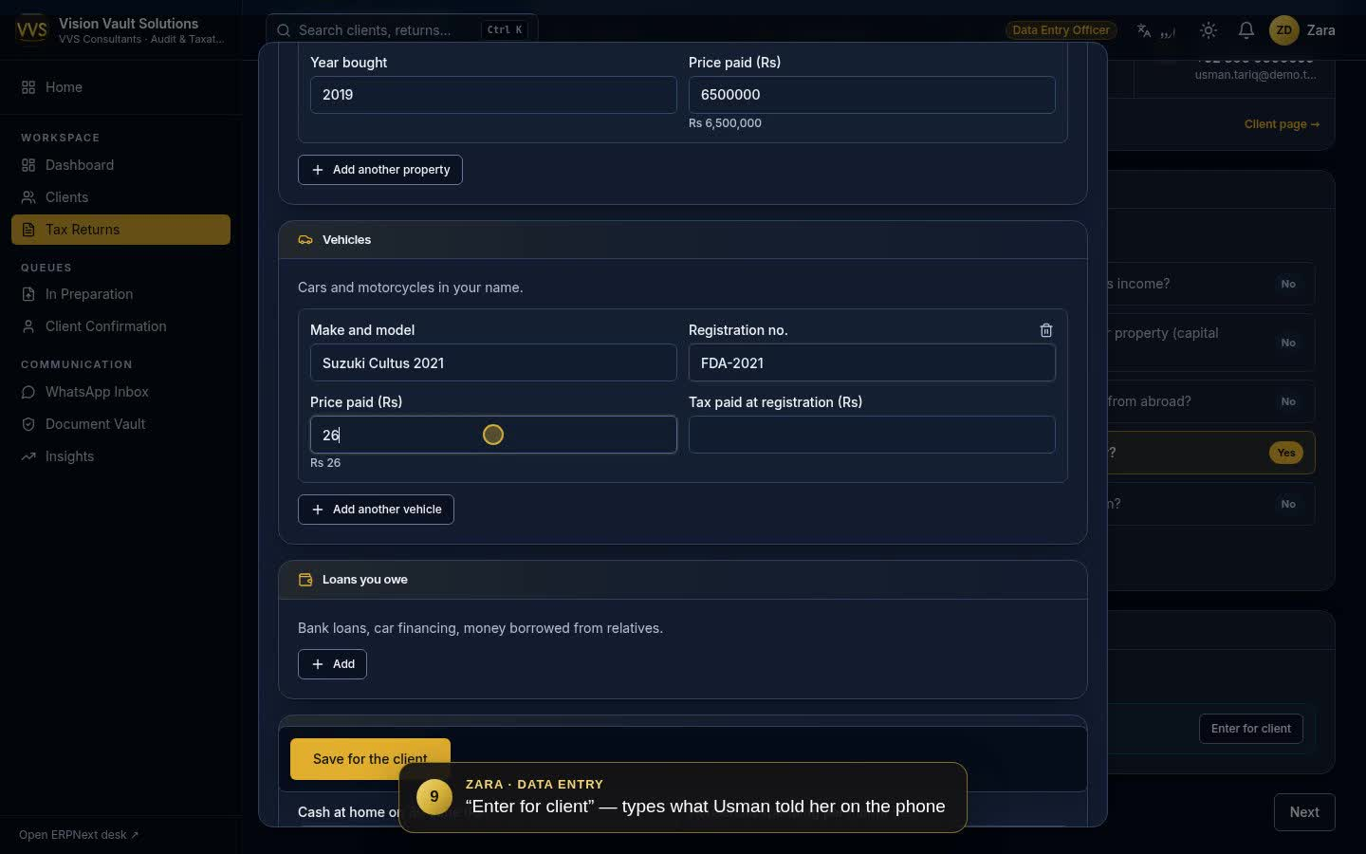
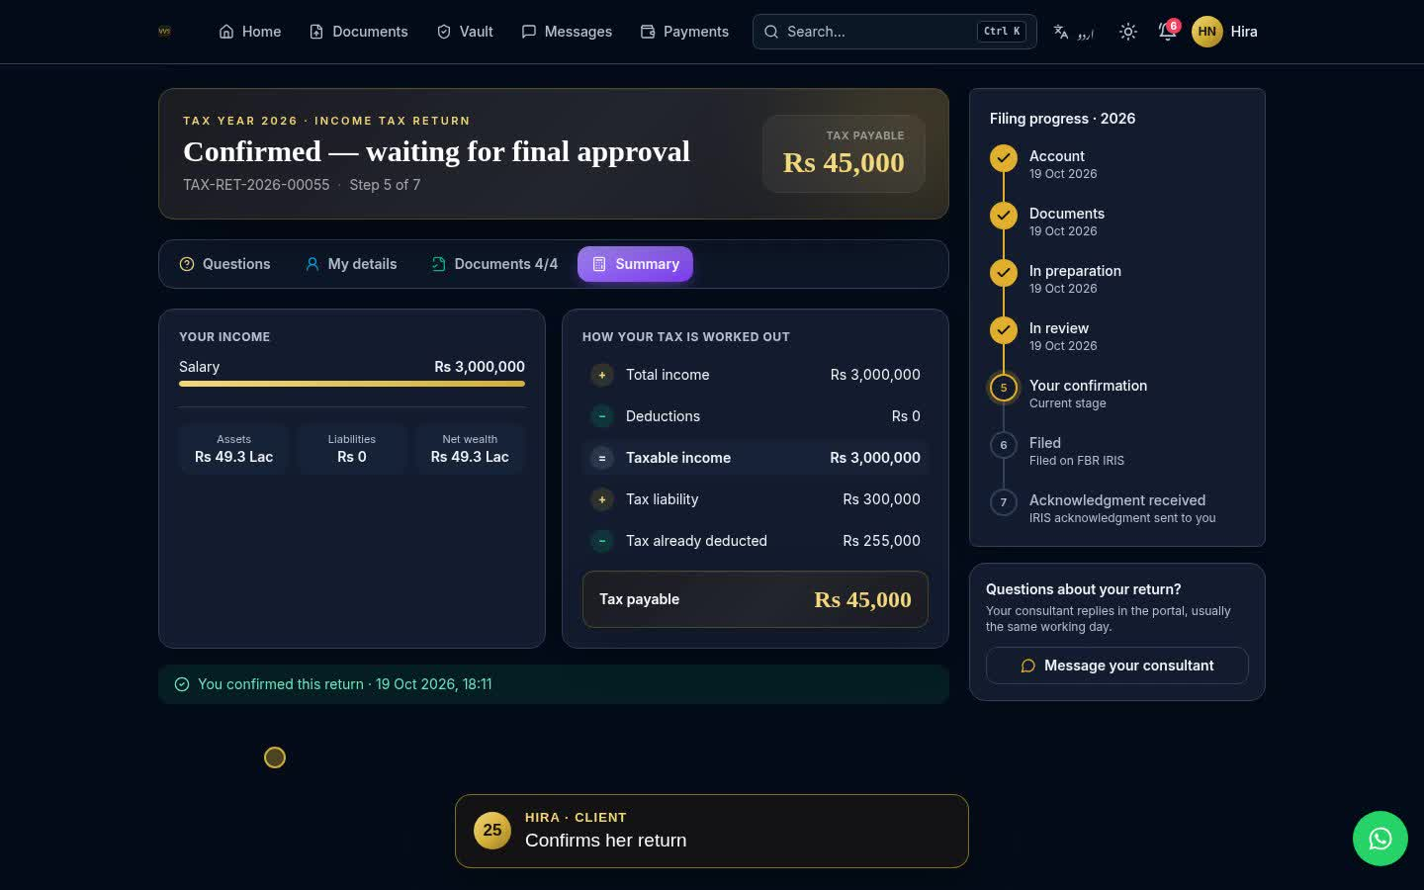
See both routes end to end
DEMO VIDEOS
Recorded on the demo site with fictitious clients — every screen, entry and approval is the real system
Video 1 · Team-assisted filing
Video 2 · Client journey from the website
VVS_Tax_Return_Full_Process.mp4 · 4 min 32 s
VVS_Client_Journey_Website_to_Filed.mp4 · 4 min 40 s
Walk-in client Usman Tariq. Admin registers him; documents arrive on WhatsApp; Zara (Data Entry) enters what he said and attaches the files; consultant prepares; reviewer checks; Zara records his phone approval; approver signs off; filing officer records the IRIS acknowledgment.
Hira Naveed finds the website, requests a login with a 6-digit code, enters her own details and documents, pays by JazzCash; the team verifies and prepares; she confirms in the portal; the return is filed and acknowledged.
Notes:
Play the videos here, or run the same flows live: returns TAX-RET-2026-00054 (team-assisted) and TAX-RET-2026-00055 (self-service) are on the demo site with their full history. All figures are demo estimates.

Slide 25
Decisions needed to go live
NEXT STEPS
1
Validate tax rates
2
Connect messaging
3
Set up email
Slabs and credit rules are demo values — confirm against the Finance Act
Meta WhatsApp account + authentication template; SMS provider
Outgoing SMTP for notices and invites
4
Confirm prices
5
Firm payment details
6
Targets (SLAs)
Express Filing Rs 10,000 shown vs Rs 12,000 discussed
Bank / Raast / wallet titles for the How to pay box
Days allowed per step for the late flags
Notes:
Close on the owner decisions that block go-live. Everything else in this document is built and running on the demo site.

