Slide 1
Zarmeen Gardens Real Estate & Society ERP
FUNCTIONAL SPECIFICATION · v1.0 · 20 OCTOBER 2026
How the system sells plots, collects installments, runs post-sale operations, bills and maintains the society, controls development cost and reports — on Frappe / ERPNext v16.
Notes:
Title. The FSD describes the Real Estate app (realestate) as built: all phases complete, acceptance 10 of 10.

Slide 2
One scheme, one ledger, every operation end to end
AT A GLANCE
400
4
352
Kanal boundary
Blocks
Plots on the map
130
16
21
Bookings
Document types, EN / اردو
Reports with charts
Notes:
Demo scheme figures. Every money movement posts to standard ERPNext documents, so the general ledger is the single source of truth.

Slide 3
Real-estate context around ERPNext accounting
PURPOSE AND SCOPE
In scope
Out of scope (this release)
Land and map: boundary, blocks, plots, infrastructure, KML / GeoJSON import
CRM and WhatsApp; booking and payment plans
Installments, receipts and recovery
Transfers, cancellations, re-allotments, merges, surcharge waivers
Agent and dealer commissions
Society billing, maintenance and complaints
Development cost, procurement, stock, assets with depreciation
Documents in English and Urdu; reports, dashboards, owner portal
Online card payments for owners
Construction (building) management after possession
Live WhatsApp Business account — runs in mock mode until credentials are supplied
Google Maps — supported, needs an API key
Notes:
In scope versus out of scope for this release.

Slide 4
Eight roles, each scoped on the server
USERS AND ROLES
1
Admin
2
Sales Manager
3
Sales Agent
4
Accounts
Setup, settings, users, imports, acceptance checks
Bookings, discount and post-sale approvals, portal invites
Leads, deals, visits, bookings, receipts, chats; raises requests
Receipts, invoices, refunds, commission and supplier payments
Sees: Everything
Sees: All sales, CRM, collections
Sees: Only their own records
Sees: All financial documents
5
Recovery Officer
6
Society Manager
7
Projects
8
Plot owner
Recovery calls, promises, dunning, waiver requests
Bills, bulk collection, charge heads, plans, merges
Development projects, budgets, material requests, tasks
Plots, schedule, bills, receipts, documents, complaints
Sees: Overdue bookings, defaulters
Sees: Society, maintenance, map
Sees: Development, maintenance
Sees: Only their own, via the portal
Notes:
Agents are scoped to their own records by server-side query conditions, not just by the screens.

Slide 5
Data flow diagrams
DFD
Level 0 shows the system against the outside world. Level 1 breaks it into ten processes and ten shared data stores (D1–D10).

Slide 6
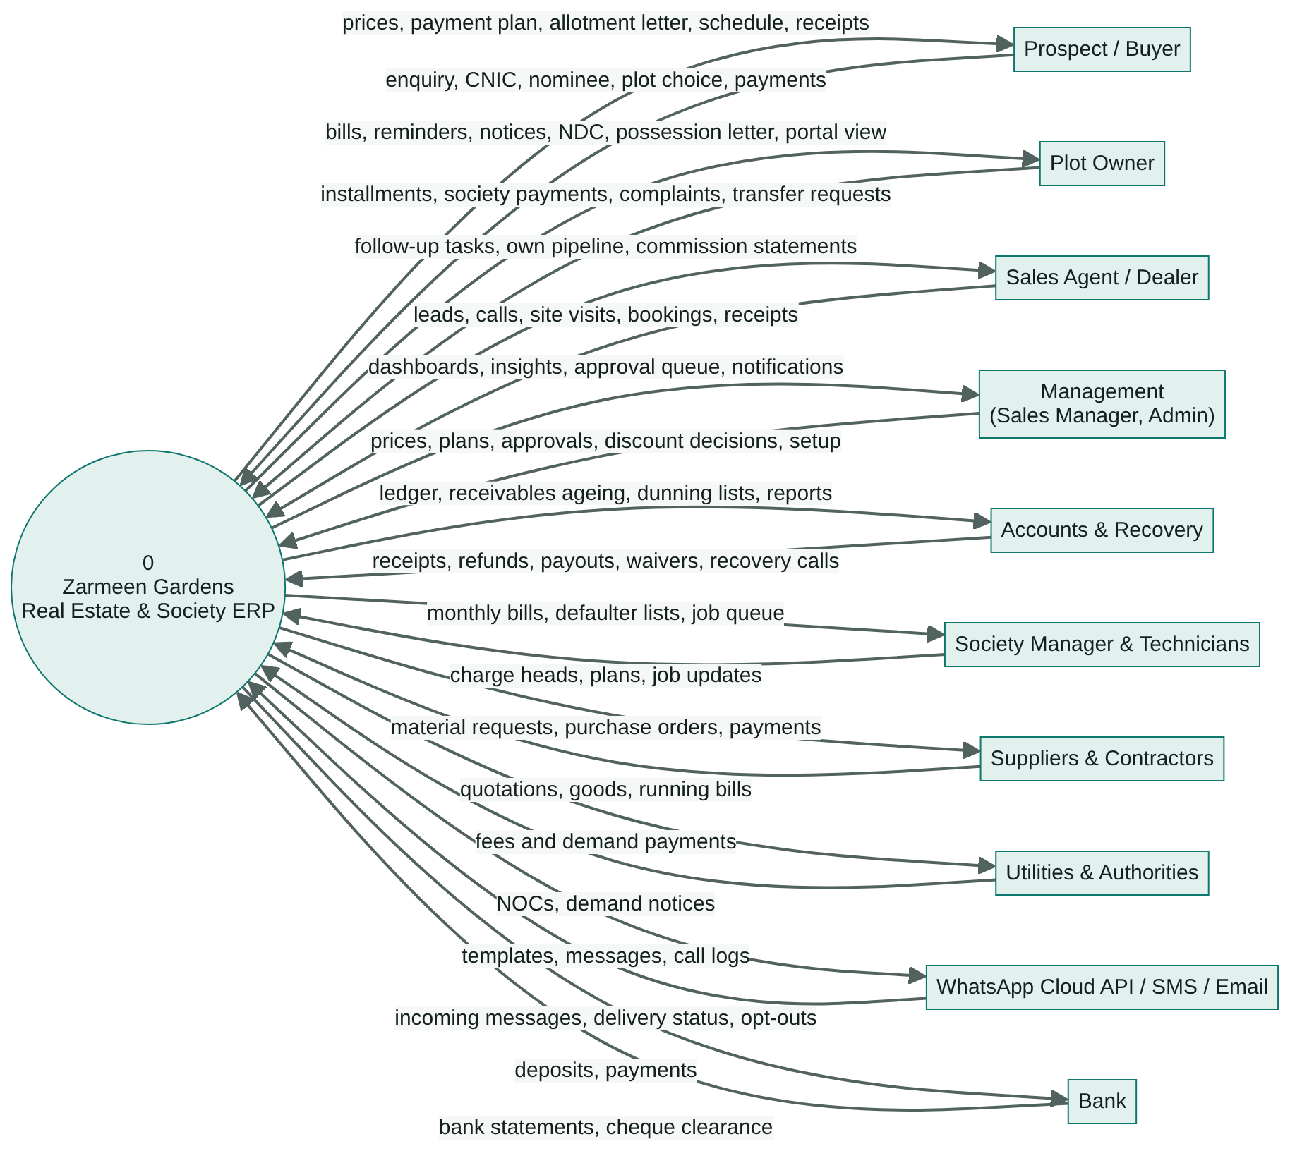
The system as one process and the parties around it
DFD LEVEL 0 · CONTEXT
How to read it
Circle — the whole system, process 0
Rectangle — an external entity: buyer, owner, agent, bank, supplier, contractor, regulator, WhatsApp
Arrow — a data flow, labelled with what moves
All stores live in the ERPNext database
Notes:
Circle = the system (process 0). Rectangles = external entities. Arrows = data flows labelled with what moves.

Slide 7
Ten processes share ten data stores
DFD LEVEL 1 · PROCESSES
1.0
2.0
3.0
4.0
5.0
Project & land setup
CRM & site visits
Booking & schedule
Collections & recovery
Post-sale operations
D1 D10
D2
D1 D3 D5
D4 D5
D1 D3 D5
6.0
7.0
8.0
9.0
10.0
Commissions
Society billing & maintenance
Development, stock & assets
Documents & messaging
Reports & dashboards
D5
D5 D6 D7
D5 D8
D9
all
Notes:
Each process maps to a group of screens in the staff app and to standard ERPNext postings.

Slide 8
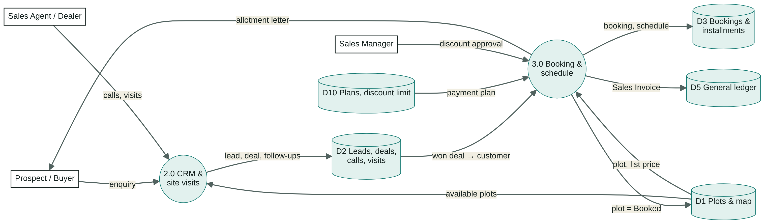
From enquiry to booked plot (2.0, 3.0)
DFD LEVEL 1 · SELLING
Notes:
A won deal becomes a customer; the booking draws plot, price and payment plan, books the plot and posts a Sales Invoice.

Slide 9
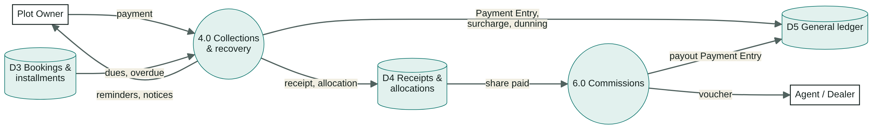
Collections, recovery and commissions (4.0, 6.0)
DFD LEVEL 1 · AFTER THE SALE
4.0
Receipts allocate oldest due first; surcharges and dunning post to the ledger
4.0
Reminders 3 days before due; overdue notices every 7 days
6.0
Commission becomes payable at 25% paid; payout by Payment Entry and voucher
Notes:
Receipts allocate oldest due first; post-sale changes need approval and post credit notes, fees or refunds; commissions pay out after 25% collected.

Slide 10
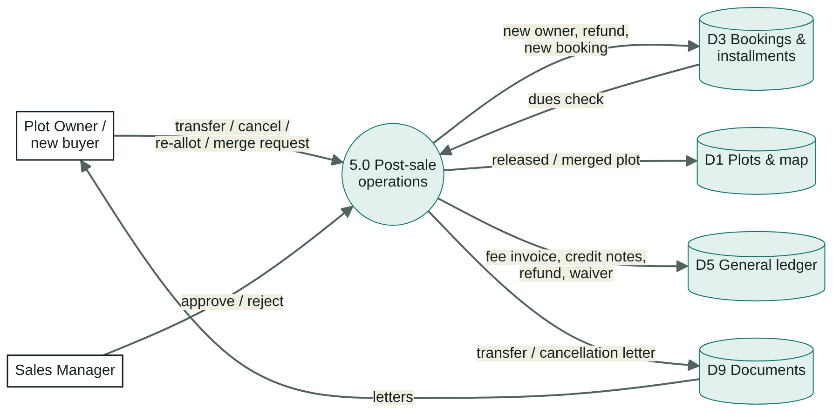
Transfers, cancellations, re-allotments, merges (5.0)
DFD LEVEL 1 · POST-SALE
Owner or buyer raises the request; the wizard checks dues first
Sales Manager approves or rejects; Revise sends it back
Approval posts fee invoices, credit notes, refunds or waivers
Plots are released, re-allotted or merged on the map
Transfer and cancellation letters are versioned in D9
Notes:
Every post-sale change waits for Sales Manager approval, then posts its accounting and its letter.

Slide 11
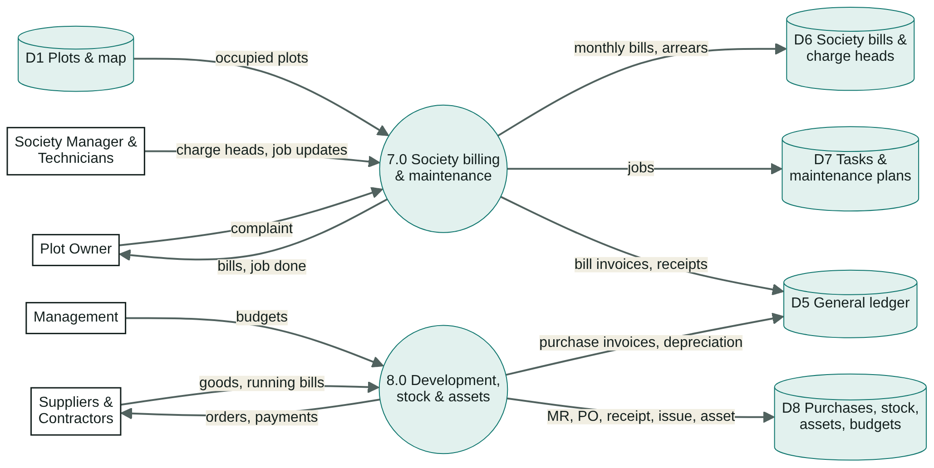
Society, maintenance and development (7.0, 8.0)
DFD LEVEL 1 · SOCIETY AND DEVELOPMENT
7.0 bills every occupied plot on day 1, due in 15 days, arrears carried
Complaints from portal, WhatsApp or staff become tasks; the owner is told when done
8.0 runs each cost head as a Project with a Budget
Material Request → PO → Receipt → Invoice; issues charge the head
Assets depreciate straight line by category
Notes:
Monthly bills with arrears; complaints become tasks; development cost heads are projects with budgets, procurement and assets.

Slide 12
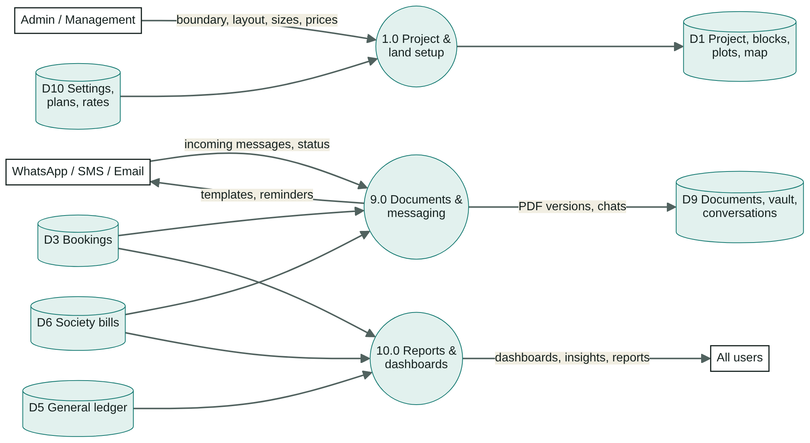
Setup, documents & messaging, reports (1.0, 9.0, 10.0)
DFD LEVEL 1 · SETUP, DOCUMENTS, REPORTS
1.0 builds the scheme: boundary, layout, sizes, prices
9.0 makes 16 document types as versioned PDFs, English or Urdu
WhatsApp first, SMS / email fallback
10.0 reads every store for dashboards, insights and 21 reports
Notes:
Setup feeds D1; documents and messages are versioned in D9; reports read every store.

Slide 13
D1–D10 are ordinary ERPNext and RE doctypes
DATA STORES
Store | Holds | DocTypes
D1 | Land & map | RE Project, RE Block, RE Plot (price history), RE Plot Size, RE Map Feature, RE Map Import, RE Land Use
D2 | CRM | CRM Lead, CRM Deal, CRM Task, CRM Call Log, RE Site Visit
D3 | Bookings | RE Booking (RE Installment rows), RE Payment Plan
D4 | Receipts | RE Payment (RE Payment Allocation rows)
D5 | Ledger | Sales Invoice, Payment Entry, Journal Entry, Dunning, GL Entry, RE Surcharge, RE Commission
D6 | Society bills | RE Society Bill (RE Bill Charge rows), RE Charge Head (RE Charge Rate rows)
D7 | Maintenance | Task, Project (maintenance), RE Maintenance Plan, ToDo
D8 | Development | Material Request, Purchase Order / Receipt / Invoice, Stock Entry, Asset, Depreciation Schedule, Budget, Project
D9 | Documents & chat | RE Generated Document, RE Vault Document, RE Conversation, WhatsApp Message, RE Reminder Log, RE Broadcast
D10 | Settings | RE Settings, RE Payment Plan, RE Quick Reply, approval workflows
Notes:
All stores live in the site database.

Slide 14
Functional requirements
FR
What each process must do, the screen in the staff app and what it posts in ERPNext. The desk offers the same documents.

Slide 15
Land, CRM and booking
FR-1 TO FR-3
1.0
Project & land
2.0
CRM & site visits
3.0
Booking & schedule
Boundary drawn or imported (KML / GeoJSON); land use must total 100%
Blocks, plot sizes with base price and maintenance; plots with flags and outline
Price revisions kept as plot price history
Infrastructure on the map; live map by status or payment health
Leads from any source; an unknown WhatsApp number creates a lead
Pipeline Opportunity → Site Visit → Negotiation → Booking creates the Customer
Calls with outcome and promise to pay; missed calls create follow-ups
Site visits with WhatsApp invitation and result
Customer with CNIC and nominee, an available plot, price, discount, plan
Discount above 5% waits for Sales Manager approval
Submit builds the schedule, books the plot, posts a Sales Invoice with payment schedule
Allotment letter and forms in English or Urdu
Notes:
FR-1.1 to FR-3.4.

Slide 16
Collections, recovery and post-sale operations
FR-4 AND FR-5
4.0 Collections & recovery
Operation | Rule | Posting on approval
Transfer | No overdue installments or society dues; fee Rs 50,000 | Fee invoice; credit note for seller; new invoice for buyer; transfer letter
Cancellation | Deduct 10% of price, never more than paid | Credit notes, refund Payment Entry, plot released, unpaid commission cancelled
Re-allotment | A plot freed by a cancellation; fee Rs 25,000 | New booking and invoice; fee invoice
Merge | Adjacent available plots | New plot with combined outline, area and price
Surcharge waiver | Part or all, with a reason | Credit note against the surcharge invoice
Receipts by cash, transfer or cheque, allocated oldest due first → Payment Entry
Unpaid → Due (7 days) → Overdue, driven by the calendar
Monthly late-payment surcharge after the grace period
Recovery calls, promises, final notice, dunning
Reminders 3 days before due; overdue notices every 7 days
Notes:
Every post-sale operation goes through an approval workflow.

Slide 17
Commissions, society and development
FR-6 TO FR-8
6.0
Commissions
7.0
Society
8.0
Development
Agent 1%, dealer 2% of net price accrue at booking
Payable once the customer has paid 25%
Paid in batches by Payment Entry with a printable voucher; cancelling reverses it
Charge heads: fixed, per marla or by plot size
Monthly bill per occupied plot, day 1, due in 15 days, with arrears
Bulk collection by owner or block
Complaints become tasks; plans create tasks ahead of due
Each cost head is a Project with a Budget
Material Request → PO → Receipt → Invoice; Stock Entry issues to the head
Contractor bills and NOC fees as Purchase Invoices
Assets depreciated straight line by category
Notes:
FR-6.1 to FR-8.4.

Slide 18
Documents, messaging, reports and portal
FR-9 AND FR-10
9.0
Documents & messaging
10.0
Reports, dashboards & portal
16 document types on the letterhead with a QR verification code
Numbered PDF versions in English or Urdu (right to left)
Vault for approvals, NOCs, registry, insurance with expiry alerts
Shared WhatsApp inbox, templates, quick replies, opt-out keywords, rate-limited broadcasts
Dashboard, Today, insights and a customer 360 with payer segment
Report centre: preview, bar / line / area / pie / donut / trend, Excel and PDF
Owner portal in English / اردو: plots on the map, schedule, bills, receipts, documents, complaints
Staff preview the portal as an owner, read-only
Notes:
FR-9.1 to FR-10.3.

Slide 19
Business rules and controls
§7
All money maths lives in one tested module (realestate/calc.py). Rates and fees are settings, not code — changes apply to new documents only.

Slide 20
Six calculations every document follows
BUSINESS RULES
Installment schedule
Receipt allocation
Late-payment surcharge
net = price − discount
fixed parts = net × % (round Rs 1,000)
each = (net − fixed) ÷ n; last absorbs the rest
Σ schedule = net, always exact
pays unpaid rows oldest due first
never more than total outstanding
after 15 days grace:
max(Rs 500, overdue × 2% / month)
capped at overdue × 10%
one per booking per month
Cancellation
Commission
Society bill
deduction = min(net × 10%, paid)
refund = paid − deduction
net × rate (agent 1%, dealer 2%)
Accrued → Payable at 25% paid → Paid
Σ charge heads for the plot
(fixed | rate × marla | size rate)
payable = bill + arrears
Notes:
Values in brackets are current RE Settings.

Slide 21
Every record moves through a fixed set of states
STATUS MODELS
Plot
Available
Hold
Booked
Sold
Possession
Booking
Draft
Due
Overdue
Paid
Cancelled
Installment
Unpaid
Due
Overdue
Partly Paid
Paid
Approval
Draft
Pending
Approved
Rejected
Revise
Society bill
Unpaid
Due
Overdue
Partly Paid
Paid
Commission
Accrued
Payable
Paid
Cancelled
Task
Open
Working
Completed
Overdue
Notes:
Statuses change on submit, on receipts, on the daily refresh and on approvals.

Slide 22
What runs on its own, and what the system talks to
JOBS AND INTEGRATIONS
Scheduled jobs
Integrations
When | Job
Daily | Refresh dues · society bills on bill day · reminders · overdue notices · vault expiry
Daily | Surcharges · dunnings · commission statuses
Daily | Planned maintenance tasks · mark overdue jobs
Every minute | WhatsApp delivery status · SMS fallback
Month end | Asset depreciation
Demo only | A live day of demo activity (re-daily-data)
Integration | Use | State
WhatsApp Cloud API | Templates, chat, delivery, webhook | Mock until credentials
SMS / email | Fallback when WhatsApp fails | Configured
Maps | MapLibre satellite; Google optional | Live; Google needs key
ERPNext | Accounts, buying, stock, assets, projects, dunning | Live
Notes:
Daily jobs are idempotent and safe to re-run.

Slide 23
Controls built into the platform
SECURITY, AUDIT AND QUALITY
✓
Role scoping
Agents see only their own records — enforced by server-side query conditions
Non-functional requirements
✓
Approvals
Usability Phone width (390 px), light and dark; portal and documents in English or Urdu
Transfers, cancellations, re-allotments, merges, waivers and large discounts
✓
No deletion
Performance Lists and insights in about a second; previews up to 1,000 rows
Submitted financial documents are cancelled and amended, never deleted
✓
Audit trail
Reliability Idempotent daily jobs; missed demo days caught up (up to 14)
Version history and an activity chain on every financial and settings record
✓
Secrets
Accuracy Schedules total the net price; ledger balances; 127 cross-page checks
API tokens and map keys stored encrypted in RE Settings
✓
Portal
Maintainability Standard ERPNext accounting; money maths in one tested module
Owners reach only their own records; staff preview is read-only
Notes:
Security and non-functional requirements (FSD §12–13).

Slide 24
Project and site setup
§14
Nine steps from an empty bench to a live scheme, checked by the acceptance command.

Slide 25
Nine steps to go live
SETUP
1
Install
4
Project & map
7
Development
ERPNext v16, Frappe CRM, WhatsApp; get-app and install-app realestate
Boundary, land use, blocks, plot sizes and prices, plots, infrastructure
Cost-head projects and budgets, site store, suppliers, asset categories
2
Company & accounts
5
Sales setup
8
Users
Fiscal year July–June, cost centers per block, banks, modes of payment
Payment plans, agents and dealers, quick replies and templates
Staff with roles; owner-portal invites from the customer page
3
RE Settings
6
Society setup
9
Go live
Discount limit, fees, surcharge and commission rules, billing day, WhatsApp, map
Charge heads and size rates, maintenance plans and assignee
Turn on the scheduler; re-acceptance until every check passes
Notes:
Demo commands only act when mock mode is on and the default project is flagged as the demo; they never touch real records.

Slide 26
Ten automated checks pass on the demo scheme
ACCEPTANCE CRITERIA
01
Land use totals 100% of the boundary (400.00 kanal)
07
Incoming WhatsApp reaches the inbox and timeline (mock)
PASS
PASS
02
Every plot inside its block, blocks inside the boundary, no overlaps
08
All documents render to PDF on the letterhead, English and Urdu
PASS
PASS
03
Every schedule = price − discount; invoice schedule = invoice total
09
Role scoping: agents, managers, portal owners
PASS
PASS
04
Every receipt has a matching submitted Payment Entry; ledger balances
10
Audit trail and no deletion of financial records
PASS
PASS
05
Map recolours live when a plot changes
11
Phone width, light and dark
PASS
BY EYE
06
Scheduled jobs enabled and current
PASS
Notes:
bench --site realestate re-acceptance runs these checks.

Slide 27
Simulator videos
▶
Sixteen narrated screen recordings on the demo scheme — one per operation. Click a thumbnail to play it (files in the videos folder beside this deck).

Slide 28
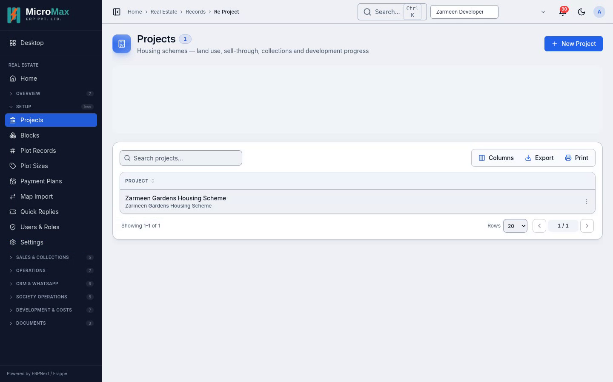
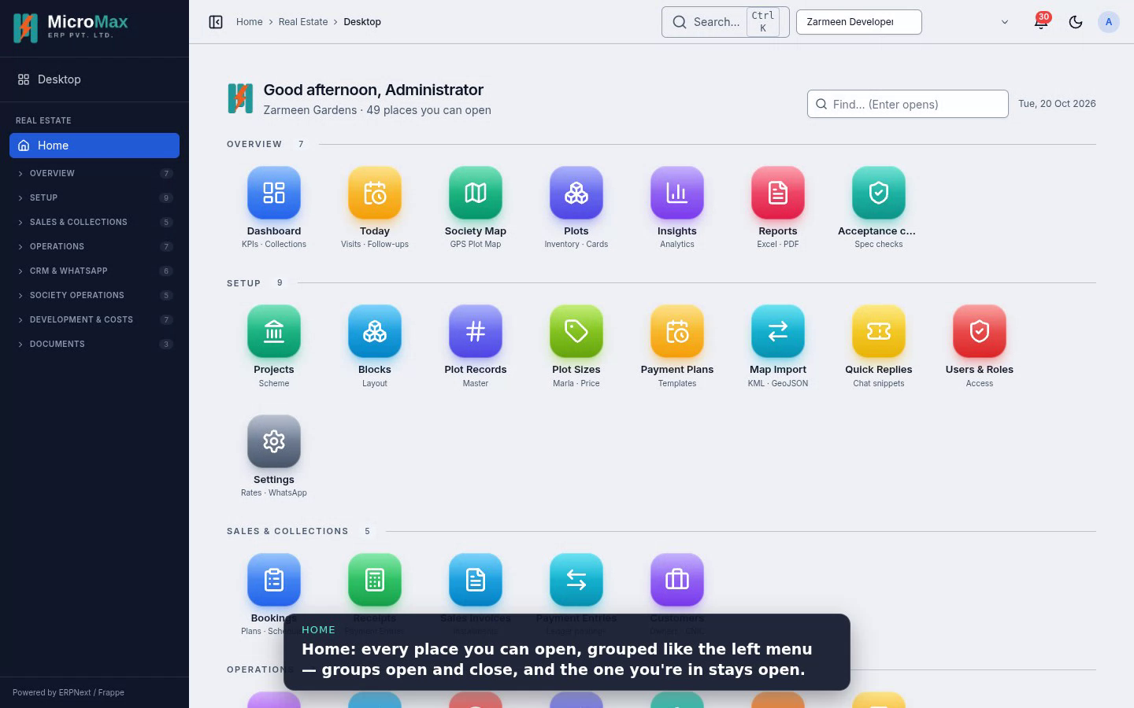
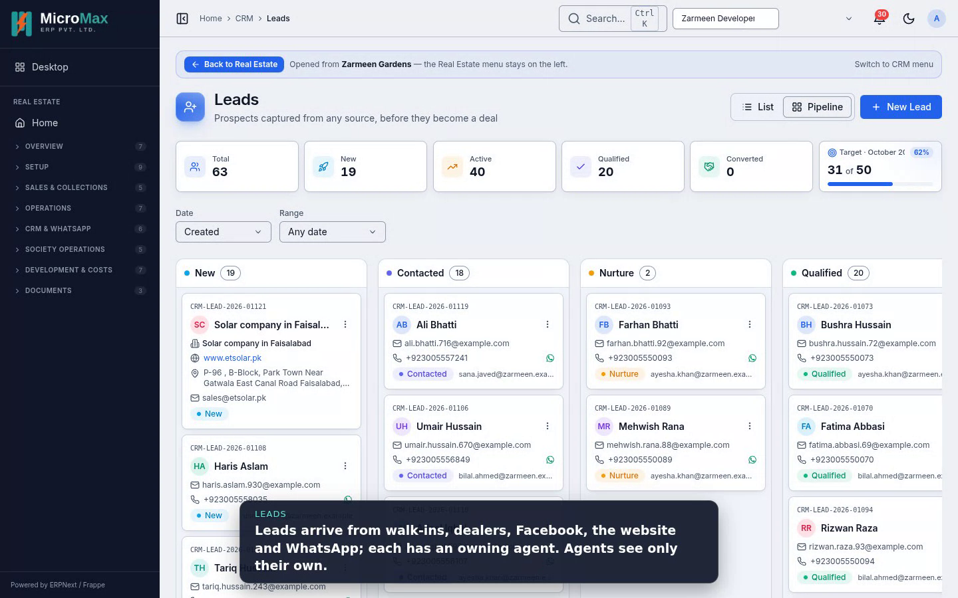
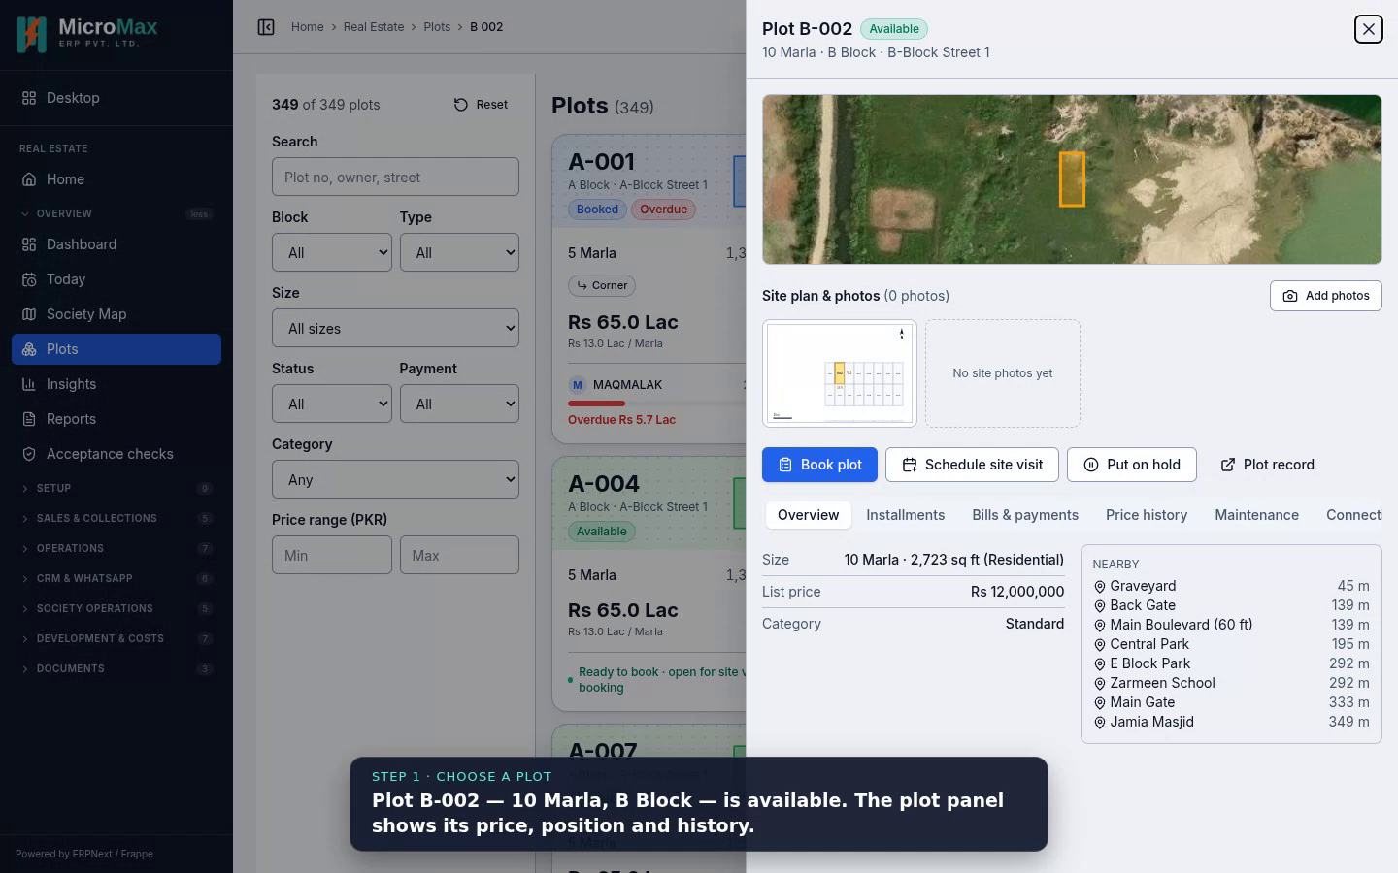
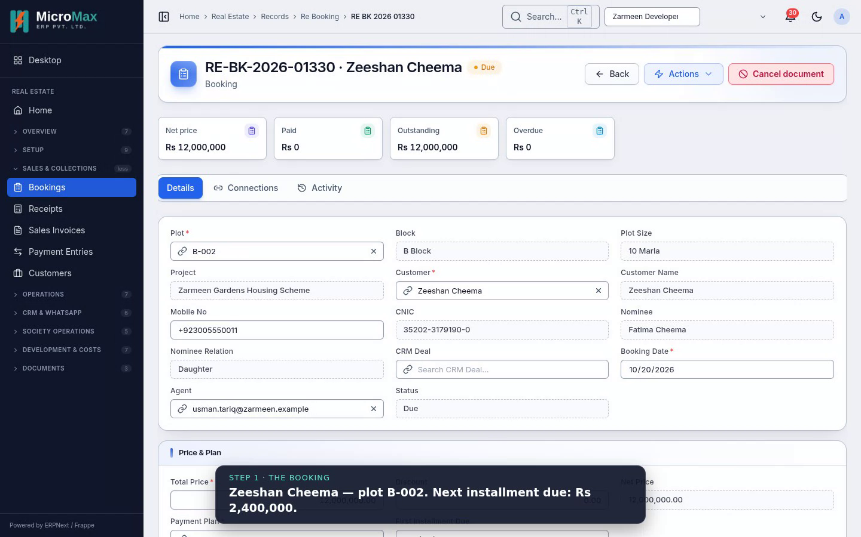
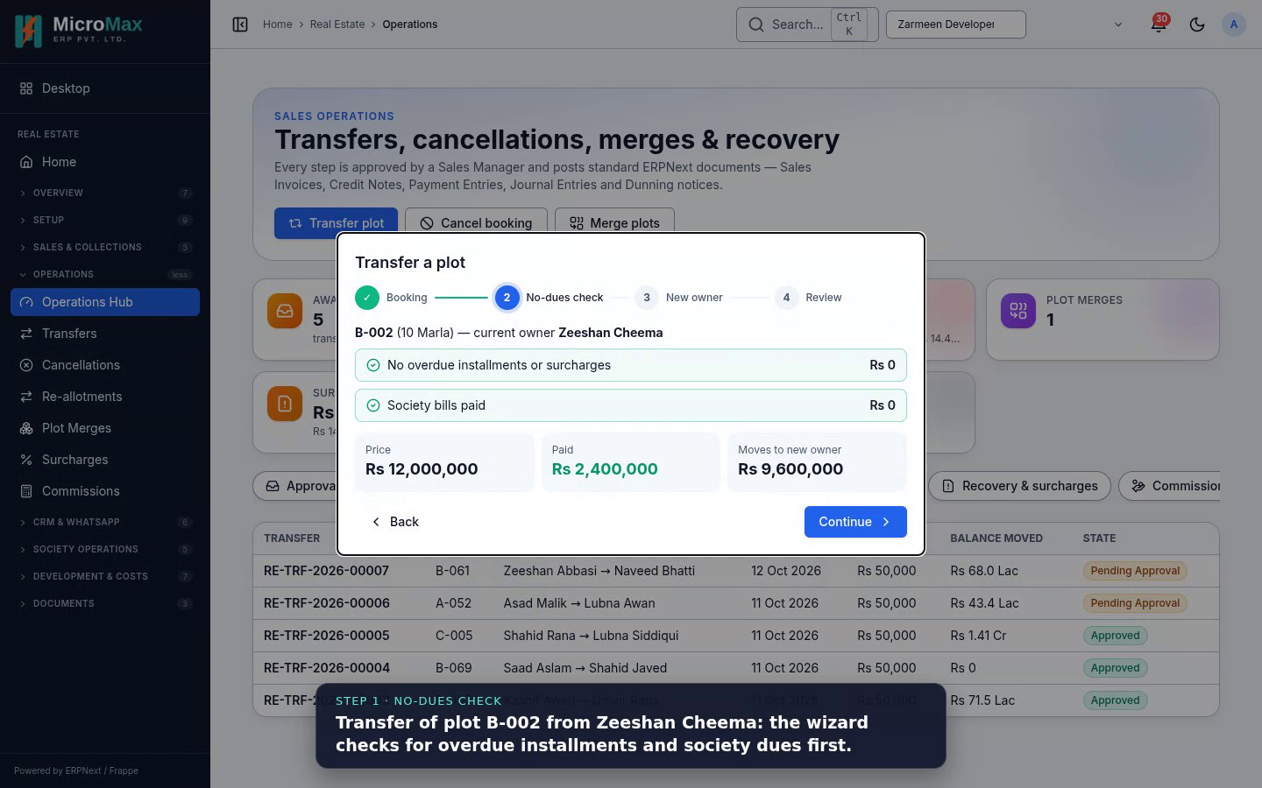
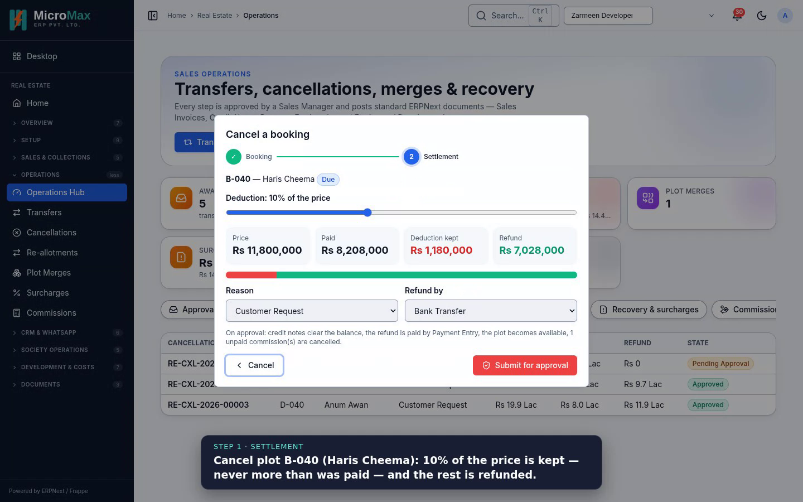
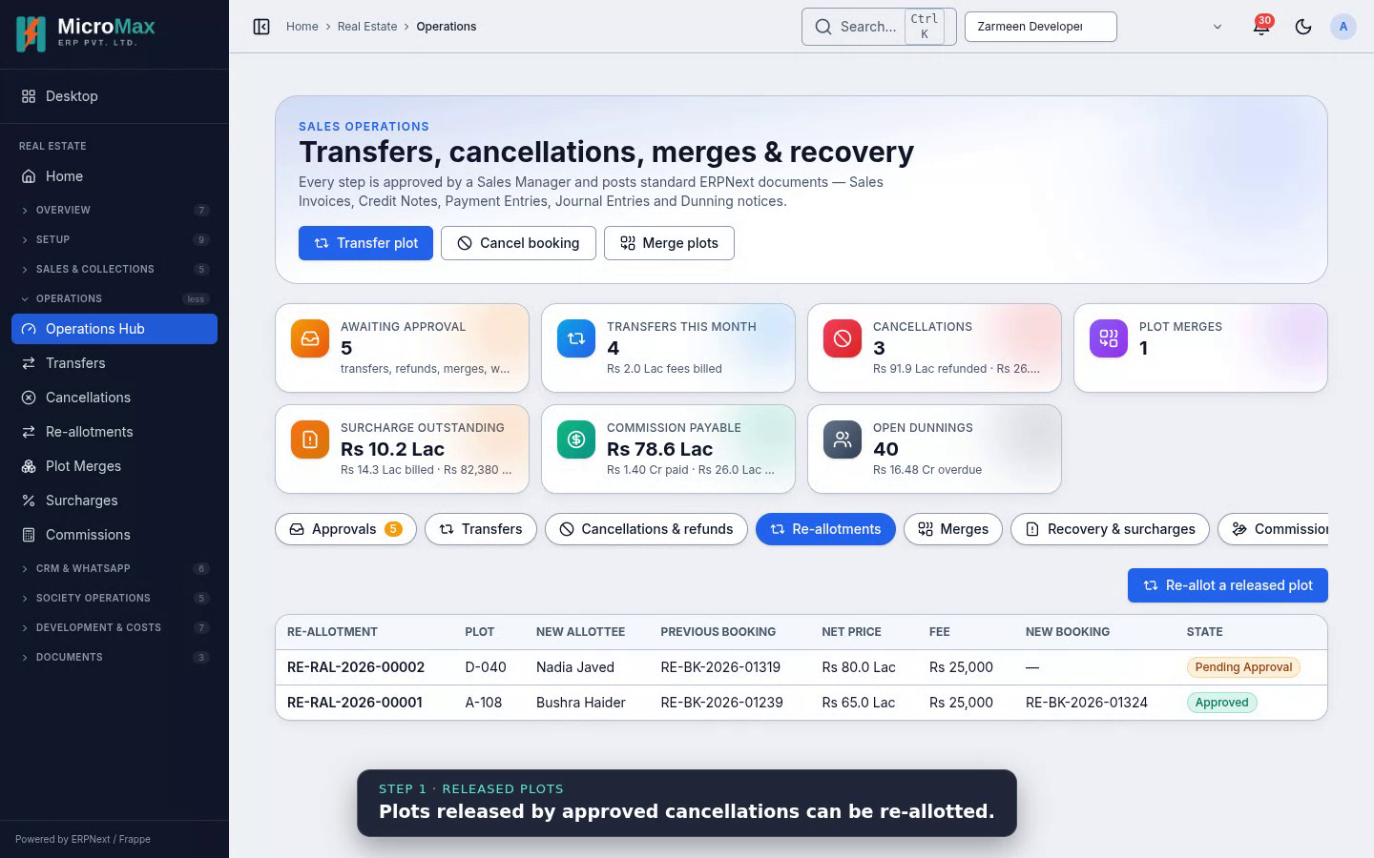
Setup, daily work and selling
VIDEO LIBRARY
00 Project & site setup
01 Your day in the app
02 CRM & WhatsApp
03 Booking a plot
Install, settings, project and map, plots, plans, users, acceptance
Home, dashboard, today's visits and follow-ups, notifications
Leads, deals, site visits, the shared inbox
Book, submit, schedule, invoice, Urdu allotment letter
04 Receiving a payment
05 Transferring a plot
06 Cancelling a booking
07 Re-allotting a plot
Oldest-due-first allocation, Payment Entry, ledger
No-dues check, new owner, fee, approval
Deduction and refund, approval, plot released
A freed plot goes to a waiting buyer
Notes:
Each video opens with a title card and narrates every step in a caption bar. Re-record with node tools/videos/record.mjs.

Slide 29
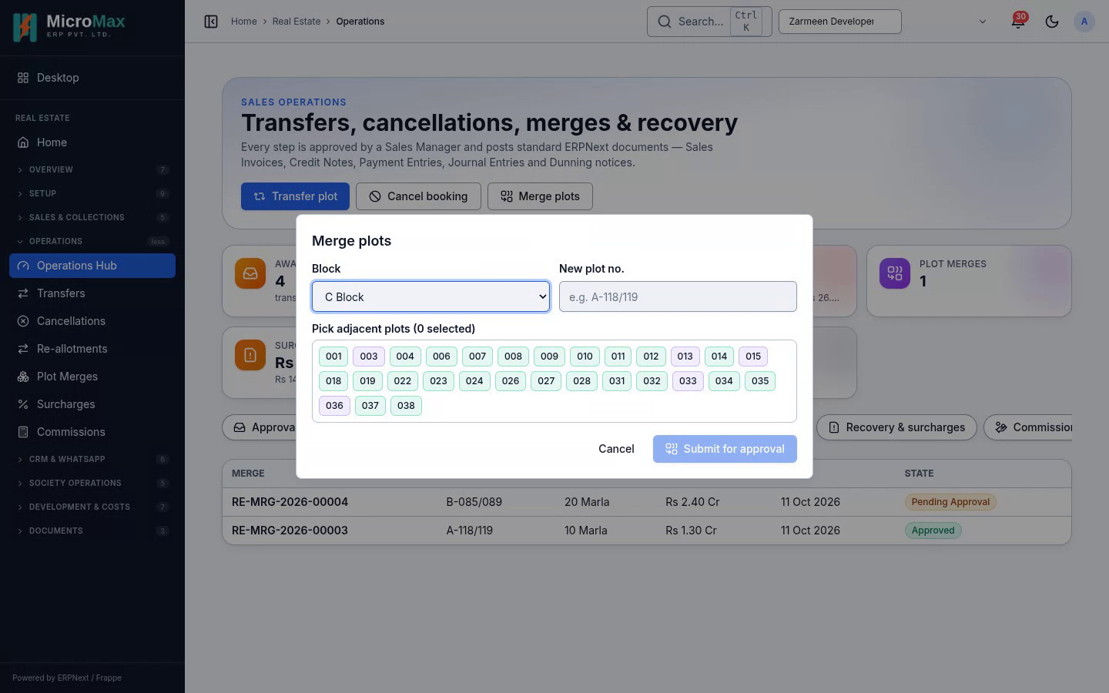
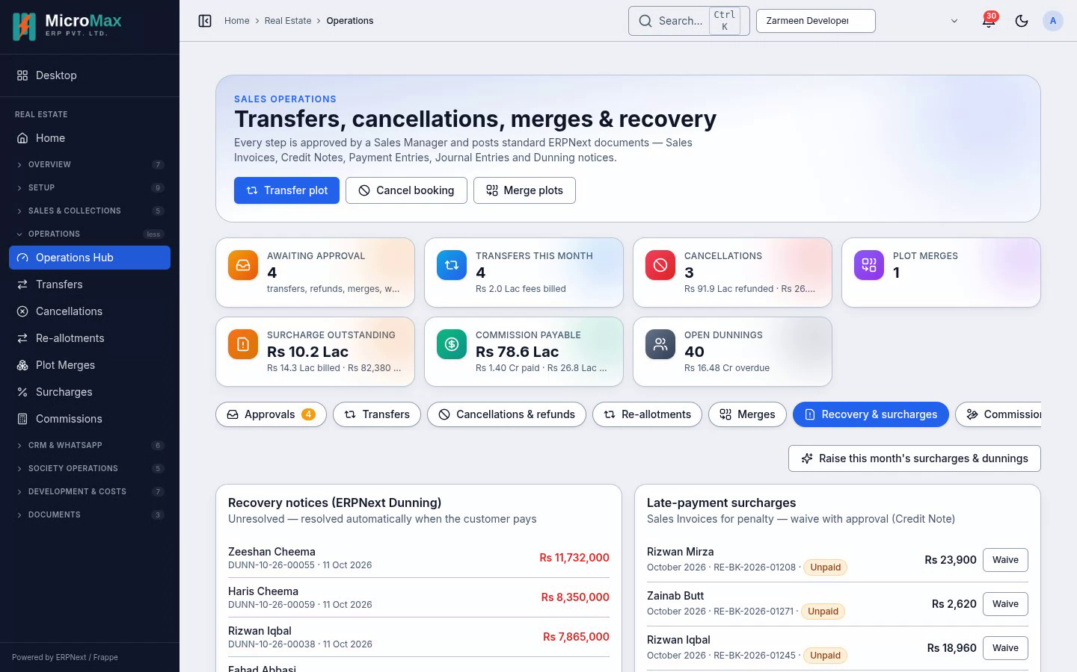
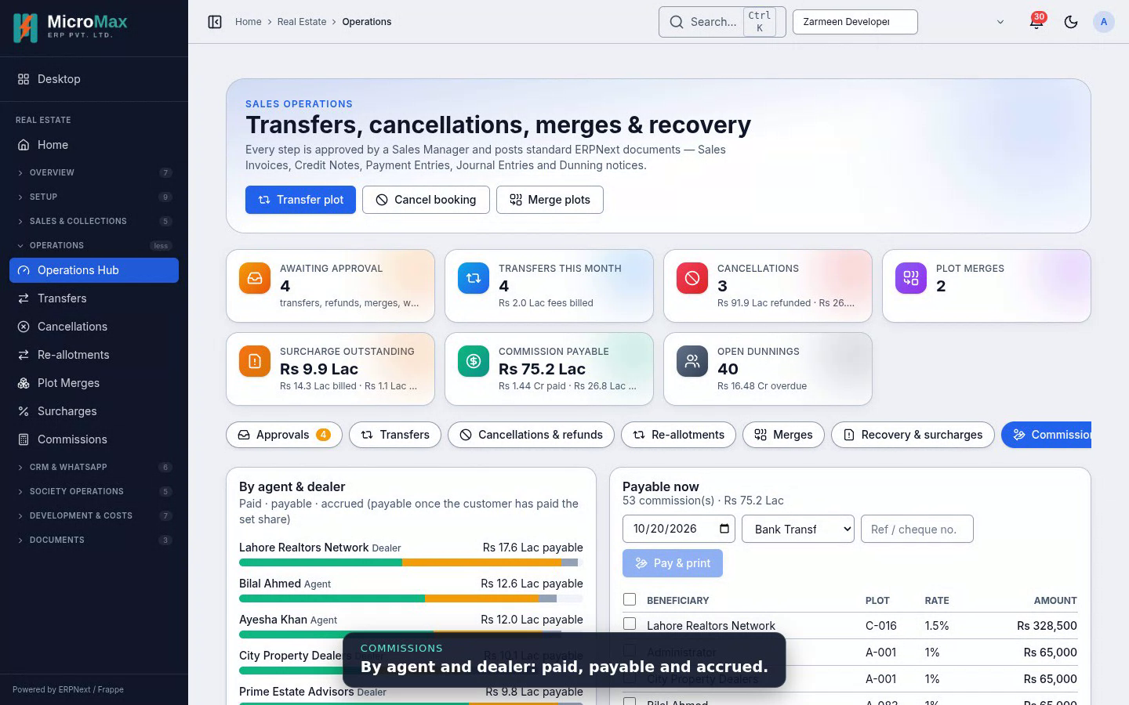
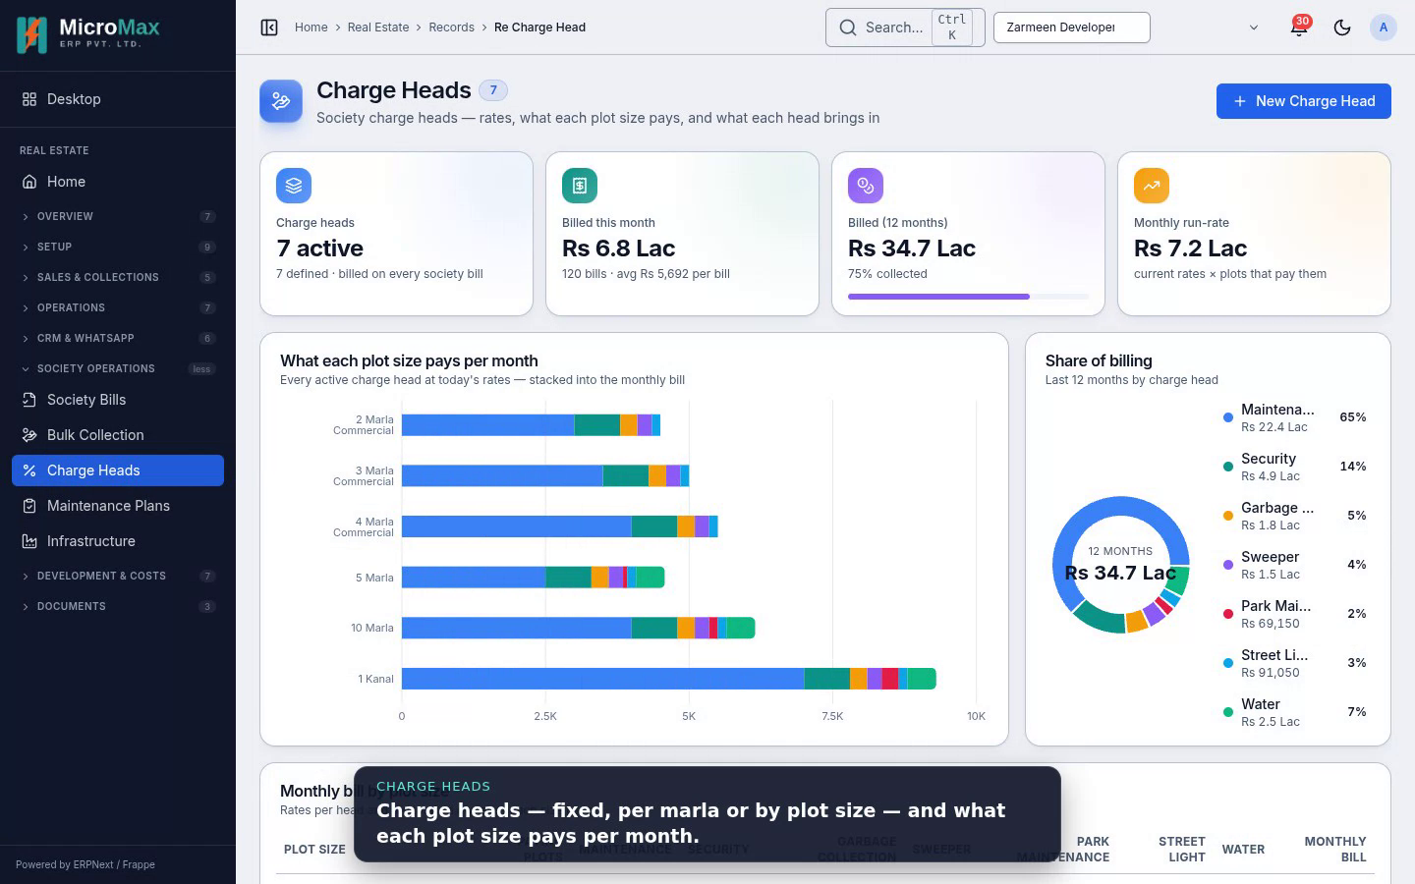
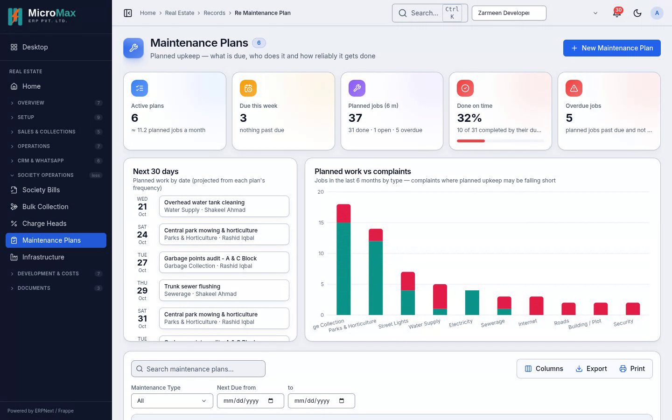
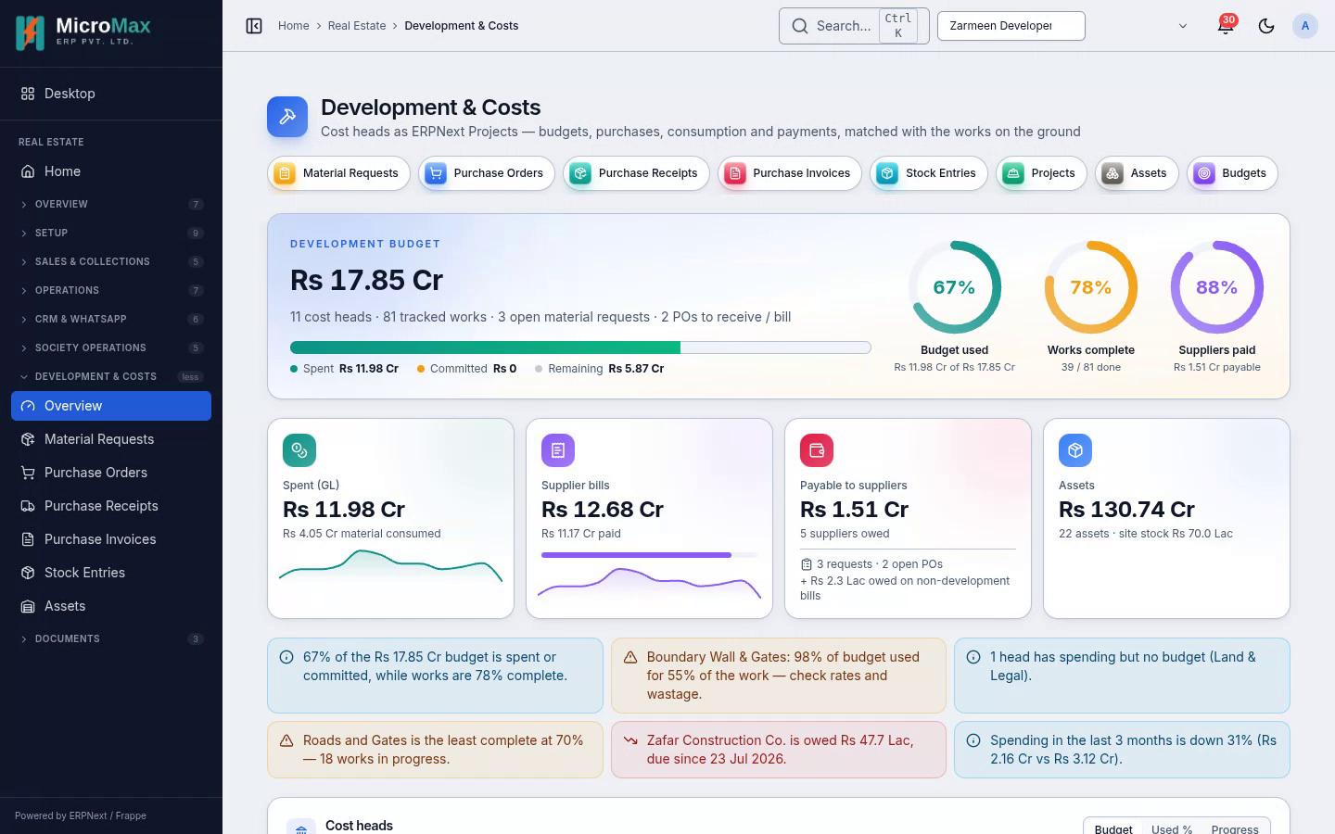
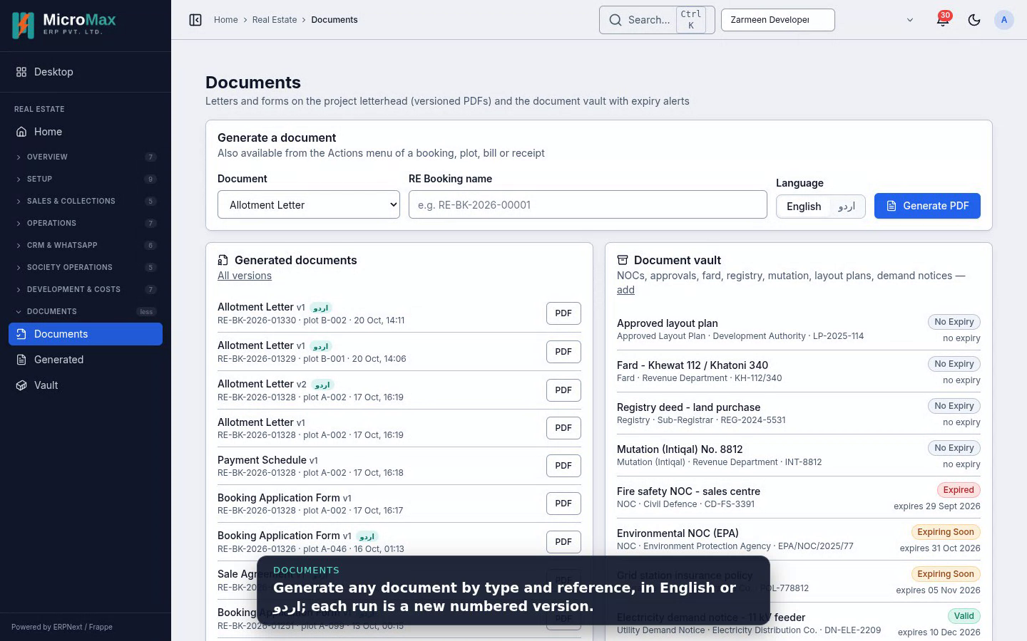
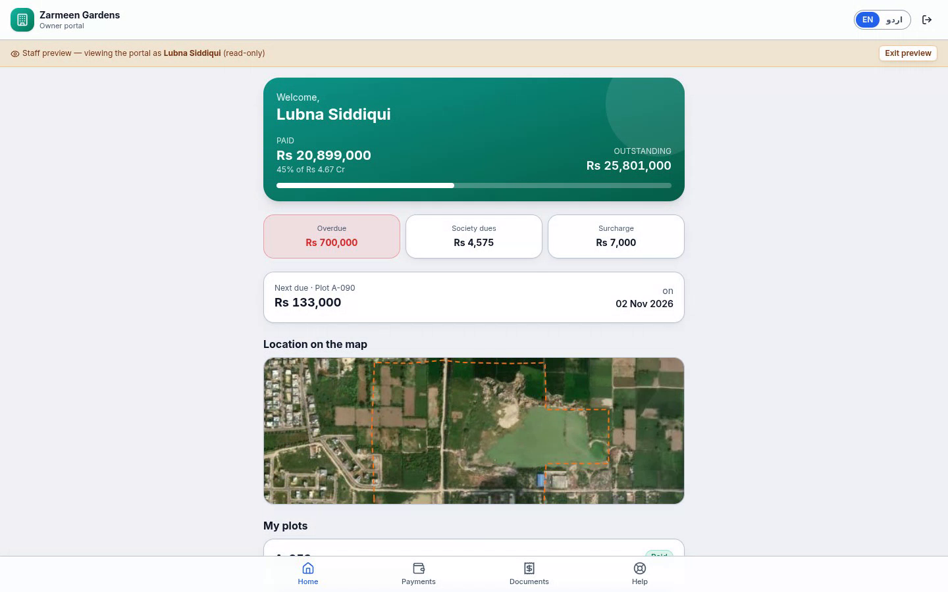
Post-sale, society, development and portal
VIDEO LIBRARY
08 Merging plots
09 Recovery & surcharges
10 Commissions
11 Society billing
Two adjacent plots become one; the map updates
Dunning, monthly surcharges, a waiver
Accrued, payable, paid with a voucher
Charge heads, bills with arrears, bulk collection
12 Maintenance
13 Development & assets
14 Documents & reports
15 Owner portal
Plans, urgent queue, complaint jobs
Budget vs actual, procurement, depreciation
English / Urdu documents, report centre
What a plot owner sees, English and Urdu
Notes:
Each video opens with a title card and narrates every step in a caption bar. Re-record with node tools/videos/record.mjs.

Slide 30
Ready for real data
ALL PHASES BUILT · ACCEPTANCE 10 / 10
Open items need the owner: live WhatsApp Business credentials, a Google Maps key if wanted, and online card payments in a later release.

