Slide 1
Introduction to information & communication technology
Instructor: Rabail Zahid

Slide 2
Table of contents
Number Systems
In depth understanding of binary, octal, hexadecimal, and decimal numbers
Conversion of binary to decimal, octal and hexadecimal numbers.
Conversion of octal to hexadecimal numbers.
Conversion of hexadecimal numbers to octal numbers.
ASCII Coding system
Introduction to Unicode

Slide 3


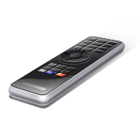
Number System
63
16
23
63
16
721
935
23
534
534
721
935
Decimal-to-Binary
Conversion
234
275
935
275
935
145
137
234
137
145
010
10101
1101
00100
10010
010
1101
00101101
0101011
1101
010
10010
1101
00100
010
00101
00101101
011011
Binary-to-Decimal
Conversion
1101
011011
011011
00101101
00100
0101011
1101
0101011
10010
10010
10101
011011
001011
00101101
00100

Slide 4
Decimal Number system
The number system that we use in our day-to-day life is the decimal number system. Decimal number system has base 10 as it uses 10 digits from 0 to 9.
The base of the number system is defined as the total number of digits available in the number system

Slide 5
Decimal (base 10) number system consists of 10 symbols or digits
0 1 2 3 4
5 6 7 8 9

Slide 6
We count in Base 10 (Decimal)
We count in Base 10 (Decimal)
15
16
17
18
19
0
1
2
3
4
5
6
7
8
9
10
11
12
13
14
95
96
97
98
99
100
101
20
21
22
23
24
15
16
17
18
19
0
1
2
3
4
5
6
7
8
9
10
11
12
13
14
95
96
97
98
99
100
101
20
21
22
23
24
Ran out of symbols (0-9), so increment the digit on the left by one unit.
Ran out of symbols (0-9), so increment the digit on the left by one unit.

Slide 7
Binary Number System
According to digital electronics and mathematics, a binary number is defined as a number that is expressed in the binary system or base 2 numeral system. It describes numeric values by two separate symbols 1 (one) and 0 (zero).
The binary system is applied internally by almost all latest computers and computer-based devices because of its direct implementation in electronic circuits using logic gates. Every digit is referred to as a bit.

Slide 8
What is Bit in Binary Number?
A single binary digit is called a “Bit”. A binary number consists of several bits. Examples are:
10101 is a five-bit binary number
101 is a three-bit binary number
100001 is a six-bit binary number

Slide 9
Binary Numbers
Each binary digit (called a bit) is either 1 or 0
Bit Numbering
  Least significant bit (LSB) is
  rightmost (bit 0)
  Most significant bit (MSB) is leftmost (bit 7 in an 8-bit number)
Least
Significant Bit
Most
Significant Bit
7
6
5
4
3
2
1
0
1
0
0
1
1
1
0
1
2
7
2
6
2
5
2
4
2
3
2
2
2
1
2
0

Slide 10
Binary (base 2) number system consists of just two
0 1

Slide 11
Computers count in Base 2 (Binary)
Counting in Binary is the same, but with only two symbols
  On (1)
  Off (0)
1000
1001
1010
1011
1100
1101
1110
1111
10000
0
1
10
11
100
101
111
110

Slide 12
Counting in Decimal
Counting in Binary
0
1
2
3
4
5
6
7
8
9
10
11
12
13
14
15
16
17
18
19
20
21
22
23
24
25
26
27
28
29
30
31
32
33
34
35
36
.
.
.
0
1
10
11
100
101
110
111
1000
1001
1010
1011
1100
1101
1110
1111
10000
10001
10010
10011
10100
10101
10110
10111
11000
11001
11010
11011
11100
11101
11110
11111
100000
100001
100010
100011
100100
.
.
.

Slide 13
Octal Number System
Uses eight digits, 0,1,2,3,4,5,6,7
Also called as base 8 number system

Slide 14
Hexa Decimal Number System
The hexadecimal number system is a type of number system, that has a base value equal to 16. Hexadecimal numbers are represented by only 16 symbols. These symbols or values are 0, 1, 2, 3, 4, 5, 6, 7, 8, 9, A, B, C, D, E and F. Each digit represents a decimal value. For example, D is equal to base-10 13.
Uses 10 digits and 6 letters, 0, 1, 2, 3, 4, 5, 6, 7, 8, 9, A, B, C, D, E, F
Letters represent the numbers starting from 10. A = 10. B = 11, C = 12, D = 13, E = 14, F = 15
Also called as base 16 number system

Slide 15
Decimal Binary conversion

Slide 16
Convert 75 to Binary
2
75
remainder
2
37
1
2
18
1
2
9
0
2
4
1
2
2
0
1
0
1001011

Slide 17
Check
1001011 = 1x2⁰ + 1x2¹ + 0x2² + 1x2³ + 0x2⁴ + 0x2⁵ + 1x2⁶
= 1 + 2 + 0 + 8 + 0 + 0 + 64
= 75

Slide 18
Convert 100 to Binary
2
100
remainder
2
50
0
2
25
0
2
12
1
2
6
0
2
3
0
1
1
1100100

Slide 19
Dec → Binary : More Examples
13₁₀ = ?
22₁₀ = ?
43₁₀ = ?
158₁₀ = ?
Notes:
If the students need more practice, here are four additional example of DECIMAL to BINARY conversion. The solution is on the next slide.
Binary Number System
Digital Electronics™
2.1 Introduction to AOI Logic
Project Lead The Way, Inc.
Copyright 2009
19

Slide 20
Dec → Binary : More Examples
13₁₀ = ?
22₁₀ = ?
43₁₀ = ?
158₁₀ = ?
1 1 0 1 ₂
1 0 1 1 0 ₂
1 0 1 0 1 1 ₂
1 0 0 1 1 1 1 0 ₂
Notes:
Here are the solutions. If you print handouts, don’t print this page.
Binary Number System
Digital Electronics™
2.1 Introduction to AOI Logic
Project Lead The Way, Inc.
Copyright 2009
20

Slide 21
Binary Decimal conversion

Slide 22
Converting Binary to Decimal
Each bit represents a power of 2
Every binary number is a sum of powers of 2
Decimal Value = (d_{n-1} × 2^{n-1}) + ... + (d₁ × 2¹) + (d₀ × 2⁰)
Binary (10011101)₂ =
2⁷ + 2⁴ + 2³ + 2² + 1 = 157
7
6
5
4
3
2
1
0
1
0
0
1
1
1
0
1
2
7
2
6
2
5
2
4
2
3
2
2
2
1
2
0

Slide 23
Converting Binary to Decimal
1 0 1 0 1 1 0 0
128
64
32
16
8
4
2
1
128
+
0
+
32
+
0
+
8
+
4
+
0
+
0
128 + 32 + 8 + 4 = 172

Slide 24
Converting Binary to Decimal
0 1 0 1 0 0 0 1
128
64
32
16
8
4
2
1
0
+
64
+
0
+
16
+
0
+
0
+
0
+
1
64 + 16 + 1 = 81

Slide 25
Converting Binary to Decimal
- - - ✓ - ✓ ✓ ✓
128
64
32
16
8
4
2
1
0
+
0
+
0
+
16
+
0
+
4
+
2
+
1
16 + 4 + 2 + 1 = 23

Slide 26
Binary → Dec : More Examples
0110 ₂ = ?
11010 ₂ = ?
0110101 ₂ = ?
11010011 ₂ = ?
Notes:
If the students need more practice, here are four additional example of DECIMAL to BINARY conversions. The solution is on the next slide.
Binary Number System
Digital Electronics™
2.1 Introduction to AOI Logic
Project Lead The Way, Inc.
Copyright 2009
26

Slide 27
Binary → Dec : More Examples
0110 ₂ = ?
11010 ₂ = ?
0110101 ₂ = ?
11010011 ₂ = ?
6 ₁₀
26 ₁₀
53 ₁₀
211 ₁₀
Notes:
Here are the solutions. If you print handouts, don’t print this page.
Binary Number System
Digital Electronics™
2.1 Introduction to AOI Logic
Project Lead The Way, Inc.
Copyright 2009
27

Slide 28
Decimal to Octal conversion

Slide 29
Decimal to octal
Problem: Suppose 560 is a decimal number. Convert it into an octal number.
Solution: If 560 is a decimal number, then,
560/8=70 and remainder is 0
70/8=8 and remainder is 6
8/8=1 and remainder is 0
And 1/8=0 and remainder is 1
So the octal number starts from MSD to LSD, i.e. 1060
Therefore, 560₁₀ = 1060₈

Slide 30
Octal to decimal
Example 1: Suppose 215₈ is an octal number, then it’s decimal form will be,
215₈ = 2 × 8² + 1 × 8¹ + 5 × 8⁰
= 2 × 64+ 1 × 8 + 5 × 1 = 128 + 8 + 5
= 141₁₀
Example 2: Let 125 is an octal number denoted by 125₈. Find the decimal number.
125₈ = 1× 8² + 2 × 8¹ + 5 × 8⁰
= 1 × 64 + 2 × 8 + 5 × 1 = 64+16+5
=85₁₀

Slide 31
Decimal to Hexadecimal conversion

Slide 32
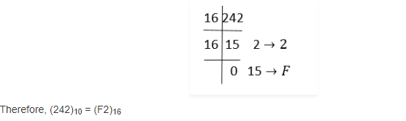
Decimal to Hexadecimal
Divide 242 by 16 and repeat the steps, till the quotient is left as 0.

Slide 33
Hexadecimal to decimal
Example 1: What is 5C6 (Hexadecimal)?
Solution: Step 1: The “5 “ is the “16 x 16” position, so that means 5 x16 x16
Step 2: The ‘C’ (12) is in the “16” position, so that means 12 x 16.
Step 3: The “6” in the “1” position so that means 6.
Answer is : 5C6 = 5 x 16 x 16 + 12 x 16 +6 = (1478 ) in Decimal.

Slide 34
Example 2: What is 3C5 (Hexadecimal)?
Solution: Step 1: The “3 “ is the “16 x 16” position, so that means 3 x16 x16
Step 2: The ‘C’ (12) is in the “16” position, so that means 12 x 16.
Step 3: The “5” is in the “1” position so that means 5.
Answer is : 3C5 = 3 x 16 x 16 + 12 x 16 + 5 = (965) in Decimal.

Slide 35
Example 3: What is 7B5 (Hexadecimal)?
Solution: Step 1: The “7 “ is the “16 x 16” position, so that means 7 x16 x16
Step 2: The ‘B’ (11) is in the “11” position, so that means 11 x 16.
Step 3: The 5” in the “1” position so that means 5.
Answer is : 7B5 = 7 x 16 x 16 + 11 x 16 +5 = (1973) in Decimal.

Slide 36
Representation of Binary Numbers in Memory

Slide 37
Nibble
4 bits form a Nibble
  “1101” is One Nibble of Information
Nibble Values:
  0000
  1111
As a result, binary numbers are mostly written as a full Nibble (0001)
3
2
1
0
1
1
0
1
= 13
2
3
2
2
2
1
2
0
3
2
1
0
0
0
0
0
= 0
2
3
2
2
2
1
2
0
3
2
1
0
1
1
1
1
= 15
2
3
2
2
2
1
2
0

Slide 38
Bytes -> char in C++
8 bits form a single byte
  “10011101” is One Byte of Information
Byte Values:
  00000000
  11111111
As a result, binary numbers are mostly written as a full byte (00000001)
7
6
5
4
3
2
1
0
1
0
0
1
1
1
0
1
= 157
2
7
2
6
2
5
2
4
2
3
2
2
2
1
2
0
7
6
5
4
3
2
1
0
0
0
0
0
0
0
0
0
= 0
2
7
2
6
2
5
2
4
2
3
2
2
2
1
2
0
7
6
5
4
3
2
1
0
= 255
1
1
1
1
1
1
1
1
2
7
2
6
2
5
2
4
2
3
2
2
2
1
2
0

Slide 39
2 Bytes -> Short in C++
16 bits form a 2 bytes
  “0001110110011101” is Two Bytes of Information
2 Bytes Value:
  0000000000000000
  1111111111111111
15
14
13
12
11
10
9
8
7
6
5
4
3
2
1
0
0
0
0
1
1
1
0
1
1
0
0
1
1
1
0
1
= 7,581
2
15
2
14
2
13
2
12
2
11
2
10
2
9
2
8
2
7
2
6
2
5
2
4
2
3
2
2
2
1
2
0
15
14
13
12
11
10
9
8
7
6
5
4
3
2
1
0
0
0
0
0
0
0
0
0
0
0
0
0
0
0
0
0
= 0
2
15
2
14
2
13
2
12
2
11
2
10
2
9
2
8
2
7
2
6
2
5
2
4
2
3
2
2
2
1
2
0
15
14
13
12
11
10
9
8
7
6
5
4
3
2
1
0
1
1
1
1
1
1
1
1
1
1
1
1
1
1
1
1
= 65,535
2
15
2
14
2
13
2
12
2
11
2
10
2
9
2
8
2
7
2
6
2
5
2
4
2
3
2
2
2
1
2
0

Slide 40
3 Bytes
24 bits form 3 bytes
  “000000000001110110011101” is Three Byte of Information
3 Byte Values:
  000000000000000000000000
  111111111111111111111111
23
22
.
.
.
.
.
8
7
6
5
4
3
2
1
0
0
0
0
1
1
1
0
1
1
0
0
1
1
1
0
1
= 7,581
2
23
2
22
2
.
2
.
2
.
2
.
2
.
2
8
2
7
2
6
2
5
2
4
2
3
2
2
2
1
2
0
23
22
.
.
.
.
.
8
7
6
5
4
3
2
1
0
0
0
0
0
0
0
0
0
0
0
0
0
0
0
0
0
= 0
2
23
2
22
2
.
2
.
2
.
2
.
2
.
2
8
2
7
2
6
2
5
2
4
2
3
2
2
2
1
2
0
23
22
.
.
.
.
.
8
7
6
5
4
3
2
1
0
1
1
1
1
1
1
1
1
1
1
1
1
1
1
1
1
= 16,777,216
2
23
2
22
2
.
2
.
2
.
2
.
2
.
2
8
2
7
2
6
2
5
2
4
2
3
2
2
2
1
2
0

Slide 41
4 Bytes -> int and long in C++
32 bits form 4 bytes
  “000000000001110110011101” is Four Byte of Information
4 Byte Values:
  00000000000000000000000000000000
  11111111111111111111111111111111
31
30
.
.
.
.
.
8
7
6
5
4
3
2
1
0
0
0
0
1
1
1
0
1
1
0
0
1
1
1
0
1
= 7,581
2
31
2
30
2
.
2
.
2
.
2
.
2
.
2
8
2
7
2
6
2
5
2
4
2
3
2
2
2
1
2
0
31
30
.
.
.
.
.
8
7
6
5
4
3
2
1
0
0
0
0
0
0
0
0
0
0
0
0
0
0
0
0
0
= 0
2
31
2
30
2
.
2
.
2
.
2
.
2
.
2
8
2
7
2
6
2
5
2
4
2
3
2
2
2
1
2
0
31
30
.
.
.
.
.
8
7
6
5
4
3
2
1
0
4,294,967,296
1
1
1
1
1
1
1
1
1
1
1
1
1
1
1
1
2
31
2
30
2
.
2
.
2
.
2
.
2
.
2
8
2
7
2
6
2
5
2
4
2
3
2
2
2
1
2
0

Slide 42
8 Bytes -> Double in C++
64 bits form 8 bytes
  “00000……….0000001110110011101” is 8 Byte of Information
4 Byte Values:
  000000000000000…………00000000000000000
  11111111111111…………111111111111111111
31
30
.
.
.
.
.
8
7
6
5
4
3
2
1
0
0
0
0
1
1
1
0
1
1
0
0
1
1
1
0
1
= 7,581
2
31
2
30
2
.
2
.
2
.
2
.
2
.
2
8
2
7
2
6
2
5
2
4
2
3
2
2
2
1
2
0
63
62
.
.
.
.
.
8
7
6
5
4
3
2
1
0
0
0
0
0
0
0
0
0
0
0
0
0
0
0
0
0
= 0
2
63
2
62
2
.
2
.
2
.
2
.
2
.
2
8
2
7
2
6
2
5
2
4
2
3
2
2
2
1
2
0
63
62
.
.
.
.
.
8
7
6
5
4
3
2
1
0
1
1
1
1
1
1
1
1
1
1
1
1
1
1
1
1
= 18,446,744,073,709,551,616
2
63
2
62
2
.
2
.
2
.
2
.
2
.
2
8
2
7
2
6
2
5
2
4
2
3
2
2
2
1
2
0

Slide 43
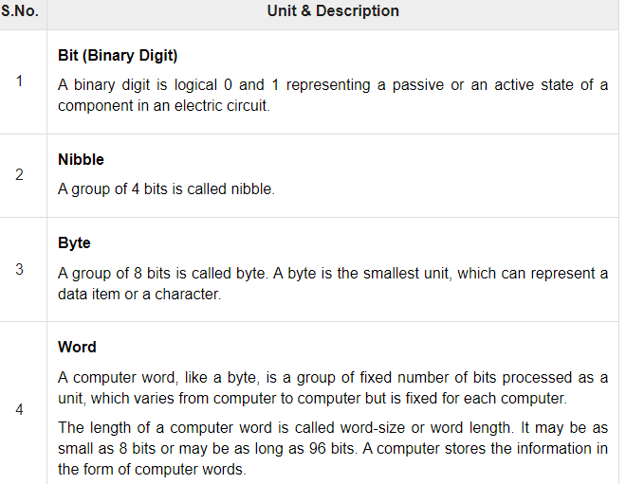

Slide 44
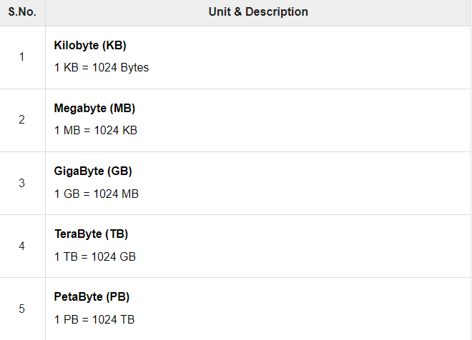

Slide 45
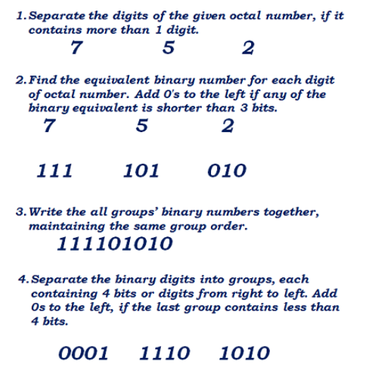
Octal to Hexadecimal
Convert octal number (7 5 2)₈ to its equivalent hexadecimal.

Slide 46
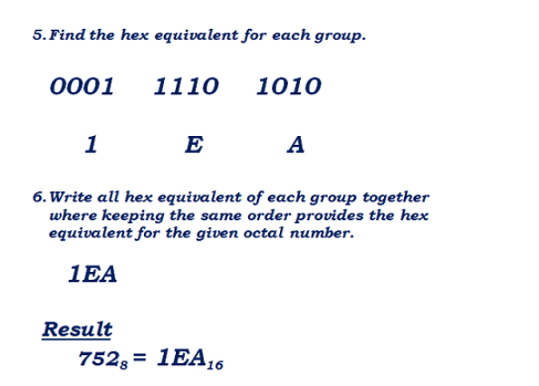

Slide 47
Octal to Hexadecimal
Octal Binary Hexadecimal
Convert (56)₈ into hexadecimal
Step 1 : Convert (56)₈ into Binary
In order to convert the octal number into binary, we need to express every octal value using 3 binary bits.
Binary equivalent of 5 is (101)₂.
Binary equivalent of 6 is (110)₂.
= (56)₈
= (101)(110)
= (101110)₂
Step 2 : Convert (101110)₂ into Hexadecimal
In order to convert the binary number into hexadecimal, we need to group every 4 binary bits and calculate the value[From left to right].

Slide 48
(101110)₂ in hexadecimal
= (101110)₂
= (10)(1110)
= (2)(14)
= (2E)₁₆

Slide 49
More examples
Convert 536 from octal to hexadecimal number
Hexadecimal number of 536 is 15E.
Convert 567 from octal to hexadecimal number
Hexadecimal number of 567 is 177.
Convert 4321 from octal to hexadecimal number
Hexadecimal number of 4321 is 8D1.

Slide 50
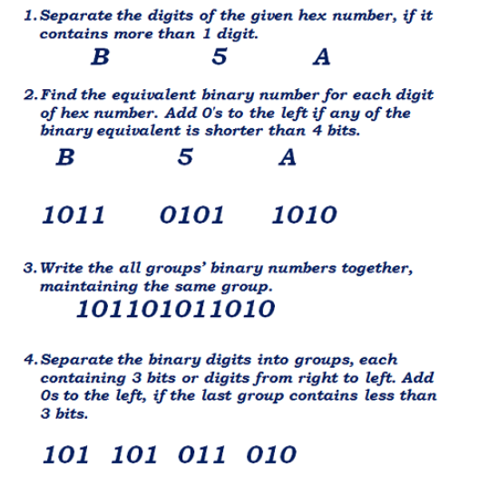
Hexadecimal to Octal
Convert the Hexadecimal (B 5 A)₁₆ to its octal equivalent.

Slide 51
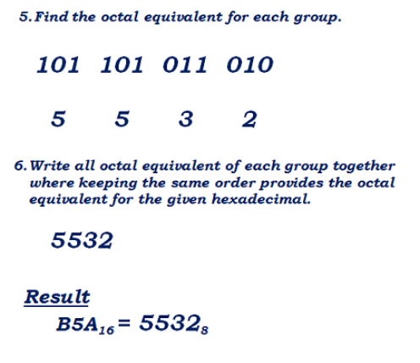

Slide 52
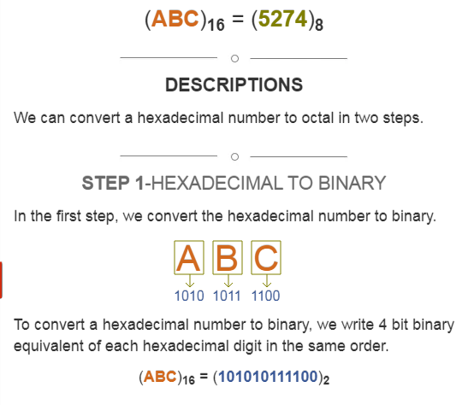
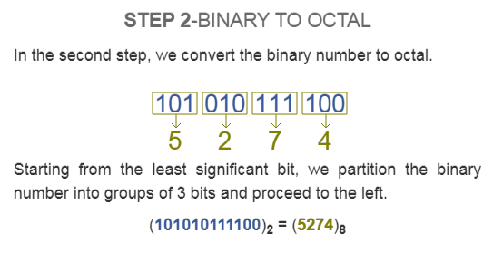
Hexadecimal to octal examples
Convert (ABC)16 into Octal.

Slide 53
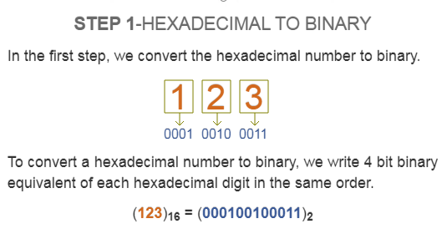
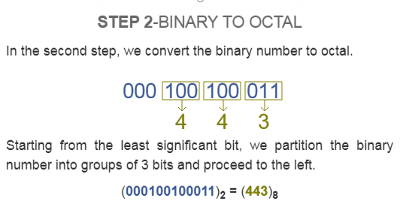
Another Example
Convert (123)16 into Octal.

Slide 54
QUESTIONS??

