Slide 1
Perception
The process by which you filter and interpret what your senses tell you so that you can then create a meaningful picture of the world. People will often view the same thing or event differently.

Slide 2

Perception
Why do people agree or disagree?
What affect does perception have in life?

Slide 3
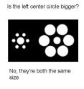
How Does it Work
1. Something affects your senses:
Sight
Sound
Taste
Smell
Touch

Slide 4

Decoding the Message
You interpret (decode) the sensation
You assign meaning to what your senses take in and put meaning to
What do your eyes see?

Slide 5
Differences
Why do people not have the same perception of the same thing, event or person?
WE ARE ALL DIFFERENT and therefore WE LIVE DIFFEENT EXPERIENCES WHICH SHAPE OUR LIFE

Slide 6
Differences
1. Physical differences
2. Past experiences and backgrounds
3. Present feelings and circumstances
4. Differences in using information
5. Differences in expectation

Slide 7


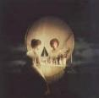
Perception Pictures

