Slide 1

Virtual Memory
Instructor Name: Ms. Laraib Razzaq
Department of Computer Science, IQRA University Islamabad – H9 Campus - Pakistan

Slide 2
Virtual Memory
Background
Demand Paging
Copy-on-Write

Slide 3
Background
Code needs to be in memory to execute, but entire program rarely used
Error code, unusual routines, large data structures
Entire program code not needed at same time
Consider ability to execute partially-loaded program
Program no longer constrained by limits of physical memory
Each program takes less memory while running -> more programs run at the same time
Increased CPU utilization and throughput with no increase in response time or turnaround time
Less I/O needed to load or swap programs into memory -> each user program runs faster

Slide 4
Background (Cont.)
Virtual memory – separation of user logical memory from physical memory
Only part of the program needs to be in memory for execution
Logical address space can therefore be much larger than physical address space
Allows address spaces to be shared by several processes
Allows for more efficient process creation
More programs running concurrently
Less I/O needed to load or swap processes

Slide 5
Background (Cont.)
Virtual address space – logical view of how process is stored in memory
Usually start at address 0, contiguous addresses until end of space
Meanwhile, physical memory organized in page frames
MMU must map logical to physical
Virtual memory can be implemented via:
Demand paging
Demand segmentation

Slide 6
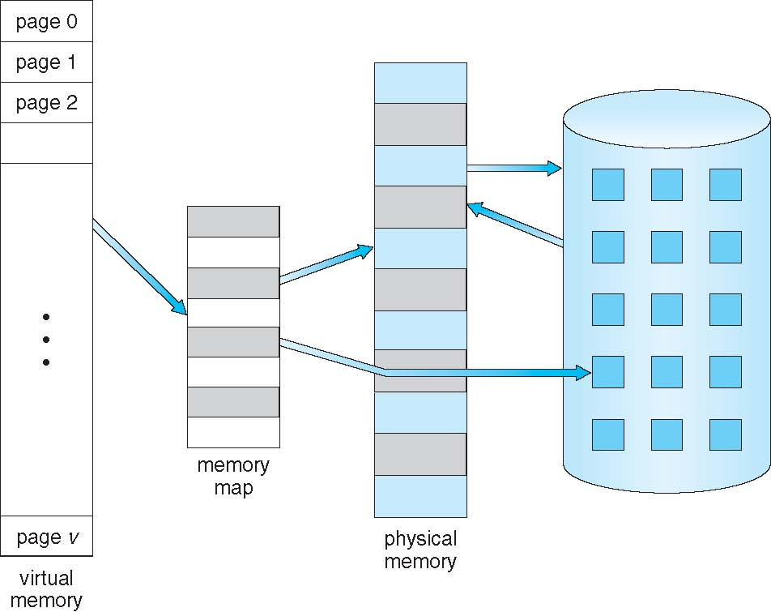
Virtual Memory That is Larger Than Physical Memory

Slide 7
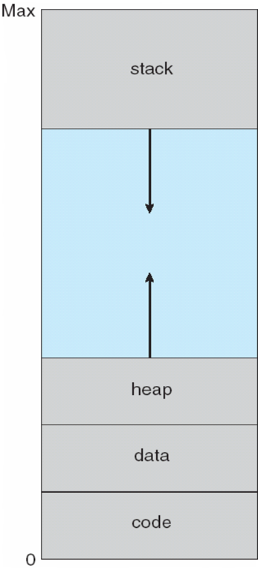
Virtual-address Space
Usually design logical address space for stack to start at Max logical address and grow “down” while heap grows “up”
Maximizes address space use
Unused address space between the two is hole
No physical memory needed until heap or stack grows to a given new page
Enables sparse address spaces with holes left for growth, dynamically linked libraries, etc
System libraries shared via mapping into virtual address space
Shared memory by mapping pages read-write into virtual address space
Pages can be shared during fork(), speeding process creation

Slide 8
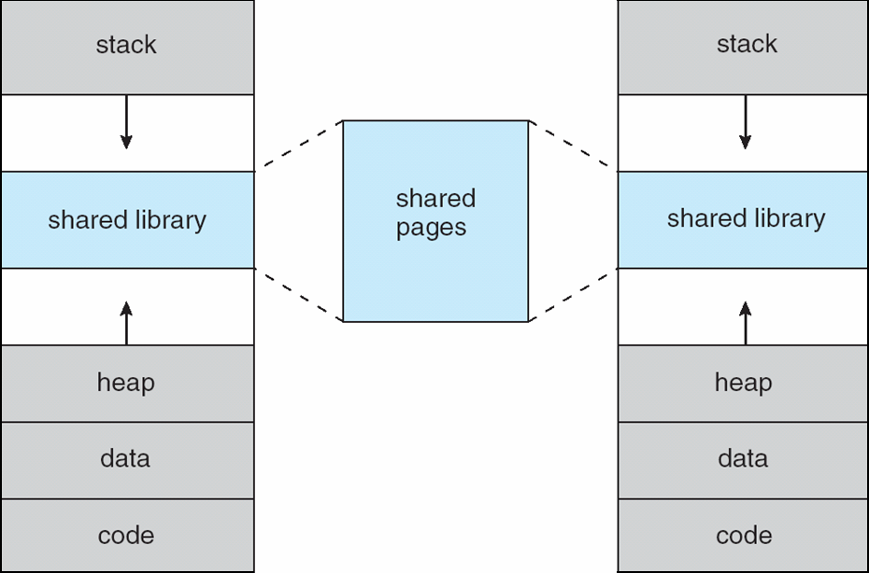
Shared Library Using Virtual Memory

Slide 9
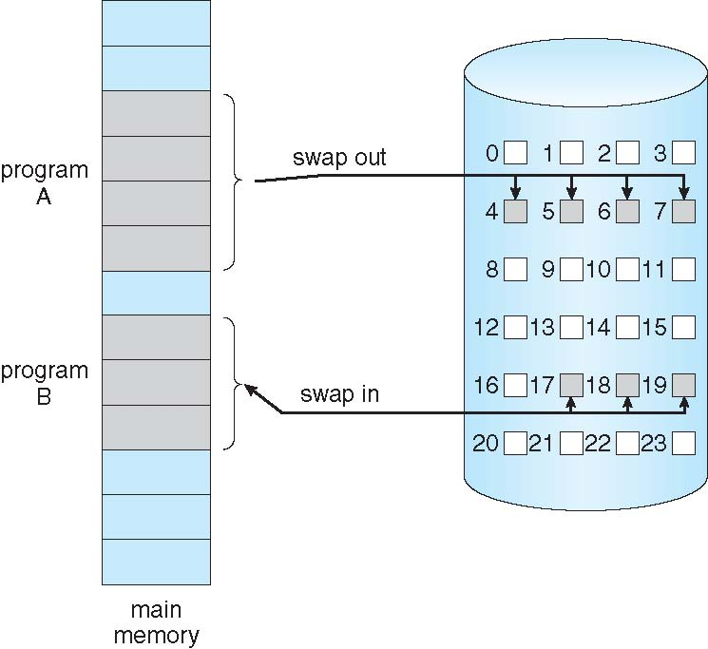
Demand Paging
Could bring entire process into memory at load time
Or bring a page into memory only when it is needed
Less I/O needed, no unnecessary I/O
Less memory needed
Faster response
More users
Similar to paging system with swapping (diagram on right)
Page is needed ⇒ reference to it
invalid reference ⇒ abort
not-in-memory ⇒ bring to memory
Lazy swapper – never swaps a page into memory unless page will be needed
Swapper that deals with pages is a pager

Slide 10
Basic Concepts
With swapping, pager guesses which pages will be used before swapping out again
Instead, pager brings in only those pages into memory
How to determine that set of pages?
Need new MMU functionality to implement demand paging
If pages needed are already memory resident
No difference from non demand-paging
If page needed and not memory resident
Need to detect and load the page into memory from storage
Without changing program behavior
Without programmer needing to change code

Slide 11
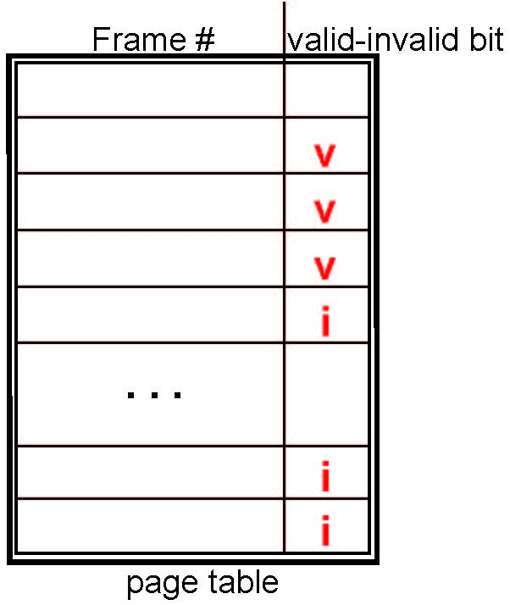
Valid-Invalid Bit
With each page table entry a valid–invalid bit is associated (v ⇒ in-memory – memory resident, i ⇒ not-in-memory)
Initially valid–invalid bit is set to i on all entries
Example of a page table snapshot:
During MMU address translation, if valid–invalid bit in page table entry is i ⇒ page fault

Slide 12
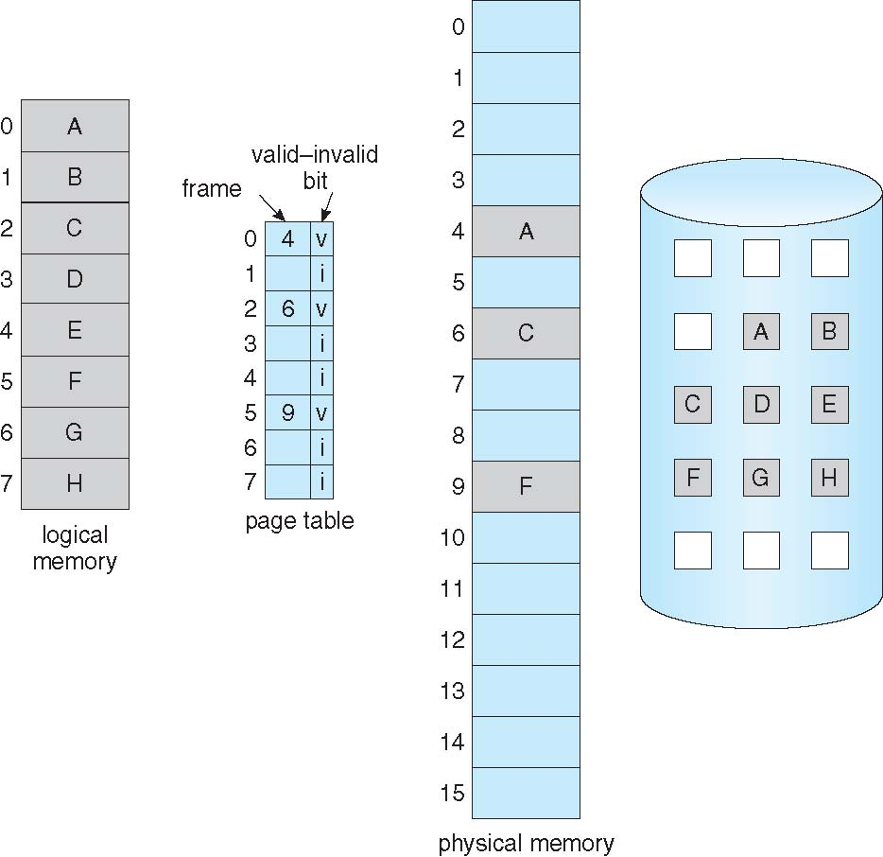
Page Table When Some Pages Are Not in Main Memory

Slide 13
Page Fault
If there is a reference to a page, first reference to that page will trap to operating system:
page fault
Operating system looks at another table to decide:
Invalid reference ⇒ abort
Just not in memory
Find free frame
Swap page into frame via scheduled disk operation
Reset tables to indicate page now in memory Set validation bit = v
Restart the instruction that caused the page fault

Slide 14
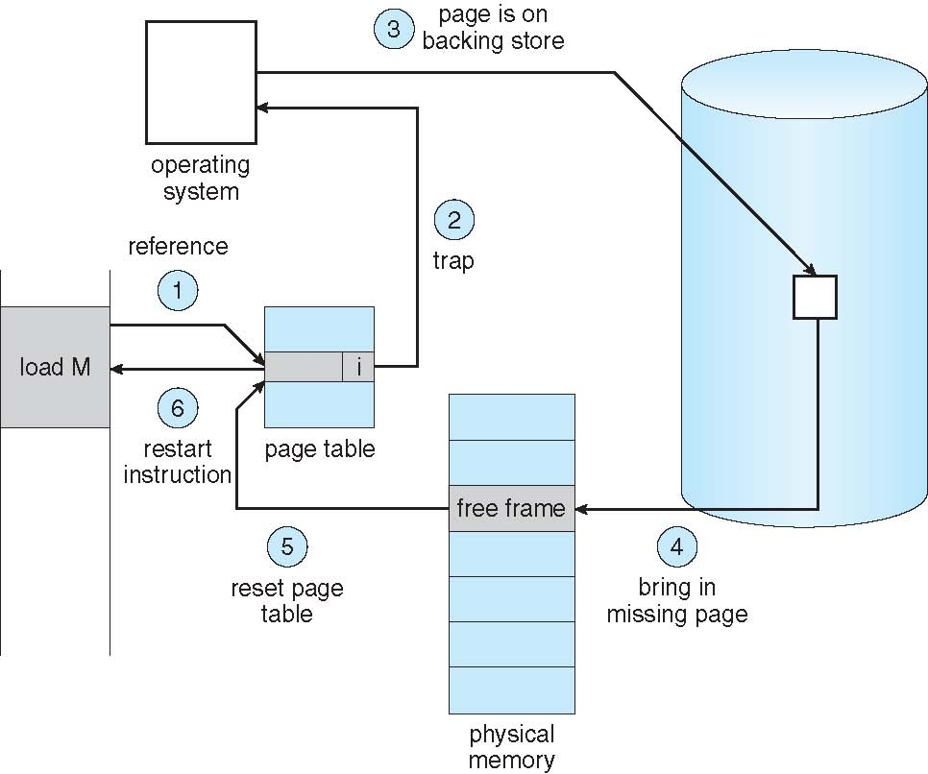
Steps in Handling a Page Fault

Slide 15
Aspects of Demand Paging
Extreme case – start process with no pages in memory
OS sets instruction pointer to first instruction of process, non-memory-resident -> page fault
And for every other process pages on first access
Pure demand paging
Actually, a given instruction could access multiple pages -> multiple page faults
Consider fetch and decode of instruction which adds 2 numbers from memory and stores result back to memory
Pain decreased because of locality of reference
Hardware support needed for demand paging
Page table with valid / invalid bit
Secondary memory (swap device with swap space)
Instruction restart

Slide 16
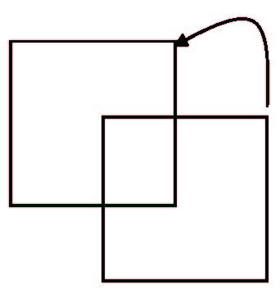
Instruction Restart
Consider an instruction that could access several different locations
block move
auto increment/decrement location
Restart the whole operation?
What if source and destination overlap?

Slide 17
Performance of Demand Paging
Stages in Demand Paging (worse case)
Trap to the operating system
Save the user registers and process state
Determine that the interrupt was a page fault
Check that the page reference was legal and determine the location of the page on the disk
Issue a read from the disk to a free frame:
Wait in a queue for this device until the read request is serviced
Wait for the device seek and/or latency time
Begin the transfer of the page to a free frame
While waiting, allocate the CPU to some other user
Receive an interrupt from the disk I/O subsystem (I/O completed)
Save the registers and process state for the other user
Determine that the interrupt was from the disk
Correct the page table and other tables to show page is now in memory
Wait for the CPU to be allocated to this process again
Restore the user registers, process state, and new page table, and then resume the interrupted instruction

Slide 18
Performance of Demand Paging (Cont.)
Three major activities
Service the interrupt – careful coding means just several hundred instructions needed
Read the page – lots of time
Restart the process – again just a small amount of time
Page Fault Rate 0 ≤ p ≤ 1
if p = 0 no page faults
if p = 1, every reference is a fault
Effective Access Time (EAT)
EAT = (1 – p) x memory access
+ p (page fault overhead
+ swap page out
+ swap page in )

Slide 19
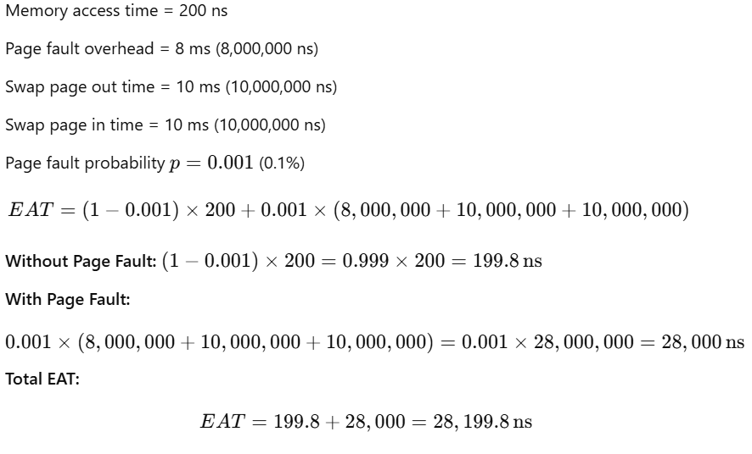
Performance of Demand Paging (Cont.)

Slide 20
Demand Paging Optimizations
Swap space I/O faster than file system I/O even if on the same device
Swap allocated in larger chunks, less management needed than file system
Copy entire process image to swap space at process load time
Then page in and out of swap space
Demand page in from program binary on disk, but discard rather than paging out when freeing frame
Used in Solaris
Still need to write to swap space
Pages not associated with a file (like stack and heap) – anonymous memory
Pages modified in memory but not yet written back to the file system

Slide 21
Copy-on-Write
Copy-on-Write (COW) allows both parent and child processes to initially share the same pages in memory
If either process modifies a shared page, only then is the page copied
COW allows more efficient process creation as only modified pages are copied
In general, free pages are allocated from a pool of zero-fill-on-demand pages
Pool should always have free frames for fast demand page execution
Don’t want to have to free a frame as well as other processing on page fault

Slide 22
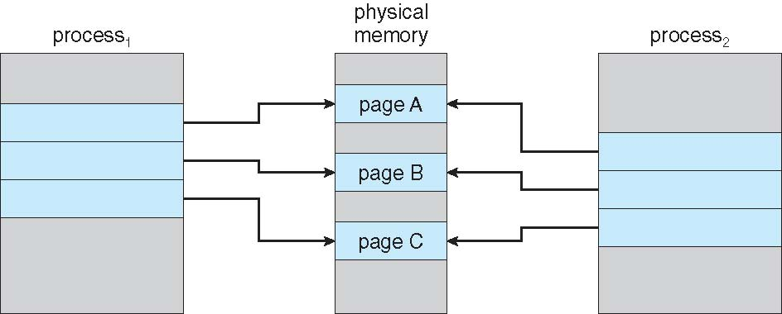
Before Process 1 Modifies Page C

Slide 23
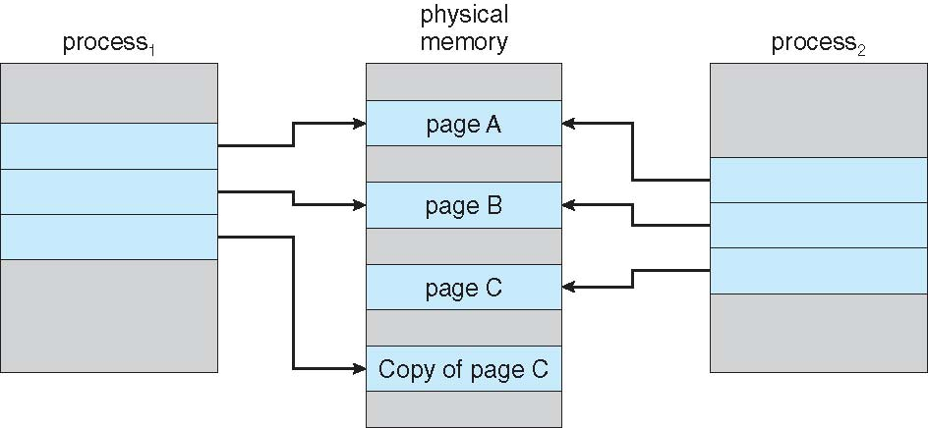
After Process 1 Modifies Page C

Slide 24
What Happens if There is no Free Frame?
Used up by process pages
Also in demand from the kernel, I/O buffers, etc
How much to allocate to each?
Page replacement – find some page in memory, but not really in use, page it out
Algorithm – terminate? swap out? replace the page?
Performance – want an algorithm which will result in minimum number of page faults
Same page may be brought into memory several times

Slide 25
Thank You

