Slide 1

Thread Scheduling& Synchronization
Instructor Name: Ms. Laraib Razzaq
Department of Computer Science, IQRA University Islamabad – H9 Campus - Pakistan

Slide 2

Contents
Critical Section
Synchronization hardware
synchronization Problems

Slide 3
Process Synchronization
Process Synchronization is the coordination of execution of multiple processes in a multi-process system to ensure that they access shared resources in a controlled and predictable manner.
It aims to resolve the problem of race conditions and other synchronization issues in a concurrent system.
The main objective of process synchronization is to ensure that multiple processes access shared resources without interfering with each other and to prevent the possibility of inconsistent data due to concurrent access.

Slide 4
Critical Section
Consider a system consisting of n processes {P0, P1, ..., Pn−1}.
Each process has a segment of code, called a critical section, in which the process may be accessing — and updating — data that is shared with at least one other process.

Slide 5
Critical Section
The important feature of the system is that, when one process is executing in its critical section, no other process is allowed to execute in its critical section.
That is, no two processes are executing in their critical sections at the same time.

Slide 6
Critical Section
The critical-section problem is to design a protocol that the processes can use to synchronize their activity so as to cooperatively share data.
Each process must request permission to enter its critical section.

Slide 7
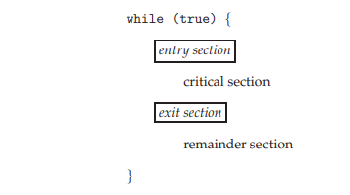
Structure of a Process

Slide 8
Structure of a Process
The section of code implementing this request is the entry section.
The critical section may be followed by an exit section. The remaining code is the remainder section.

Slide 9
Requirements of a solution to the Critical Section problem
A solution to the critical-section problem must satisfy the following three requirements:
Mutual Exclusion
Progress
Bounded Wait

Slide 10
Mutual Exclusion
If process Pi is executing in its critical section, then no other processes can be executing in their critical sections.
Mutual exclusion methods are used in concurrent programming to avoid the simultaneous use of a common resource, such as a global variable, by pieces of computer code called critical sections.

Slide 11
Mutual Exclusion
The requirement of mutual exclusion is that when process P1 is accessing a shared resource R1, another process should not be able to access resource R1 until process P1 has finished its operation with resource R1.
Examples of such resources include files, I/O devices such as printers, and shared data structures.

Slide 12
Progress
If no process is executing in its critical section and some processes wish to enter their critical sections, then only those processes that are not executing in their remainder sections can participate in deciding which will enter its critical section next, and this selection cannot be postponed indefinitely.

Slide 13
Bounded Waiting
There exists a bound, or limit, on the number of times that other processes are allowed to enter their critical sections after a process has made a request to enter its critical section and before that request is granted.

Slide 14
Synchronization Hardware
There are a software as well as hardware solutions to this problem.
There are three algorithms in the hardware approach of solving Process Synchronization problem:
Unlock and Lock
Test and Set
Swap

Slide 15
1. Lock Variable Synchronization
A lock variable provides the simplest synchronization mechanism for processes. Some noteworthy points regarding Lock Variables are-
Its a software mechanism implemented in user mode, i.e. no support required from the Operating System.
Its a busy waiting solution (keeps the CPU busy even when its technically waiting).
It can be used for more than two processes.
When Lock = 0 implies critical section is vacant (initial value ) and Lock = 1 implies critical section occupied.

Slide 16
1. Lock Variable Synchronization
Entry section –
while(lock != 0);
Lock = 1;
//critical section
Exit section –
Lock = 0;

Slide 17
2. Test and Set
The shared variable is lock which is initialized to false. TestAndSet(lock) algorithm works in this way – it always returns whatever value is sent to it and sets lock to true.
The first process will enter the critical section at once as TestAndSet(lock) will return false and it’ll break out of the while loop.
The other processes cannot enter now as lock is set to true and so the while loop continues to be true.

Slide 18
2. Test and Set
Mutual exclusion is ensured. Once the first process gets out of the critical section, lock is changed to false.
So, now the other processes can enter one by one. Progress is also ensured.
However, after the first process, any process can go in.
There is no queue maintained, so any new process that finds the lock to be false again can enter.

Slide 19
2. Test and Set
boolean lock; boolean TestAndSet (boolean &target){ boolean rv = target; target = true; return rv; } while(1){ while (TestAndSet(lock)); critical section lock = false; remainder section }

Slide 20
3. Swap
Swap algorithm is a lot like the TestAndSet algorithm. Instead of directly setting lock to true in the swap function, key is set to true and then swapped with lock.
First process will be executed, and in while(key), since key=true , swap will take place and hence lock=true and key=false.
Again next iteration takes place while(key) but key=false , so while loop breaks and first process will enter in critical section.

Slide 21
3. Swap
Now another process will try to enter in Critical section, so again key=true and hence while(key) loop will run and swap takes place so, lock=true and key=true (since lock=true in first process).
Again on next iteration while(key) is true so this will keep on executing and another process will not be able to enter in critical section.

Slide 22
3. Swap
Therefore Mutual exclusion is ensured.
Again, out of the critical section, lock is changed to false, so any process finding it gets t enter the critical section.
Progress is ensured. However, again bounded waiting is not ensured for the very same reason.

Slide 23
3. Swap
boolean lock; Individual key; void swap(boolean &a, boolean &b){ boolean temp = a; a = b; b = temp; } while (1){ key = true; while(key) swap(lock,key); critical section
lock = false; remainder section }

Slide 24
synchronization Problems
The following problems of synchronization are considered as classical problems:
1. Producer-Consumer Problem, 2. Dining-Philosophers Problem, 3. Readers and Writers Problem, 4. Sleeping Barber Problem

Slide 25
Bounded-Buffer (or Producer-Consumer) Problem
The Bounded Buffer problem is also called the producer-consumer problem. This problem is generalized in terms of the Producer-Consumer problem.
The solution to this problem is, to create two counting semaphores “full” and “empty” to keep track of the current number of full and empty buffers respectively.
Producers produce a product and consumers consume the product, but both use of one of the containers each time.

Slide 26
Dining-Philosophers Problem
The Dining Philosopher Problem states that K philosophers seated around a circular table with one chopstick between each pair of philosophers.
There is one chopstick between each philosopher. A philosopher may eat if he can pickup the two chopsticks adjacent to him.
One chopstick may be picked up by any one of its adjacent followers but not both.
This problem involves the allocation of limited resources to a group of processes in a deadlock-free and starvation-free manner.

Slide 27
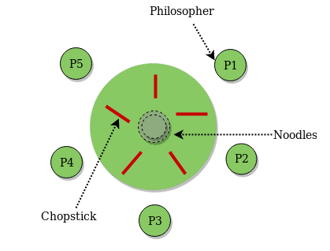
Dining-Philosophers Problem

Slide 28
Readers-Writers Problem
Suppose that a database is to be shared among several concurrent processes.
Some of these processes may want only to read the database, whereas others may want to update (that is, to read and write) the database.
We distinguish between these two types of processes by referring to the former as readers and to the latter as writers.

Slide 29
Readers-Writers Problem
Problem parameters:
One set of data is shared among a number of processes.
Once a writer is ready, it performs its write. Only one writer may write at a time.
If a process is writing, no other process can read it.
If at least one reader is reading, no other process can write.
Readers may not write and only read.

Slide 30
Sleeping Barber Problem
Barber shop with one barber, one barber chair and N chairs to wait in.
When no customers the barber goes to sleep in barber chair and must be woken when a customer comes in.
When barber is cutting hair new customers take empty seats to wait, or leave if no vacancy. This is basically the Sleeping Barber Problem.

Slide 31
Sleeping Barber Problem
Barber shop with one barber, one barber chair and N chairs to wait in.
When no customers the barber goes to sleep in barber chair and must be woken when a customer comes in.
When barber is cutting hair new customers take empty seats to wait, or leave if no vacancy. This is basically the Sleeping Barber Problem.

Slide 32
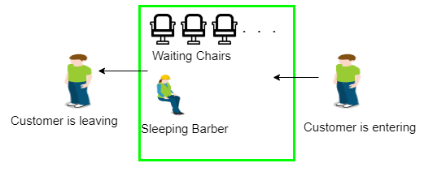
Sleeping Barber Problem

Slide 33
References
Operating System Concept | 10th | Abraham Silberschatz | Wiley | 2013 | 978-1-119-32091-3

Slide 34
THANK YOU

