Slide 1

Synchronization & Deadlocks
Instructor Name: Ms. Laraib Razzaq
Department of Computer Science, IQRA University Islamabad – H9 Campus - Pakistan

Slide 2

Contents
Semaphores
Monitors
Deadlocks
Detecting and recovering from deadlocks

Slide 3
Semaphore
A semaphore is a variable (non –ive integer) that,
Controlling access by multiple processes to a common resource in a parallel programming environment.
A useful way to think of a semaphore is as a record of how many units of a particular resource are available (without race conditions) adjust that record as units are required or become free, and if necessary wait until a unit of the resource becomes available.

Slide 4
Semaphore
Semaphores are a useful tool in the prevention of race conditions.
Semaphores which allow an arbitrary resource count are called counting semaphores, while semaphores which are restricted to the values 0 and 1 (or locked/unlocked, unavailable/available) are called binary semaphores.
Semaphores could be thought of as an all-purpose lock. When a thread needs to enter the critical area, semaphores keep track of a counter and decrease it. The running thread becomes immobilized if the counter decreases

Slide 5
Semaphore Example
Suppose a library has 10 identical study rooms, intended to be used by one student at a time.
To prevent disputes, students must request a room from the front counter if they wish to make use of a study room.
When a student has finished using a room, the student must return to the counter and indicate that one room has become free.
If no rooms are free, students wait at the counter until someone free a room.

Slide 6
Semaphore Example
The clerk at the front desk does not keep track of which room is occupied, only the number of free rooms available.
When a student requests a room, the clerk decreases this number, if available.
When a student releases a room, the clerk increases this number.
Once access to a room is granted, the room can be used for as long as desired, and so it is not possible to book rooms ahead of time

Slide 7
Semaphore Example
In this scenario the front desk represents a semaphore, the rooms are the resources, and the students represent processes.
The value of the semaphore in this scenario is initially 10 (assume).
When a student requests a room he or she is granted access and the value of the semaphore is changed to 9. After the next student comes, it drops to 8, then 7 and so on.
If someone requests a room and the resulting value of the semaphore is negative, they are forced to wait.

Slide 8
Semaphore Example
When multiple people are waiting, they will either wait in a queue, or use Round-robin scheduling and race back to the counter when someone releases a room.
Semaphore operations are commonly implemented in the nucleus of the OS where process state switching is controlled.

Slide 9
Semaphore Implementation
One important property of the semaphore variables is that its value cannot be changed except by using the wait() and signal() functions.
Counting semaphores are equipped with two operations,
V → signal() and
P → wait()
Operation V increments the semaphore S, and,
Operation P decrements it(S).
The operations are atomic(The process is either executed completely, or not at all; ).

Slide 10
Semaphore Implementation
The value of the semaphore S is the number of units of the resource that are currently available.
The P(S) operates as follows,
if S > 0
then S → S – 1
else
wait on S
V (S) operates as follows,
if (one or more processes are waiting on S)
then (let of the these processes proceed)
else
S → S+1

Slide 11
Types of Semaphores
There are two main types of semaphores :
Counting semaphores
Binary semaphores.

Slide 12
Binary Semaphore
These are integer value semaphores and have an unrestricted value domain.
These semaphores are used to coordinate the resource access, where the semaphore count is the number of available resources.
If the resources are added, semaphore count automatically incremented and if the resources are removed, the count is decremented.

Slide 13
Binary Semaphore
P(Semaphore S)
{
while(S==0);
S=S-1;
}
V(Semaphore S)
{
S=S+1;
}
Workflow
P(S)
CS
V(S)
RS

Slide 14
Counting Semaphore
The binary semaphores are like counting semaphores but their value is restricted to 0 and 1.
The wait operation only works when the semaphore is 1 and the signal operation succeeds when semaphore is 0.
It is sometimes easier to implement binary semaphores than counting semaphores.

Slide 15
Monitors
Monitors are a higher-level synchronization construct that simplifies process synchronization by providing a high-level abstraction for data access and synchronization.
Monitors are implemented as programming language constructs, typically in object-oriented languages, and provide mutual exclusion, condition variables, and data encapsulation in a single construct.

Slide 16
Monitors
A monitor is essentially a module that encapsulates a shared resource and provides access to that resource through a set of procedures.
The procedures provided by a monitor ensure that only one process can access the shared resource at any given time, and that processes waiting for the resource are suspended until it becomes available.

Slide 17
Monitors
Monitors are used to simplify the implementation of concurrent programs by providing a higher-level abstraction that hides the details of synchronization.
Monitors provide a structured way of sharing data and synchronization information, and eliminate the need for complex synchronization primitives such as semaphores and locks.

Slide 18
Monitors
The key advantage of using monitors for process synchronization is that they provide a simple, high-level abstraction that can be used to implement complex concurrent systems.
Monitors also ensure that synchronization is encapsulated within the module, making it easier to reason about the correctness of the system.

Slide 19
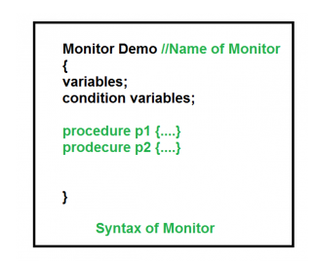
Monitors

Slide 20
Deadlocks
Deadlock is a situation in computing where two or more processes are unable to proceed because each is waiting for the other to release resources.
Key concepts include mutual exclusion, resource holding, circular wait, and no preemption.
Consider an example when two trains are coming toward each other on the same track and there is only one track, none of the trains can move once they are in front of each other. This is a practical example of deadlock.

Slide 21
How Does Deadlock occur in the Operating System?
Before going into detail about how deadlock occurs in the Operating System, let’s first discuss how the Operating System uses the resources present. A process in an operating system uses resources in the following way.
Requests a resource
Use the resource
Releases the resource

Slide 22
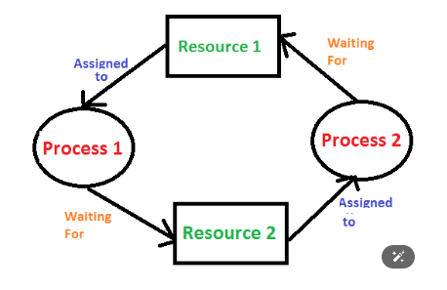
How Does Deadlock occur in the Operating System?

Slide 23
Examples of Deadlock
There are several examples of deadlock. Some of them are mentioned below.
The system has 2 tape drives. P0 and P1 each hold one tape drive and each needs another one.
Semaphores A and B, initialized to 1, P0, and P1 are in deadlock as follows:
P0 executes wait(A) and preempts.
P1 executes wait(B).
Now P0 and P1 enter in deadlock.
Assume the space is available for allocation of 200K bytes, and the following sequence of events occurs.

Slide 24
Necessary Conditions for Deadlock in OS
Deadlock can arise if the following four conditions hold simultaneously (Necessary Conditions)
Mutual Exclusion: Two or more resources are non-shareable (Only one process can use at a time).
Hold and Wait: A process is holding at least one resource and waiting for resources.
No Preemption: A resource cannot be taken from a process unless the process releases the resource.
Circular Wait: A set of processes waiting for each other in circular form.

Slide 25
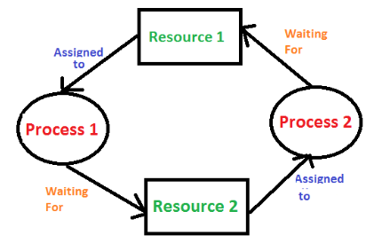
Deadlock Detection
1. If Resources Have a Single Instance
In this case for Deadlock detection, we can run an algorithm to check for the cycle in the Resource Allocation Graph. The presence of a cycle in the graph is a sufficient condition for deadlock.

Slide 26
Deadlock Detection
Wait-For Graph Algorithm
The Wait-For Graph Algorithm is a deadlock detection algorithm used to detect deadlocks in a system where resources can have multiple instances. The algorithm works by constructing a Wait-For Graph, which is a directed graph that represents the dependencies between processes and resources.

Slide 27
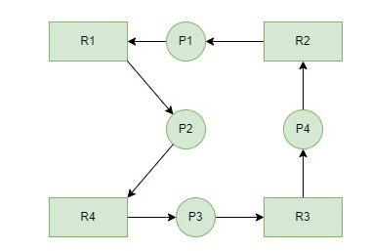
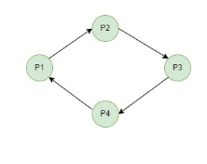
Deadlock Detection
Resource Allocation and Wait-For Graph Algorithm Example

Slide 28
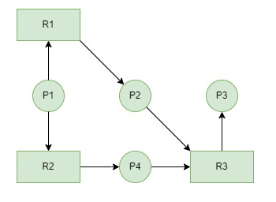
Deadlock Detection
Resource Allocation graph is available. Detect deadlock by making wait for graph.

Slide 29
Deadlock Detection
2. If There are Multiple Instances of Resources
Detection of the cycle is necessary but not a sufficient condition for deadlock detection, in this case, the system may or may not be in deadlock varies according to different situations.

Slide 30
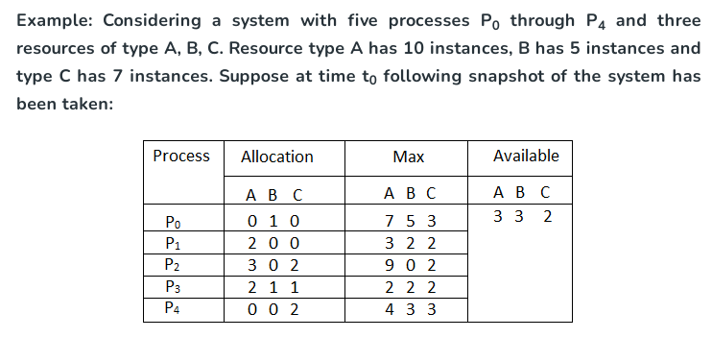
Banker’s Algorithm

Slide 31
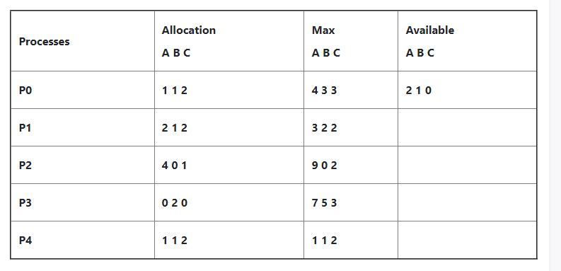
Banker’s Algorithm

Slide 32
Deadlock Recovery
There are several Deadlock Recovery Techniques:
Manual Intervention
Automatic Recovery
Process Termination
Resource Preemption

Slide 33
Deadlock Recovery
1. Manual Intervention
When a deadlock is detected, one option is to inform the operator and let them handle the situation manually.
While this approach allows for human judgment and decision-making, it can be time-consuming and may not be feasible in large-scale systems.

Slide 34
Deadlock Recovery
2. Automatic Recovery
An alternative approach is to enable the system to recover from deadlock automatically.
This method involves breaking the deadlock cycle by either aborting processes or preempting resources.

Slide 35
Deadlock Recovery
3. Process Termination
Abort all Deadlocked Processes
This approach breaks the deadlock cycle, but it comes at a significant cost. The processes that were aborted may have executed for a considerable amount of time, resulting in the loss of partial computations. These computations may need to be recomputed later.

Slide 36
Deadlock Recovery
Abort one process at a time
Instead of aborting all deadlocked processes simultaneously, this strategy involves selectively aborting one process at a time until the deadlock cycle is eliminated.
However, this incurs overhead as a deadlock-detection algorithm must be invoked after each process termination to determine if any processes are still deadlocked.
Factors for choosing the termination order:
The process’s priority
Completion time and the progress made so far
Resources consumed by the process
Resources required to complete the process
Number of processes to be terminated
Process type (interactive or batch)

Slide 37
Deadlock Recovery
4. Resource Preemption
Selecting a Victim
Resource preemption involves choosing which resources and processes should be preempted to break the deadlock. The selection order aims to minimize the overall cost of recovery. Factors considered for victim selection may include the number of resources held by a deadlocked process and the amount of time the process has consumed.

Slide 38
Deadlock Recovery
4. Resource Preemption
Rollback
If a resource is preempted from a process, the process cannot continue its normal execution as it lacks the required resource.
Rolling back the process to a safe state and restarting it is a common approach.
Determining a safe state can be challenging, leading to the use of total rollback, where the process is aborted and restarted from scratch.

Slide 39
Deadlock Recovery
4. Resource Preemption
Starvation Prevention
To prevent resource starvation, it is essential to ensure that the same process is not always chosen as a victim.
If victim selection is solely based on cost factors, one process might repeatedly lose its resources and never complete its designated task.
To address this, it is advisable to limit the number of times a process can be chosen as a victim, including the number of rollbacks in the cost factor.

Slide 40
References
Operating System Concept | 10th | Abraham Silberschatz | Wiley | 2013 | 978-1-119-32091-3

Slide 41
THANK YOU

