Slide 1

Memory Management
Instructor Name: Ms. Laraib Razzaq
Department of Computer Science, IQRA University Islamabad – H9 Campus - Pakistan

Slide 2

Contents
Background
Basic Hardware
Address Binding
Logical Versus Physical Address Space
Dynamic Loading
Dynamic Linking and Shared Libraries
Swapping

Slide 3
Background
Memory consists of a large array of bytes, each with its own address.
The CPU fetches instructions from memory according to the value of the program counter.
These instructions may cause additional loading from and storing to specific memory addresses.

Slide 4
Background cont..
A typical instruction-execution cycle, for example, first fetches an instruction from memory.
The instruction is then decoded and may cause operands to be fetched from memory.
After the instruction has been executed on the operands, results may be stored back in memory.
The memory unit sees only a stream of memory addresses; it does not know how they are generated (by the instruction counter, indexing, indirection, literal addresses, and so on) or what they are for (instructions or data).
Accordingly, we can ignore how a program generates a memory address. We are interested only in the sequence of memory addresses generated by the running program.

Slide 5
Basic Hardware
Main memory and the registers built into each processing core are the only
general-purpose storage that the CPU can access directly.
There are machine instructions that take memory addresses as arguments, but none that take disk addresses.
Therefore, any instructions in execution, and any data being used by the instructions, must be in one of these direct-access storage devices.
If the data are not in memory, they must be moved there before the CPU can operate on them.

Slide 6
Basic Hardware cont..
Registers that are built into each CPU core are generally accessible within
one cycle of the CPU clock.
Some CPU cores can decode instructions and perform simple operations on register contents at the rate of one or more operations per clock tick.
The same cannot be said of main memory, which is accessed via a transaction on the memory bus.
Completing a memory access may take many cycles of the CPU clock.
In such cases, the processor normally needs to stall, since it does not have the data required to complete the instruction that it is executing.

Slide 7
Basic Hardware cont..
This situation is intolerable because of the frequency of memory accesses.
The remedy is to add fast memory between the CPU and main memory, typically on the CPU chip for fast access.
To manage a cache built into the CPU, the hardware automatically speeds up memory access without any operating-system control.

Slide 8
Basic Hardware cont..
Not only are we concerned with the relative speed of accessing physical memory, but we also must ensure correct operation.
For proper system operation, we must protect the operating system from access by user processes, as well as protect user processes from one another.
This protection must be provided by the hardware, because the operating system doesn’t usually intervene between the CPU and its memory accesses (because of the resulting performance penalty).

Slide 9
Basic Hardware cont..
We first need to make sure that each process has a separate memory space.
Separate per-process memory space protects the processes from each other and is fundamental to having multiple processes loaded in memory for concurrent execution.
To separate memory spaces, we need the ability to determine the range of legal addresses that the process may access and to ensure that the process can access only these legal addresses.

Slide 10
Basic Hardware cont..
The base register holds the smallest legal physical memory address; the limit register specifies the size of the range.
For example, if the base register holds 300040 and the limit register is 120900, then the program can legally access all addresses from 300040 through 420939 (inclusive).

Slide 11
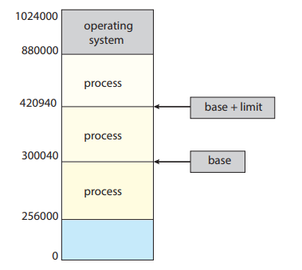
Basic Hardware cont..

Slide 12
Basic Hardware cont..
Protection of memory space is accomplished by having the CPU hardware
Compare every address generated in user mode with the registers. Any attempt by a program executing in user mode to access operating-system memory or other users’ memory results in a trap to the operating system.
This scheme prevents a user program from (accidentally or deliberately) modifying the code or data structures of either the operating system or other users.

Slide 13
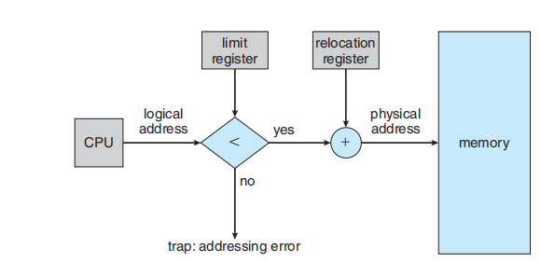
Basic Hardware cont..

Slide 14
Address Binding
Usually, a program resides on a disk as a binary executable file. To run, the program must be brought into memory and placed within the context of a process , where it becomes eligible for execution on an available CPU.
As the process executes, it accesses instructions and data from memory.
Eventually, the process terminates, and its memory is reclaimed for use by other processes.

Slide 15
Address Binding cont..
In most cases, a user program goes through several steps—some of which may be optional—before being executed.
Addresses may be represented in different ways during these steps. Addresses in the source program are generally symbolic.
A compiler typically binds these symbolic addresses to relocatable addresses (such as “14 bytes from the beginning of this module”).
The linker or loader in turn binds the relocatable addresses to absolute addresses (such as 74014). Each binding is a mapping from one address space to another.

Slide 16
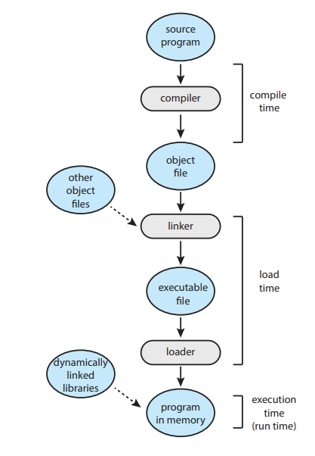
Address Binding cont..

Slide 17
Address Binding cont..
Compile time:
If you know at compile time where the process will reside in
memory, then absolute code can be generated.
For example, if you know that a user process will reside starting at location R, then the generated compiler code will start at that location and extend up from there. If, at some later time, the starting location changes, then it will be necessary to recompile this code.

Slide 18
Address Binding cont..
Load time:
If it is not known at compile time where the process will reside in memory, then the compiler must generate relocatable code.
In this case, final binding is delayed until load time.
If the starting address changes, we need only reload the user code to incorporate this changed value.

Slide 19
Address Binding cont..
Execution time:
If the process can be moved during its execution from one memory segment to another, then binding must be delayed until run time.

Slide 20
Logical Versus Physical Address Space
An address generated by the CPU is commonly referred to as a logical address, whereas an address seen by the memory unit— that is, the one loaded into the memory-address register of the memory—is commonly referred to as a physical address.

Slide 21
Logical Versus Physical Address Space cont..
However, the execution-time address-binding scheme results in differing logical and physical addresses.
In this case, we usually refer to the logical address as a virtual address. We use logical address and virtual address interchangeably in this text.
The set of all logical addresses generated by a program is a logical address space. The set of all physical addresses corresponding to these logical addresses is a physical address space.

Slide 22
Logical Versus Physical Address Space cont..
The run-time mapping from virtual to physical addresses is done by a hardware device called the memory-management unit (MMU) .
The value in the relocation register is added to every address generated by a user process at the time the address is sent to memory.
For example, if the base is at 14000, then an attempt by the user to address location 0 is dynamically relocated to location 14000; an access to location 346 is mapped to location 14346.

Slide 23
Logical Versus Physical Address Space cont..
We now have two different types of addresses: logical addresses (in the range 0 to max) and physical addresses (in the range R + 0 to R + max for a base value R).
The user program generates only logical addresses and thinks that the process runs in memory locations from 0 to max.
However, these logical addresses must be mapped to physical addresses before they are used.
The concept of a logical address space that is bound to a separate physical address space is central to proper memory management.

Slide 24
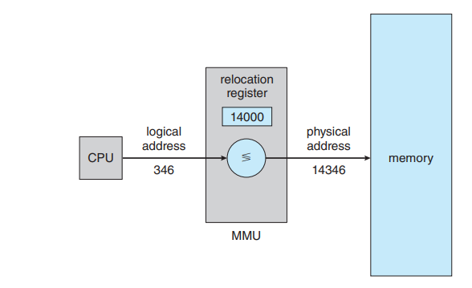
Logical Versus Physical Address Space cont..

Slide 25
Dynamic Loading
The size of a process has thus been limited to the size of physical memory. To obtain better memory-space utilization, we can use dynamic loading.
With dynamic loading, a routine is not loaded until it is called. All routines are kept on disk in a relocatable load format. The main program is loaded into memory and is executed.

Slide 26
Dynamic Loading cont..
When a routine needs to call another routine, the calling routine first checks to see whether the other routine has been loaded.
If it has not, the relocatable linking loader is called to load the desired routine into memory and to update the program’s address tables to reflect this change. Then control is passed to the newly loaded routine.

Slide 27
Dynamic Loading cont..
The advantage of dynamic loading is that a routine is loaded only when it is needed.
This method is particularly useful when large amounts of code are needed to handle infrequently occurring cases, such as error routines.
In such a situation, although the total program size may be large, the portion that is used (and hence loaded) may be much smaller.

Slide 28
Dynamic Linking and Shared Libraries
Dynamically linked libraries (DLLs) are system libraries that are linked to user programs when the programs are run ).
Some operating systems support only static linking, in which system libraries are treated like any other object module and are combined by the loader into the binary program image.

Slide 29
Dynamic Linking and Shared Libraries cont..
Dynamic linking, in contrast, is similar to dynamic loading. Here, though, linking, rather than loading, is postponed until execution time.
This feature is usually used with system libraries, such as the standard C language library. Without this facility, each program on a system must include a copy of its language library (or at least the routines referenced by the program) in the executable image.
This requirement not only increases the size of an executable image but also may waste main memory.

Slide 30
Dynamic Linking and Shared Libraries cont..
Unlike dynamic loading, dynamic linking and shared libraries generally require help from the operating system.
If the processes in memory are protected from one another, then the operating system is the only entity that can check to see whether the needed routine is in another process’s memory space or that can allow multiple processes to access the same memory addresses.

Slide 31
Swapping in Operating System
To increase CPU utilization in multiprogramming, a memory management scheme known as swapping can be used.
Swapping is the process of bringing a process into memory and then temporarily copying it to the disc after it has run for a while.
The purpose of swapping in an operating system is to access data on a hard disc and move it to RAM so that application programs can use it.

Slide 32
What is Swapping in the Operating System?
Swapping in an operating system is a process that moves data or programs between the computer’s main memory (RAM) and a secondary storage (usually a hard disk or SSD).
This helps manage the limited space in RAM and allows the system to run more programs than it could otherwise handle simultaneously.

Slide 33
What is Swapping in the Operating System? cont..
It’s important to remember that swapping is only used when data isn’t available in RAM.
Although the swapping process degrades system performance, it allows larger and multiple processes to run concurrently.
Because of this, swapping is also known as memory compaction.
The CPU scheduler determines which processes are swapped in and which are swapped out. Consider a multiprogramming environment that employs a priority-based scheduling algorithm.

Slide 34
What is Swapping in the Operating System? cont..
When a high-priority process enters the input queue, a low-priority process is swapped out so the high-priority process can be loaded and executed.
When this process terminates, the low-priority process is swapped back into memory to continue its execution.

Slide 35
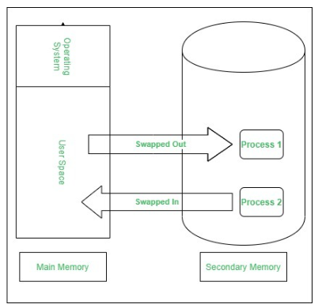
What is Swapping in the Operating System? cont..

Slide 36
What is Swapping in the Operating System? cont..
Swapping has been subdivided into two concepts: swap-in and swap-out
Swap-out is a technique for moving a process from RAM to the hard disc.
Swap-in is a method of transferring a program from a hard disc to main memory, or RAM.

Slide 37
What is Swapping in the Operating System? cont..
When the RAM is full and a new program needs to run, the operating system selects a program or data that is currently in RAM but not actively being used.
The selected data is moved to the secondary storage, making space in RAM for the new program.
When the swapped-out program is needed again, it can be swapped back into RAM, replacing another inactive program or data if necessary.

Slide 38
Real Life Example of Swapping
magine you have a disk (RAM) that is too small to hold all your books and papers (programs).
You keep the most important items on the desk and store the rest in a cabinet (secondary storage).
When you need something from the cabinet, you swap it with something on your desk. This way, you can work with more items than your desk alone could hold.

Slide 39
Advantages of Swapping
If there is low main memory so some processes may has to wait for much long but by using swapping process do not have to wait long for execution on CPU.
It utilize the main memory.
Using only single main memory, multiple process can be run by CPU using swap partition.
The concept of virtual memory start from here and it utilize it in better way.
This concept can be useful in priority based scheduling to optimize the swapping process.

Slide 40
References
Operating System Concept | 10th | Abraham Silberschatz | Wiley | 2013 | 978-1-119-32091-3

Slide 41
THANK YOU

