Slide 1
Deviance crime and Social Control

Slide 2
Introduction
Deviance- the violation of social norms
Stigma- the disapproval attached to disobeying the expected norms
Crime- the forms of deviance in which formal penalties are imposed by the society
We are all deviant at some time or another and in some places

Slide 3
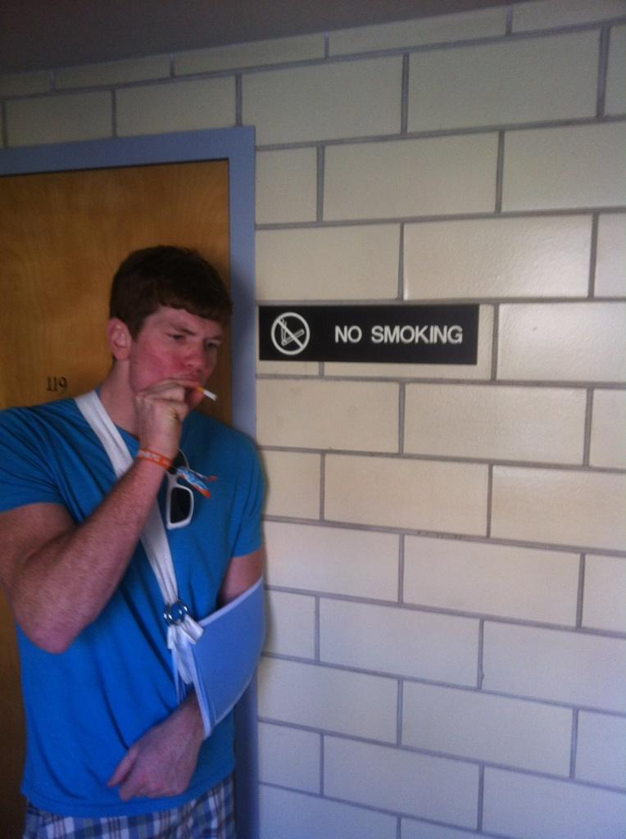
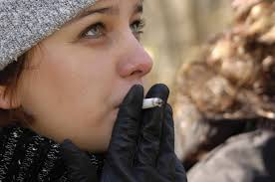
Crime and Deviance

Slide 4
Crime vs. Deviance
A crime is any act which breaks the formal, written laws of a state.
governing authority or force may ultimately prescribe a punishment.
Deviance is any act that breaks society’s unwritten rules, or expected ‘norms’ of behaviour
non-conformist behaviour

Slide 5
Deviance
Behavior that is contrary to the standards of conduct or social expectations of a given group or society defines as deviance .
Any failure to conform to customary norms is called deviance.

Slide 6
Deviance
Deviance is behavior that departs from society's norms.
Deviance can vary depending on the group of society's ideas of what is acceptable and unacceptable.
According to sociologists a deviant is someone who violates a major social norm of a society or group.

Slide 7
Deviance
Low status persons (e.g. ethnic minorities, poor people) are more likely to be perceived as deviant, their good behavior “explained away”
Higher status persons (e.g. priests, doctors) are less likely to be defined as deviant, their bad behavior “explained away”

Slide 8
Causes of deviance and crime
Improper socialization
Lack of interest in education and vice versa
Lack of religious education and morality
Broken homes (family
Lack of basic facilities.
Desire of accumulation of wealth
Mass media
Friends’ influence
Racial descrimination, Religious discrimination
Violence on TV, radio and Internet.

Slide 9
types of crime White Collar Crimes
Within criminology, it was first defined by sociologist Edwin Sutherland in 1939 as "a crime committed by a person of respectability and high social status in the course of his occupation".
Crime committed by respectable people of high status in the course of their occupation.
Often unreported and difficult to detect.

Slide 10
White Collar Crimes
today, our society is full of white collar crimes. Affluent, respectable people commit these crimes in the course of their everyday business.
In our society, a big array of crimes are now categorized as white-collar crimes like income tax dodging, consumer fraud, bribery, Computer crime, financial fraud and money laundering.

Slide 11
BLUE COLLAR CRIME
in criminology, blue-collar crime is any crime committed by an individual from a lower social class
as opposed to white-collar crime which is associated with crime committed by individuals of a higher social class.
Blue collar crimes are also crimes which are more visible, detected sooner, and occur on a more frequent basis.

Slide 12
Blue collar crimes may involve the following types of crimes, but not limited to:
Forms of Robbery;
Kidnapping;
Gang Related Crimes;
Sexual Crimes;
Drug Crimes
Domestic Violence;
Illegal Gambling;

Slide 13
pink-collar crime
The term pink-collar crime was coined by Kathleen Daly during the 1980s to describe embezzlement type crimes that typically were committed by females based on limited opportunity.
white-collar crime committed by women is sometimes labeled pink-collar crime.
Unfortunately, Pink Collar Criminals are increasing not only in numbers, but also in the amounts they steal.

Slide 14
Theoretical EXPLANATION OF CRIME
Classical explanation .people comit crime after a care full thinking (know well about punishment and advantages).
he classical view in criminology explains crime as a free-will decision to make a criminal choice. This choice is made by applying the pain-pleasure principle: people act in ways that maximize pleasure and minimize pain.

Slide 15
Biological Explanation
chromosome theory xx , inherit crime, inborn crime ,
A legal theory that holds that a perpetrator's XYY chromosomal abnormality is a condition that should relieve him or her of legal responsibility for his or her criminal act.

Slide 16
Sociological Explanation ( people comet crime because of social circumstances the face in society.
Sociological theories of criminology believe that society influences a person to become a criminal. Examples include the social learning theory, which says that people learn criminal behavior from the people around them, and social conflict theory, which says that class warfare is responsible for crime.

Slide 17
Merton’s Theory Of Deviance/Social Strain Typology

Slide 18
The social strain typology is a theory of deviance that was developed by sociologist Robert K. Merton. Building off of Durkheim’s work on anomie, Merton (1957) was the first person to write about what sociologists call strain theory.
To Merton, anomie was a condition that existed in the discrepancy between societal goals and the means that individuals have to achieve them.
Merton”s theory is based on the idea that there is a tension between goals and means in society. Goals are the things that people want to achieve, such as wealth or success. Means are the ways in which people go about achieving these goals, such as working hard or getting an education.

Slide 19
When people cannot achieve their goals through legitimate means, they may turn to deviant behavior in order to get what they want. For example, someone who wants to be wealthy but cannot legitimately earn enough money may turn to theft or robbery.
The social strain typology is a helpful way of understanding why people engage in deviant behavior.
Merton argued that individuals at the bottom of society could respond to this strain in a number of ways. Different orientations toward society’s goals and differential access to the means to achieve those goals combine to create different categories of deviance.

Slide 20
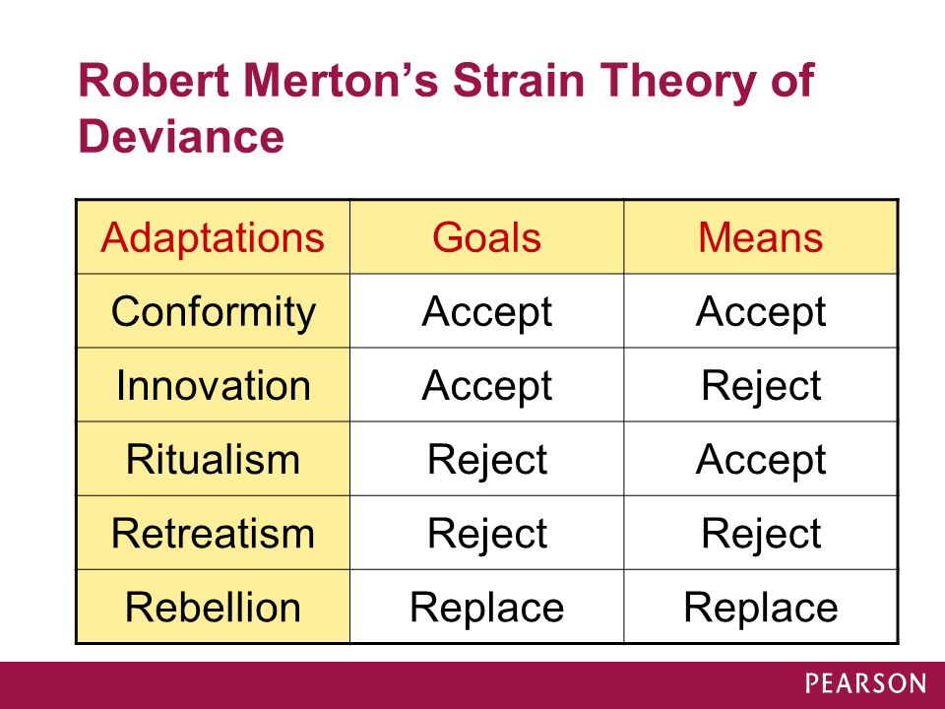

Slide 21
Conformity: individuals are following a societal goal through legitimate means.
For example, a student who is going to school to advance a professional career is conforming, as he is following the Pakistani cultural value of success through an approved means.
Innovation: the individual shares the cultural goal of the society but reaches this goal through illegitimate means. Thieves – who share the cultural goal of wealth obtainment but do so through breaking the law (such as drug dealing or embezzlement), are innovators.
Ritualists: individuals who have given up hope of achieving society’s approved goals but still operate according to society’s approved means. A member of middle management, for example, who accepts that they will never progress but stays in their position is a ritualist.

Slide 22
Retreatists (like dropouts or hermits): individuals who have rejected both a society’s goals and the legitimate means of obtaining them and live outside conventional norms altogether. These people choose to cut themselves off from the world, such as individuals addicted to drugs or dealing with homelessness.
Rebellion Rebels aim to replace societal goals with those of their own and devise their own means of achieving them.
The most obvious examples of rebellion are terrorist organizations, which attempt to advance a goal, typically political, through means such as violence

Slide 23
Labeling Theory
Labeling theory is a sociological theory that views deviance as a result of the way society labels people. The theory is based on the idea that people who are labeled as deviant are more likely to engage in deviant behavior.
For example, a teacher labeling a student as a troublemaker. That label can then be mentally adopted by the person it’s been assigned to, leading them to exhibit the actions, attitudes, and behaviors associated with it.
In short, this theory tends to focus on how people become deviant as a result of others forcing that identity upon them.

Slide 24
Police, judges, and educators are the individuals tasked with enforcing standards of normalcy and labeling certain behaviors as deviant in nature. By applying labels to people and creating categories of deviance, these officials reinforce society's power structure.
Often, the wealthy define deviancy for the poor, men for women, older people for younger people, and racial or ethnic majority groups for minorities. In other words, society's dominant groups create and apply deviant labels to subordinate groups.

Slide 25
Many children, for example, break windows, steal fruit from other people’s trees, climb into neighbors' yards, or skip school. In affluent neighborhoods, parents, teachers, and police regard these behaviors as typical juvenile behavior.
But in poor areas, similar conduct might be viewed as signs of juvenile delinquency. This suggests that class plays an important role in labeling. Race is also a factor.

Slide 26
Social Control and conformity

Slide 27
Social control
Social control is the study of the mechanisms, in the form of patterns of pressure, through which society maintains social order and cohesion.
Social control is typically employed by group members in response to anyone it considers deviant, problematic, threatening, or undesirable, with the goal of ensuring conformity.

Slide 28
Social control
Social control involves a society finding ways to promote conformity to norms.
- two type of social control
internal social control. This is shaped by socialization and involves someone not doing a deviant act because they know its wrong.
External social control is based on social sanctions.

Slide 29
Informal controls,
Informal control typically involves an individual internalizing certain norms and values This process is called socialization.
The social values present in individuals are products of informal social control exercised implicitly by a society through particular customs, norms and mores.
Individuals internalize the values of their society whether conscious or not .

Slide 30
Informal sanctions may include shame, ridicule, criticism, and disapproval, which can cause an individual to conform to the social norms of the society
In extreme cases, sanctions may include social discrimination exclusion, and violence. Informal social control has the potential to have a greater impact on an individual than formal control.
When social values become internalized, they become an aspect of an individual’s personality.

Slide 31
Formal social control
Formal controls, the state or authorities discourage nonconformity.
Formal means of social control are the means of social control exercised by the government and other organizations who use law enforcement mechanisms and sanctions such as fines and imprisonment to enact social control.

Slide 32
IMPORTANCE OF SOCIAL CONTROL
Social control is necessary to protect social interests and satisfy common needs. If social control is removed and every individual is left to behave freely society would be reduced to a state of lawlessness.
Social control regulates behavior in accordance with established norms which brings uniformity of behavior and leads to unity among the individuals
.

Slide 33
Social conformity
Social conformity is a type of social influence involving a change in belief or behaviour in order to fit in with a group. Humans have a common tendency to adopt the opinions and follow the behaviours of the majority.

Slide 34
types of conformity Normative Conformity
Normative conformity is that occurs because of the desire to be liked and accepted.
Most people probably think of peer pressure amongst teens when they think of normative conformity, and for good reason.
Most teens and pre-teens are particularly vulnerable to influence because they long to be accepted by their peers.
I'm sure when you were a teenager you heard the phrase, ''If all of your friends jumped off a bridge, would you do it, too?'' Peer pressure is certainly a good example of normative conformity, but it happens to adults, too.

Slide 35
Informational Conformity
The other type of conformity is informational conformity, which is conformity that occurs because of the desire to be correct
In Asch's experiment, some of the participants stated that they believed they must be wrong since no one else agreed with them. They changed their answer so that they would be 'right.' Informational conformity is so named because we believe that it gives us information that we did not previously have.

Slide 36
Compliance
Here a person changes their public behaviour (the way they act) but not their private beliefs. This is usually a short-term change and often the result of normative social influence
Normative social influence is where a person conforms to fit in with the group because they don't want to appear foolish or be left out. Normative social influence is usually associated with compliance, where a person changes their public behaviour but not their private beliefs.

Slide 37
Identification
Identification conformity occurs when someone changes their behaviour or beliefs due to real or imagined pressure from others
Yes their private belief is changed but (Only in the presence of the majority) but the change will be short term

Slide 38
Internalisation
Internalisation is the deepest level of conformity. Here a person changes their public behaviour and their private beliefs.
This is usually a long-term change and often the result of informational social influence .
For example, if an individual is influenced by a group of Buddhists and converts to this faith, then their new religious way of life will continue without the presence of the group as they have internalised this belief as true and this religious way of life as the correct way to behave.

Slide 39
Conformity
 | CHANGE IN PUBLIC BEHAVIOUR? | CHANGE IN PRIVATE BELIEF? | SHORT-TERM / LONG-TERM
Compliance | Yes | No | Short term
Identification | Yes | Yes (Only in the presence of the majority) | Short term
Internalisation | Yes | Yes | Long term

