Slide 1
Project Title: AgriFarma
Farmers’ Digital Hub

Slide 2
1. Introduction
1.1 Purpose
AgriFarma aims to create a digital platform for farmers where they can:
Gain agricultural knowledge
Connect with consultants and experts
Share success stories and advice
Buy and sell agricultural products online
This web platform serves as a one-stop portal for agriculture-related learning, collaboration, and commerce in Sindh, Pakistan.

Slide 3
1.2 Target Users
👨‍🌾 Farmers – to gain knowledge, share experiences, and sell produce
👩‍🔬 Consultants / Experts – to offer paid or voluntary consultancy
🧑‍🏫 Academics / Students – to post research and educational content
🛒 Buyers / Sellers – for agricultural e-commerce

Slide 4
⚙️ 2. System Features
2.1 User Profiles
Register, login, and reset password
Profile fields: Name, Email, Mobile, Location(City, State, Country), Profession, level of expertise (expert, intermediate, beginner), Picture
View join date, number of posts, likes, latest posts
Edit profile and change password

Slide 5
2.2 Discussion Forum
Categories & subcategories (e.g., Crops → Wheat → Diseases)
Start threads, post replies, and search discussions
Admin moderation: delete/move inappropriate posts
Latest discussions displayed in sidebar

Slide 6
2.3 Knowledge Base (Blogs)
Post blogs with multimedia (images, video, PPT, docs)
Categorized (e.g., Success Stories, Techniques, Weather Tips)
Commenting system
Admin approval & removal of inappropriate content
Search functionality + sidebar for trending articles

Slide 7
2.4 Consultancy Services
Users can register as consultants
Admin reviews & approves profiles
Consultancy listed by category (e.g., soil, irrigation, crop disease)
Contact option via message or email

Slide 8
2.5 E-Commerce (Agri Marketplace)
Farmers and Admins can post items for sale
Product info: name, price, images, category, description
Shopping cart system (add/edit/remove items)
Orders, payments, and shipping options
Admin dashboard:
  Add/remove products
  Approve/delete reviews
  Manage orders & view reports
  Date-range sales report, low inventory alert

Slide 9
💾 3. Technology Stack
Layer | Technology
Backend | Flask (Python)
Frontend | HTML5, CSS3, Bootstrap
Database | SQLite / MySQL
Data Handling | Pandas, CSV, JSON
Authentication | Flask-Login, Werkzeug
Visualization | Chart.js / Plotly
File Uploads | Flask-Uploads
Error Handling | Flask error decorators
Deployment | Render / PythonAnywhere / Localhost

Slide 10
🧠 4. Functional Modules
Module | Description
User Management | Register/login, roles (Admin, User, Consultant)
Forum Module | Category-based discussions with replies
Knowledge Module | Blog posting and commenting
Consultancy Module | Consultant profiles & approval system
E-Commerce Module | Product listings, orders, reports
Admin Panel | Manage users, posts, products, and analytics

Slide 11
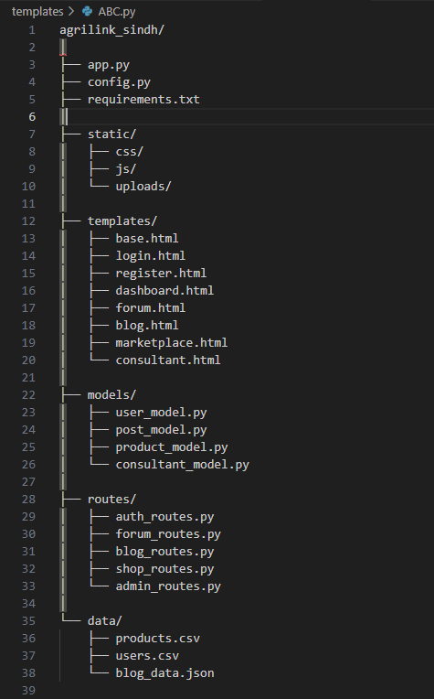
🧱 5. Project Folder Structure

Slide 12
🗓️ 6. 5-Day Roadmap (Milestone Plan)
🧩 Day 1 — Project Setup & User Authentication
Goal: Establish base Flask app and user management
Tasks:
Create project structure and virtual environment
Setup Flask, Flask-Login, Flask-WTF, and SQLite database
Build User model (name, email, password, role, expertise)
Implement routes: /register, /login, /logout
Create templates for authentication
Add session handling & password hashing
✅ Output: Fully working user login/register module

Slide 13
💬 Day 2 — Discussion Forum & Knowledge Base
Goal: Implement forum & blog system
Tasks:
Create models: Category, Post, Comment
Routes for:
  Add new post (category-based)
  Reply/comment
  Admin: delete/move posts
Implement blog system with multimedia upload (Flask-Uploads)
Add search bar and sidebar for latest posts
✅ Output: Working forum and knowledge base with post/comment functionality

Slide 14
🤝 Day 3 — Consultancy & Profile Module
Goal: Build consultant registration and profile system
Tasks:
Add Consultant model (category, expertise, contact info)
Consultant registration form
Admin approval panel
Update user profile view: show posts, join date, likes, etc.
✅ Output: Consultant profiles visible on public directory

Slide 15
🛒 Day 4 — E-Commerce Module
Goal: Add marketplace for products & orders
Tasks:
Create Product, Order, Cart models
Admin: add/remove/update products
Farmer: post produce for sale
User: add to cart, view order history
Implement search, sort, and filtering (using Pandas)
✅ Output: Working buy/sell functionality with data persistence

Slide 16
📊 Day 5 — Admin Panel, Reports & Testing
Goal: Integrate all modules + polish interface
Tasks:
Build Admin dashboard (view stats, manage users, products)
Generate reports using Pandas:
  Top-selling products
  Low inventory
  New users by date
Add error handling for invalid input and missing files
Final testing and responsive design polishing
✅ Output: Complete web application ready for demo/deployment

Slide 17
🧩 7. Data Collection & Management
Module | Data Source | Tool
User / Consultant | Registration forms | Flask-Forms + SQLite
Forum / Blog | User submissions | CSV + JSON
E-Commerce | Manual entry by admin/farmers | CSV + Pandas
Reports | Derived from transactions | Pandas dataframes

