Slide 1
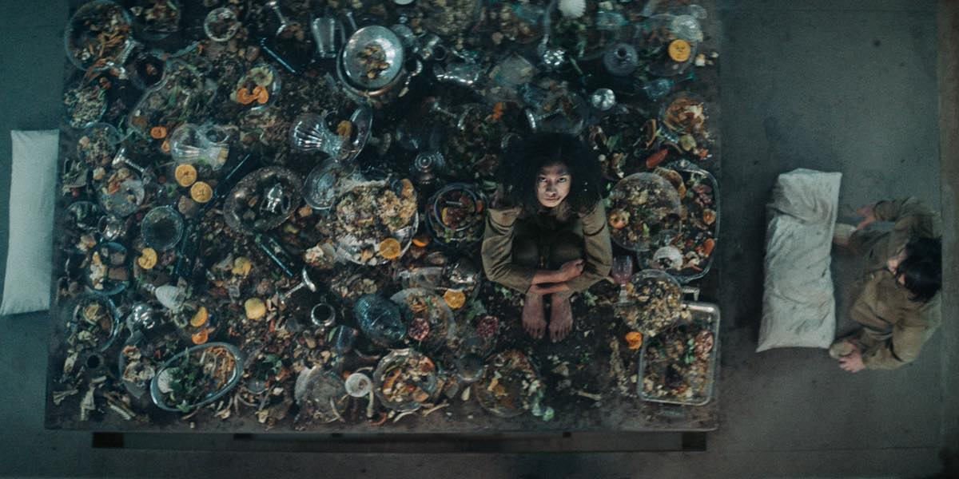
SPEAKING / MY FAVORITE MOVIE
WHAT
WOULD YOU DO?
EAT — OR LEAVE SOMETHING BELOW?
Keep your answer.
FILM STILL: IMDB / EL HOYO
Notes:
TIME: 0:00–0:30 (30 sec)
GOAL: Savol → 2 soniya pauza → javoblarini o‘ylash.
SAY:
“Imagine a table full of food. The people above you have already eaten. The people below you are still hungry. You have only two minutes. What would you do — eat as much as possible, or leave something for them?”
[PAUSE FOR 2 SECONDS. LOOK AT THE AUDIENCE.]
“Keep your answer in mind.”
KEYWORDS: FULL TABLE → ABOVE ATE → BELOW HUNGRY → 2 MINUTES → YOUR CHOICE.
ACTION: Slaydga emas, odamlarga qara. “What would you do?”dan keyin albatta pauza qil.

Slide 2
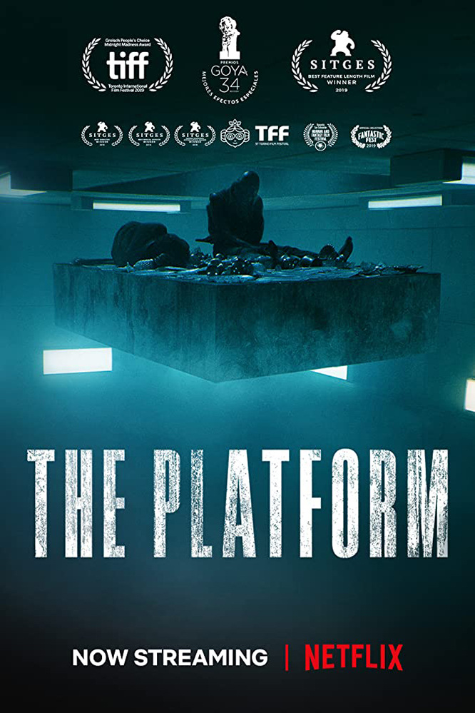
TITLE REVEAL / 2019 / SPAIN
THE
PLATFORM
A dystopian thriller by
Galder Gaztelu-Urrutia
One table. Hundreds of floors.
One uncomfortable question.
POSTER: IMDB / FILM: NETFLIX
Notes:
TIME: 0:30–0:55 (25 sec)
GOAL: Kino nomini ayt → janr → nega tanlaganing.
SAY:
“This question is the heart of my favorite movie, The Platform. It is a Spanish dystopian thriller directed by Galder Gaztelu-Urrutia. I chose it because one simple situation tells us a lot about people.”
KEYWORDS: QUESTION → THE PLATFORM → SPANISH THRILLER → SIMPLE SITUATION, COMPLEX PEOPLE.
PRONUNCIATION: Galder Gaztelu-Urrutia degan ismni sekin ayt; adashsang ham to‘xtab qolma.

Slide 3
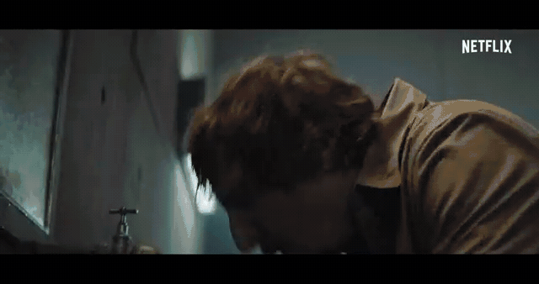
HOW THE PRISON WORKS
REAL TRAILER / 8 SEC
ONE TABLE.
EVERY FLOOR.
01
ONE PLATFORM
Food starts at the top.
02
TWO MINUTES
Then the table moves down.
03
A NEW LEVEL
Every month. No control.
“If everyone ate only what they needed…”
CLIP + FRAMES: ROTTEN TOMATOES / MOVIECLIPS
Notes:
TIME: 0:55–1:40 (45 sec, including the 8-sec clip)
GOAL: 3 qoida → video → asosiy jumla.
SAY:
“The movie takes place in a vertical prison. Every day, one platform carries food from the top to the bottom. It stops at each floor for only two minutes. People at the top get everything. People below get whatever is left. Every month, prisoners wake up on a different level. Watch this short moment.”
ACTION: 8 soniyalik real klipni ko‘rsat. Gapirma. Klipdan keyin:
“That sentence sounds simple: if everyone ate only what they needed, the food could reach the lowest level.”
KEYWORDS: VERTICAL PRISON → TOP TO BOTTOM → 2 MINUTES → LEFTOVERS → NEW LEVEL MONTHLY.
KEYNOTE: Slaydda harakatli lavha bor. Ovozli versiya uchun berilgan MP4 faylni shu kadr ustiga joyla va Format → Movie → Start Movie: Automatically tanla.

Slide 4
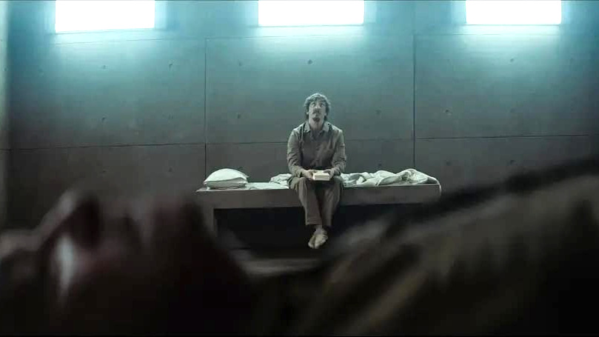
MEET GORENG
HE CHOSE
A BOOK.
One volunteer.
Six months.
One personal item.
COULD YOU SHARE
WHEN NOBODY
FORCES YOU?
FILM STILL: THE PLATFORM (2019) / FRAME SOURCE
Notes:
TIME: 1:40–2:20 (40 sec)
GOAL: Qahramon → o‘zgarishi → uning savoli.
SAY:
“The main character is Goreng. He enters the prison voluntarily and brings one book, Don Quixote. At first, he believes people can simply agree to share. Then he sees how fear and hunger change their decisions. I like Goreng because he is not a typical superhero. He makes mistakes, but he keeps asking one question: can we choose solidarity when nobody forces us?”
KEYWORDS: GORENG → VOLUNTEER → DON QUIXOTE → BELIEVES IN SHARING → FEAR + HUNGER → NOT A SUPERHERO.
ACTION: “Solidarity” so‘zini urtda sekin ayt: birdamlik / hamjihatlik.

Slide 5
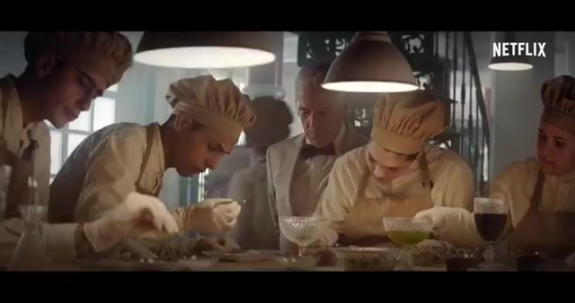
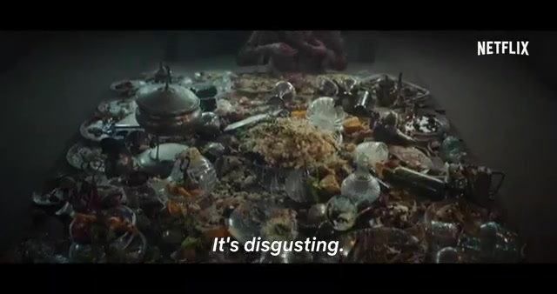
MEME BREAK / 20 SEC
UNIVERSITY GROUP PROJECT
LEVEL 1 / THE PROMISE
LEVEL 100 / THE REALITY
“WE’LL SPLIT
THE WORK EQUALLY.”
“SO… WHO DID
EVERYTHING?”
ORIGINAL MEME CAPTIONS / REAL FRAMES: THE PLATFORM: TRAILER 1
Notes:
TIME: 2:20–2:50 (30 sec)
GOAL: Yengil kulgu → kinoni real hayotga bog‘lash.
SAY:
“Okay, a small university version of The Platform. At level one, everybody says, ‘We will share the group project equally.’ At level one hundred, one person has done everything, and the others are asking, ‘When is the deadline?’”
[SHORT PAUSE. LET THEM REACT.]
“That is why the movie feels familiar. We often care about fairness until caring costs us something.”
KEYWORDS: UNIVERSITY VERSION → GROUP PROJECT → LEVEL 1 PROMISE → LEVEL 100 REALITY → FAIRNESS HAS A COST.
ACTION: Meme’ni tez o‘qib o‘tirma. Birinchi panel → ikkinchi panel → odamlarning reaktsiyasini kut.

Slide 6
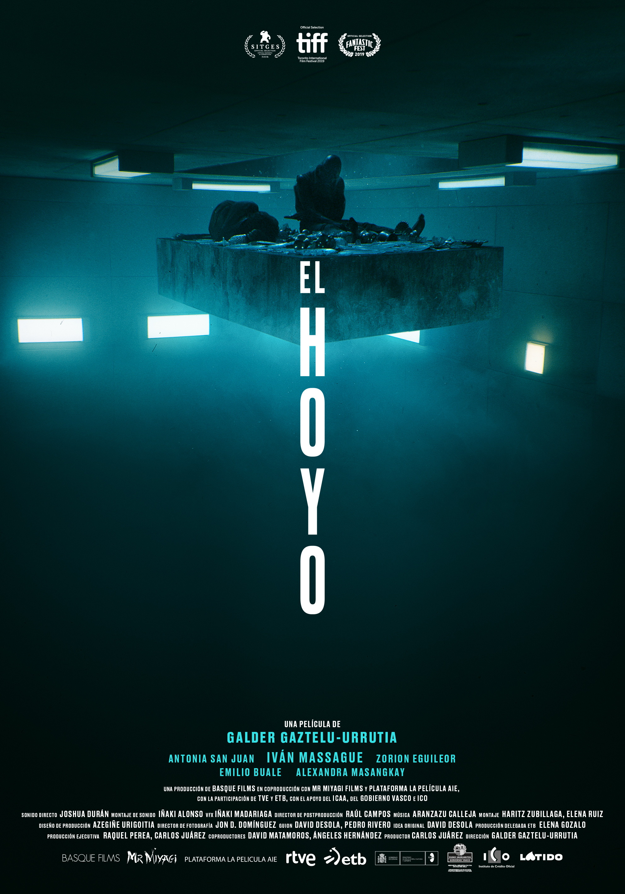
WHY IT IS MY FAVORITE
01
SIMPLE PREMISE
02
BRUTAL CHOICES
03
LASTING QUESTION
DISTURBING. SMART. UNFORGETTABLE.
POSTER: IMDB / EL HOYO
Notes:
TIME: 2:50–3:30 (40 sec)
GOAL: 3 sabab → shaxsiy fikr.
SAY:
“I love this movie for three reasons. First, the idea is easy to understand, but it stays in your head. Second, almost everything happens in one location, so the acting and atmosphere become stronger. Third, the movie does not give a comfortable lesson. It asks us to look at our own behavior, not just blame the system. For me, that makes it disturbing, smart, and unforgettable.”
KEYWORDS: SIMPLE IDEA → ONE LOCATION → ACTING + ATMOSPHERE → NO EASY LESSON → LOOK AT YOURSELF.
ACTION: Har bir sababda bitta qadam oldinga yoki barmoq bilan 1–2–3 qil. Ro‘yxatni robotdek o‘qima.

Slide 7
NOW…
WHAT WOULD
YOU DO?
Take what you need.
Remember the person below.
THANK YOU
FILM STILL: IMDB / EL HOYO
Notes:
TIME: 3:30–4:00 (30 sec)
GOAL: Boshidagi savolga qayt → o‘z javobing → auditoriyaga yakuniy savol.
SAY:
“At the beginning, I asked what you would do. My answer is: take what I need and remember the person below me. It sounds small, but in the movie, that small decision could save a life. The Platform is my favorite movie because after it ends, the question does not end. So now I will ask you again: what would you do? Thank you.”
KEYWORDS: BEGINNING QUESTION → MY ANSWER → SMALL DECISION CAN SAVE A LIFE → QUESTION CONTINUES → THANK YOU.
ACTION: “What would you do?”dan keyin 2 soniya to‘xta. Keyin tabassum qilib “Thank you” de.

Slide 8
BACKUP SLIDE / DO NOT PRESENT
SOURCES & MEDIA
01 NETFLIX — OFFICIAL FILM PAGE
netflix.com/title/81128579
02 ROTTEN TOMATOES / MOVIECLIPS
Trailer 1 (1:48): 8.3-sec clip, trailer frames and meme frames.
rottentomatoes.com/m/the_platform/videos/WAHke5gO83mX
03 NETFLIX — OFFICIAL MAIN TRAILER
Additional official trailer reference.
youtube.com/watch?v=RlfooqeZcdY
04 IMDB — POSTERS + OVERHEAD STILL
imdb.com/title/tt8228288/mediaindex
05 GORENG FILM STILL
Frame published with a review of The Platform (2019).
neverthinkimpossible.com — The Platform review
06 PLOT DETAILS CROSS-CHECK
Two-minute stops and monthly level changes.
en.wikipedia.org/wiki/The_Platform_(film)
All visuals are real posters, film stills or trailer frames. Meme captions and slide design are original.
Sources accessed 9 November 2026 / Classroom speaking presentation / Approx. 4 minutes.
Notes:
BACKUP SLIDE — DO NOT PRESENT.
Ustoz yoki auditoriya rasm/video manbasini so‘rasa, shu slaydni och.
Real video: Rotten Tomatoes / Movieclips’ning 1:48 treyleridan 66.0–74.3 soniya oralig‘i.
Barcha rasmlar real poster, kino kadri yoki treyler freymi. Meme matnlari original.

