Slide 1
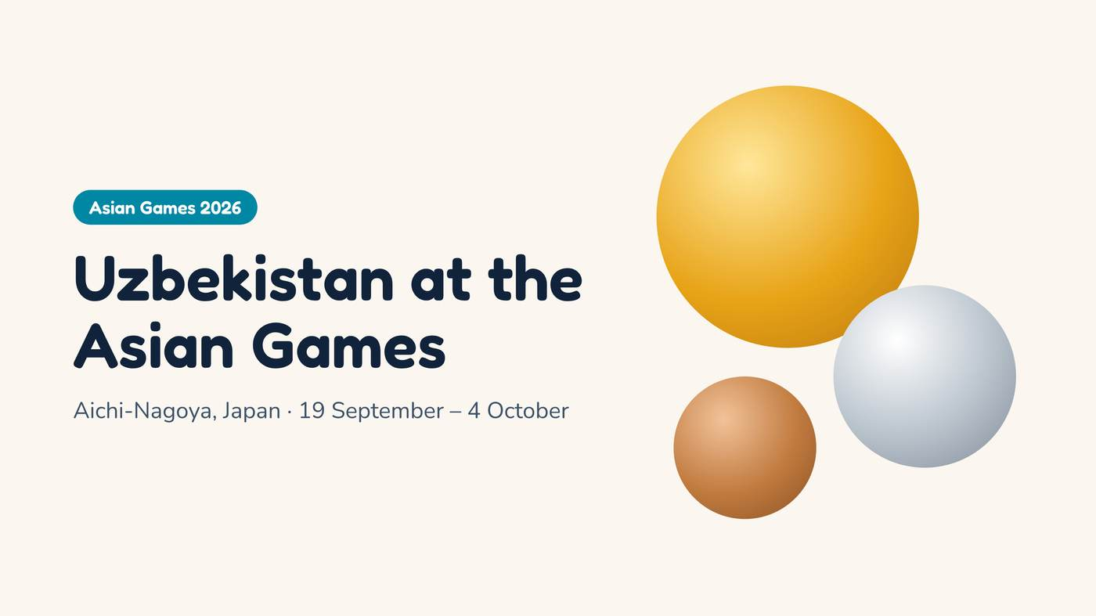
Notes:
Hello everyone! Today I want to tell you about Uzbekistan at the Asian Games in Japan.

Slide 2
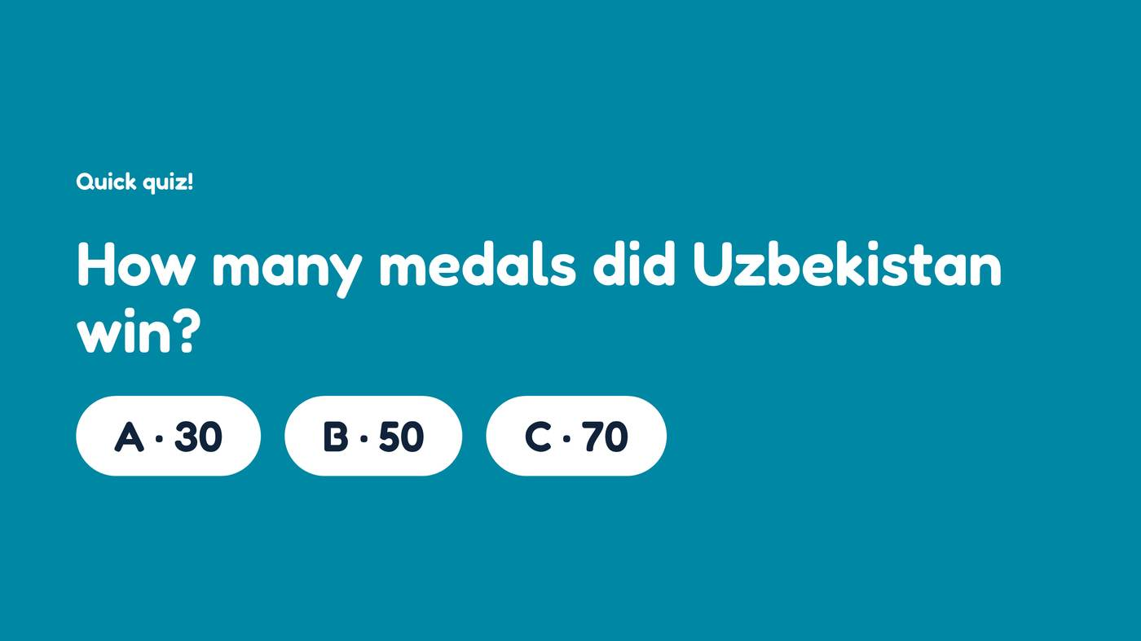
Notes:
Let’s start with a quick quiz! How many medals did Uzbekistan win? Thirty, fifty or seventy? [Wait for answers.]

Slide 3
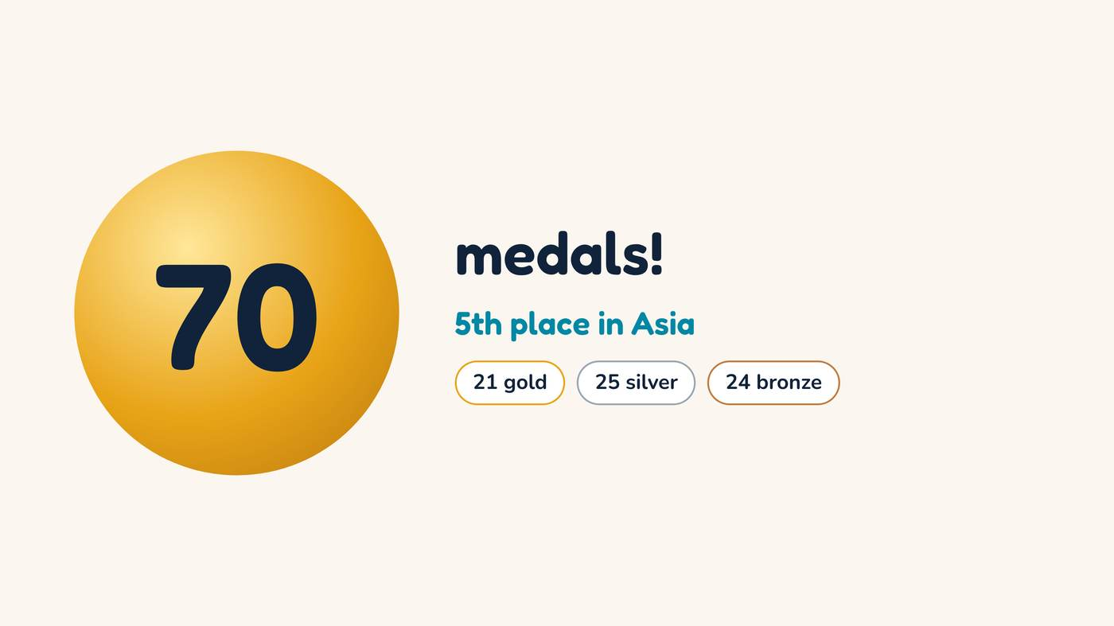
Notes:
The answer is seventy! Twenty-one gold, twenty-five silver and twenty-four bronze. Uzbekistan finished fifth in Asia!

Slide 4
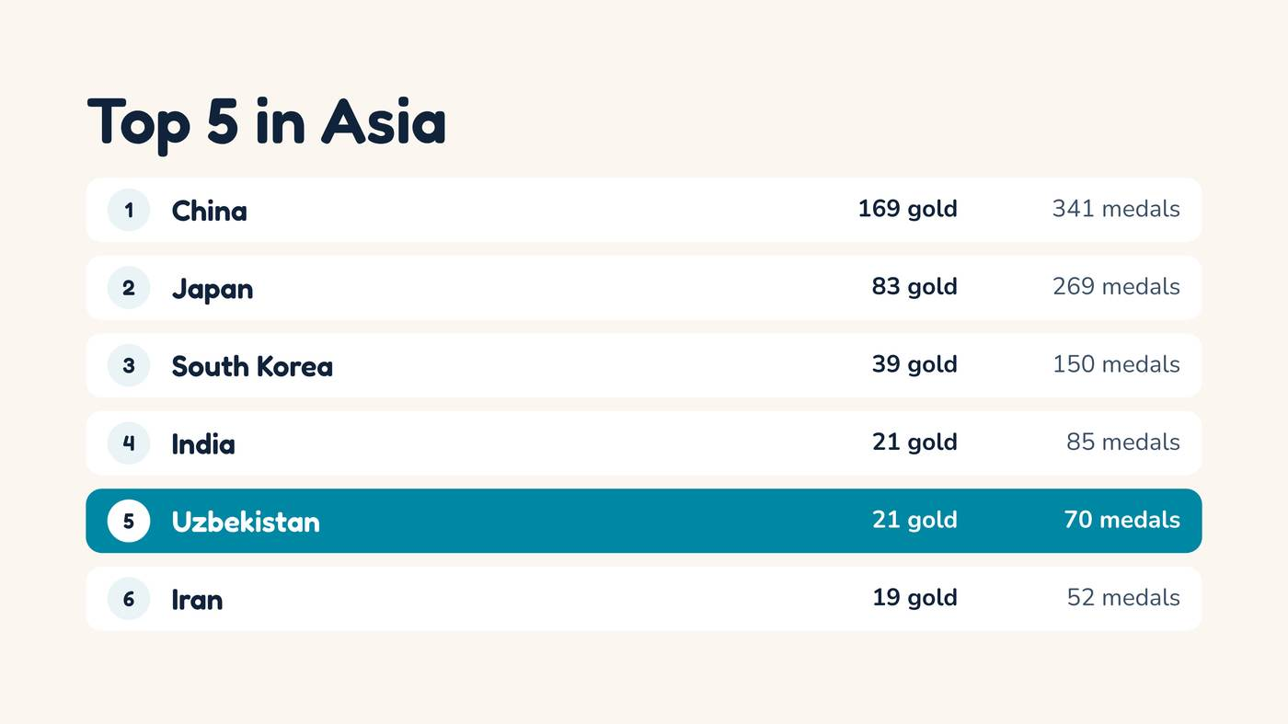
Notes:
Only China, Japan, South Korea and India were ahead of us. India had the same number of gold medals: twenty-one!

Slide 5
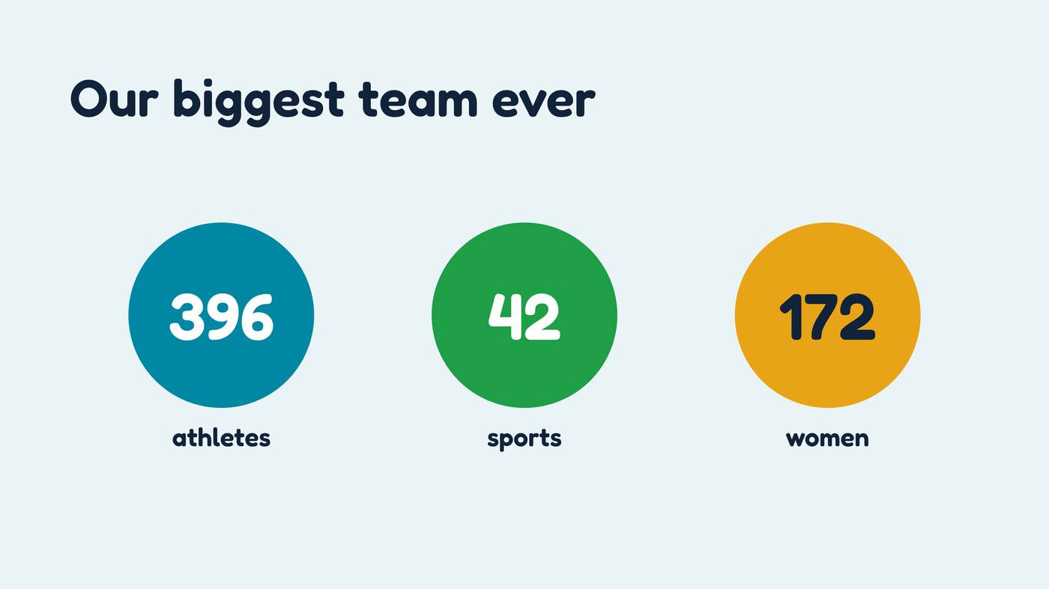
Notes:
It was our biggest team ever: almost four hundred athletes. And one hundred seventy-two of them were women!

Slide 6
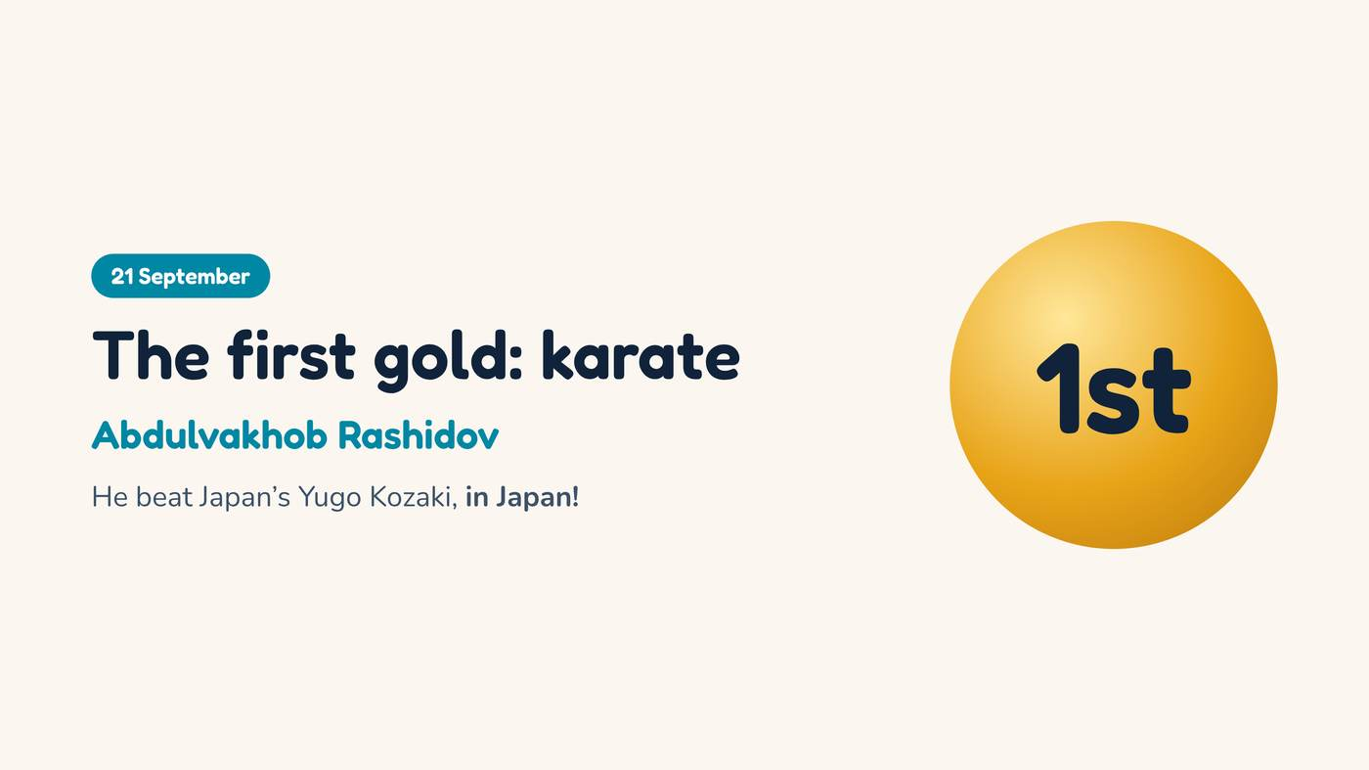
Notes:
The first gold came in karate. Abdulvakhob Rashidov beat a Japanese fighter, in Japan!

Slide 7
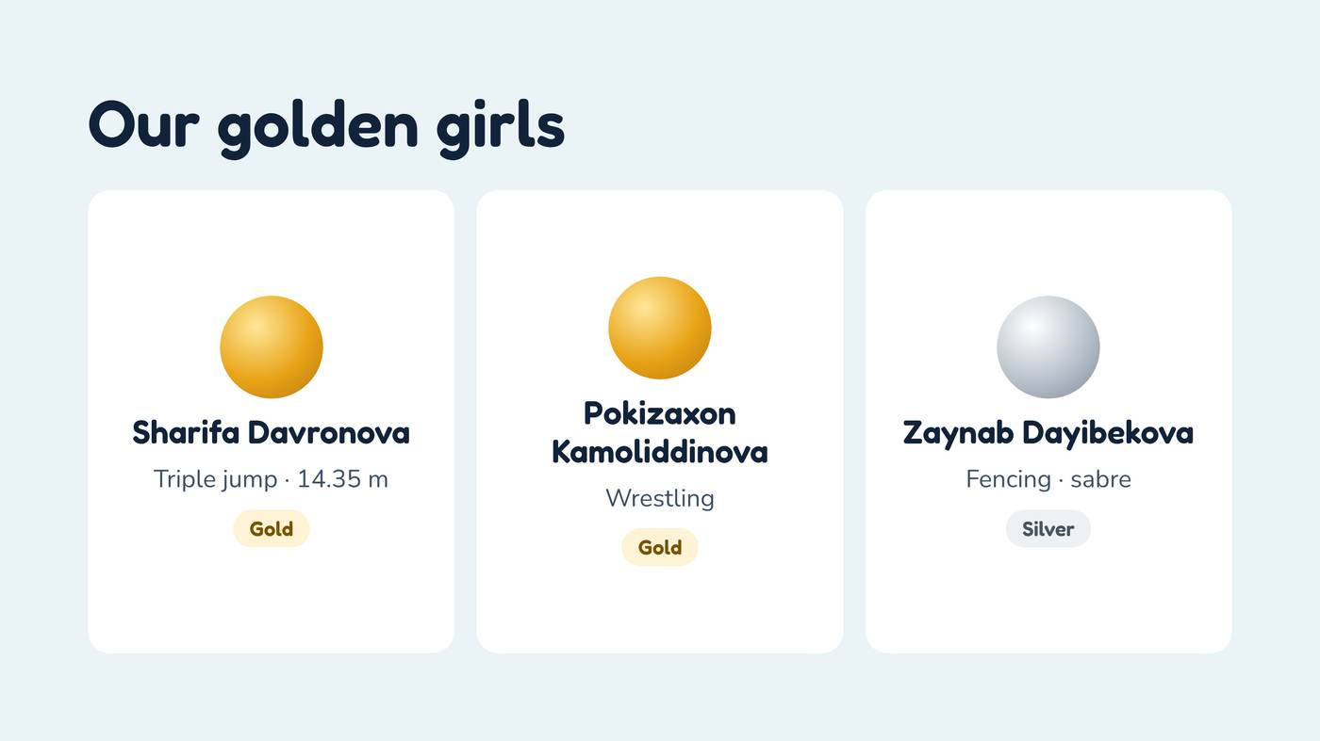
Notes:
And our girls were amazing! Sharifa Davronova won gold in triple jump, and Pokizaxon Kamoliddinova won gold in wrestling.

Slide 8
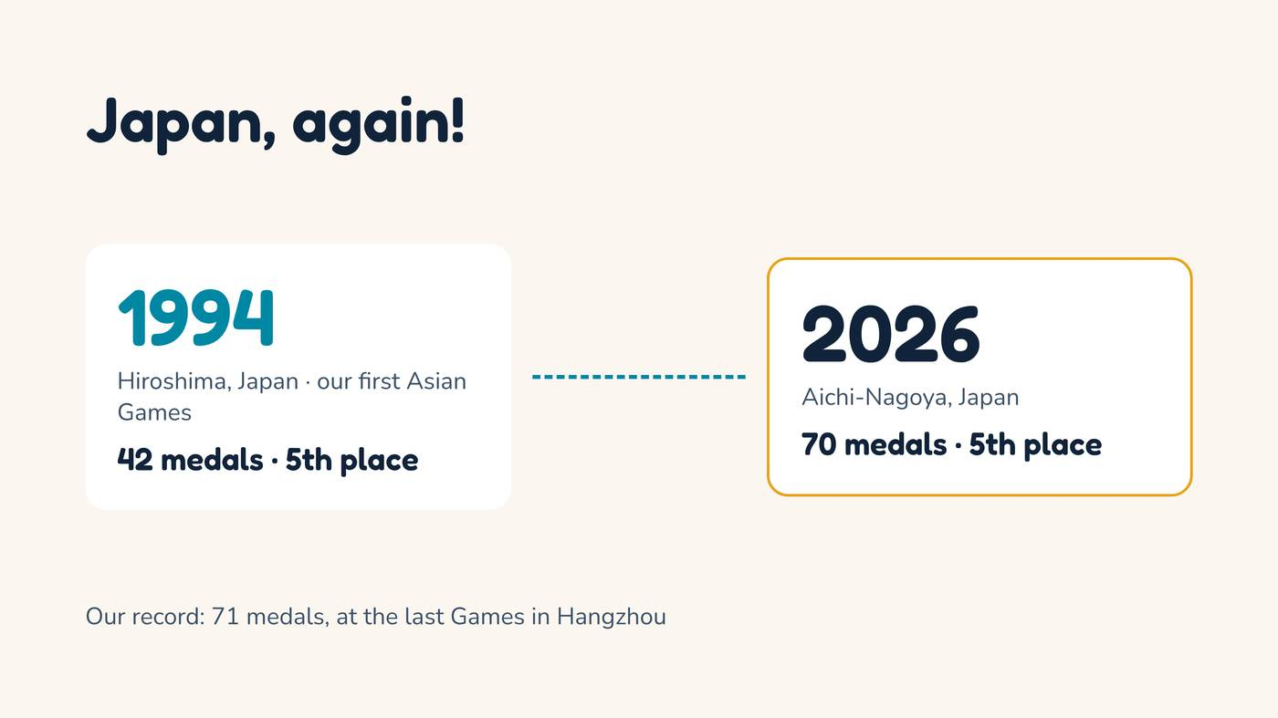
Notes:
Fun fact: our first Asian Games were also in Japan, in 1994. Then we won forty-two medals. Now: seventy!

Slide 9
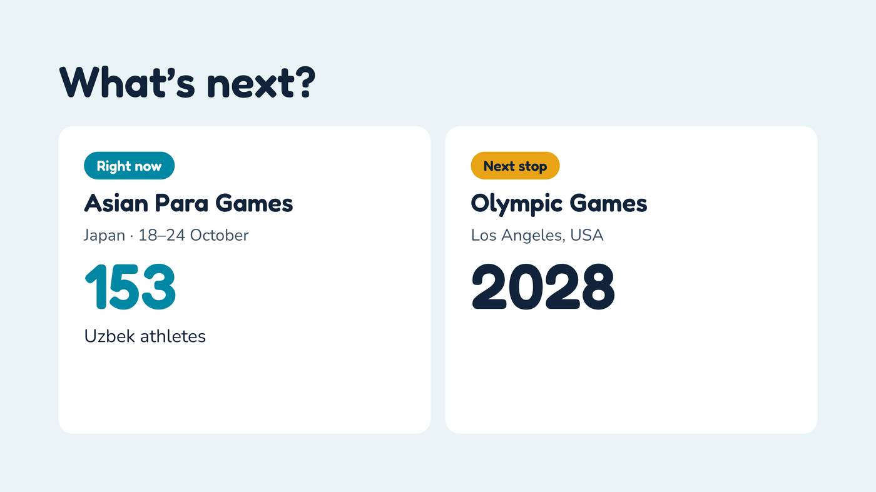
Notes:
And right now, one hundred fifty-three Uzbek athletes are at the Asian Para Games in Japan. Good luck to them!

Slide 10

Notes:
Thank you for listening! Do you have any questions?

