Slide 1
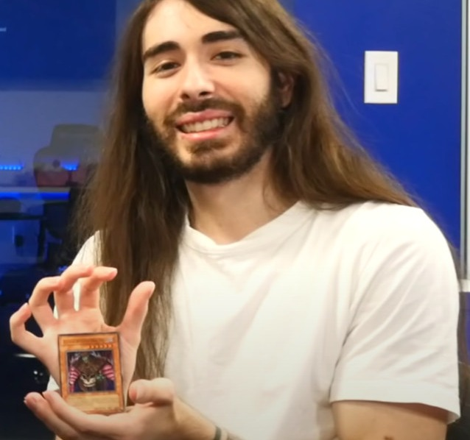
The YouTuber Card Collector
Charlie White (penguinz0)
Photo: Ruxin34 / Wikimedia Commons, CC BY 3.0
Notes:
Photo: "Cr1TiKaL in 2022 - 2.jpg" by Ruxin34, Wikimedia Commons, CC BY 3.0: https://commons.wikimedia.org/wiki/File:Cr1TiKaL_in_2022_-_2.jpg
Sources: https://youtube.fandom.com/wiki/Penguinz0 ; https://fabledframing.co.uk/blogs/journal/moistcr1tikal-penguinz0-yu-gi-oh-collection

Slide 2
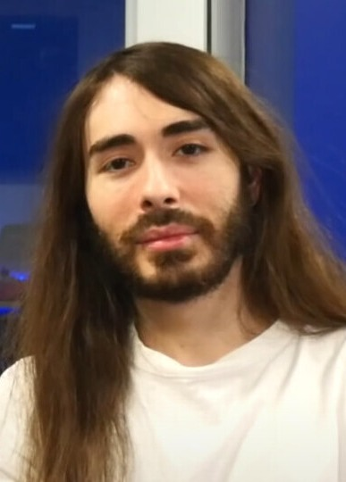
Who is he?
Charlie White
American YouTuber
and streamer
Who?
Also known as:
penguinz0
MoistCr1TiKaL
Photo: Ruxin34 / Wikimedia Commons, CC BY 3.0
Notes:
Photo: "Cr1TiKaL in 2022.jpg" by Ruxin34, Wikimedia Commons, CC BY 3.0: https://commons.wikimedia.org/wiki/File:Cr1TiKaL_in_2022.jpg
Facts: https://youtube.fandom.com/wiki/Penguinz0 ; https://commons.wikimedia.org/wiki/Category:Cr1TiKaL

Slide 3
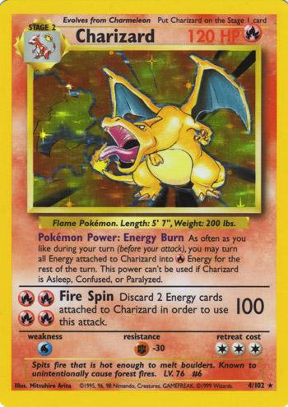
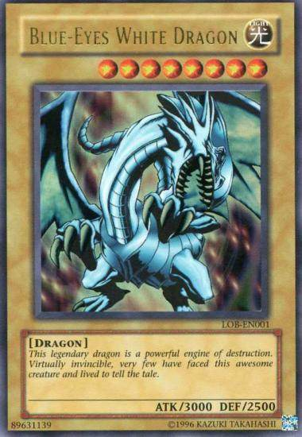
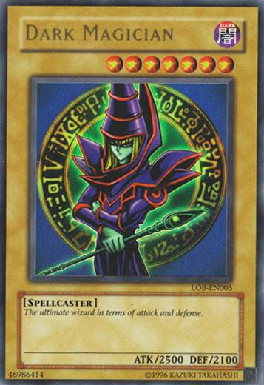
What does he collect?
Trading cards
Yu-Gi-Oh!
Pokémon
Card scans: Yugipedia (Blue-Eyes, Dark Magician); Bulbapedia (Charizard)
Blue-Eyes White Dragon
Yu-Gi-Oh!
Dark Magician
Yu-Gi-Oh!
Charizard
Pokémon
Notes:
Card scans: Blue-Eyes White Dragon LOB-EN (Yugipedia): https://yugipedia.com/wiki/File:BlueEyesWhiteDragon-LOB-EN-UR-UE.png
Dark Magician LOB-EN (Yugipedia): https://yugipedia.com/wiki/File:DarkMagician-LOB-EN-UR-UE.png
Charizard Base Set 4 (Bulbapedia Archives): https://archives.bulbagarden.net/wiki/File:CharizardBaseSet4.jpg
Fact (collects Yu-Gi-Oh! and Pokemon): https://youtube.fandom.com/wiki/Penguinz0 ; https://fabledframing.co.uk/blogs/journal/moistcr1tikal-penguinz0-yu-gi-oh-collection

Slide 4
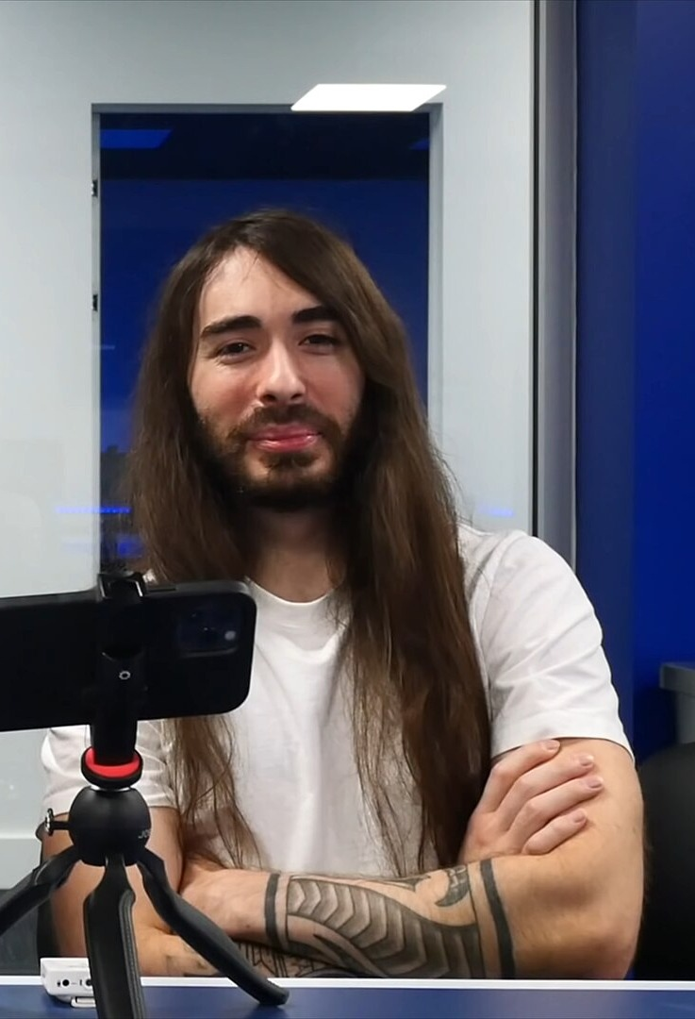
Photo: Ruxin34 / Wikimedia Commons, CC BY 3.0
Charlie White
His card story
2019
He started opening card packs on his live streams.
Over the years
Timeline
He has spent thousands of dollars on cards.
2022
He posted the video "It's Time I Finally Admit It" and showed his Yu-Gi-Oh! collection.
Notes:
Photo: "Ruxin34 and Cr1TiKaL.jpg" (cropped) by Ruxin34, Wikimedia Commons, CC BY 3.0: https://commons.wikimedia.org/wiki/File:Ruxin34_and_Cr1TiKaL.jpg
2019 card openings on streams: https://youtube.fandom.com/wiki/Penguinz0 ("Since late-2019 ... Card Openings")
Thousands of dollars: https://medium.com/exploring-sobriety/youtuber-penguinz0s-important-lesson-about-addiction-3f512f150140 (over $10,000 on cards in a single month)
2022 video: https://fabledframing.co.uk/blogs/journal/moistcr1tikal-penguinz0-yu-gi-oh-collection

Slide 5
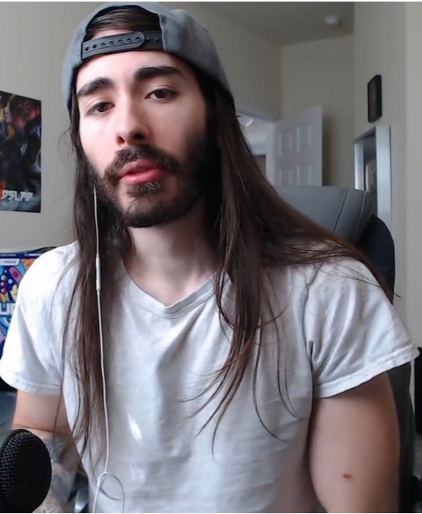
COLLECTION
The collection
Every Ultra Rare (and rarer) card ever printed, all first edition
A first-edition "Legend of Blue-Eyes White Dragon"
All sixty Collector's Rares
Photo: screenshot of penguinz0, "It's Time I Finally Admit It" (YouTube, 2022), via fabledframing.co.uk
FRAMED
On his walls
Many cards hang in frames in his studio.
Notes:
Facts: https://fabledframing.co.uk/blogs/journal/moistcr1tikal-penguinz0-yu-gi-oh-collection (every Ultra Rare and above, all first edition; 1st ed. Legend of Blue-Eyes White Dragon; all sixty Collector's Rares; much of it framed on the walls)
Photo: screenshot of the video https://www.youtube.com/watch?v=pluQWcp_Jx4 as shown on the Fabled Framing article. The frame shows Charlie; the framed card walls are not visible in this still.

Slide 6
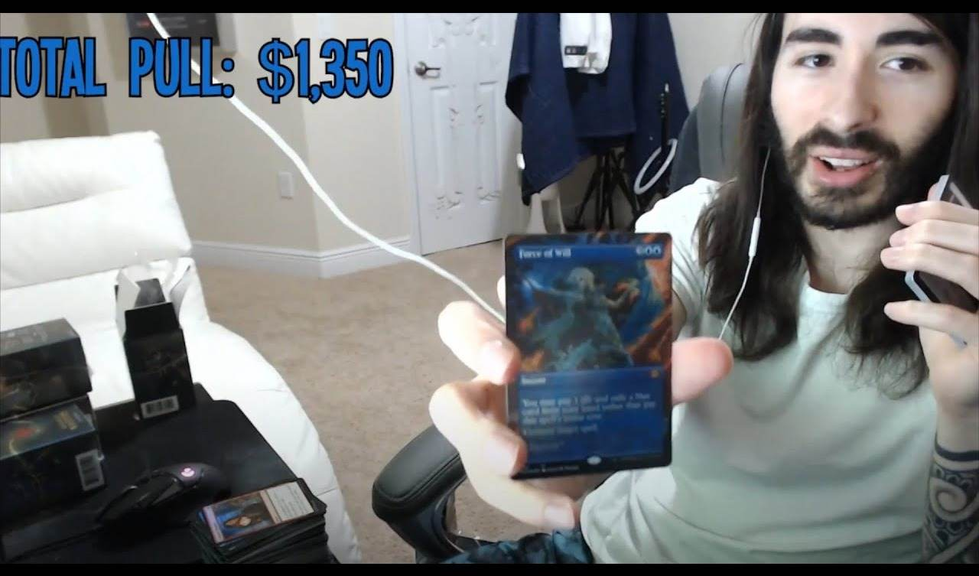
"My addiction"
Video: "I'm Still Not Addicted"
He often jokes that collecting cards is his "addiction".
But he has also made money from it: millions of people have watched his videos.
Thumbnail: penguinz0 on YouTube (i.ytimg.com)
Notes:
"Addiction" joke: https://youtube.fandom.com/wiki/Penguinz0 ("Charlie jokingly calls it an addiction")
Money / views: https://medium.com/exploring-sobriety/youtuber-penguinz0s-important-lesson-about-addiction-3f512f150140
Thumbnail: https://i.ytimg.com/vi/cqUcJrJrQiU/maxresdefault.jpg ; video: https://www.youtube.com/watch?v=cqUcJrJrQiU ("I'm Still Not Addicted", penguinz0)

Slide 7
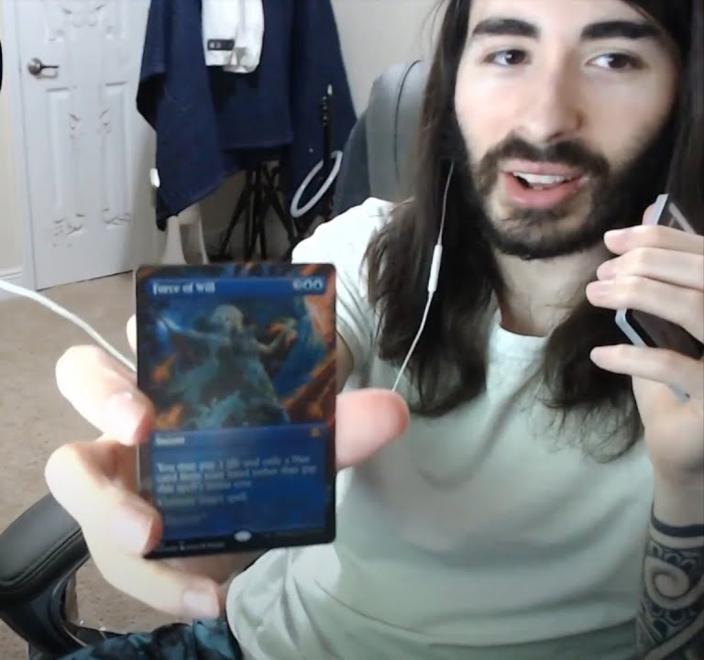
Grammar in the story
Past simple
He started opening packs in 2019.
He posted a video in 2022.
He showed his collection.
Rule: exact past time (in 2019, in 2022, ago, last ...)
Present perfect
He has spent thousands of dollars.
He has put his cards in frames.
Millions of people have watched his videos.
Rule: no exact time, result now (so far, already, ever, since, for)
Thumbnail: penguinz0 on YouTube (i.ytimg.com)
Notes:
Example sentences use facts from earlier slides: https://youtube.fandom.com/wiki/Penguinz0 ; https://fabledframing.co.uk/blogs/journal/moistcr1tikal-penguinz0-yu-gi-oh-collection ; https://medium.com/exploring-sobriety/youtuber-penguinz0s-important-lesson-about-addiction-3f512f150140
Photo: thumbnail of penguinz0 "I'm Still Not Addicted": https://www.youtube.com/watch?v=cqUcJrJrQiU

Slide 8
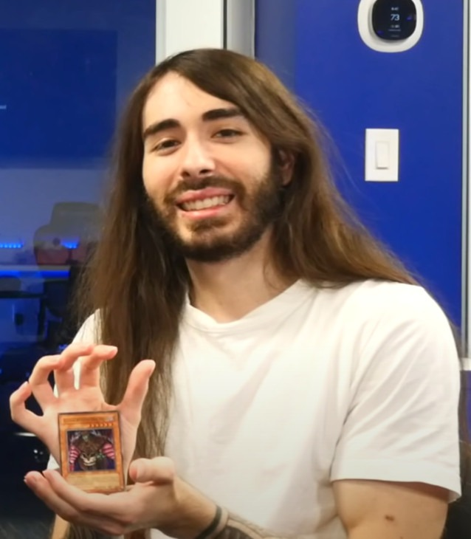
Thank you!
Any questions?
Photo: Ruxin34 / Wikimedia Commons, CC BY 3.0
Notes:
Photo: "Cr1TiKaL in 2022 - 2.jpg" by Ruxin34, Wikimedia Commons, CC BY 3.0: https://commons.wikimedia.org/wiki/File:Cr1TiKaL_in_2022_-_2.jpg

