Slide 1
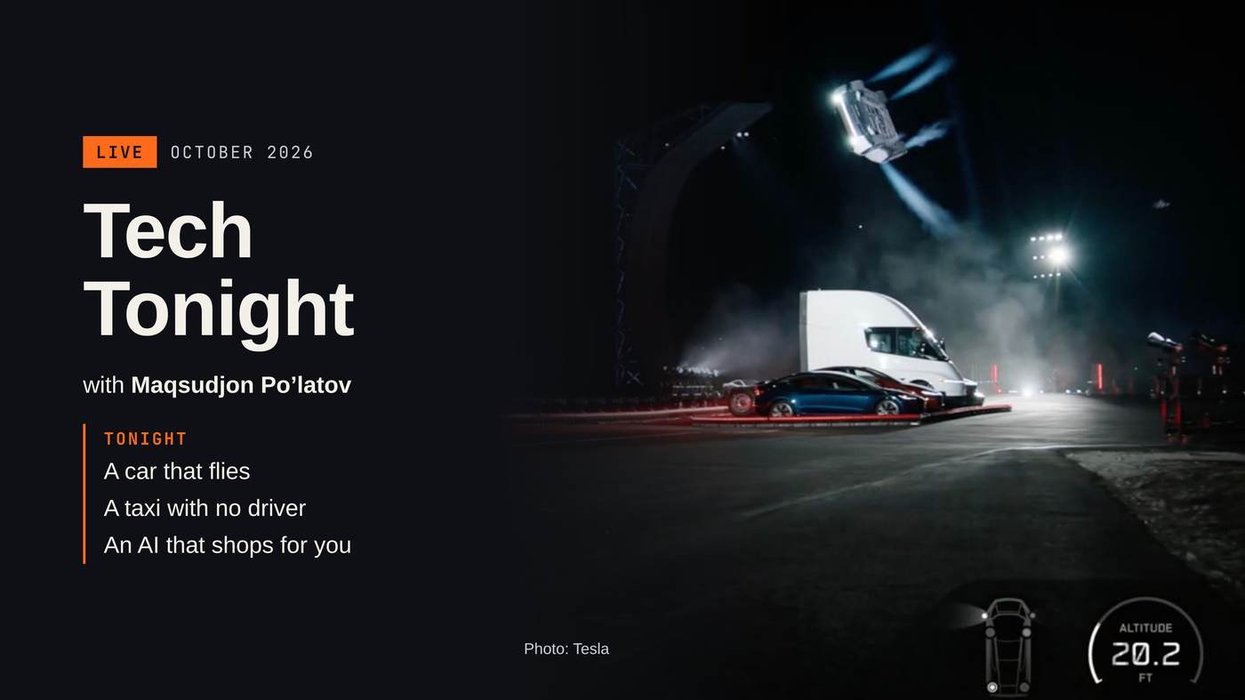
Notes:
Good evening! Welcome to Tech Tonight. I’m Maqsudjon. Tonight: a car that flies, a taxi with no driver, and an AI that shops for you.

Slide 2
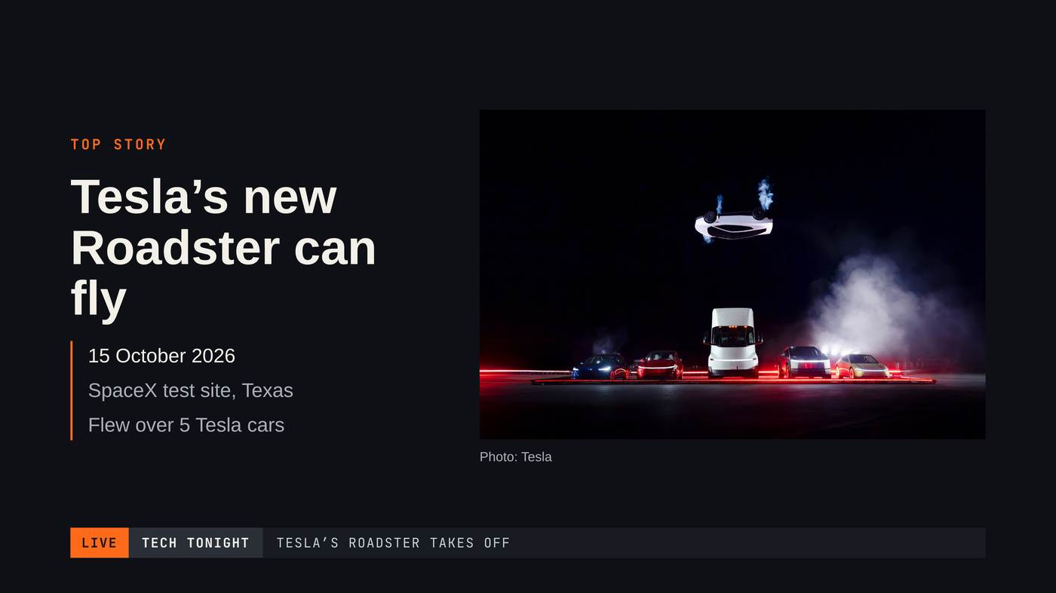
Notes:
On October 15th, Tesla showed its new Roadster. And this car can fly!

Slide 3
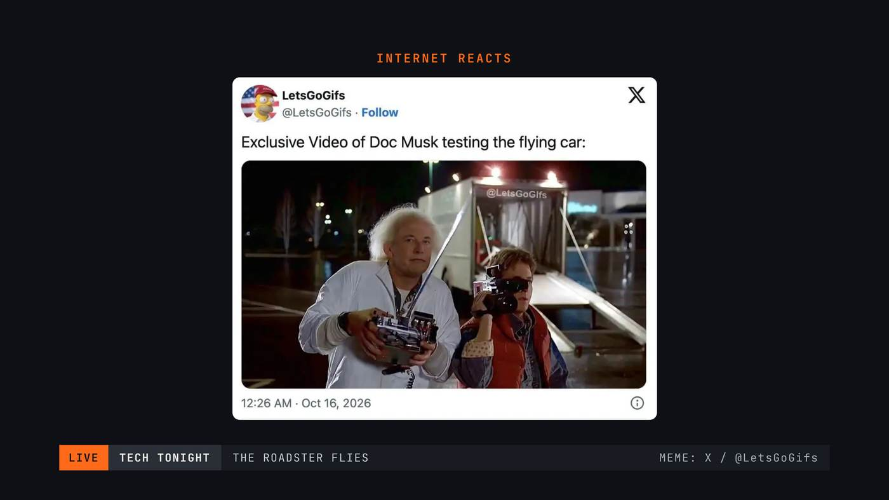
Notes:
The internet reacted very fast. [Pause. Let them laugh.]

Slide 4
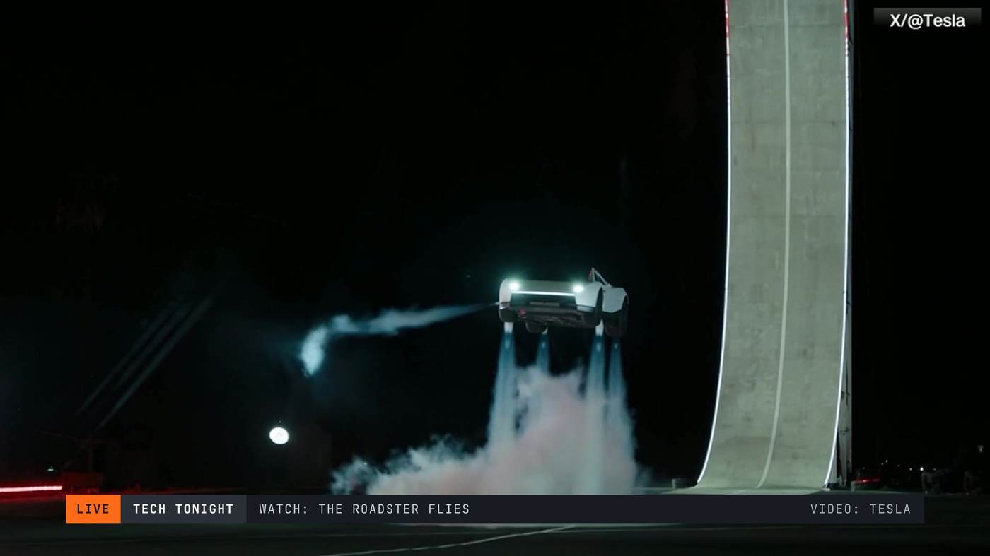
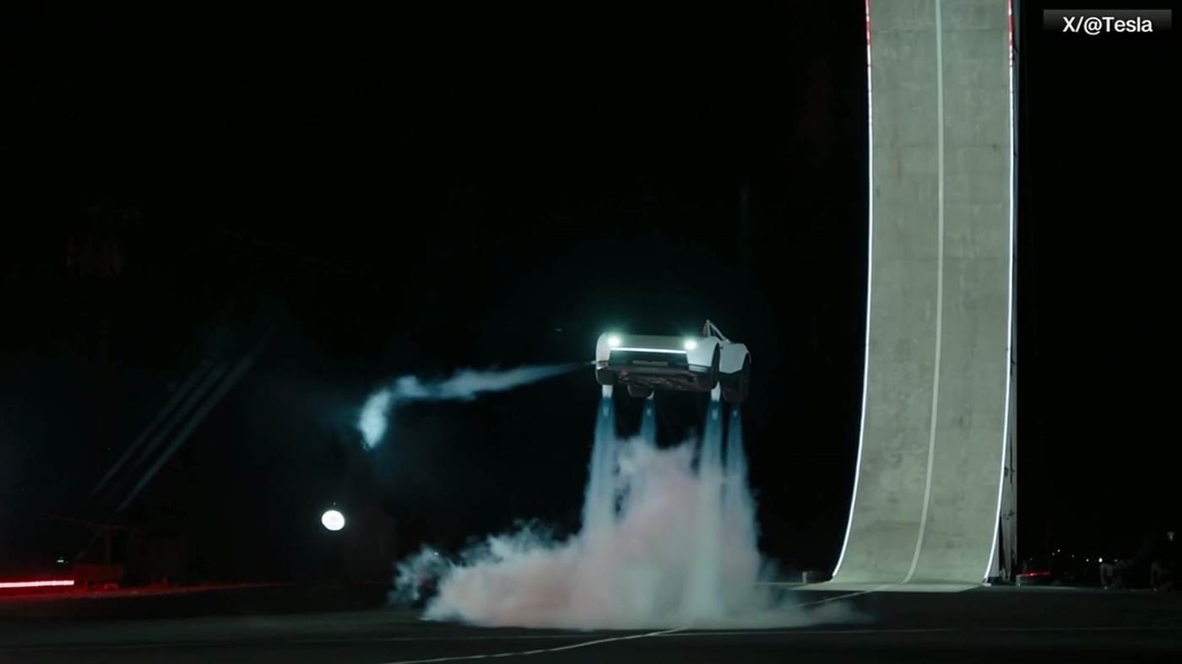
Notes:
And this is the real video. [Let it play.]

Slide 5
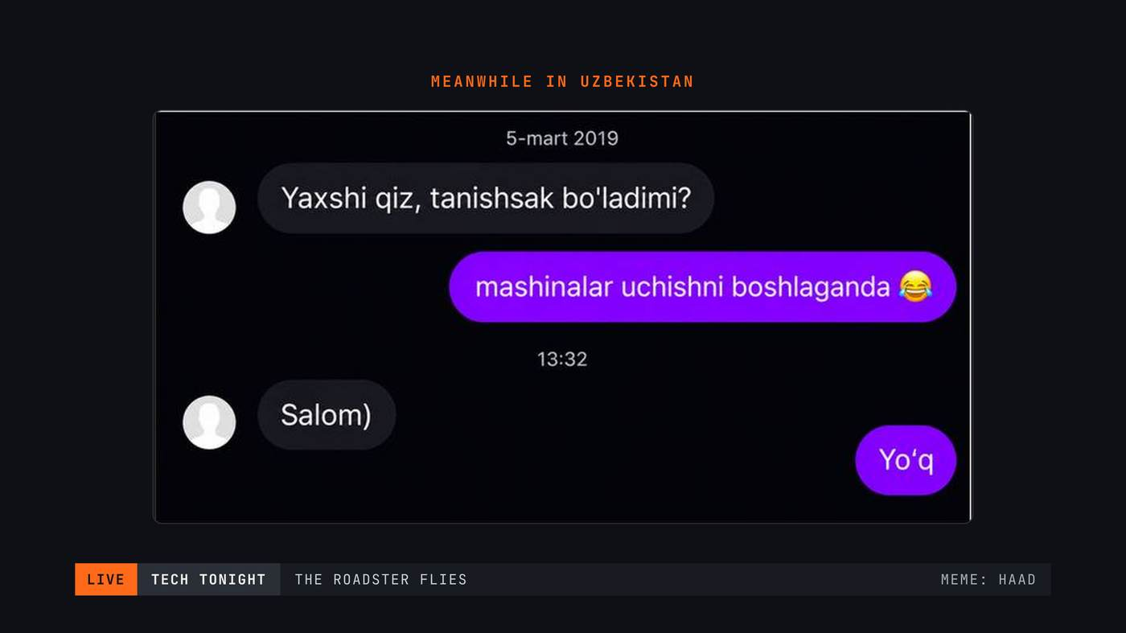
Notes:
And the Uzbek internet was ready too. [Pause. Let them read and laugh.]

Slide 6
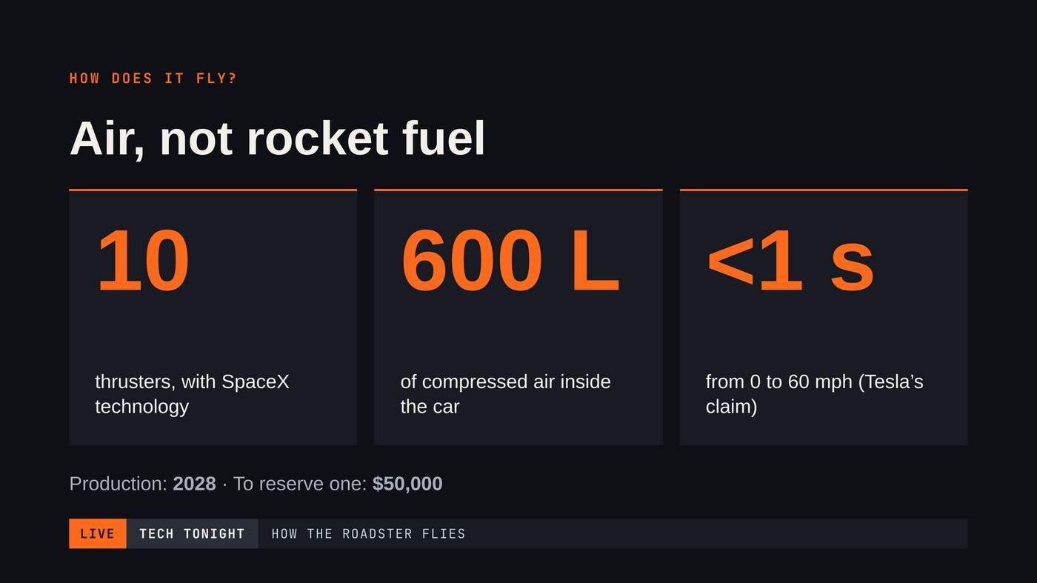
Notes:
How does it fly? With air! Ten thrusters. Six hundred liters of air. Zero to sixty in under one second. And to reserve one: fifty thousand dollars!

Slide 7
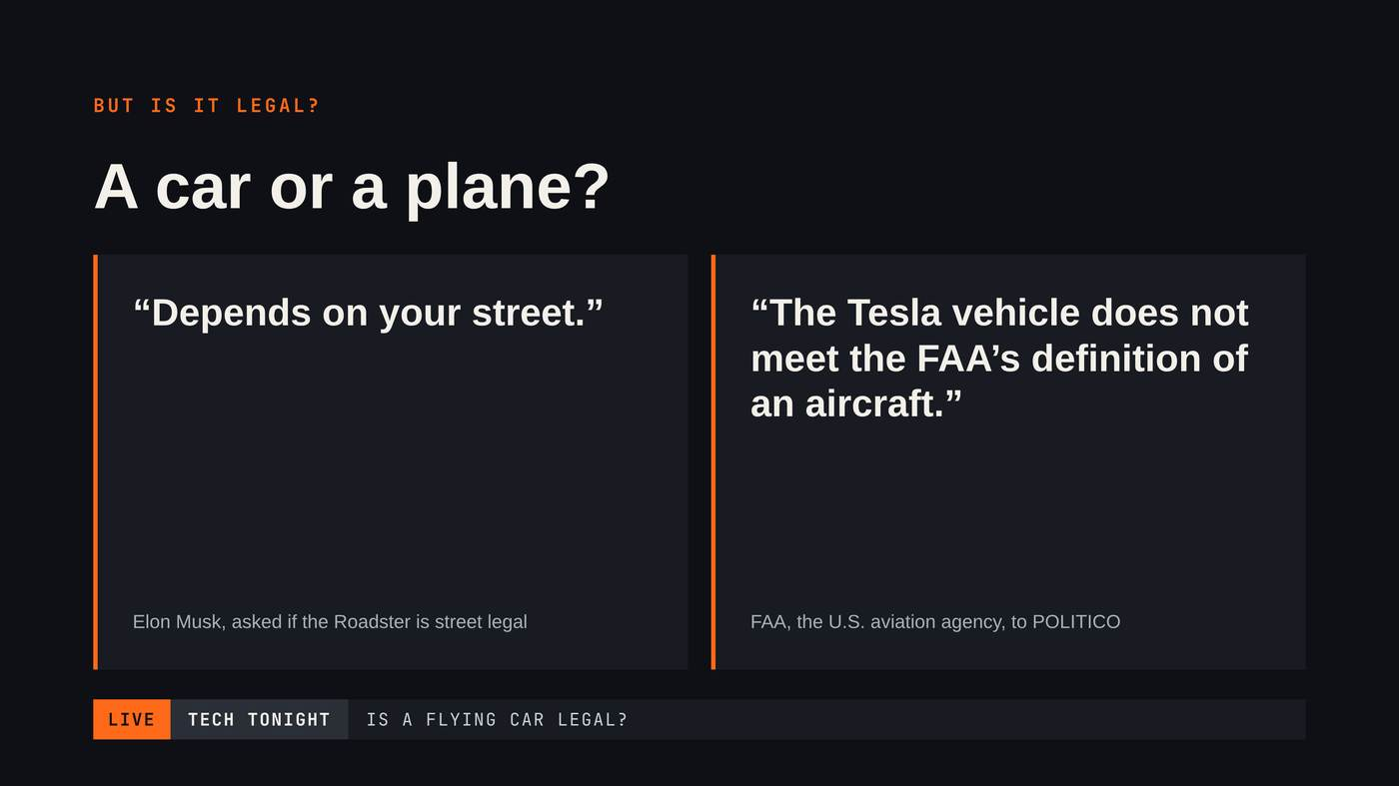
Notes:
But is it legal? Elon Musk says: “Depends on your street.”

Slide 8
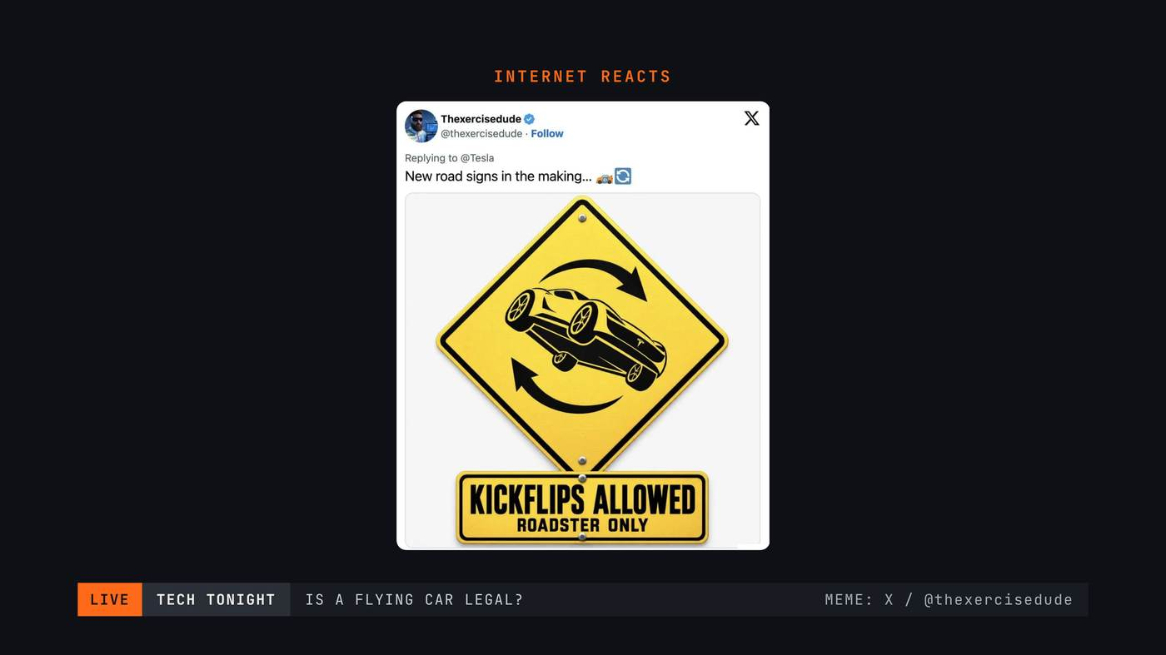
Notes:
So, new road signs are coming. [Pause.]

Slide 9
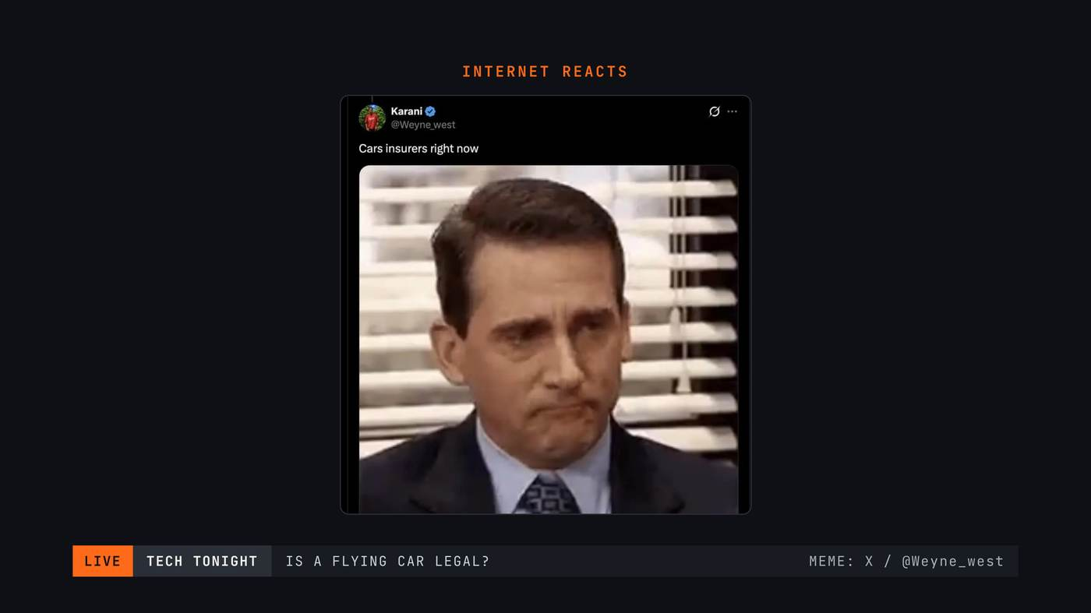
Notes:
And car insurance companies right now… [Pause.]

Slide 10
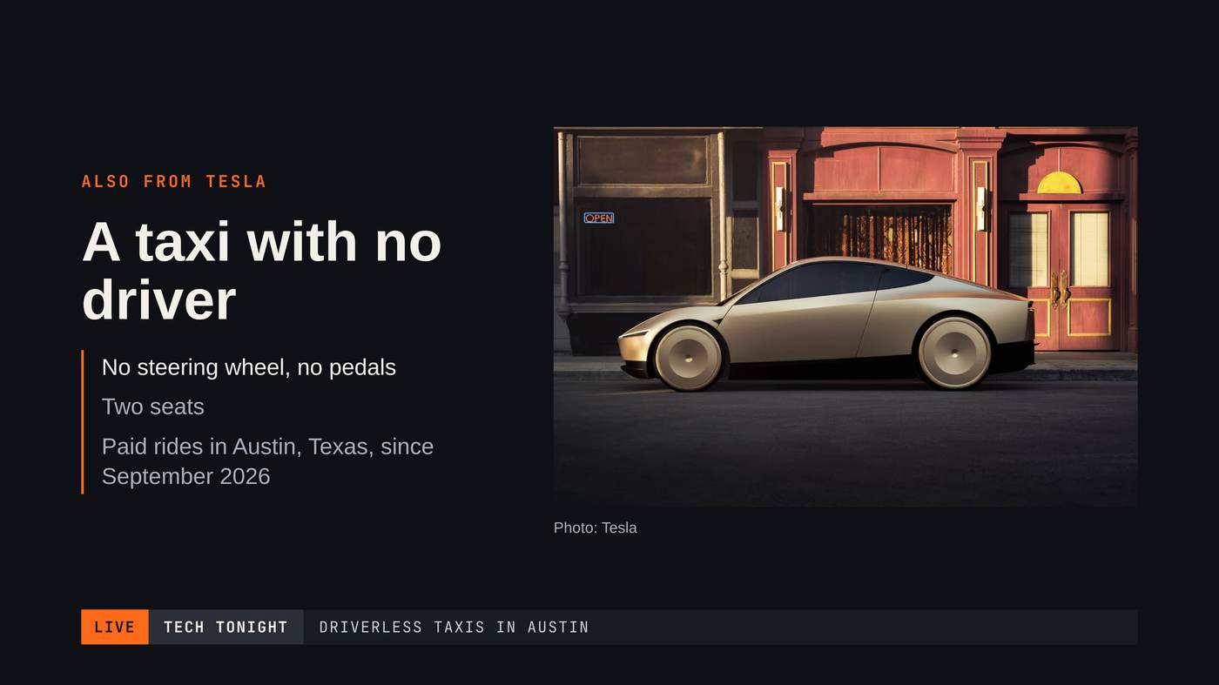
Notes:
Tesla also has a taxi with no driver. In Texas, people already ride in it.

Slide 11
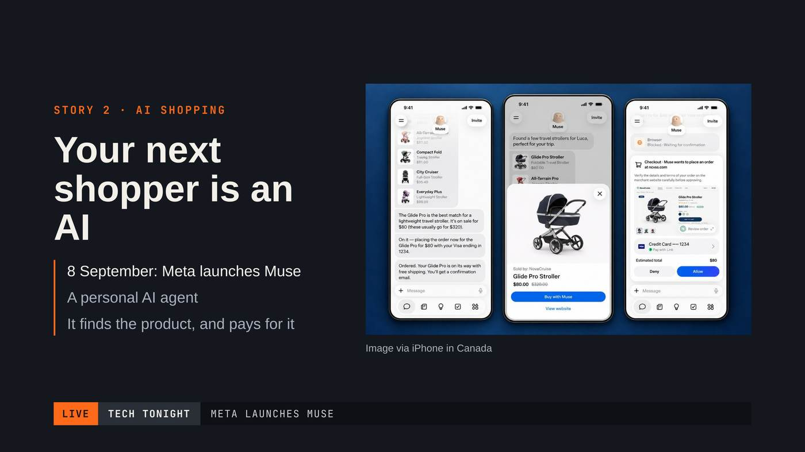
Notes:
Story two. Meta made Muse: an AI that shops for you. It finds the product and pays for it.

Slide 12
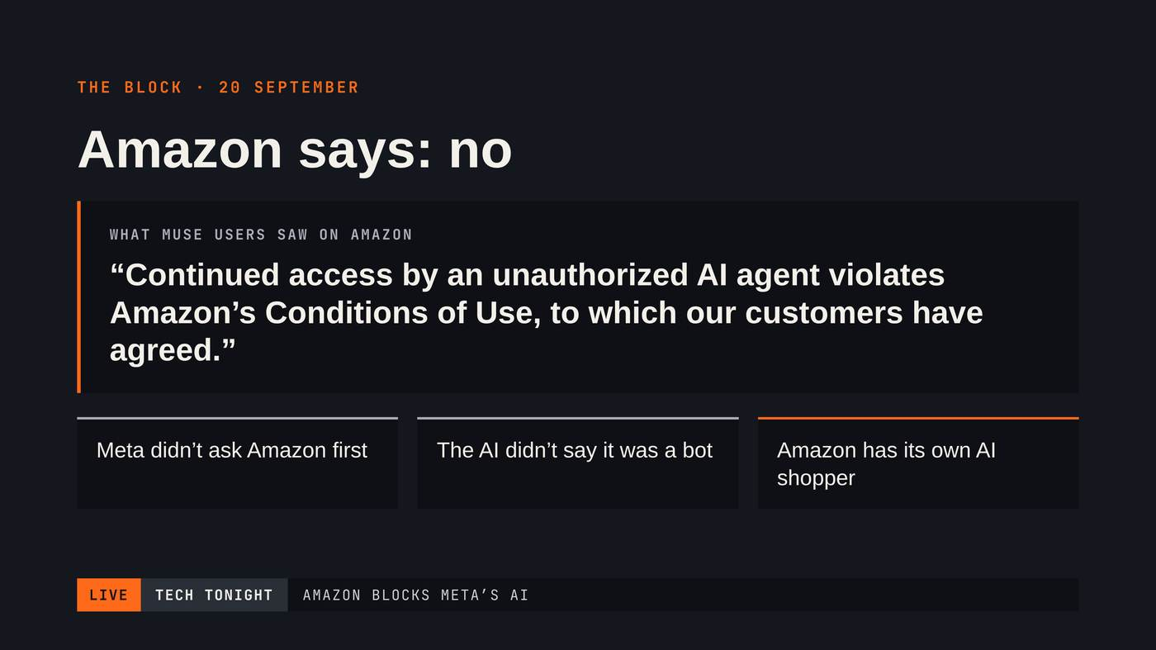
Notes:
But Amazon said no and blocked it.

Slide 13
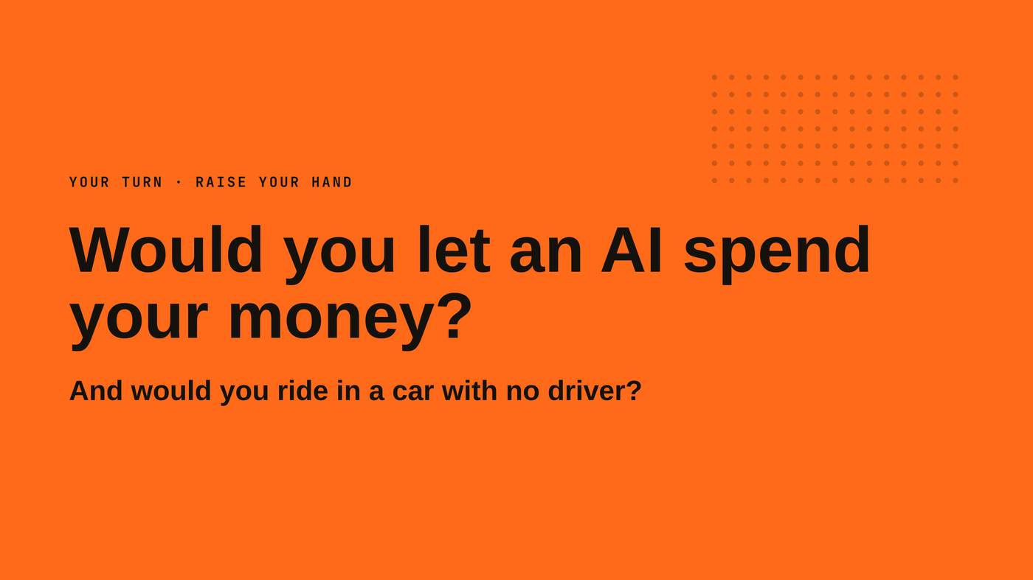
Notes:
A question for you. Raise your hand: who would let an AI spend your money? [Pause.] And who would ride in a car with no driver? [Pause.]

Slide 14
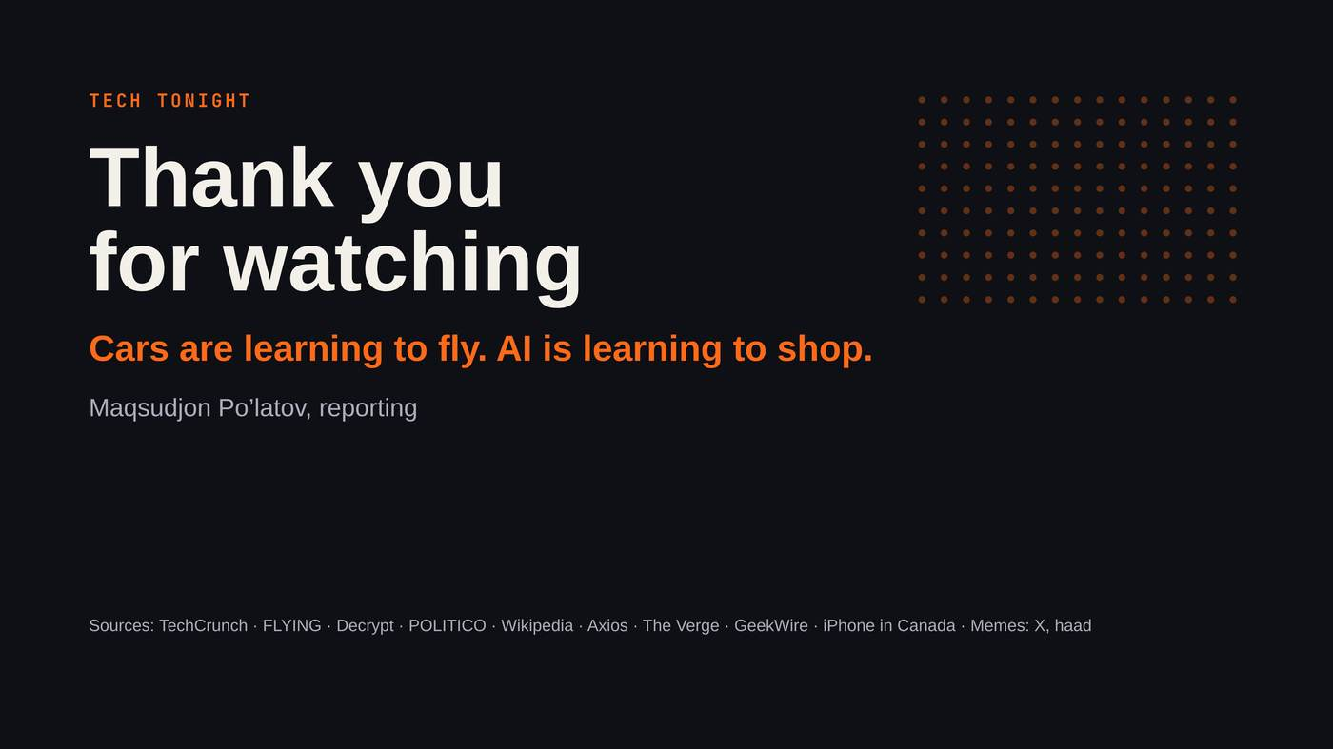
Notes:
Cars are learning to fly, and AI is learning to shop. That’s all for Tech Tonight. Thank you for watching!

