Slide 1

A FILM THAT MADE ME THINK A LOT

Slide 2
To be honest, I only watch movies once in a blue moon since I don’t have a lot of free time. However, there’s one movie that really moved me and which I consider my greatest inspiration every time I feel like giving up and that’s the 2006 movie, The Pursuit of Happyness. That movie was released more than a decade ago but I got the chance to watch it some time last year when a friend of mine insisted on me watching it. The movie was starred by high-caliber actor Will Smith, together with his real-life son, Jaden Smith who acted as his young son in the movie and who was only eight years old then.

Slide 3

It’s still vivid in my memory how the movie left me teary-eyed witnessing the struggle of Chris Gardner, played by Will Smith.

Slide 4
To give you a synopsis of that movie, Chris became a single father after his wife left him because of financial instability. He was evicted from his apartment with his son for failing to pay the rent, and because of that, they ended up sleeping in a restroom at a station and in homeless shelters. Life’s a struggle for Chris but he refused to give in to despair and did his very best to create a better life for himself and his son. Because of his persistence, he’s able to get a job as a stockbroker and eventually became the owner of a multi-million dollar brokerage firm.

Slide 5
The story was really inspirational, I remember after watching that movie, I thought about my life – I thought about the personal struggles that I’d gone through and told myself that everything would be alright. Since then, that movie became my reminder to not lose hope whenever I face some difficulties that test my strength or when time comes that I doubt myself. If my friend hadn’t recommended that film and if I hadn’t spread time watching it and learned the valuable life lessons, I would have given up long before.

Slide 6

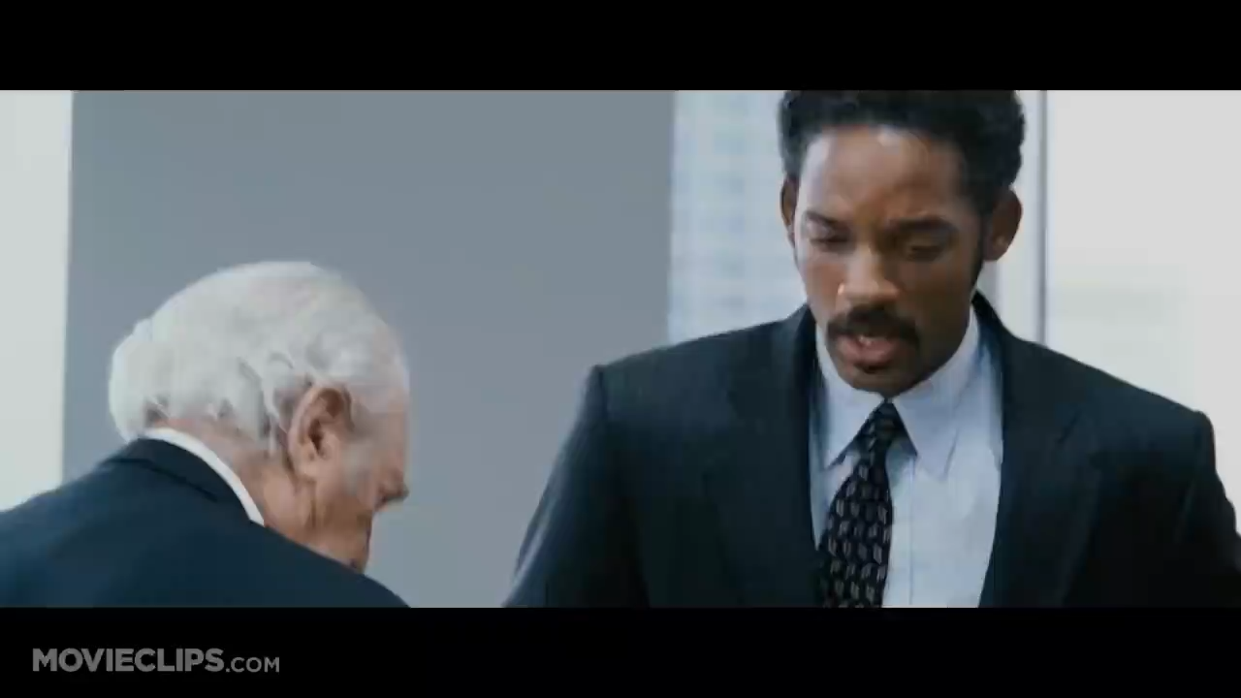
THE PURSUIT OF HAPPYNESS

Slide 7

THANK YOU
FOR YOUR ATTENTION!

