Slide 1
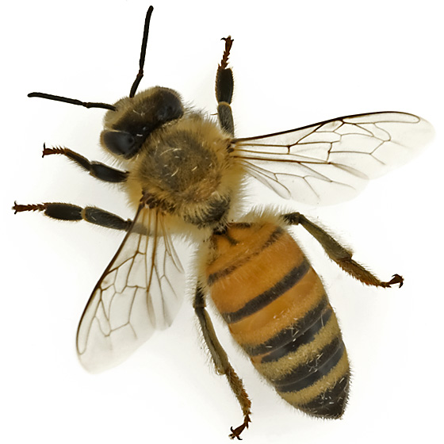
Floral visitors in urban gardens and natural areas: diversity and interaction networks in a neotropical urban landscape
L. Marin*, H Morales, P Sagot, R Vandame,
ME Martinez-Sanchez

Slide 2
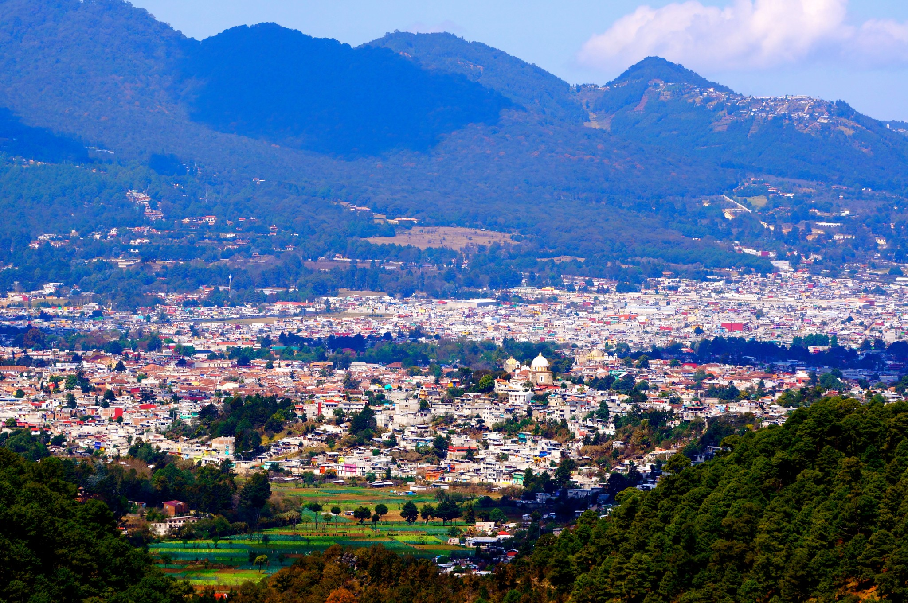
The study
Find sites
  9 urban gardens and 9 natural areas
  Get permissions
Sample floral visitors
  2 hours per site
  Capture and classify
Repeat each season
  Frost, dry, rainy
1301 observations

Slide 3
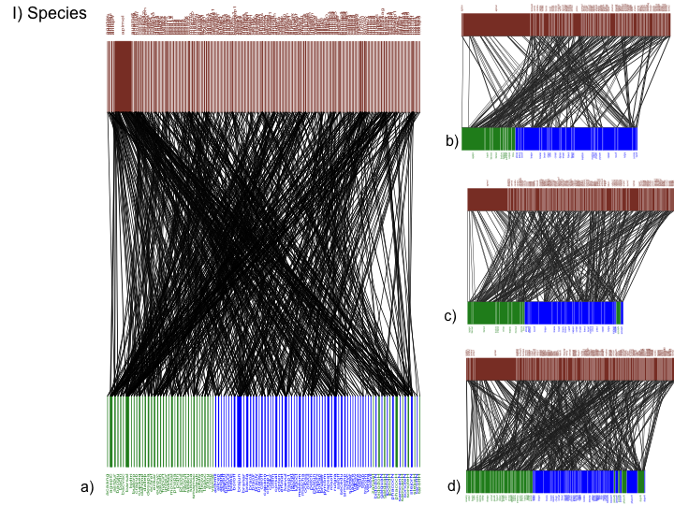
The study
Key properties:
Richness, abundance, and density
Specialisation, generality, and vulnerability
Seasonality

Slide 4
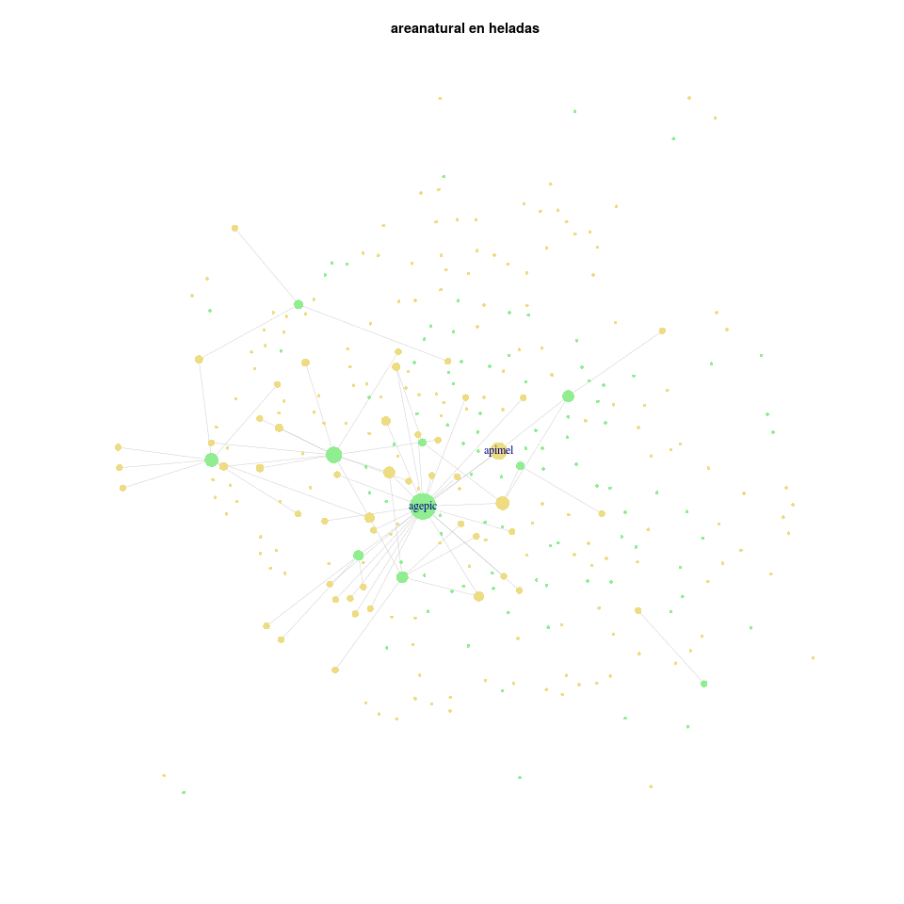
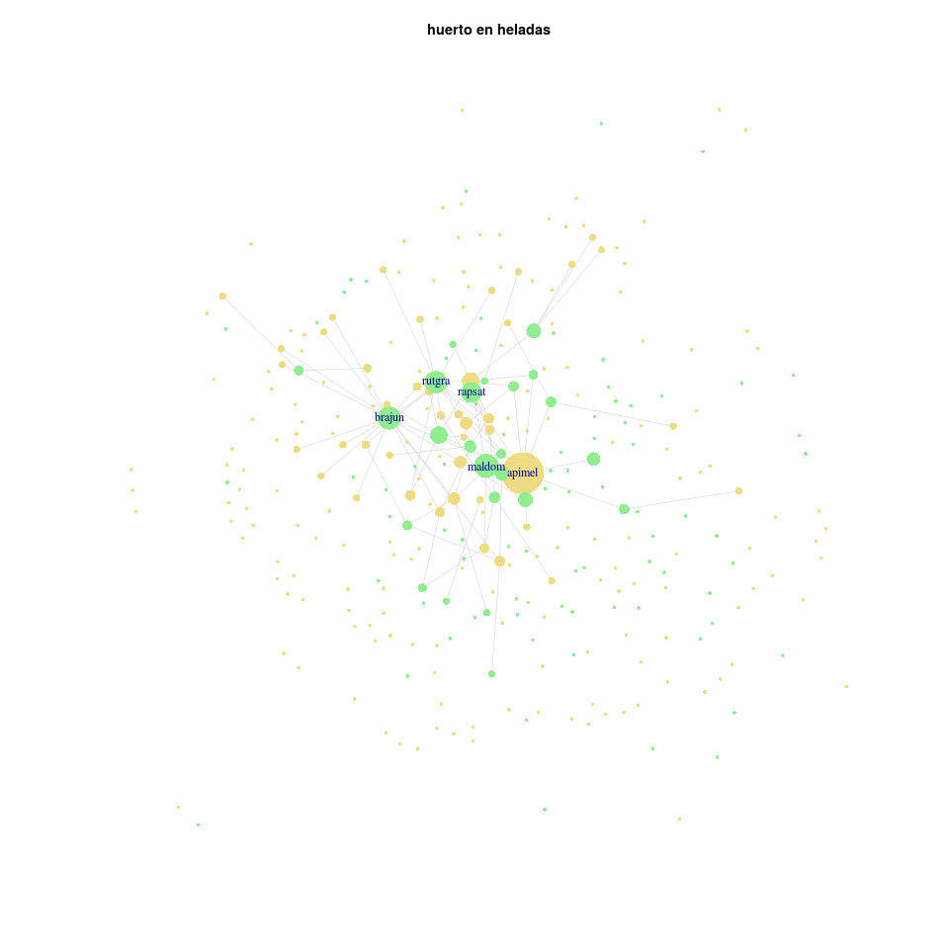
The naive approach

Slide 5
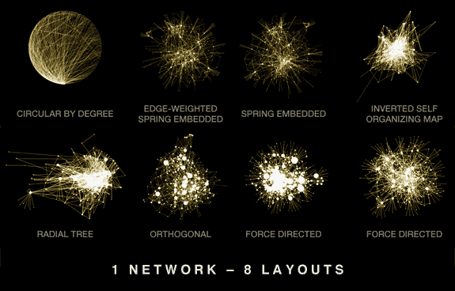
A common visualization problem
Martin Krzywinski http://www.hiveplot.com/

Slide 6
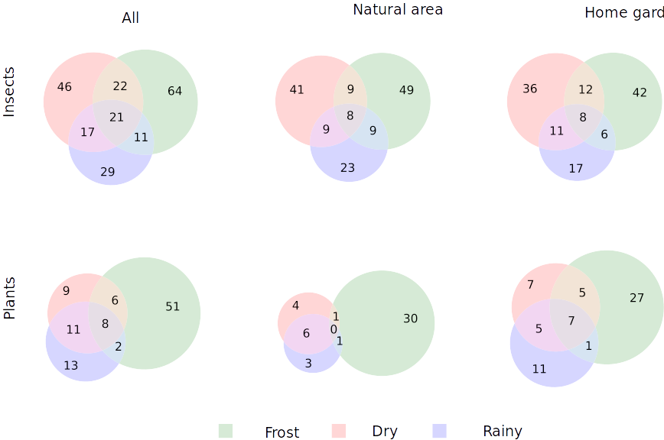
Properties
Matplotlib Venn3

Slide 7
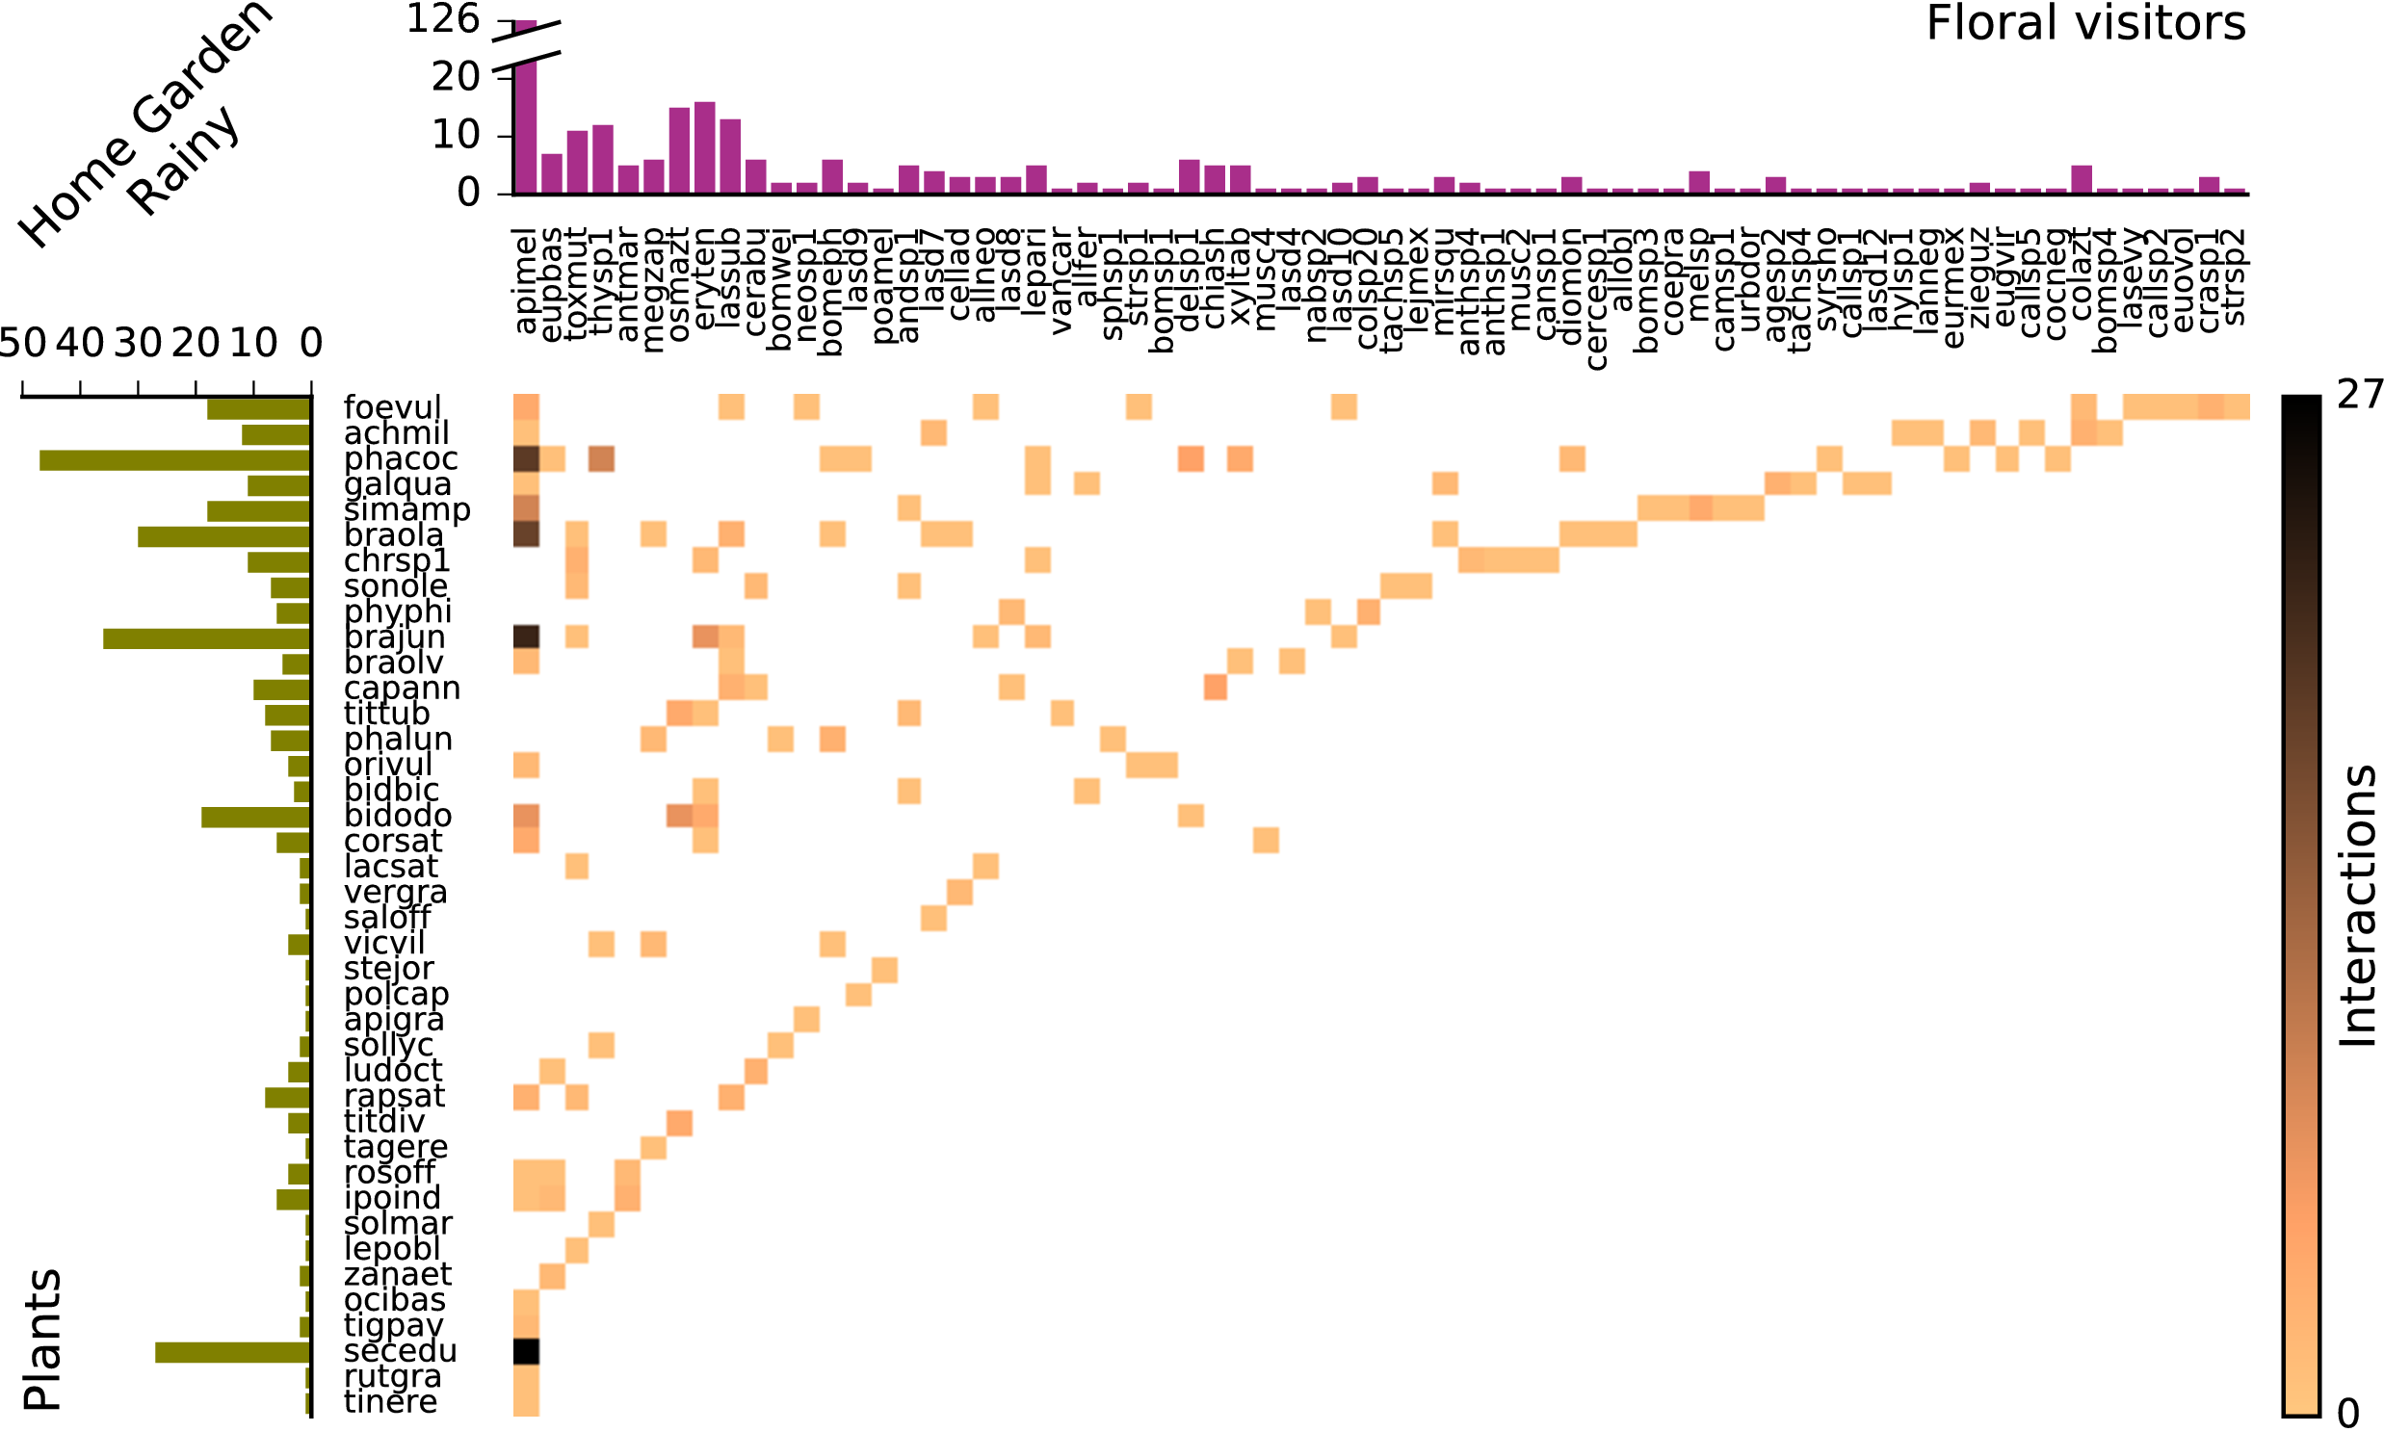
The network
So many bees!

Slide 8
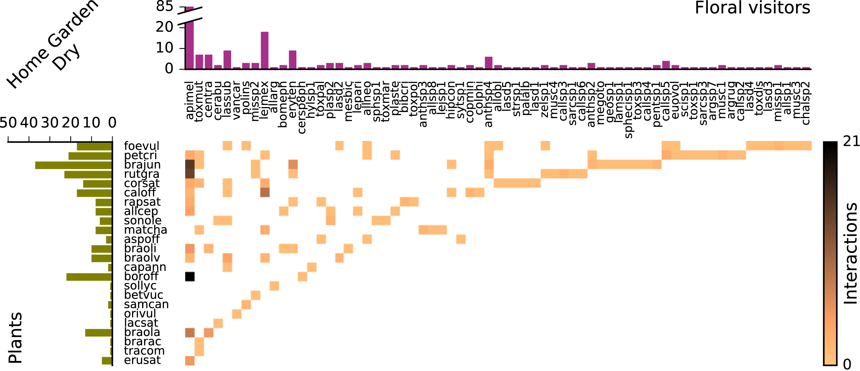
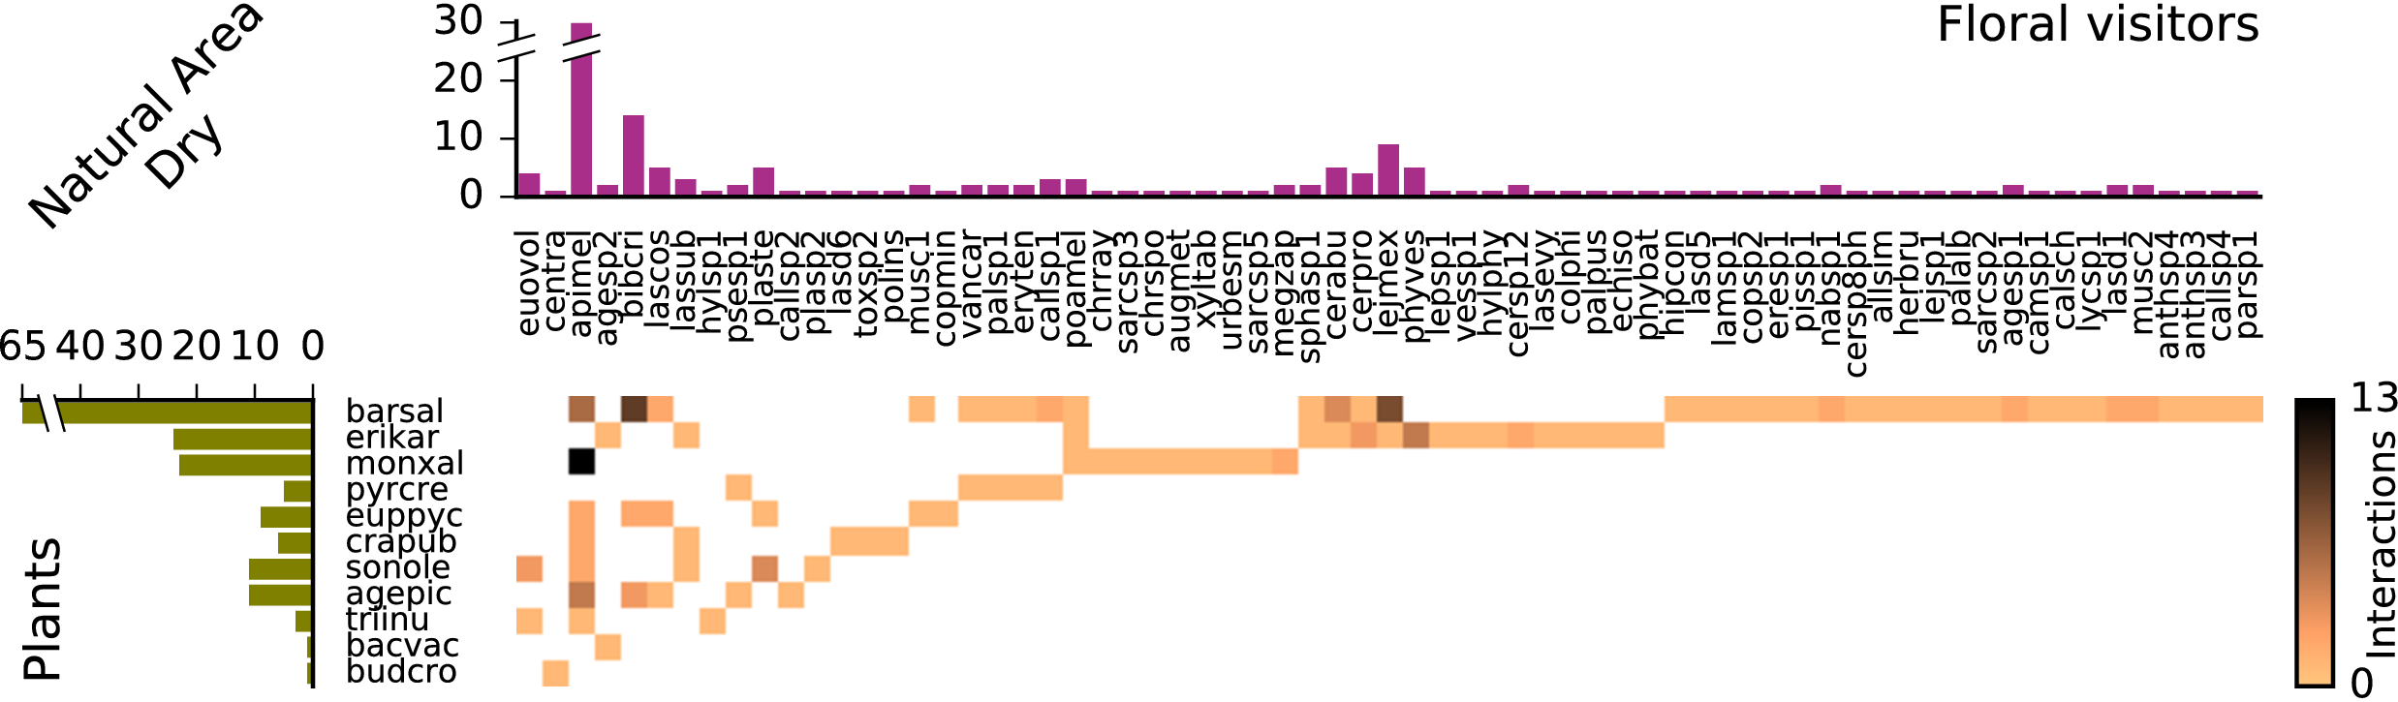
Compare and contrast
Richness
Abundance
Generality
Vulnerability
Communities*
Not nested*

Slide 9
Visualization
Exploratory and explanatory visualization
Decide what properties you are interested in
Plot properties, not networks
Visualizations that can be compared

Slide 10
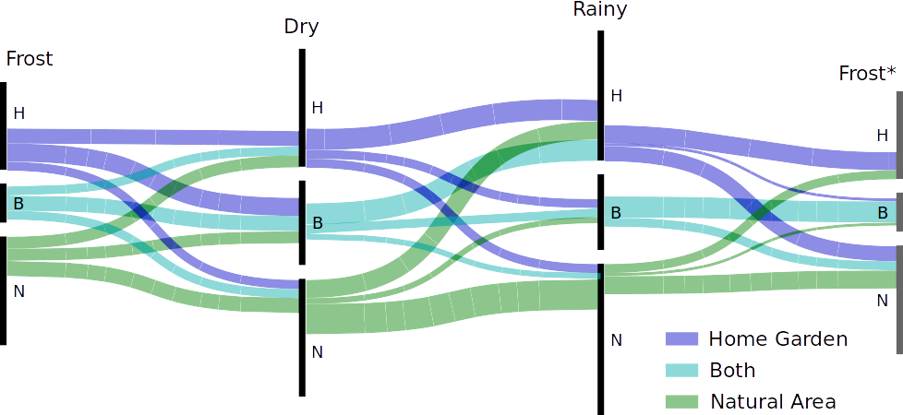
Extra: Seasonality

