Slide 1
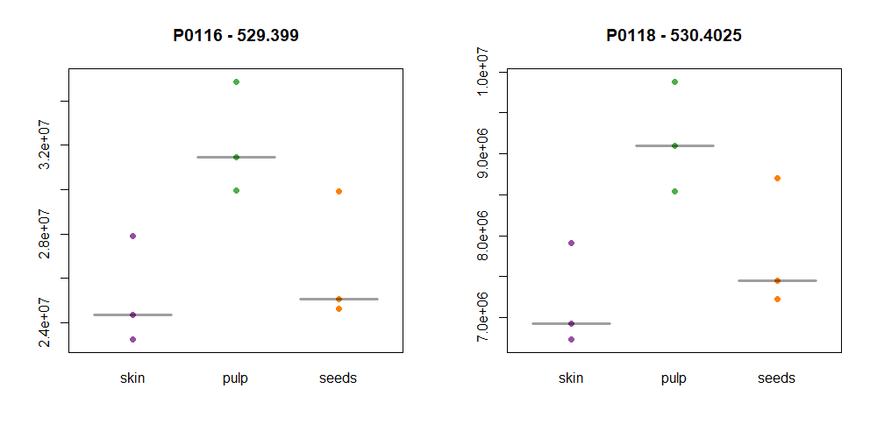
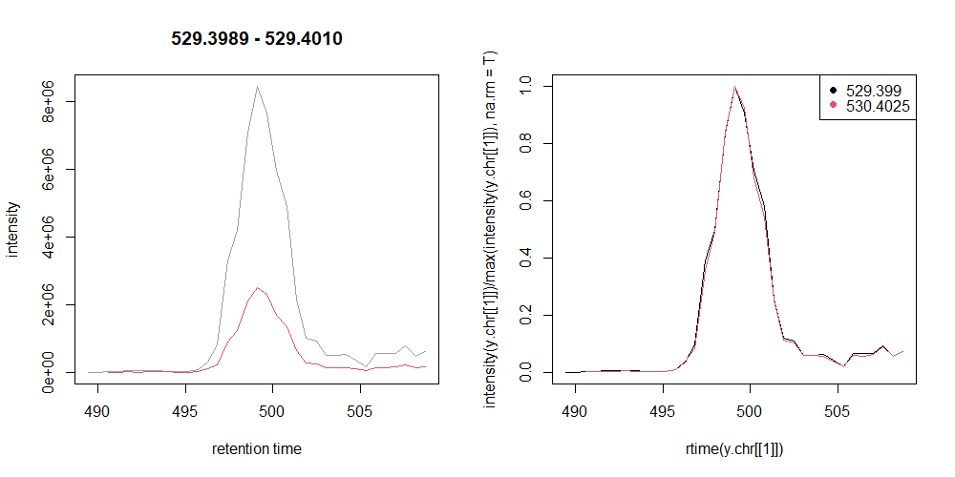
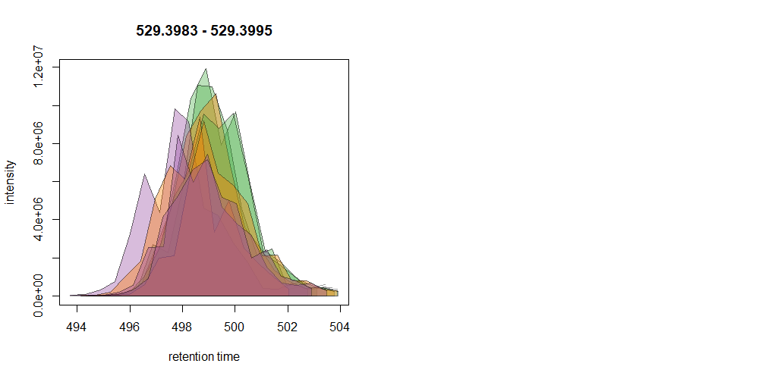
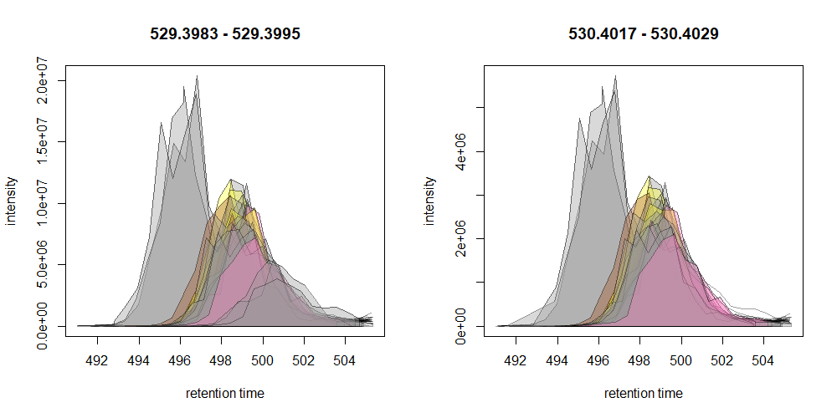
FG | compound | RT | NEG | POS | beh
P0002 | 18:1(d7) Lyso PC | 8.32 |  | 529.399 [M+H]+; 530.4025 13C[M+H]+ | pulp > (seeds & skin)

Slide 2
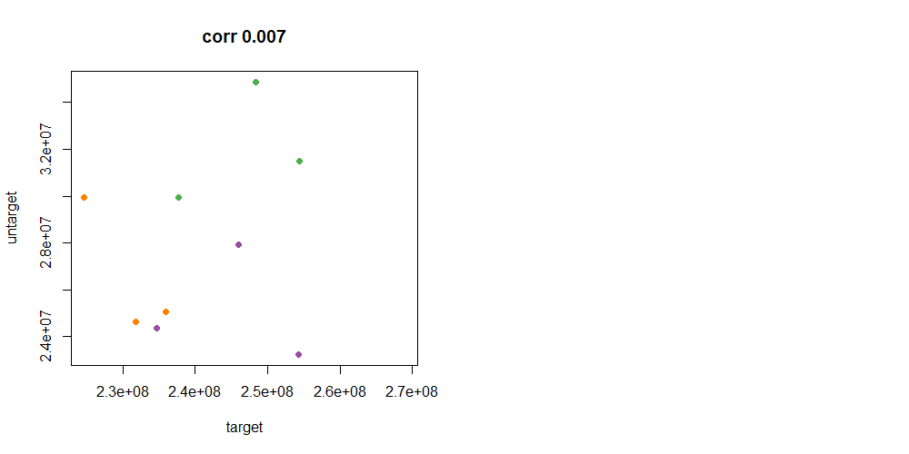

Slide 3
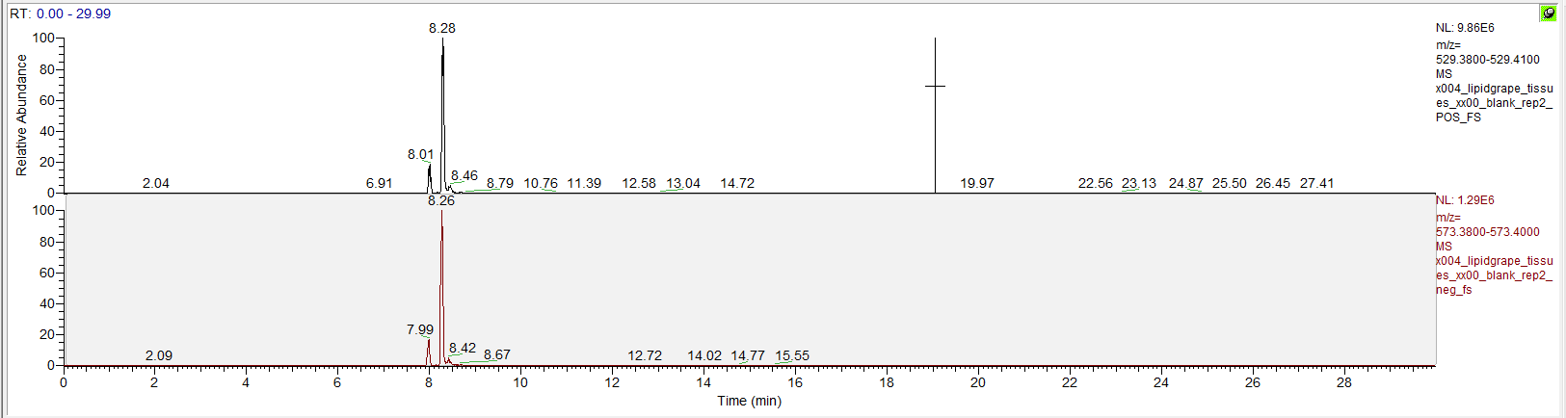
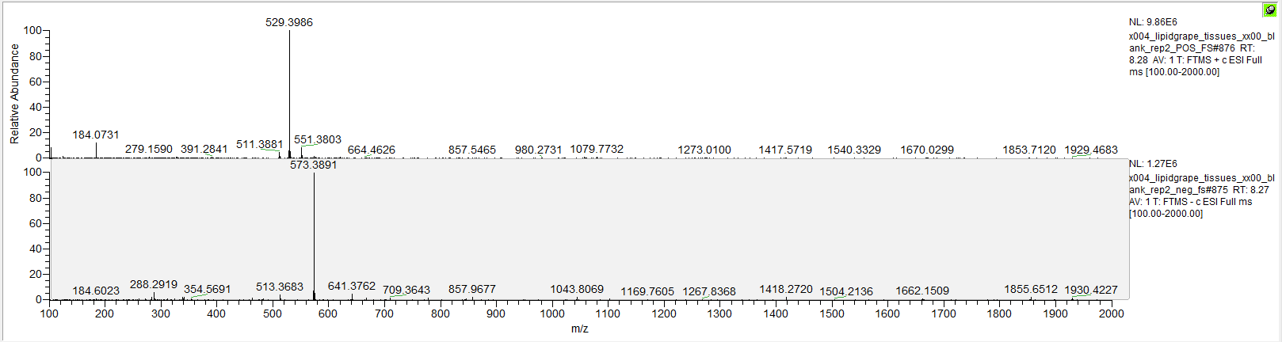
[M+H]+
[M-H+HCOOH]-
C26H45D7NO7P

Slide 4
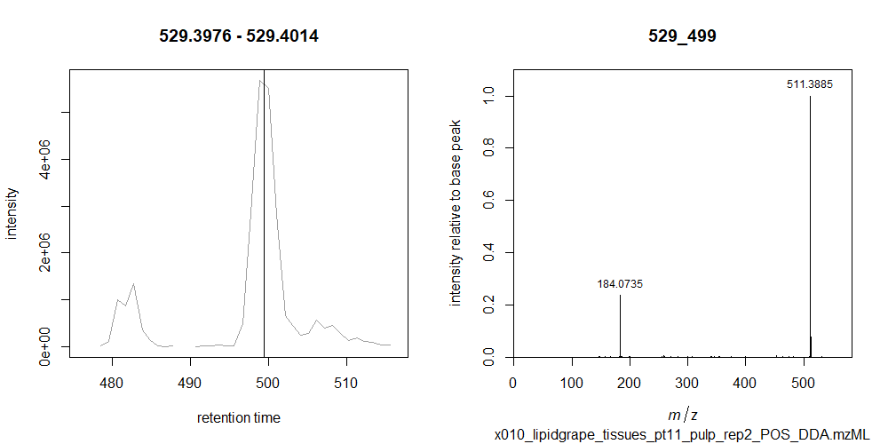
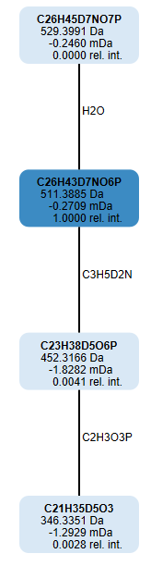
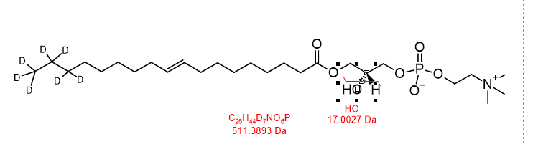
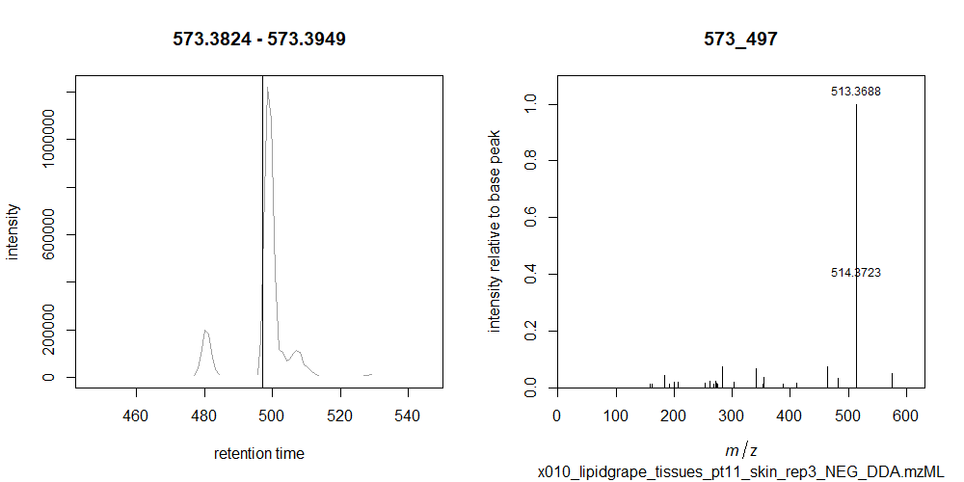
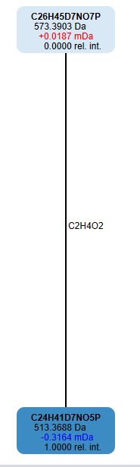
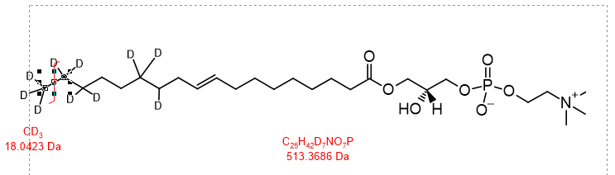
x010_lipidgrape_tissues_pt11_pulp_rep2_POS_DDA.mzML
x010_lipidgrape_tissues_pt11_skin_rep3_NEG_DDA.mzML
C2H4O2-CH2O2=CH2

