Slide 1
COVERD SECTIONS :
paper summary.
Project description
Import data set.
Import all necessary libraries.
Preprocess the images by scaling them and reshaping them to fit the input shape of the CNN.
Build a CNN model using the TensorFlow library.
Compile the model and train the CNN on the training set.

Slide 2
COVERD SECTIONS cont :
Evaluate model performance on the Training set.
Save the trained model.
Visualize the performance of the CNN by displaying the ROC curve and the confusion matrix.
Visualization of Predictions with Confidence
Visualize the dataset by making a boundaries over every detected character and displaying random samples of the images.

Slide 3

paper summary:
Author name | I Khandokar1, M Hasan Md1, F Ernawan1, S Islam Md1 and M N Kabir1
Paper name | Handwritten character recognition using cnn
Publisher name | Published under licence by IOP Publishing Ltd
Year of publication | 2021
Dataset used
To test the HCR system
NIST database has been used. To assess the performance of CNN algorithm, we experimented with the
dataset NIST and found the accuracy of handwritten characters. The handwritten characters in NIST are
given as images. The images are split into training and testing sets. Training is carried out with various
number of images; then testing is conducted to find the accuracy of the CNN.
The implemented algorithm
The implemented algorithm is the CNN architecture algorithm ,Three types of layers used the conv layer , pooling and finally the fully connected and the training worked on 4 stages [pre-processing -segmentation -Feature extraction -Training and prediction]
The result
The result of this algorithm is a text formed from the input image which contains the characters

Slide 4
paper summary Cont:
Abstract. Handwritten character recognition (HCR) is the detection of characters from images,
documents and other sources and changes them in machine-readable shape for further
processing. The accurate recognition of intricate-shaped compound handwritten characters is
still a great challenge. Recent advances in convolutional neural network (CNN) have made great
progress in HCR by learning discriminatory characteristics from large amounts of raw data. In
this paper, CNN is implemented to recognize the characters from a test dataset. The main focus
of this work is to investigate CNN capability to recognize the characters from the image dataset
and the accuracy of recognition with training and testing. CNN recognizes the characters by
considering the forms and contrasting the features that differentiate among characters. Our CNN
implementation is experimented with the dataset NIST to obtain the accuracy of handwritten
characters. Test result provides that an accuracy of 92.91% accuracy is obtained on 200 images
with a training set of 1000 images from NIST.

Slide 5
Project description:
Information on the selected dataset :
DatasetName | Handwriting Recognition Handwritten characters
Link of the dataset | https://www.kaggle.com/datasets/landlord/handwriting-recognition?datasetId=818027 https://www.kaggle.com/datasets/vaibhao/handwritten-characters
Total number of samples | Train samples are about 600k image Validation samples = 270k images Test samples = 380k image
Dimension of image | (32*32) grey scale
Classification | 25 class from (a~z) both lowercase and uppercase
Implementation details
The ratio user for training is : 133218 90%
The ratio of validation is : 6651 10 %
Testing on names dataset : 388k images

Slide 6
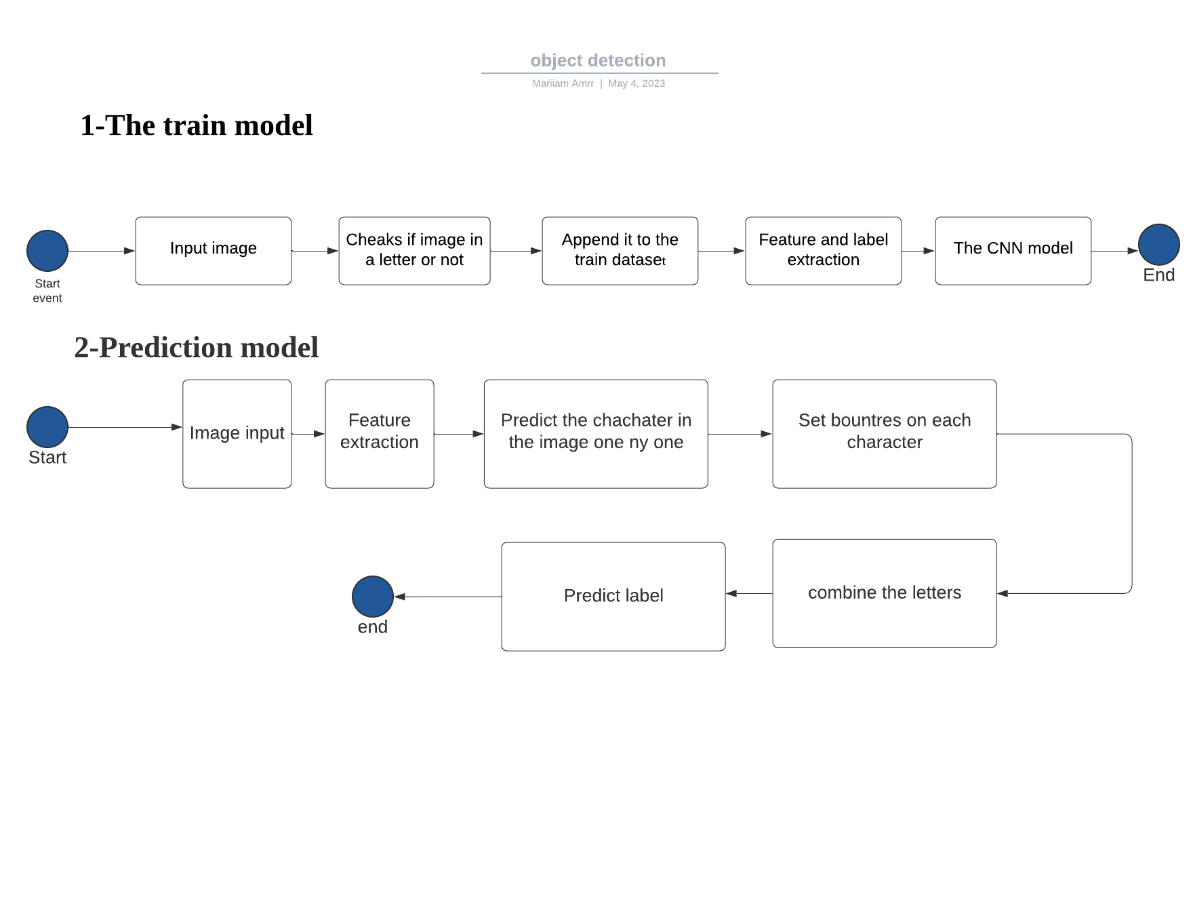
block diagram:

Slide 7
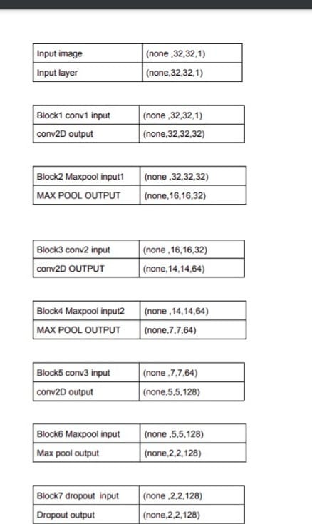
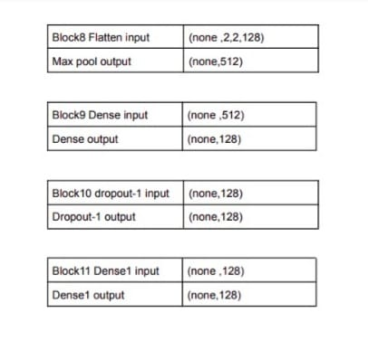
block diagram:

Slide 8
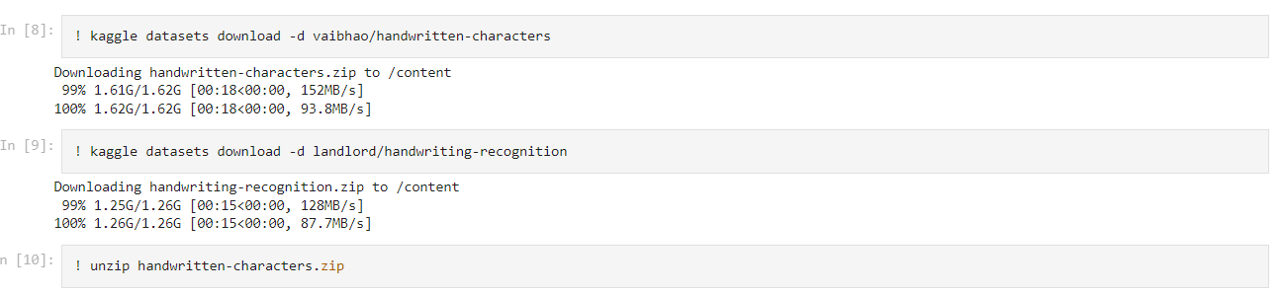
Importing the data set:

Slide 9
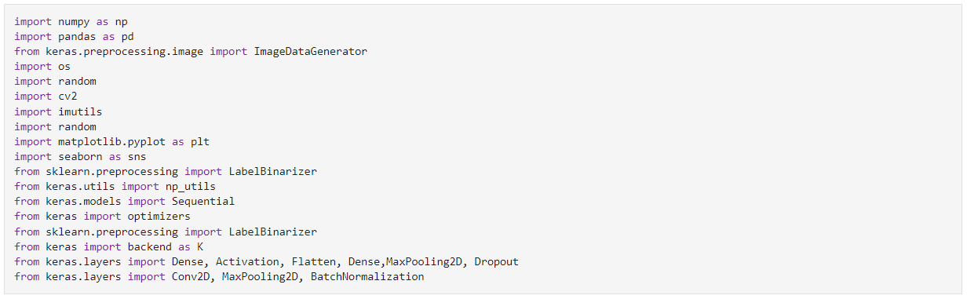
Import all necessary libraries:

Slide 10
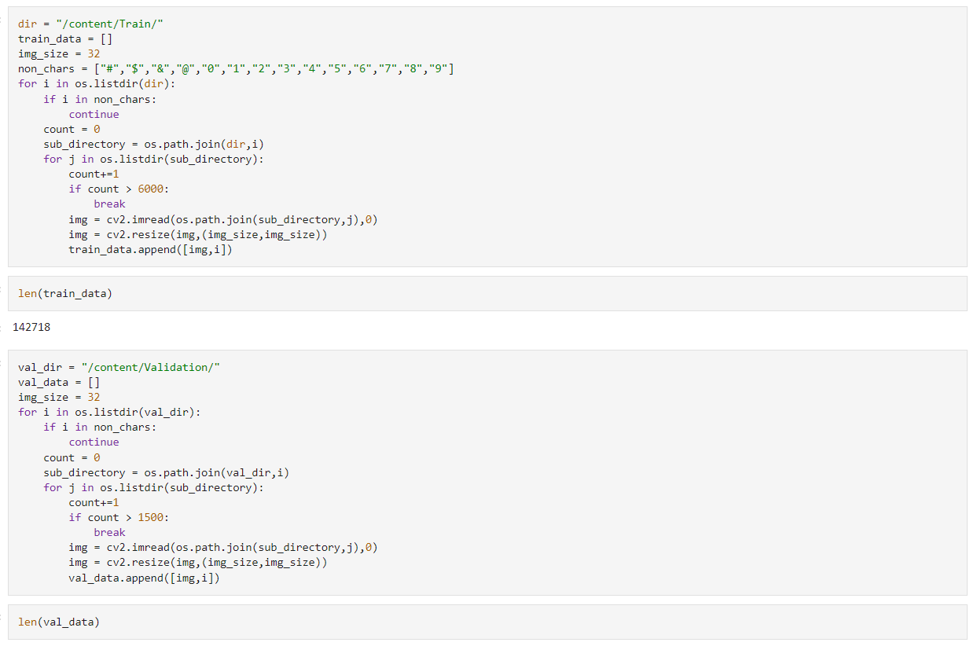
Preprocess the images by scaling them and reshaping them to fit the input shape of the CNN.

Slide 11
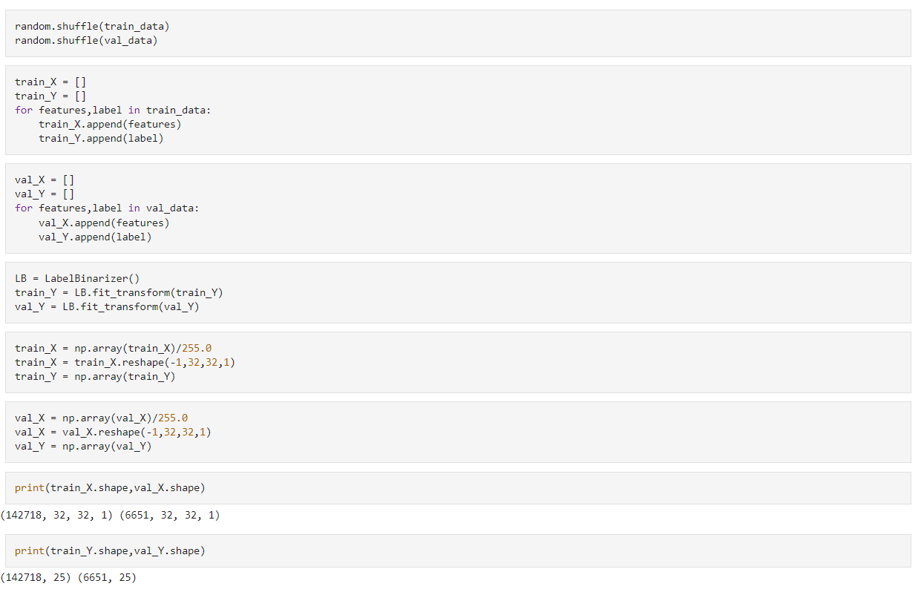
Train Model :

Slide 12
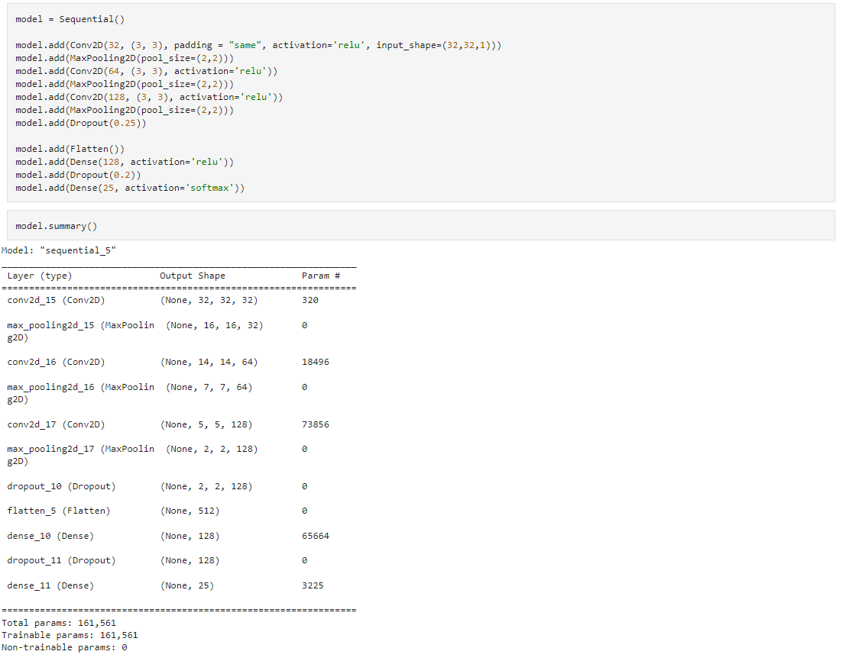
Build a CNN model using the TensorFlow library.

Slide 13
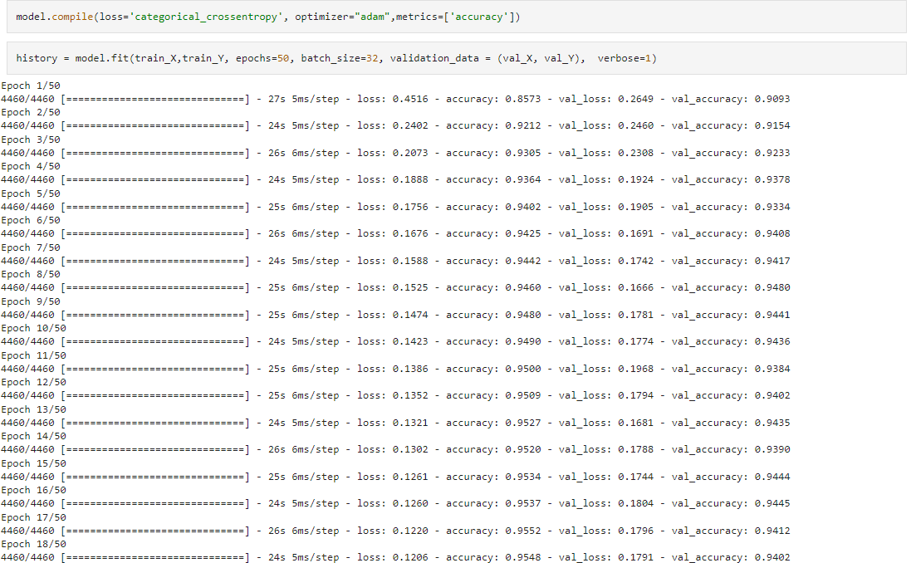
Compiling the cnn model

Slide 14
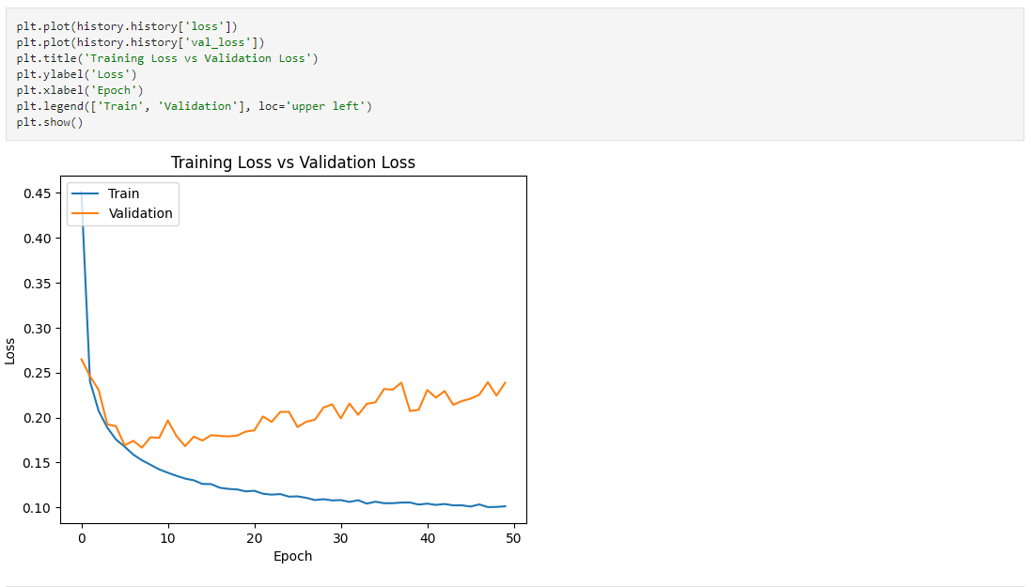
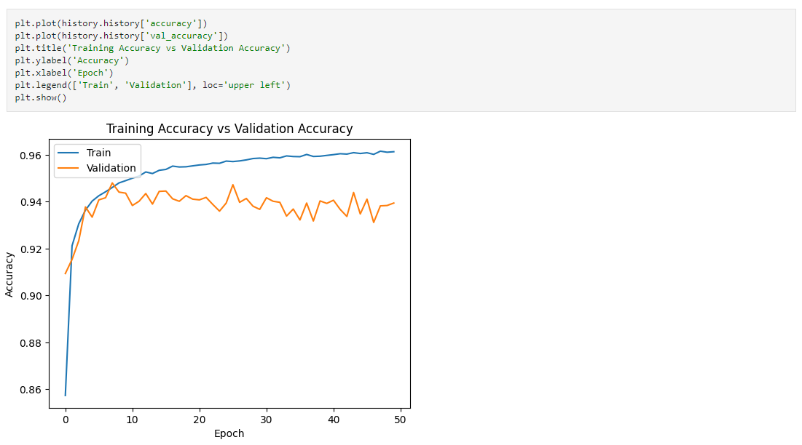
Visualize the performance of the CNN by displaying the ROC curve and the confusion matrix.

Slide 15
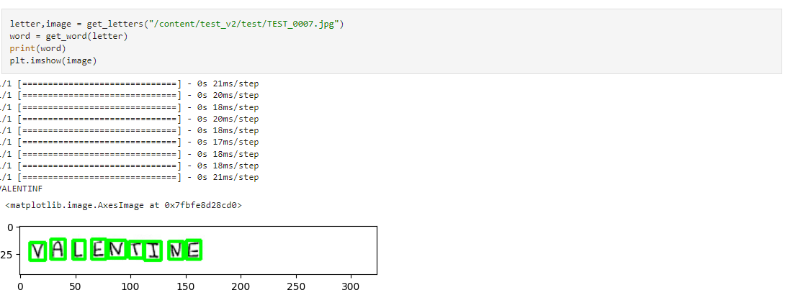
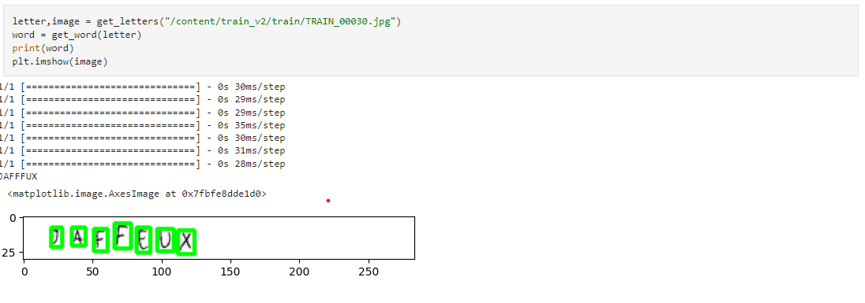
Visualization of Predictions with Confidence

Slide 16
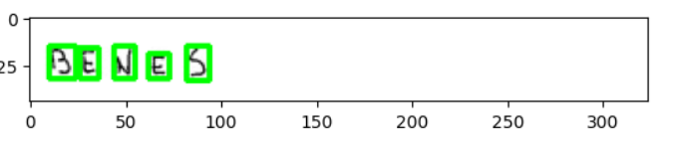
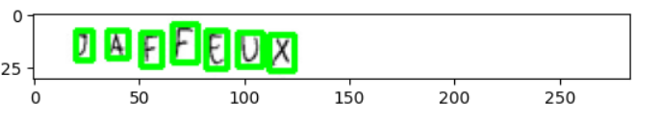
Visualize the dataset by making a boundaries over every detected character and displaying random samples of the images.

