Slide 1
FACULTY OF ELECTRICAL AND ELECTRONICS ENGINEERING
Application of Machine Learning to Stock Market Index Prediction
HUMAN SIDE OF TECHNOLOGY
Project author: Martin X. Gomez S.
Supervisor: Prof. Dr. Renaldas Urniežius
Kaunas, 2024

Slide 2
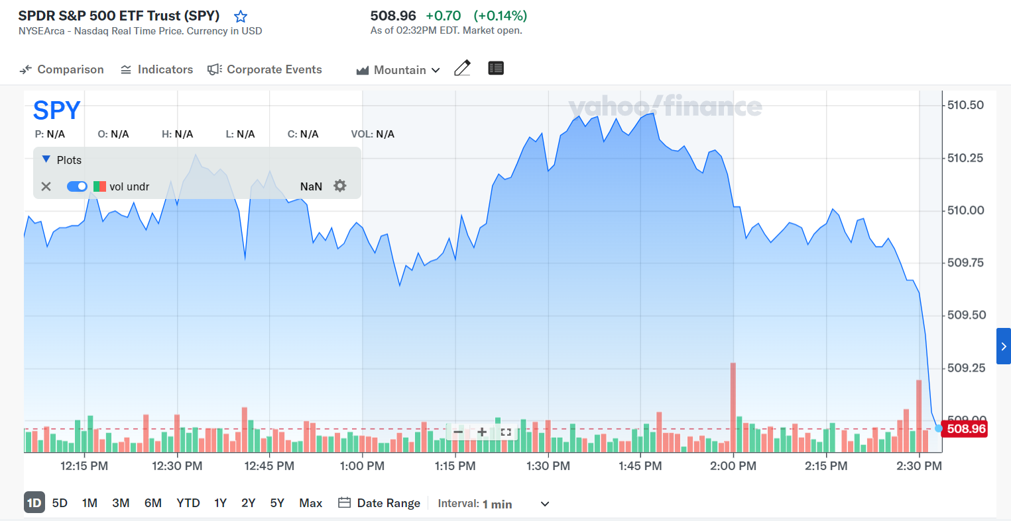
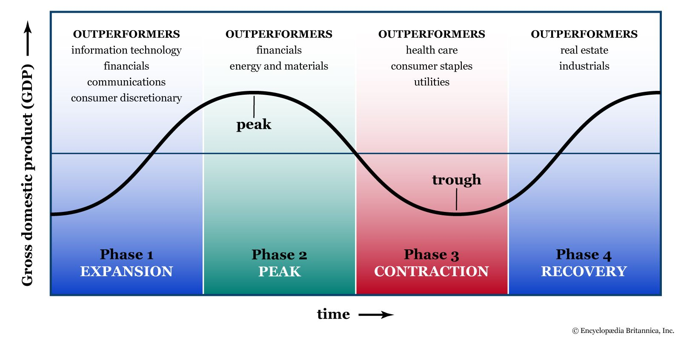
Stock Market
A place where different assets are commercialized, e.g. Stocks, Exchange Trust Funds (ETF’s), commodities, currencies, cryptocurrencies etc.
Regulated market by local governments, entities, and brokers for trading security.
Market affected by offer and demand, which leads to different economic cycles.

Slide 3
Machine Learning and Artificial Intelligence
Artificial intelligence seeks to perform activities done by individuals with the use of a computer.
Computational intelligence is based on several mathematical models and algorithms that have been developed for several decades.
Different algorithms fit for different purposes.
ML Model | Type of learning | Type of data | Application Example
Neural Networks | Unsupervised | Raw abstract, unstructured | Image or speech recognition
Linear Regression | Supervised | numerical | Stock prices prediction
Clustering | Unsupervised | Unlabled, patterned | Feature recognition
Decision trees | Supervised | Numerical/categotical | House-price prediction
Random forrests | Supervised | Numerical/categorical | Medical diagnostics

Slide 4


ML and AI into the stock Market
Several companies have tried to implement these algorithms to forecast the future, of the assets on the market.
Example: “Trading Bots” , this services can signal, buy or sell assets for you, when they think is the best time to do so.
Other services as “Robo Advisors”, help you understand when is a good time to buy or sell assets.

Slide 5




Development tools
This project was developed using the following platforms:
Visual Studio Code
Scikit Learn
Jupyter Notebooks
Python Programming Language.

Slide 6
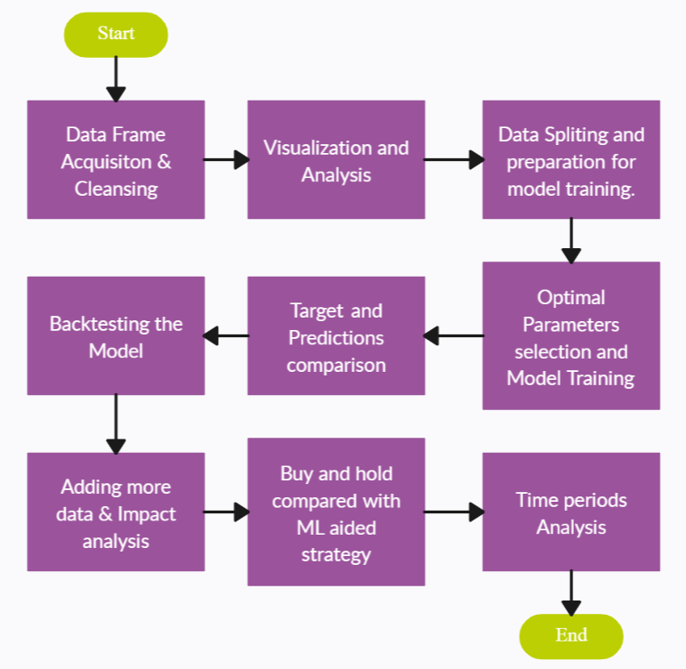
Research Roadmap
To facilitate the development, a visual flowchart aided the project.
After looking different ML projects and previous tasks elaborated this steps were determined.

Slide 7
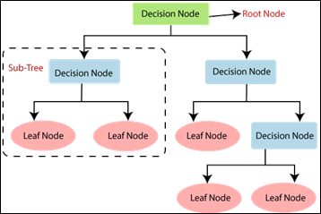
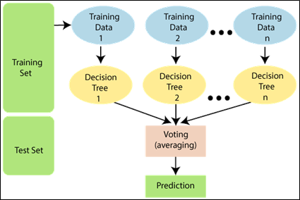
Random Forest Classifier
Decision Trees Algorithm
Random Forest Algorithm
When selecting the Classifier for this task the following parameters were considered:
Training speed
Overfitting tendency
Supervised Learning

Slide 8
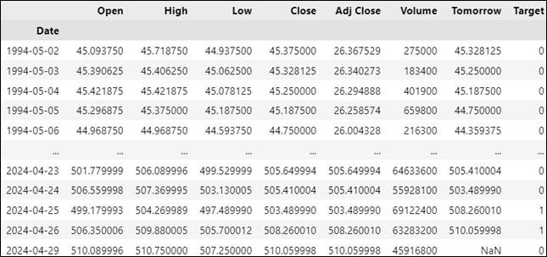
Dataset Format
Data extracted using Yahoo Finance API

Slide 9
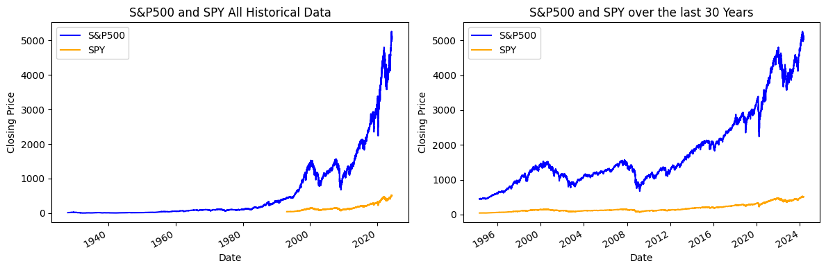
The S&P500 and The SPY ETF’s
Comparison helped determine the relationship of this ETF’s

Slide 10
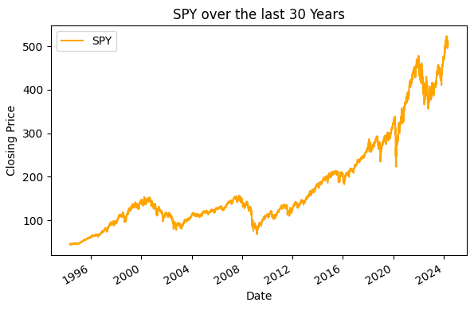
SPY According to an interpretable scale
Similarity to S&P500 ETF.
Capability of acquisition.

Slide 11
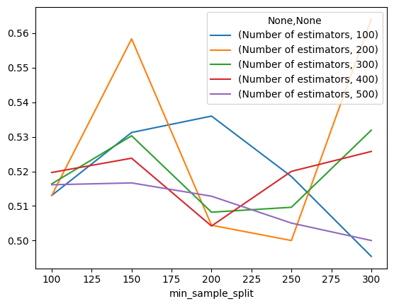
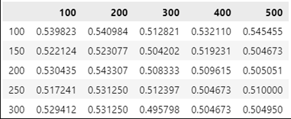
Random Forest Parameters Optimization
Parameter selection for the random forest classifier included several iterations.
Results were recorded into a table and plotted for better interpretation.

Slide 12
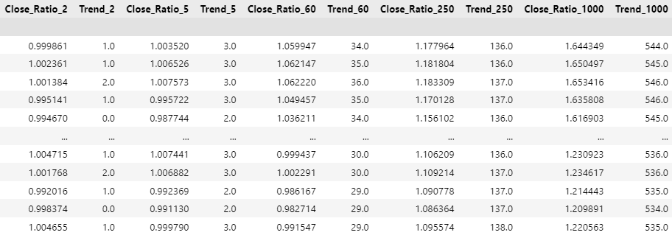
Additional Data for Model Training
Forecasting improvement.
Result Comparison.
 | Confidence Score
Initial Model | 0.5641
Including Backtesting | 0.5452
Data Addition with backtesting | 0.5547

Slide 13
Buy & Hold and Daily Trading Strategies
Trading strategy | Initial Investment, eur | Profit after 30 yrs, eur | Profit after 30 yrs, %
Buy and Hold | 1000 | 12,312.001 | 1231,2%
Daily Trading | 1000 | 12,149.015 | 1214,9%
Initial investment was simulated to acquire 26.036 shares of the SPY 30 years ago.
Then buy and hold strategy determined and increase of 1231.2%
Using the model trained the gains were of 1214.9%.
Meaning a lowest performance.

Slide 14
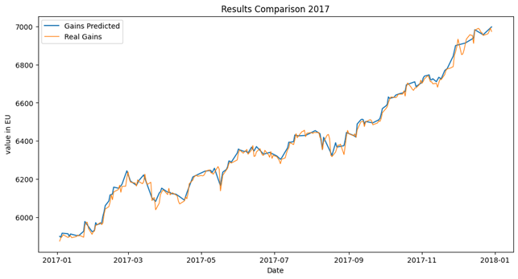
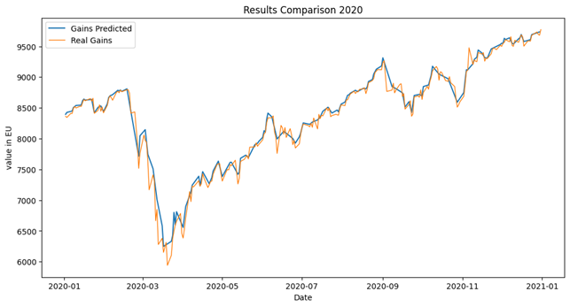
Performance in 2017
Performance in 2020
Covid Pandemic.
Market Depression..
Trump elected President.
Tax cuts & Beneficial business policies.

Slide 15
Research on Machine Learning , Artificial Intelligence and the Stock Market was completed. Research found current ML applications for stock market tools could be further tailored, as there is a big field for ML applied to the stock market.
Conclusions
2. Research on different machine learning algorithms was completed, and selection of optimal ML model to help predict the market’s share prices was random forests.
3. Data from the last 30 years for S&P 500 and SPY ETF’s was extracted via Yahoo Finance for the prediction of rise or drop in share prices. Random forests model was implemented with optimally selected parameters, and back-tested for improved real-world performance. Model implemented using Python and Scikit learn libraries.
4. Trained model had a confidence score of 55%. Using this model, two different trading strategies were compared for profit; the buy and hold strategy vs. the daily trading strategy. The buy and hold strategy proved to be more effective by generating 16.3% more profit than daily trading.

Slide 16
Thank you!

Slide 17
List of references
1. BOUCHEFRY, K. EL - SOUZA, R.S. DE Learning in Big Data: Introduction to Machine Learning. In Knowledge Discovery in Big Data from Astronomy and Earth Observation: Astrogeoinformatics . 2020. p. 225–249. [žiūrėta 2024-05-03]. . .
2. EDGAR, T.W. - MANZ, D.O. Machine Learning. In Research Methods for Cyber Security [interaktyvus]. 2017. p. 153–173. [žiūrėta 2024-05-03]. . Prieiga per internetą: <https://linkinghub.elsevier.com/retrieve/pii/B9780128053492000066>.
3. PEDREGOSA FABIANPEDREGOSA, F. ir kt. Scikit-learn: Machine Learning in Python. In Journal of Machine Learning Research [interaktyvus]. 2011. Vol. 12, no. 85, p. 2825–2830. [žiūrėta 2024-05-03]. . Prieiga per internetą: <http://jmlr.org/papers/v12/pedregosa11a.html>.
4. (2) Yahoo Finance: Overview | LinkedIn. In [interaktyvus]. [žiūrėta 2024-05-04]. Prieiga per internetą: <https://www.linkedin.com/company/yahoo-finance/>.
5. 4 Stages of the Economic Cycle | Britannica Money. In [interaktyvus]. [žiūrėta 2024-05-03]. Prieiga per internetą: <https://www.britannica.com/money/stages-of-economic-cycle>.

Slide 18
6. (25) Machine Learning for Trading — Can It Predict the Trend? | LinkedIn. In [interaktyvus]. [žiūrėta 2024-05-04]. Prieiga per internetą: <https://www.linkedin.com/pulse/machine-learning-trading-can-predict-trend-datatobiz/>.
7. About Us – QuantumstreetAI. In [interaktyvus]. [žiūrėta 2024-05-04]. Prieiga per internetą: <https://quantumstreetai.com/about-us/>.
8. Artificial intelligence (AI) | Definition, Examples, Types, Applications, Companies, & Facts | Britannica. In [interaktyvus]. [žiūrėta 2024-05-02]. Prieiga per internetą: <https://www.britannica.com/technology/artificial-intelligence>.
9. ASSET | English meaning - Cambridge Dictionary. In [interaktyvus]. [žiūrėta 2024-05-04]. Prieiga per internetą: <https://dictionary.cambridge.org/dictionary/english/asset>.
10. Backtesting - MATLAB & Simulink. In [interaktyvus]. [žiūrėta 2024-05-04]. Prieiga per internetą: <https://se.mathworks.com/discovery/backtesting.html>.
11. Best Stock Brokers for Europeans in 2024 | BrokerChooser. In [interaktyvus]. [žiūrėta 2024-05-03]. Prieiga per internetą: <https://brokerchooser.com/best-brokers/best-stock-brokers-for-europeans>.
12. Composer – Investing. Built Better. In [interaktyvus]. [žiūrėta 2024-05-04]. Prieiga per internetą: <https://www.composer.trade/>.

Slide 19
13. Convert your savings into investments | Luminor. In [interaktyvus]. [žiūrėta 2024-05-03]. Prieiga per internetą: <https://www.luminor.lt/en/investments>.
14. Decision Tree Algorithm in Machine Learning - Javatpoint. In [interaktyvus]. [žiūrėta 2024-05-03]. Prieiga per internetą: <https://www.javatpoint.com/machine-learning-decision-tree-classification-algorithm>.
15. ETFs - Swedbank. In [interaktyvus]. [žiūrėta 2024-05-03]. Prieiga per internetą: <https://www.swedbank.lt/private/investor/stock/lyxor?language=ENG>.
16. Forecasting: What It Is, How It’s Used in Business and Investing. In [interaktyvus]. [žiūrėta 2024-05-02]. Prieiga per internetą: <https://www.investopedia.com/terms/f/forecasting.asp>.
17. Here’s How the Stock Market Performed Under President Donald Trump. In [interaktyvus]. [žiūrėta 2024-05-12]. Prieiga per internetą: <https://markets.businessinsider.com/news/stocks/stock-market-performance-under-president-donald-trump-dow-jones-sp500-2021-1-1029987163>.
18. If Trump wins, here’s how the S&P 500 could react - CBS News. In [interaktyvus]. [žiūrėta 2024-05-12]. Prieiga per internetą: <https://www.cbsnews.com/news/if-trump-wins-heres-how-the-s-p-500-could-react/>.
19. Inflation vs. Deflation: What’s the Difference? In [interaktyvus]. [žiūrėta 2024-05-02]. Prieiga per internetą: <https://www.investopedia.com/ask/answers/111414/what-difference-between-inflation-and-deflation.asp>.

Slide 20
20. Machine Learning Random Forest Algorithm - Javatpoint. In [interaktyvus]. [žiūrėta 2024-05-03]. Prieiga per internetą: <https://www.javatpoint.com/machine-learning-random-forest-algorithm>.
21. project-walkthroughs/sp_500 at master · dataquestio/project-walkthroughs. In [interaktyvus]. [žiūrėta 2024-05-04]. Prieiga per internetą: <https://github.com/dataquestio/project-walkthroughs/tree/master/sp_500>.
22. SHARE | English meaning - Cambridge Dictionary. In [interaktyvus]. [žiūrėta 2024-05-04]. Prieiga per internetą: <https://dictionary.cambridge.org/dictionary/english/share?q=shares>.
23. S&P 500: impact of COVID-19 vs previous major crashes 2020 | Statista. In [interaktyvus]. [žiūrėta 2024-05-12]. Prieiga per internetą: <https://www.statista.com/statistics/1175227/s-and-p-500-major-crashes-change/>.
24. SPY Interactive Stock Chart | SPDR S&P 500 ETF Trust Stock - Yahoo Finance. In [interaktyvus]. [žiūrėta 2024-05-04]. Prieiga per internetą: <https://finance.yahoo.com/chart/SPY >.
25. Technical Analysis Basics | What is Technical Analysis? | IG US. In [interaktyvus]. [žiūrėta 2024-05-02]. Prieiga per internetą: <https://www.ig.com/us/trading-strategies/beginners-guide-to-technical-analysis-190430>.
26. TICKER | English meaning - Cambridge Dictionary. In [interaktyvus]. [žiūrėta 2024-05-04]. Prieiga per internetą: <https://dictionary.cambridge.org/dictionary/english/ticker?q=tickers>.

Slide 21
27. TRADE | English meaning - Cambridge Dictionary. In [interaktyvus]. [žiūrėta 2024-05-04]. Prieiga per internetą: <https://dictionary.cambridge.org/dictionary/english/trade>.
28. Trade Ideas: AI-Driven Stock Scanning & Charting Platform. In [interaktyvus]. [žiūrėta 2024-05-04]. Prieiga per internetą: <https://www.trade-ideas.com/>.
29. Trading Strategy - Overview, Components, How To Develop. In [interaktyvus]. [žiūrėta 2024-05-02]. Prieiga per internetą: <https://corporatefinanceinstitute.com/resources/career-map/sell-side/capital-markets/trading-strategy/>.
30. What are Machine Learning Models? In [interaktyvus]. [žiūrėta 2024-05-02]. Prieiga per internetą: <https://www.databricks.com/glossary/machine-learning-models>.
31. What Is a Broker? Definition, Examples and How to Find One - NerdWallet. In [interaktyvus]. [žiūrėta 2024-05-02]. Prieiga per internetą: <https://www.nerdwallet.com/article/investing/what-is-a-broker>.
32. What is a Candlestick? - 2022 - Robinhood. In [interaktyvus]. [žiūrėta 2024-05-02]. Prieiga per internetą: <https://learn.robinhood.com/articles/3YzdYQ8bI4XqfnYUNj3dac/what-is-a-candlestick/>.
33. What Is a Neural Network? - MATLAB & Simulink. In [interaktyvus]. [žiūrėta 2024-05-03]. Prieiga per internetą: <https://www.mathworks.com/discovery/neural-network.html>.

Slide 22
34. What is Artificial Intelligence (AI)? Everything You Need to Know. In [interaktyvus]. [žiūrėta 2024-05-02]. Prieiga per internetą: <https://www.techtarget.com/searchenterpriseai/definition/AI-Artificial-Intelligence>.
35. What is Stock? | Types & Examples - Lesson | Study.com. In [interaktyvus]. [žiūrėta 2024-05-02]. Prieiga per internetą: <https://study.com/academy/lesson/what-is-a-stock-definition-types-examples.html>.
36. What Is the Stock Market and How Does it Work? In [interaktyvus]. [žiūrėta 2024-05-02]. Prieiga per internetą: <https://www.investopedia.com/terms/s/stockmarket.asp>.
37. What’s in a Name? Meta Platforms Stock Down 61% Since Its Infamous Name Change | The Motley Fool. In [interaktyvus]. [žiūrėta 2024-05-04]. Prieiga per internetą: <https://www.fool.com/investing/2023/01/10/what-name-meta-platforms-stock-down-since-change/>.

