Slide 1


Slide 2
Topics to cover
DWH architecture
DWH life cycle
Success factors and failure warnings in DWH
DWH definition- Pages 19-24
Reference: Dataware housing fundamentals- Pages 25-36 and 82-85

Slide 3

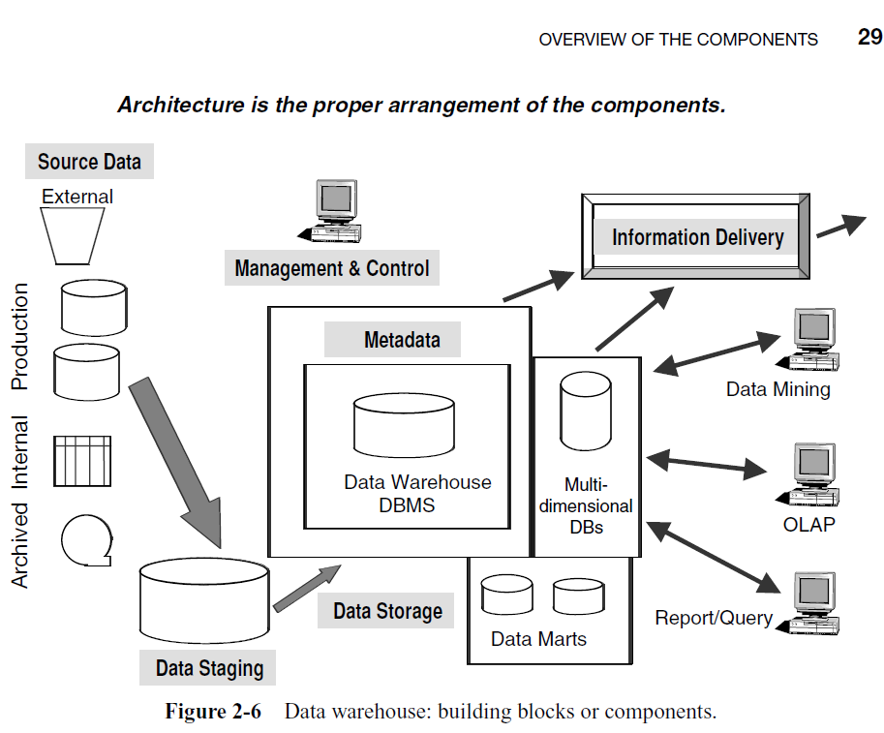

Slide 4
DWH architecture
Summarized reports
Ralph Kimball 1998:
Staging Area
Data Warehouse
ETL
Operational
system
Summarized reports
Data Mart

Slide 5
Components of a DWH
Source System:
An operational system whose function is to capture the transaction of the business.
Often called ‘legacy systems’ in a main frame environment.
Source systems may be in the form of data existing in:
  Production operational systems
  Archives
  External data from outside the company, such as external statistics relating to the company business, Market share data of competitors, financial indicator data for performance monitoring.
Provide input for data staging area.

Slide 6
DWH architecture
Summarized reports
Ralph Kimball 1998:
Staging Area
Data Warehouse
ETL
Operational
system
Summarized reports
Data Mart

Slide 7
Components of a DWH
Data Staging Area:
Is a major process that includes sub processes: extracting, transforming and loading; (ETL)
Extracting: Reading and understanding the source data, and copying the parts that are needed to the data staging area for further work.
Transforming: Once the data is extracted into the staging area, transformation takes place:
  Cleaning the data by correcting misspellings, resolving domain conflicts (e.g. Employee and staff, customer and subscriber).
  Creating surrogate keys for each dimension record in order to avoid a dependence on legacy defined keys, where the surrogate key generation process enforces referential integrity between the dimension tables and the fact tables. (More to be discussed on dimension & facts)

Slide 8
    At the end of transformation; there is a collection of integrated data that is clean, standardized, and summarized.
Loading: At the end of the transformation loading process, dimensions and facts tables are populated
  Initial Load (populating all the data warehouse tables for the first time)
  Incremental Load (applying ongoing changes as necessary in a periodic manner)
  Refresh Loading (consider full and partial refreshing): Removing existing data and re uploading

Slide 9
Why ETL?
To ensure that data resident in the DWH is:
  Relevant and useful to the business users.
  High quality to ensure quality information
Building the ETL is the biggest task of building a warehouse; it is complex and time consuming. In many implementations, it can take more than half of the total warehouse implementation effort.

Slide 10
DWH architecture
Summarized reports
Ralph Kimball 1998:
Staging Area
Data Warehouse
ETL
Operational
system
Summarized reports
Data Mart

Slide 11
Components of a DWH
Data storage Component (DWH and Data Marts)
A Data Mart is a subset of a DWH facts and summary data that provide users with information specific to their requirements.
Scope
  A DWH deals with multiple subject areas and implemented at enterprise level while data mart is on departmental level.
Implementation
  Less time to implement. Easier to build and maintain. Can be used as a “proof of concept” step towards building an enterprise warehouse.

Slide 12
Data Warehouses and Data Marts
Data
Mart 1
Sales Dept
Enterprise Data
Warehouse
Data
Mart 2
Marketing Dept
Data
Mart 3
Human Resources Dept

Slide 13
Data Warehouses and Data Marts
Property | Data Warehouse | Data Mart
Scope | Enterprise | Department
Subjects | Multiple | Single
Data Source | Many | Few
Size | 100 GB to > 1 TB | < 100 GB
Implementation time | Months to years | Months

Slide 14
DWH architecture
Summarized reports
Ralph Kimball 1998:
Staging Area
Data Warehouse
ETL
Operational
system
Summarized reports
Data Mart

Slide 15
Components of a DWH
Information Delivery Component :
This is to enable the process of subscribing for data warehouse information and having it delivered to one or more destinations according to some user-specified scheduling algorithm
  Ad-hoc Reports
  Complex Query tools
  Multidimensional analysis
  OLAP (Online Analytical Processing)
  Data Mining
  EIS (Executive Information Systems)
  Web Browsers

Slide 16
Components of a DWH
Metadata Component:
Metadata is data about data that describes the data warehouse. It is used for building, maintaining, managing and using the data warehouse; classified into:-
  Technical Metadata: contains information about warehouse data for use by warehouse designers and administrators when carrying out warehouse development and management tasks
    Operational (Data about the operational data sources)
    Extraction and Transformation (Information about all the data transformations conducted at the staging area)
  Business Metadata: contains information that gives users an easy-to-understand perspective of the information stored in the data warehouse

Slide 17
Components of a DWH
Management and Control Component:
This component coordinates the services and activities within the data warehouse. Its source of information is the metadata.
  Security and priority management
  Monitoring updates from the multiple sources
  Data quality checks
  Managing and updating meta data
  Auditing and reporting data warehouse usage and status
  Purging data, replicating, sub-setting and distributing data
  Backup & recovery and data warehouse storage management

Slide 18
Approaches to building Data Warehouses
Top down (by Bill Inmon)
  Extract data from the Operational systems
  Transform, clean, integrate, store data in the Data warehouse
  Derive the respective Data Marts
Bottom up (Ralph Kimball)
  Build individual Data Marts one by one from operational systems
  Combine the Data Marts into a Data Warehouse
Hybrid
  A compromise drawing from the advantages and disadvantages of each of the Top-down and Bottom-up

Slide 19
Data Marts Dependent/Independent
Dependent (Used in the Top – Down Approach)
Created from warehouse
Replicated (Functional subset of warehouse)
Independent (Used in the Bottom – Up Approach)
Scaled down, less expensive version of data warehouse
Designed for a department or BU
Org may have multiple data marts
  Difficult to integrate
Data
Mart 1
Enterprise
Data
Warehouse
Source 1
Data
Mart 1
Source 1
Data
Warehouse
Data
Mart 2
Source 2
Data
Mart 2
Source 2
Source 3
Data
Mart 3
Source 3
Data
Mart 3

Slide 20
Approaches to building Data Warehouses
Top – down Approach
Advantages
Enterprise view of Data
Inherently architected – not just a union of disparate Data Marts
Single, central storage of data about the content
Centralized rules and control
May see quick results if implemented with iterations
Disadvantages
Takes longer to build (even with an iterative method)
High Exposure to failure
Needs high level of cross-functional skills
High outlay without proof of concept

Slide 21
Approaches to building Data Warehouses
Bottom – Up Approach
Advantages
Faster and easier implementation of manageable pieces
Favorable return on investment and proof of concept
Less risk of failure
Could be done incrementally (more important Data Marts fast)
Allows project team to learn and grow
Disadvantages
Each Data Mart has its own narrow view of data
Keeps redundant data at every Data Mart
Keeps inconsistent and irreconcilable data
Accumulates unmanageable interfaces

Slide 22
Approaches to building Data Warehouses
Hybrid Approach
  A compromise drawing from the advantages and disadvantages of each of the Top-down and Bottom-up
  Accommodates both views
  Benefits to an organization
    Enterprise long term goals can easily be achieved
    Fast Data Marts
    Proof of concept

Slide 23
Approaches to building Data Warehouses
Steps (Hybrid Approach)
  Plan and define requirements at the overall corporate level
  Create a surrounding architecture for a complete warehouse
  Conform and Standardize the data content (Data types, Field lengths, precision, and semantics)
  Implement the Data Warehouse as a series of super marts (carefully architected Data Marts), one at a time

Slide 24
DWH Lifecycle overview
Business
Requirement
Definition
Technical
Architecture
Design
Product
Selection &
Installation
Project
Planning
Dimensional
Modeling
Physical
Design
Data Staging
Design &
Development
Deployment
Maintenance
and
Growth
End-User
Application
Specification
End-User
Application
Development
Project Management

Slide 25
Program/Project Planning
Kimball’s view of programs and projects
  Project refers to a single iteration of the Kimball Lifecycle
    from launch through deployment
  Program refers to the broader, ongoing coordination of resources, infrastructure, timelines, and communication across multiple projects
    a program contains multiple projects
  In real world, programs do not necessarily start before projects although ideally they should be.

Slide 26
Program/Project Planning
Project planning
  Scope definition ⬄understanding business requirements
  Tasks’ identification
  Scheduling
  Resource planning
  Workload assignment
  The end document represents a blueprint of the project

Slide 27
Program/Project Management
Enforces the project plan
Activities:
  Status monitoring
  Issue tracking
  Development of a comprehensive communication plan that addresses both the business and IT units

Slide 28
DWH Lifecycle overview
Business
Requirement
Definition
Technical
Architecture
Design
Product
Selection &
Installation
Project
Planning
Dimensional
Modeling
Physical
Design
Data Staging
Design &
Development
Deployment
Maintenance
and
Growth
End-User
Application
Specification
End-User
Application
Development
Project Management

Slide 29
Business Requirements Definition
Success of the project depends on a solid understanding of the business requirements!!!
Understanding the key factors driving the business is crucial for successful translation of the business requirements into design considerations

Slide 30
What follows the business requirements definition?
3 concurrent tracks focusing on
  Technology
  Data
  End user (BI) applications
Arrows in the diagram indicate the activity workflow along each of the parallel tracks
Dependencies between the tasks are illustrated by the vertical alignment of the task boxes.

Slide 31
DWH Lifecycle overview
The Technology Track
Business
Requirement
Definition
Technical
Architecture
Design
Product
Selection &
Installation
Project
Planning
Dimensional
Modeling
Physical
Design
Data Staging
Design &
Development
Deployment
Maintenance
and
Growth
End-User
Application
Specification
End-User
Application
Development
Project Management

Slide 32
Technology Track
Technical Architecture Design
  Overall architectural framework and vision
  Considerations:
    the business requirements
    current technical environment
    planned strategic technical directions

Slide 33
Technology Track
Product Selection and Installation
  Based on the designed technical architecture
    Evaluation and selection of
      Products that will deliver needed capabilities
      Hardware platform
      Database management system
      Extract-transformation-load (ETL) tools
      Data access query tools
      Reporting tools must be evaluated
    Installation of selected products/ components/ tools
    Testing of installed products to ensure appropriate end-to-end integration within the data warehouse environment.

Slide 34
DWH Lifecycle overview
The Data Track
Business
Requirement
Definition
Technical
Architecture
Design
Product
Selection &
Installation
Project
Planning
Dimensional
Modeling
Physical
Design
Data Staging
Design &
Development
Deployment
Maintenance
and
Growth
End-User
Application
Specification
End-User
Application
Development
Project Management

Slide 35
Data Track
Design of the dimensional model
The physical design of the model
Extraction, transformation, and loading (ETL) of source data into the target models (Data Staging design & development).

Slide 36
Dimensional Design
Detailed data analysis of a single business process is performed to identify the fact tables, associated dimensions and attributes, and numeric facts.

Slide 37
Physical Design
Defining the physical structures
  setting up the database environment
  Setting up appropriate security
  preliminary performance tuning strategies, from indexing to partitioning and aggregations.
  If appropriate, OLAP databases are also designed during this process.

Slide 38
Data staging (ETL) Design and Development
The MOST important stage
70% of the risk and effort in the DW project is attributed to this stage
ETL system capabilities:
  Extraction
  Cleansing and conforming
  Delivery and management
ETL processes must be architected long before any data is extracted from the source
Kimball calls ETL a “data warehouse back room”

Slide 39
DWH Lifecycle overview
The End user (Business Intelligence Track)
Business
Requirement
Definition
Technical
Architecture
Design
Product
Selection &
Installation
Project
Planning
Dimensional
Modeling
Physical
Design
Data Staging
Design &
Development
Deployment
Maintenance
and
Growth
End-User
Application
Specification
End-User
Application
Development
Project Management

Slide 40
End user (Business Intelligence)
Application Track
End user (BI) Application Design
  Identify the candidate BI applications and appropriate navigation interfaces to address the users’ needs and needed capabilities.
  Produce BI application specification
End user (BI) Application Development
  Configuration of the business metadata and tool infrastructure
  Construction and validation of the specified analytic and operational BI applications and the navigational portal

Slide 41
DWH Lifecycle overview
Business
Requirement
Definition
Technical
Architecture
Design
Product
Selection &
Installation
Project
Planning
Dimensional
Modeling
Physical
Design
Data Staging
Design &
Development
Deployment
Maintenance
and
Growth
End-User
Application
Specification
End-User
Application
Development
Project Management

Slide 42
Deployment
It is crucial that adequate planning was performed to make sure that:
  the results of technology, data, and BI application tracks are tested and fit together properly
  Appropriate education and support infrastructure is in place.
It is critical that deployment be well coordinated
Deployment should be deferred if all the pieces, such as training, documentation, and validated data, are not ready for production release.

Slide 43
DWH Lifecycle overview
Business
Requirement
Definition
Technical
Architecture
Design
Product
Selection &
Installation
Project
Planning
Dimensional
Modeling
Physical
Design
Data Staging
Design &
Development
Deployment
Maintenance
and
Growth
End-User
Application
Specification
End-User
Application
Development
Project Management

Slide 44
Maintenance
Occurs when the system is in production
Includes:
  technical operational tasks that are necessary to keep the system performing optimally
    usage monitoring
    performance tuning
    index maintenance
    system backup
  Ongoing support, education, and communication with business users

Slide 45
Growth
DWH systems tend to expand (if they were successful)
  Is considered as a sign of success
  New requests need to be prioritized
  Starting the cycle again
    Building upon the foundation that has already been established
    Focusing on the new requirements

Slide 46
Guiding principles to a successful DWH project
Project Manager. Should not be more technology- oriented than user-oriented and business-oriented.
New Paradigm. Innovative project management methods are essential to deal with the unexpected challenges.
Team Roles. Team roles are not to be assigned arbitrarily; the roles must reflect the needs of each individual data warehouse project.
Data Quality. Three critical aspects of data in the data warehouse are: quality, quality, and quality.

Slide 47
User Requirements. User requirements alone form the driving force of every task on the project schedule.
Building for Growth. Should allow room for growth
Project Politics. The first data warehouse project in a company poses challenges and threats to users at different levels.
Realistic Expectations. Setting expectations at the right and attainable levels is the best course.

Slide 48
Dimensional Data Modeling. A well-designed dimensional data model is a required foundation and blueprint.
External Data. A data warehouse does not live by internal data alone; data from relevant external sources is an absolutely necessary ingredient.
Training. Data warehouse user tools are different and new. If the users do not know how to use the tools, they will not use the data warehouse. An unused data warehouse is a failed data warehouse.

Slide 49
Warning of failure Signs
The Requirements Definition phase is well past the target date.
The need to write too many in-house programs.
Users not cooperating to provide details of data.
Users not comfortable with the query tools.
Continuing problems with data brought over to the staging area.

Slide 50
Reading Assignment
Project Team and their Roles

