Slide 1
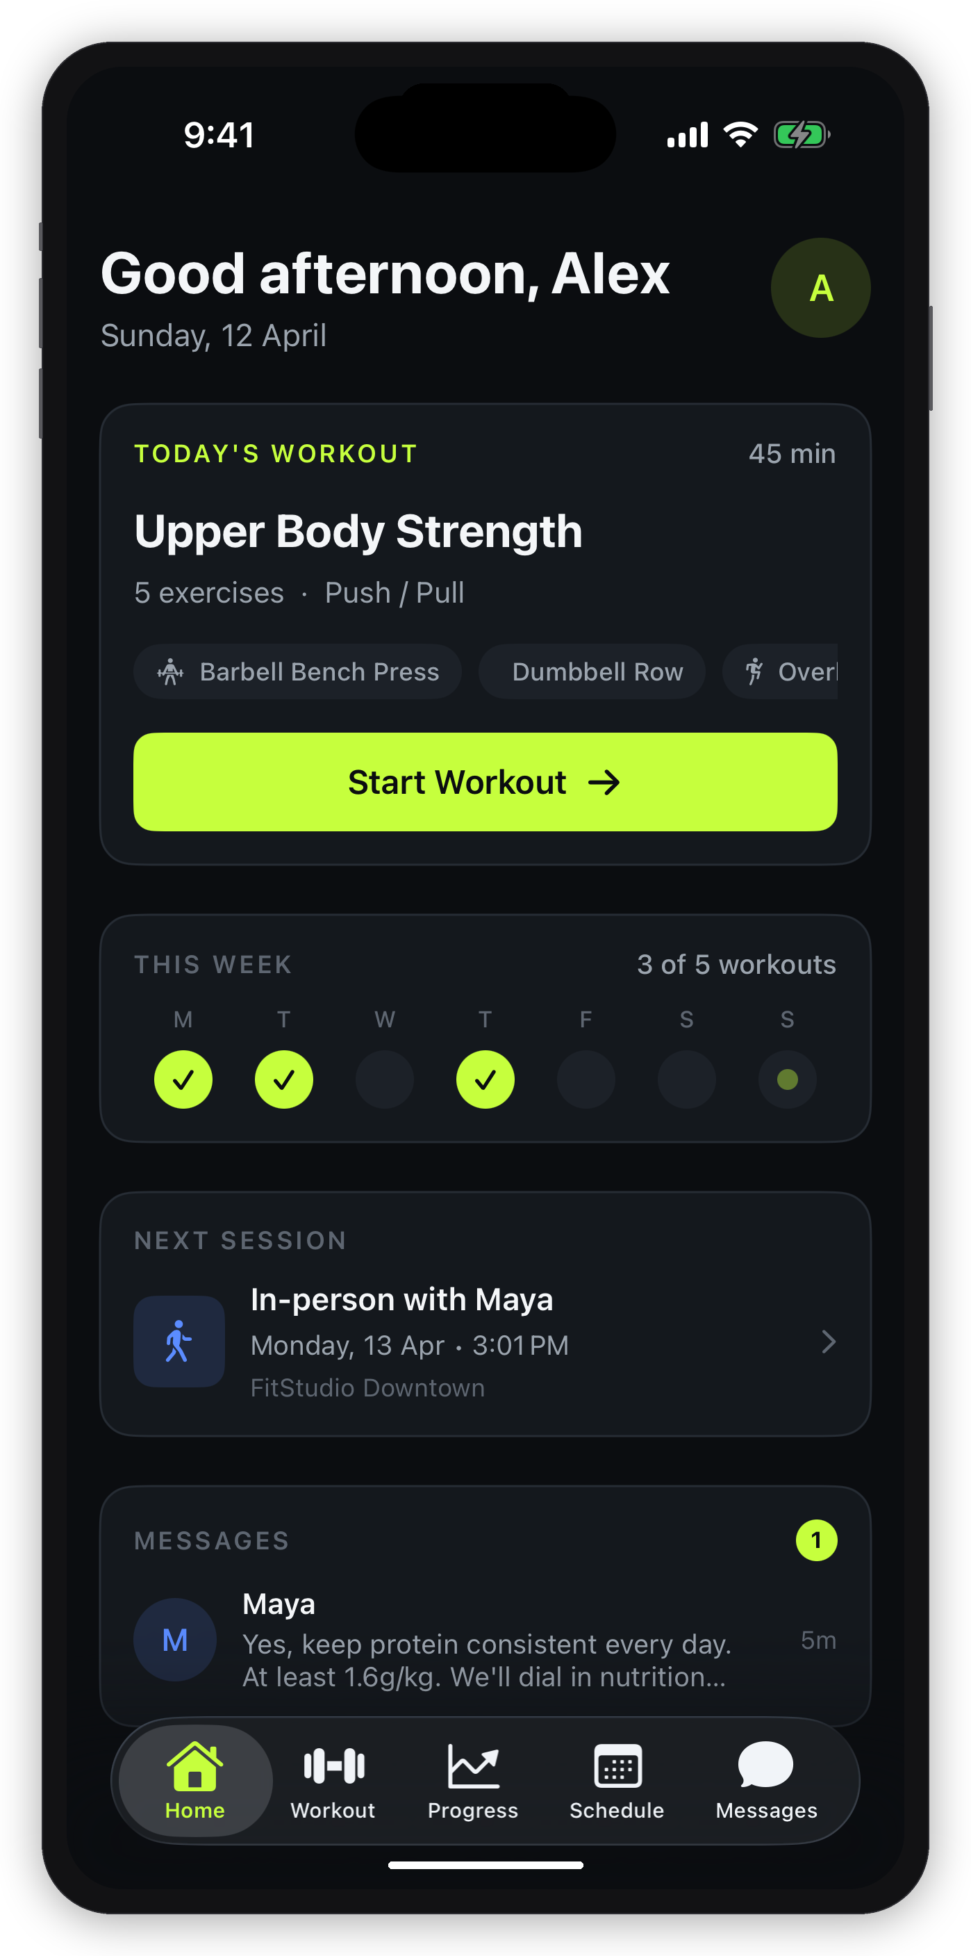
FitHero
The operating system for
independent personal trainers.
Partner Briefing | Confidential | April 2026

Slide 2
The Problem
Independent trainers cobble together 5–7 tools to run their business.
Client communication scattered across WhatsApp, SMS, email
6+
Programs built in Google Sheets or scribbled on paper
hours/week
lost to admin
Scheduling via Calendly, DMs, or verbal agreements
Payments chased via Revolut links, Venmo, or cash
5–7
Progress tracked in Notion, Notes, or not at all
different tools used

Slide 3
Our Vision
One beautiful app that replaces everything.
Convenience
Design Quality
Every action a trainer or client needs is two taps away.
Programs, payments, scheduling, messaging, and progress — all in one place. No switching apps.
Feels like a premium consumer app, not a clunky SMB tool.
Trainers are proud to show it to clients. Clients love using it more than their other fitness apps.
"Become the default OS for the independent trainer — the way Square became the default for the independent merchant."

Slide 4
What FitHero is Not
Focus means saying no. Here's what we deliberately leave out of MVP.
✕
No AI features (form check, program generation, chatbot)
Why?
✕
No group classes or bootcamps
These features are deferred to Phase 2 as paid add-ons. The MVP core must be:
✕
No nutrition / meal planning
✕
No in-app video calls (use Zoom/Meet links)
Near-zero cost
✕
No marketplace or "find a trainer" directory
Dead simple
✕
No social feed, leaderboards, or public profiles
Ship fast
✕
No wearable integrations (Apple Health, Garmin)

Slide 5
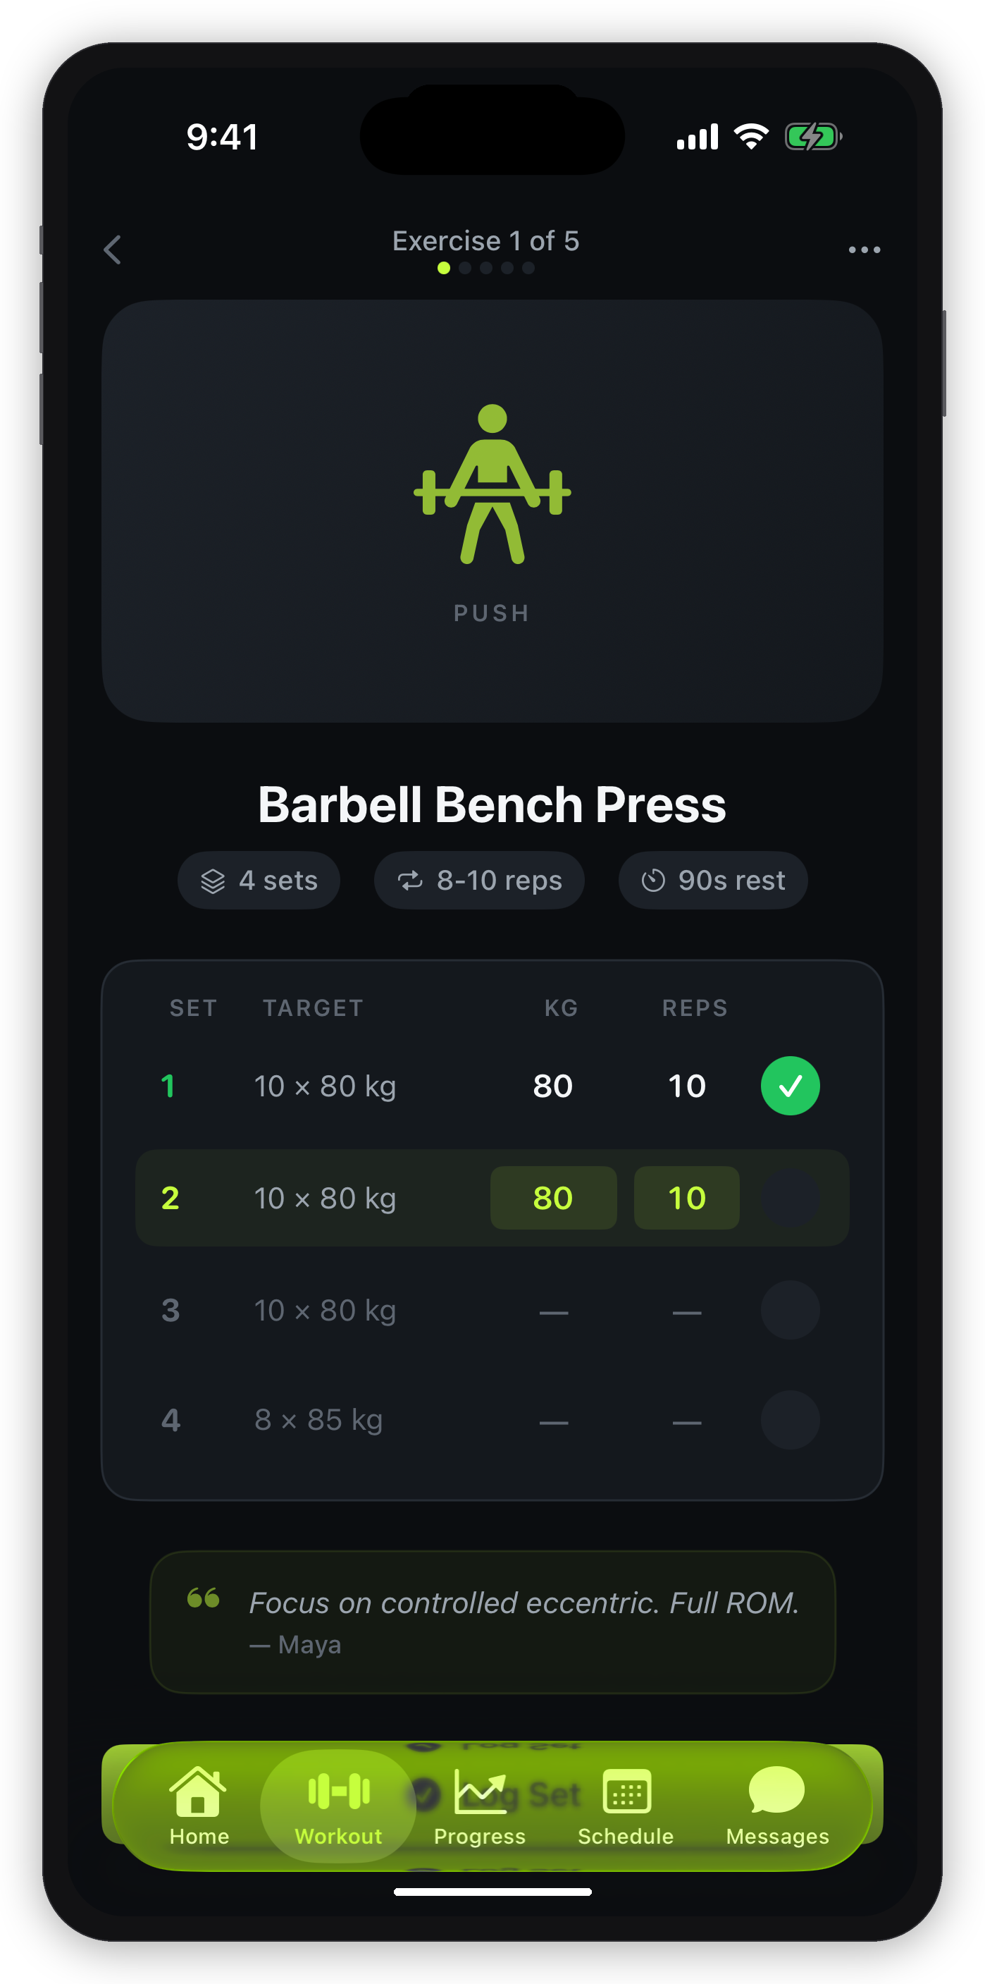
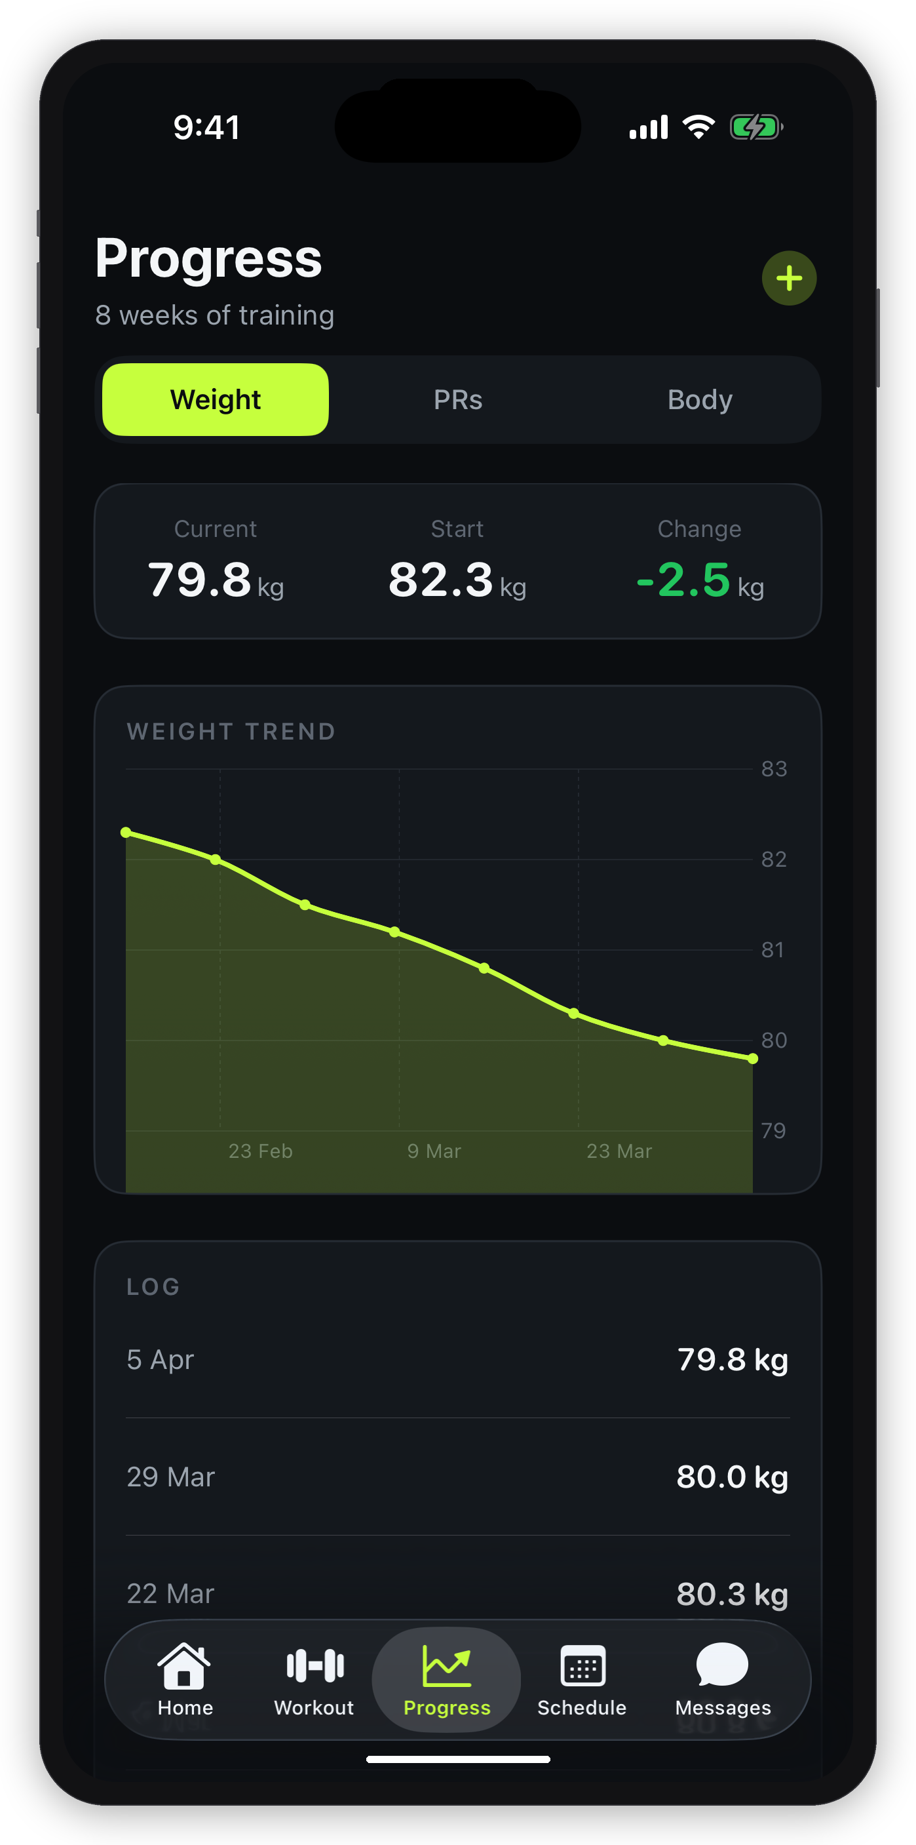
The Client Experience
What your clients see every day — clean, focused, two taps to start training.
Home
Active Workout
Progress
Today's workout, schedule,
messages — all at a glance
Log sets, rest timer,
coach notes in real time
Weight trends, PRs,
body measurements

Slide 6
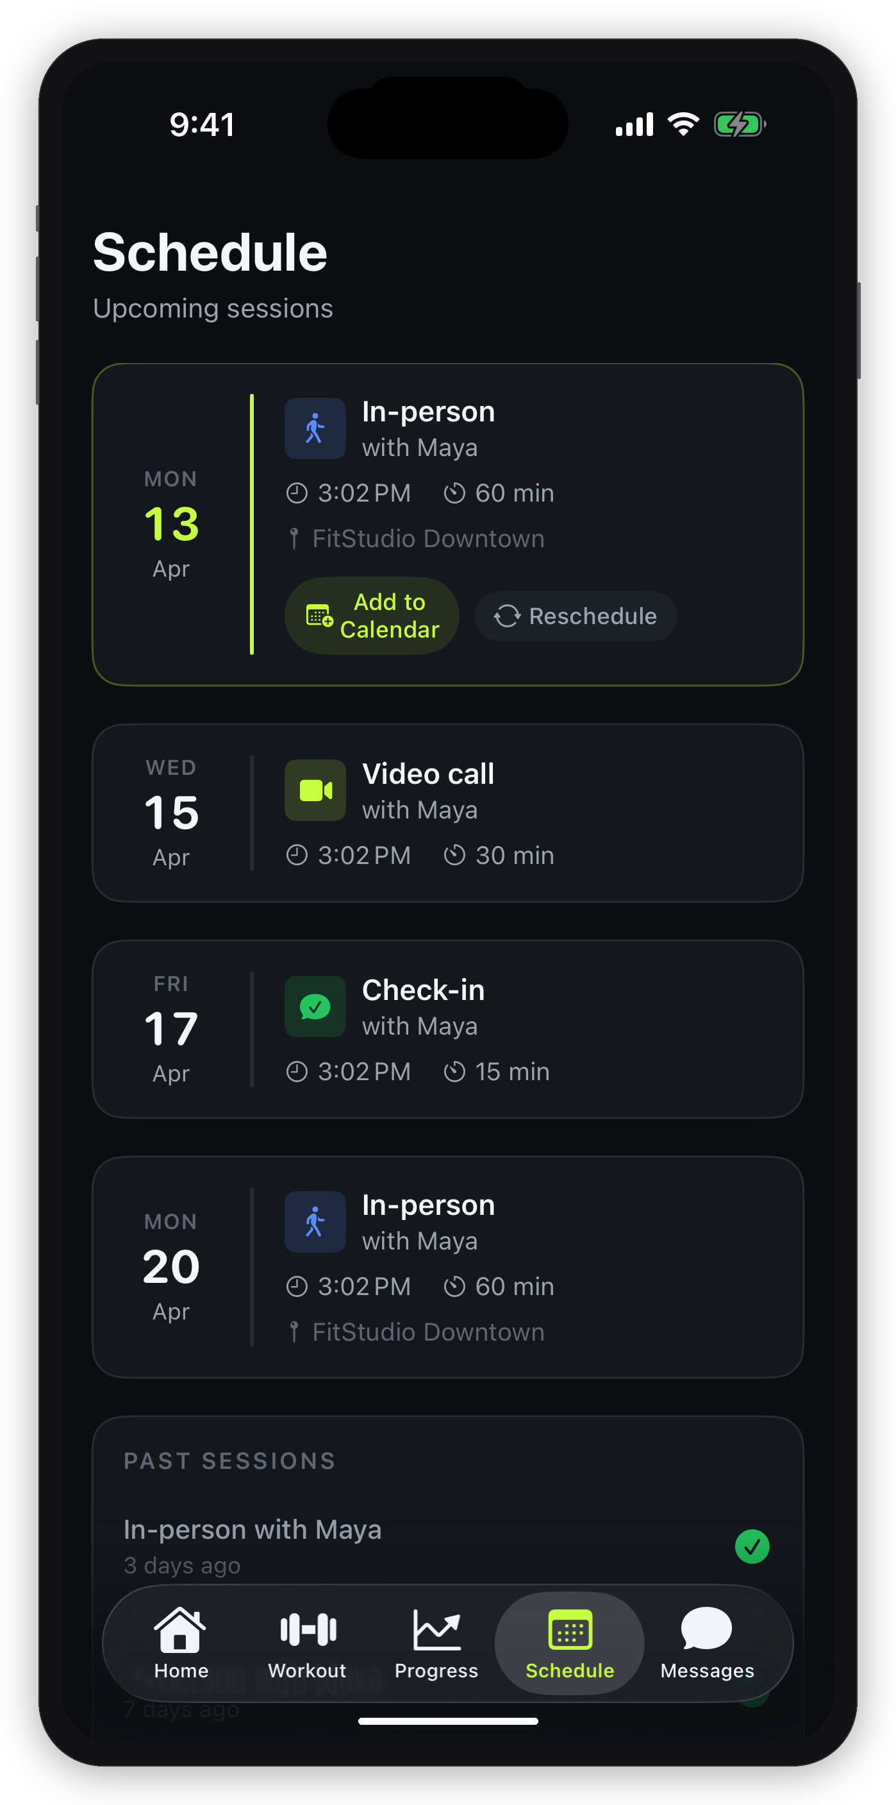
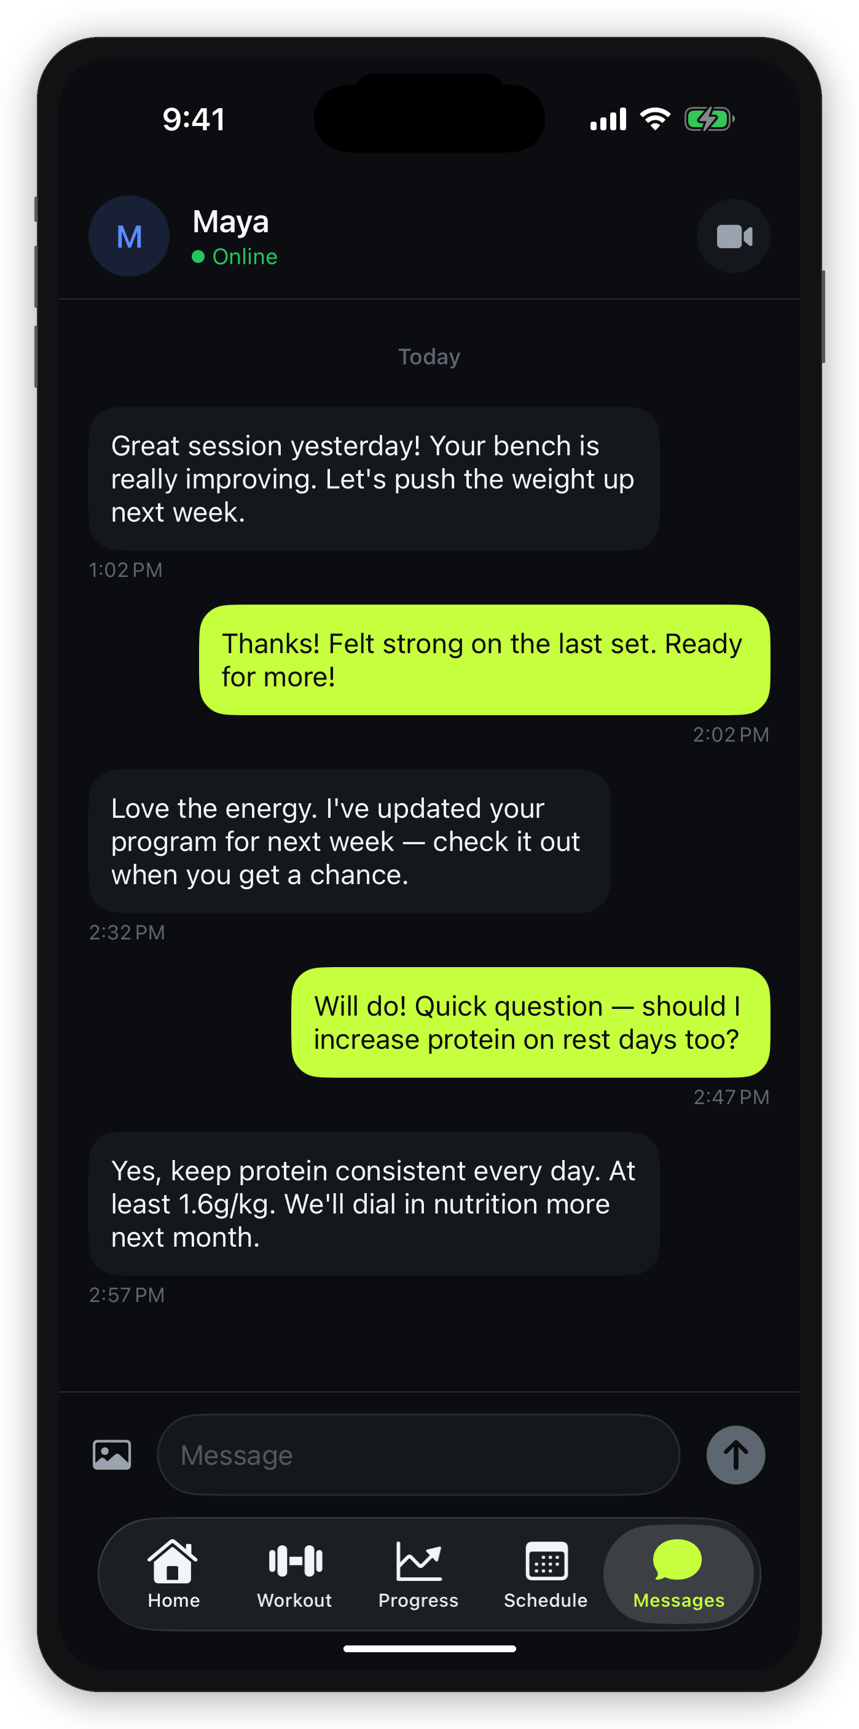
Schedule & Communication
Clients book sessions and message their trainer — no WhatsApp needed.
Schedule
Messages
Upcoming sessions, reschedule
requests, calendar integration
1:1 chat with trainer,
push notifications, images

Slide 7
The Trainer Side
Trainers get a web dashboard + mobile app to run their entire business.
Client Management
Program Builder
Scheduling
Invite clients, track goals, intake forms, notes. See everything about each client in one profile.
Drag-and-drop workout builder with 300+ exercises. Create once, assign to many. Templates save hours.
Calendar view with 1:1 sessions. In-person, video, or check-in. Clients get notifications + calendar invites.
Payments
Messaging
Dashboard
Send invoices, set up recurring subscriptions. Clients pay with saved card or Apple Pay. Auto-charge.
Built-in 1:1 chat. Push + email notifications. No more scattered WhatsApp threads.
Today's sessions, revenue, pending payments, unread messages — all at a glance when you open the app.

Slide 8
Business Model
The trainer pays. The client never pays FitHero directly.
RECOMMENDED
Solo
Starter
Pro
Studio
Free
$19/mo
$39/mo
$79/mo
Up to 3
Up to 15
Up to 40
Up to 100
Acquisition funnel
$1.27 per client
$0.98 per client
$0.79 per client
Additional Revenue Streams
"Active client" = logged in or had a workout assigned in the last 30 days. Inactive clients are free. This removes friction for trainers.
1% platform fee on client-to-trainer payments (via Stripe Connect)
Phase 2: AI add-ons, branded apps, nutrition, wearables, marketplace

Slide 9
MVP Scope
Ship a focused product one trainer can use to fully manage 10–30 clients.
Trainer (Web + Mobile)
Client (Mobile)
Account setup + Stripe Connect onboarding
Client invite & management
Drag-and-drop program builder
300+ exercise library
Calendar scheduling (1:1 sessions)
1:1 messaging with push notifications
Invoicing + subscription billing
Revenue dashboard
Accept invite + intake form
Today's workout with "Start" CTA
Active workout logging (sets, reps, weight)
Rest timer + coach notes
Progress charts + personal records
Session schedule + reschedule
1:1 messaging with trainer
Payment management + receipts

Slide 10
Phase 2 — What Comes Next
After product-market fit. Each feature is a revenue lever, not a freebie.
AI Program Generation
Auto-create periodized programs from goals + history
$10–20/mo add-on
AI Form Check
Upload a video, get rep-by-rep feedback on technique
$10–20/mo add-on
Nutrition Module
Meal logging, macro targets, food photos
Premium tier
Wearable Sync
Apple Health, Garmin, Whoop — auto-import activity data
Premium tier
Custom Branding
Trainer's logo, colors, and custom app icon for clients
$25/mo add-on
Group Programs
One program for a cohort — bootcamps, challenges, classes
Studio plan
Template Marketplace
Trainers sell programs to other trainers. FitHero takes 15%
Revenue share
Document Signing
PAR-Q forms, liability waivers — built-in, no DocuSign needed
Pro+ plan

Slide 11
Why We Win
The market has tools, but none that trainers actually love using.
Product | Strength | Our Advantage
Trainerize | Mature features | Dated UI, complex, expensive at scale
TrueCoach | Serious coaches | Limited payments, feels like 2018
Everfit | Free tier, AI push | Cluttered, AI-first not coach-first
PT Distinction | Nutrition tools | Steep learning curve, ugly client UX
Spreadsheets + WhatsApp | Free, flexible | The messy status quo we replace
Our wedge: the prettiest, simplest product in the category — with native payment handling — priced for solo trainers.

Slide 12
Why We Need You
We have the product and engineering. You have the domain expertise.
What We Bring
What You Bring
Product vision and design
Full engineering team
Business model + go-to-market strategy
Design system + working prototype
Payment infrastructure (Stripe Connect)
Commitment to ship MVP in 8–12 weeks
Real-world training experience
Understanding of what trainers actually need
Insight into client expectations and pain points
Validation of features and pricing
Beta testing with your own client base
Network access to the trainer community

Slide 13
Questions for You
We'd love your honest input on these before we finalize the MVP.
1
Is the feature set right?
Are we missing something critical that solo trainers can't live without? Is anything here unnecessary?
2
Is the pricing fair?
Would you pay $19–39/mo for this? Would your peers? What's the price sensitivity in this market?
3
Programs vs. ad-hoc workouts?
Do most trainers plan multi-week programs, or do they decide workouts day-by-day? How should the builder work?
4
Payments — what's reality?
How do you currently collect payments? Would built-in billing change your workflow for the better?
5
Client adoption — what's the barrier?
Would your clients actually download and use an app? What would make them resist?
6
What would make you switch?
If you're using something today, what would FitHero need to do to make you move?

Slide 14
Let's Build This Together
FitHero is early-stage and intentionally so.
Your expertise shapes what we build.
Peter — Founder
Let's talk when you're ready.
FitHero | Confidential | April 2026

