Slide 1

The Danish Parliament Corpus
Computational Data
Analysis
Bjorn Hansen s193035
Martin Johnsen s144731
Peter Asbjørn Leer Bysted s144045
Olena Holubowska s190323

Slide 2
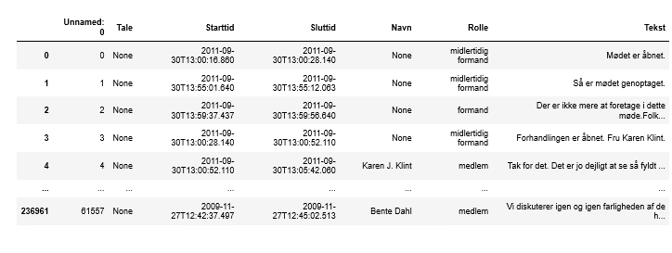
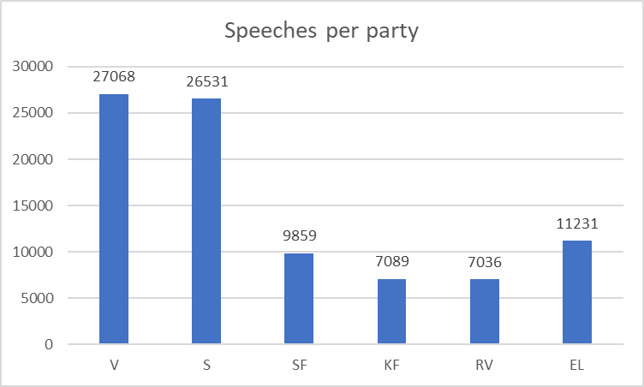
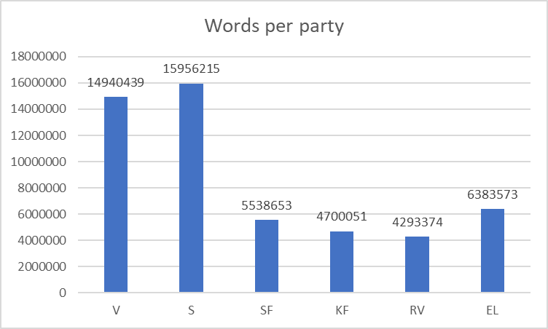
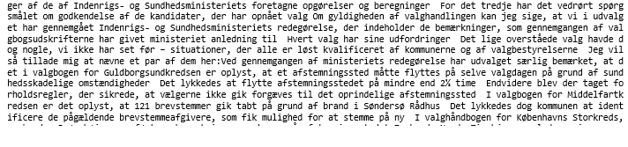
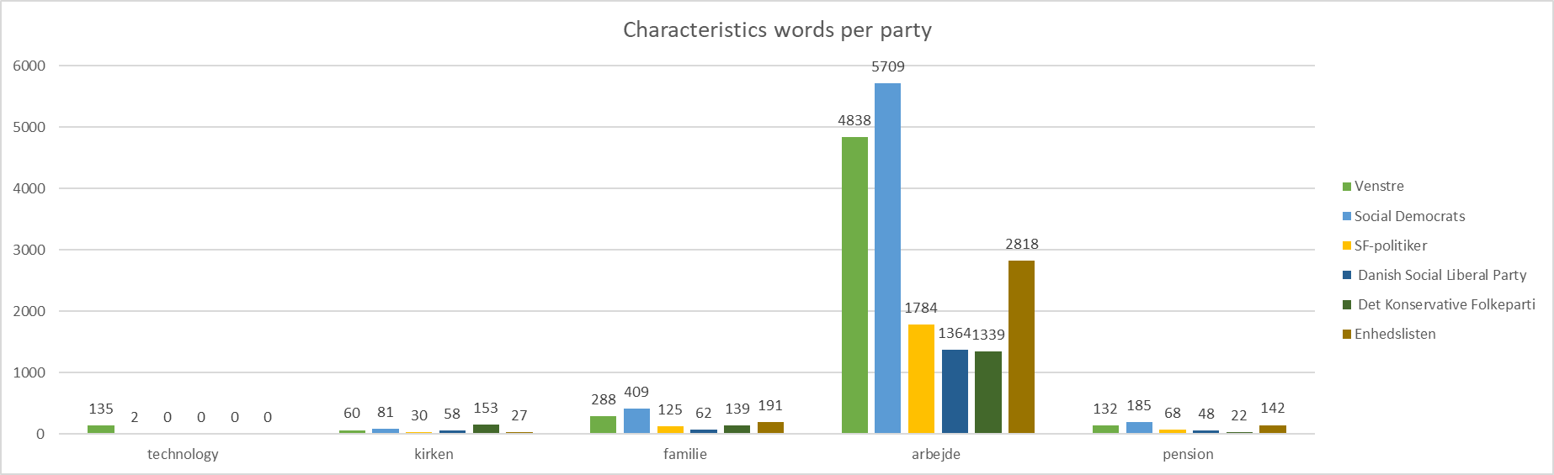
Descriptive statistics
Pre-processing methods and frequency analysis
Tokenization
Vectorization
By the comparison of the most frequent, characteristics words (table on left, marked words), summary of the general performance (top graphs) and count of the particular words (bottom graph), the general characterisation of the parties is performed.

Slide 3
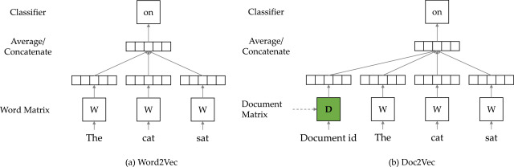

Embedding the text
TFIDF embedding
Doc2Vec embedding
- Generates a (word x document) matrix
- Each entry in the matrix is given by:
$$tfidf\left(t,D\right)=tf\left(t,d\right)∗idf(t,D)$$
where $d ∈D$
Learns latent space similar to autoencoder by predicting context of the document

Slide 4
Clustering
…..

Slide 5
Martin’s part
….

