Slide 1

Week 2: Processes and Threads
Sherif Khattab
http://www.cs.pitt.edu/~skhattab/cs1550
(Some slides are from Silberschatz, Galvin and Gagne ©2013)

Slide 2
Chapter 3: Processes
Process Concept
Process Scheduling
Operations on Processes
Interprocess Communication
Examples of IPC Systems
Communication in Client-Server Systems

Slide 3
Process Concept
An operating system executes a variety of programs:
Batch system – jobs
Time-shared systems – user programs or tasks
Process – a program in execution; process execution must progress in sequential fashion
Multiple parts
The program code, also called text section
Current activity including program counter, processor registers
Stack containing temporary data
Function parameters, return addresses, local variables
Data section containing global variables
Heap containing memory dynamically allocated during run time

Slide 4
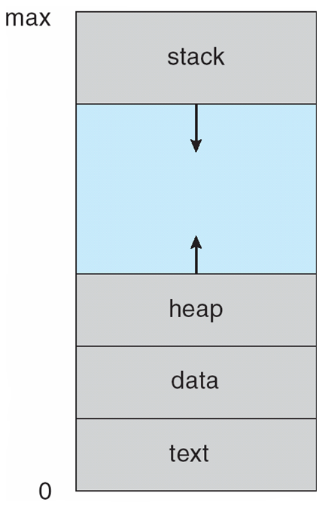
Process in Memory

Slide 5
Process State
As a process executes, it changes state
new: The process is being created
running: Instructions are being executed
waiting: The process is waiting for some event to occur
ready: The process is waiting to be assigned to a processor
terminated: The process has finished execution

Slide 6
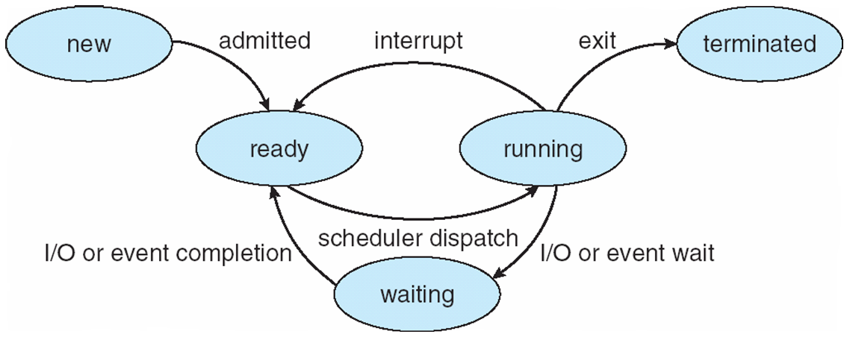
Diagram of Process State

Slide 7
Process Control Block (PCB)
Information associated with each process
(also called task control block)
Process state – running, waiting, etc
Program counter – location of instruction to execute next
CPU registers – contents of all process-centric registers
CPU scheduling information- priorities, scheduling queue pointers
Memory-management information – memory allocated to the process
Accounting information – CPU used, clock time elapsed since start, time limits
I/O status information – I/O devices allocated to process, list of open files

Slide 8
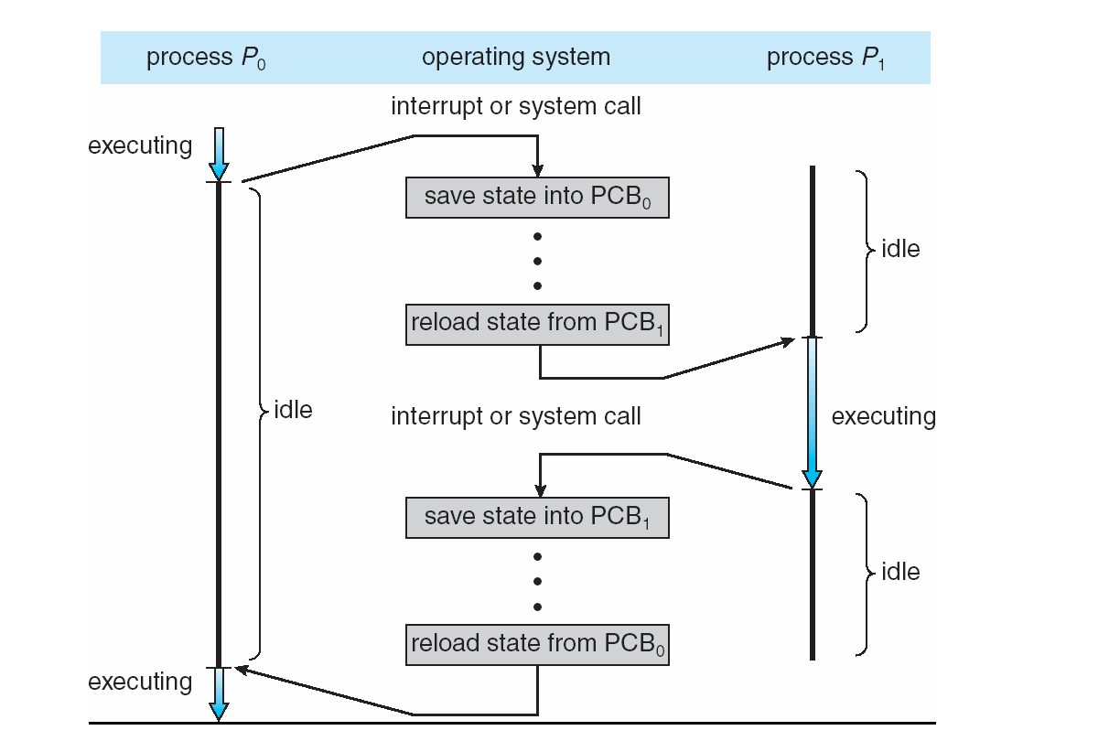
CPU Switch From Process to Process

Slide 9
Threads
So far, process has a single thread of execution
Consider having multiple program counters per process
Multiple locations can execute at once
Multiple threads of control -> threads
Must then have storage for thread details, multiple program counters in PCB
More on threads next lecture

Slide 10
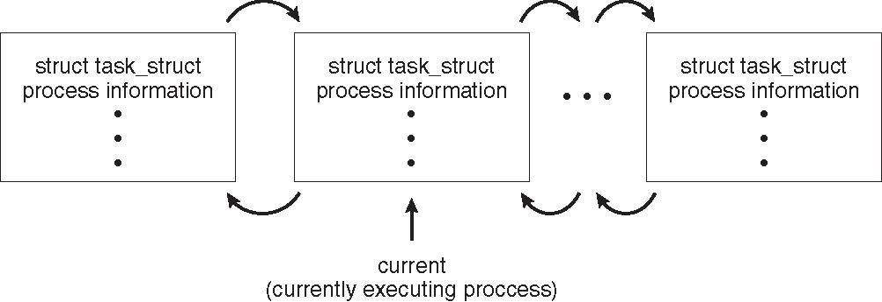
Process Representation in Linux
Represented by the C structure task_struct
pid t_pid; /* process identifier */ long state; /* state of the process */ unsigned int time_slice /* scheduling information */ struct task_struct *parent; /* this process’s parent */ struct list_head children; /* this process’s children */ struct files_struct *files; /* list of open files */ struct mm_struct *mm; /* address space of this process */

Slide 11
Process Scheduling
Maximize CPU use, quickly switch processes onto CPU for time sharing
Process scheduler selects among available processes for next execution on CPU
Maintains scheduling queues of processes
Job queue – set of all processes in the system
Ready queue – set of all processes residing in main memory, ready and waiting to execute
Device queues – set of processes waiting for an I/O device
Processes migrate among the various queues

Slide 12
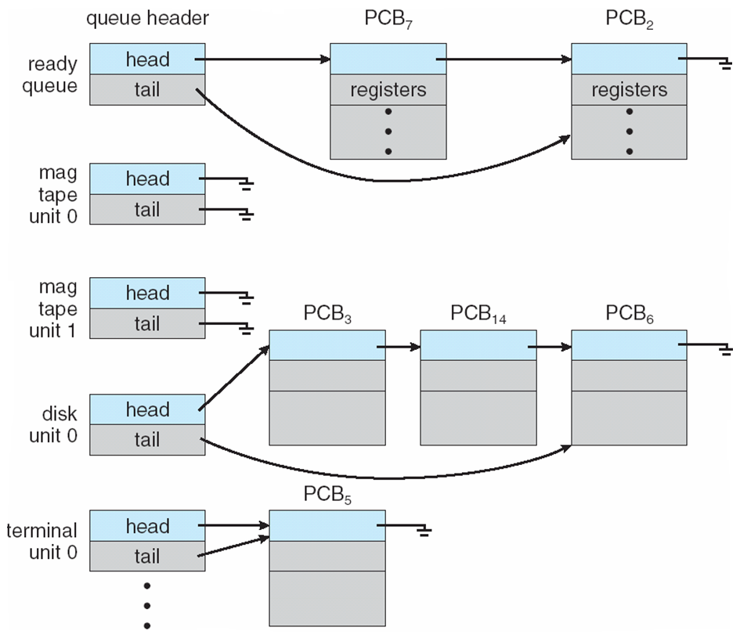
Ready Queue And Various I/O Device Queues

Slide 13
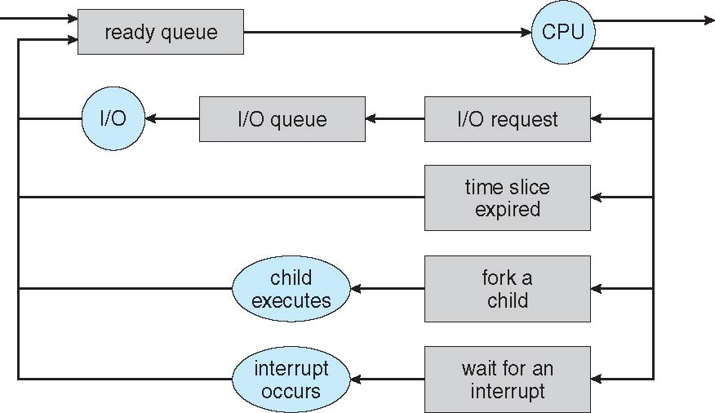
Representation of Process Scheduling
Queueing diagram represents queues, resources, flows

Slide 14
Schedulers
Short-term scheduler (or CPU scheduler) – selects which process should be executed next and allocates CPU
invoked frequently (milliseconds) ⇒ (must be fast)
Long-term scheduler (or job scheduler) – selects which processes should be brought into the ready queue
invoked infrequently (seconds, minutes) ⇒ (may be slow)
controls the degree of multiprogramming
Processes can be described as either:
I/O-bound process – spends more time doing I/O than computations, many short CPU bursts
CPU-bound process – spends more time doing computations; few very long CPU bursts
Long-term scheduler strives for good process mix

Slide 15
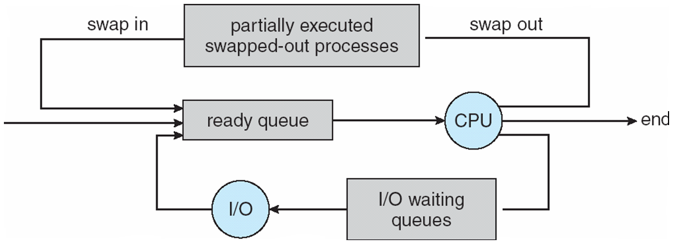
Addition of Medium Term Scheduling
Medium-term scheduler can be added if degree of multiple programming needs to decrease
Remove process from memory, store on disk, bring back in from disk to continue execution: swapping

Slide 16
Context Switch
When CPU switches to another process, the system must save the state of the old process and load the saved state for the new process via a context switch
Context of a process represented in the PCB
Context-switch time is overhead; the system does no useful work while switching
The more complex the OS and the PCB ➔ the longer the context switch
Time dependent on hardware support
Some hardware provides multiple sets of registers per CPU ➔ multiple contexts loaded at once

Slide 17
Operations on Processes
System must provide mechanisms for:
process creation,
process termination,
and so on as detailed next

Slide 18
Process Creation
Parent process creates children processes, which, in turn create other processes, forming a tree of processes
Generally, process identified and managed via a process identifier (pid)
Resource sharing options
Parent and children share all resources
Children share subset of parent’s resources
Parent and child share no resources
Execution options
Parent and children execute concurrently
Parent waits until children terminate

Slide 19
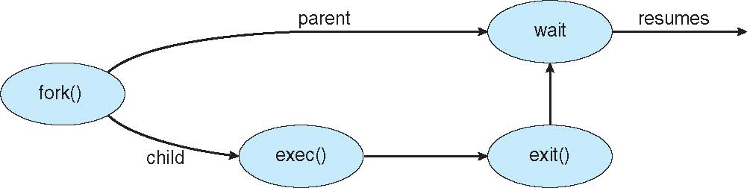
Process Creation (Cont.)
Address space
Child duplicate of parent
Child has a program loaded into it
UNIX examples
fork() system call creates new process
exec() system call used after a fork() to replace the process’ memory space with a new program

Slide 20
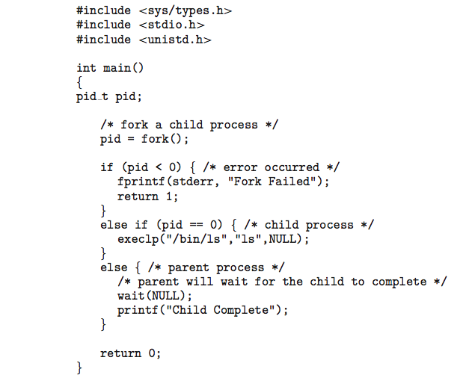
C Program Forking Separate Process

Slide 21
Process Termination
Process executes last statement and then asks the operating system to delete it using the exit() system call.
Returns status data from child to parent (via wait())
Process’ resources are deallocated by operating system
Parent may terminate the execution of children processes using the abort() system call. Some reasons for doing so:
Child has exceeded allocated resources
Task assigned to child is no longer required
The parent is exiting and the operating systems does not allow a child to continue if its parent terminates

Slide 22
Process Termination
Some operating systems do not allow a child to exist if its parent has terminated. If a process terminates, then all its children must also be terminated.
cascading termination. All children, grandchildren, etc. are terminated.
The termination is initiated by the operating system.
The parent process may wait for termination of a child process by using the wait()system call. The call returns status information and the pid of the terminated process
pid = wait(&status);
If no parent waiting (did not invoke wait()) process is a zombie
If parent terminated without invoking wait , process is an orphan

Slide 23
Multiprocess Architecture – Chrome Browser
Many web browsers ran as single process (some still do)
If one web site causes trouble, entire browser can hang or crash
Google Chrome Browser is multiprocess with 3 different types of processes:
Browser process manages user interface, disk and network I/O
Renderer process renders web pages, deals with HTML, Javascript. A new renderer created for each website opened
Runs in sandbox restricting disk and network I/O, minimizing effect of security exploits
Plug-in process for each type of plug-in

Slide 24
Interprocess Communication
Processes within a system may be independent or cooperating
Cooperating process can affect or be affected by other processes, including sharing data
Reasons for cooperating processes:
Information sharing
Computation speedup
Modularity
Convenience
Cooperating processes need interprocess communication (IPC)
Two models of IPC
Shared memory
Message passing

Slide 25
Communications Models
(a) Message passing. (b) shared memory.

Slide 26
Producer-Consumer Problem
Paradigm for cooperating processes, producer process produces information that is consumed by a consumer process

Slide 27
Bounded-Buffer – Shared-Memory Solution
Shared data
#define BUFFER_SIZE 10
typedef struct {
. . .
} item;
item buffer[BUFFER_SIZE];
int in = 0;
int out = 0;
Solution is correct, but can only use BUFFER_SIZE-1 elements

Slide 28
Bounded-Buffer – Producer
item next_produced;
while (true) {
/* produce an item in next produced */
while (((in + 1) % BUFFER_SIZE) == out)
; /* do nothing */
buffer[in] = next_produced;
in = (in + 1) % BUFFER_SIZE;
}

Slide 29
Bounded Buffer – Consumer
item next_consumed;
while (true) { while (in == out)
; /* do nothing */ next_consumed = buffer[out];
out = (out + 1) % BUFFER_SIZE;
/* consume the item in next consumed */
}

Slide 30
Interprocess Communication – Shared Memory
Major issue is to provide a mechanism that will allow the user processes to synchronize their actions when they access shared memory.
Synchronization is discussed in great details next week.

Slide 31
Interprocess Communication – Message Passing
IPC facility provides two operations:
send(message)
receive(message)
The message size is either fixed or variable

Slide 32
Direct Communication
Processes must name each other explicitly:
send (P, message) – send a message to process P
receive(Q, message) – receive a message from process Q
Properties of direct links
Links are established automatically
A link is associated with exactly one pair of communicating processes
Between each pair there exists exactly one link
The link may be unidirectional, but is usually bi-directional

Slide 33
Indirect Communication
Messages are directed and received from mailboxes (also referred to as ports)
Each mailbox has a unique id
Processes can communicate only if they share a mailbox
Properties of indirect link
Link established only if processes share a common mailbox
A link may be associated with many processes
Each pair of processes may share several communication links
Link may be unidirectional or bi-directional

Slide 34
Indirect Communication
Operations
create a new mailbox (port)
send and receive messages through mailbox
destroy a mailbox
Primitives are defined as:
send(A, message) – send a message to mailbox A
receive(A, message) – receive a message from mailbox A

Slide 35
Indirect Communication
Mailbox sharing
P₁, P₂, and P₃ share mailbox A
P₁, sends; P₂ and P₃ receive
Who gets the message?
Solutions
Allow a link to be associated with at most two processes
Allow only one process at a time to execute a receive operation
Allow the system to select arbitrarily the receiver. Sender is notified who the receiver was.

Slide 36
Synchronization
Message passing may be either blocking or non-blocking
Blocking is considered synchronous
Blocking send -- the sender is blocked until the message is received
Blocking receive -- the receiver is blocked until a message is available
Non-blocking is considered asynchronous
Non-blocking send -- the sender sends the message and continue
Non-blocking receive -- the receiver receives:
A valid message, or
Null message
Different combinations possible
If both send and receive are blocking, we have a rendezvous

Slide 37
Synchronization (Cont.)
Producer-consumer becomes trivial
message next_produced;
while (true) { /* produce an item in next produced */
send(next_produced);
}
message next_consumed;
while (true) {
receive(next_consumed);
/* consume the item in next consumed */
}

Slide 38
Buffering
Queue of messages attached to the link.
implemented in one of three ways
1. Zero capacity – no messages are queued on a link. Sender must wait for receiver (rendezvous)
2. Bounded capacity – finite length of n messages Sender must wait if link full
3. Unbounded capacity – infinite length Sender never waits

Slide 39
Examples of IPC Systems - POSIX
Process first creates shared memory segment shm_fd = shm_open(name, O_CREAT | O_RDWR, 0666);
Also used to open an existing segment to share it
Set the size of the object
ftruncate(shm_fd, 4096);
Map the shared memory object
ptr = mmap(0, 4096, PROT_WRITE,
MAP_SHARED, shm_fd, 0);
Now the process could write to the shared memory
sprintf(ptr, "Writing to shared memory");

Slide 40
Communications in Client-Server Systems
Sockets
Remote Procedure Calls
Pipes

Slide 41
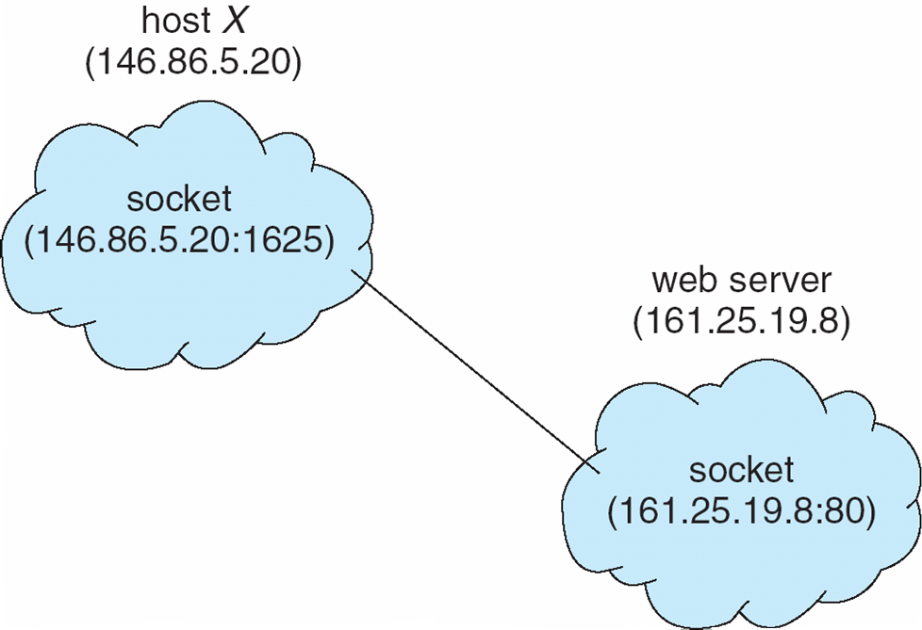
Socket Communication

Slide 42
Remote Procedure Calls
Remote procedure call (RPC) abstracts procedure calls between processes on networked systems
Again uses ports for service differentiation
Stubs – client-side proxy for the actual procedure on the server
The client-side stub locates the server and marshalls the parameters
The server-side stub receives this message, unpacks the marshalled parameters, and performs the procedure on the server
On Windows, stub code compile from specification written in Microsoft Interface Definition Language (MIDL)

Slide 43
Remote Procedure Calls (Cont.)
Data representation handled via External Data Representation (XDL) format to account for different architectures
Big-endian and little-endian
Remote communication has more failure scenarios than local
Messages can be delivered exactly once rather than at most once
OS typically provides a rendezvous (or matchmaker) service to connect client and server

Slide 44
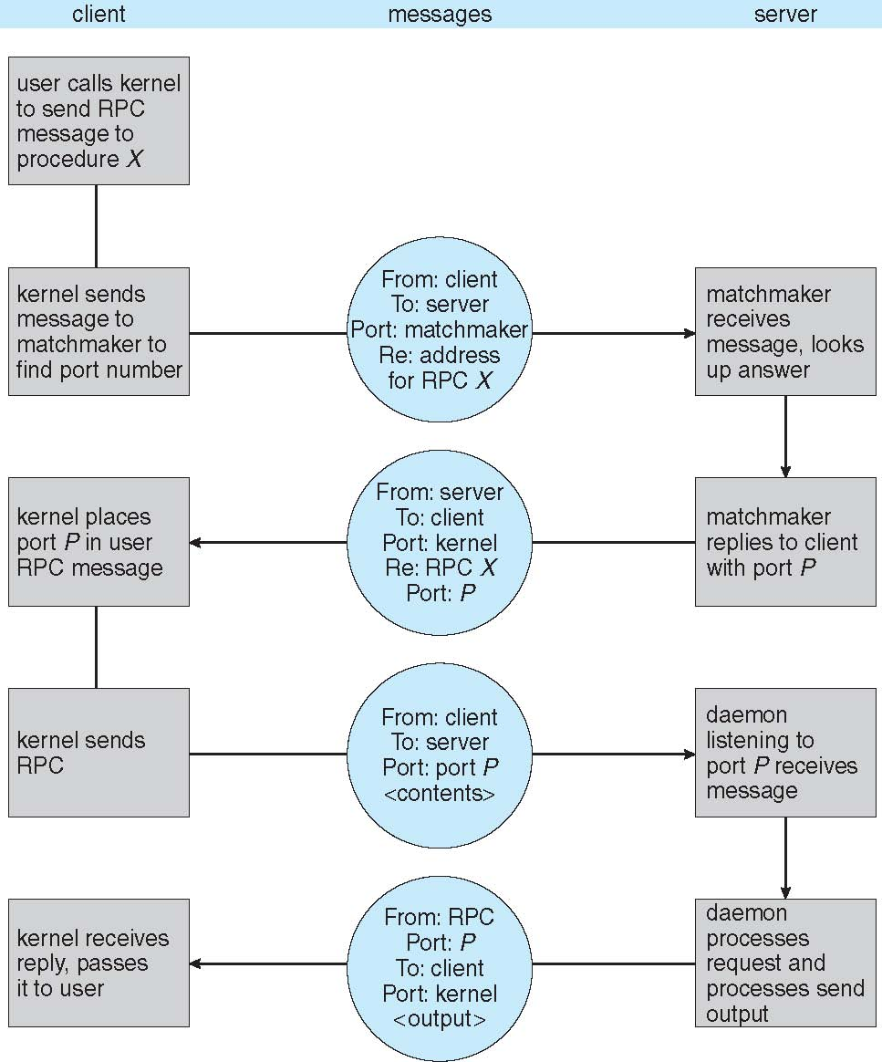
Execution of RPC

Slide 45
Pipes
Acts as a conduit allowing two processes to communicate
Ordinary pipes – cannot be accessed from outside the process that created it. Typically, a parent process creates a pipe and uses it to communicate with a child process that it created.
Named pipes – can be accessed without a parent-child relationship.

Slide 46
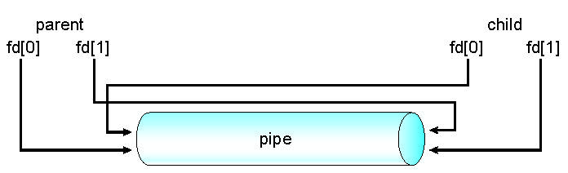
Ordinary Pipes
Ordinary Pipes allow communication in standard producer-consumer style
Producer writes to one end (the write-end of the pipe)
Consumer reads from the other end (the read-end of the pipe)
Ordinary pipes are therefore unidirectional
Require parent-child relationship between communicating processes
Windows calls these anonymous pipes
See Unix and Windows code samples in textbook

Slide 47
Named Pipes
Named Pipes are more powerful than ordinary pipes
Communication is bidirectional
No parent-child relationship is necessary between the communicating processes
Several processes can use the named pipe for communication
Provided on both UNIX and Windows systems

Slide 48
Chapter 4: Threads
Overview
Multicore Programming
Multithreading Models
Thread Libraries
Implicit Threading
Threading Issues
Operating System Examples

Slide 49
Multithreaded Server Architecture
Notes:
Benefits:
Responsiveness – may allow continued execution if part of process is blocked, especially important for user interfaces
Resource Sharing – threads share resources of process, easier than shared memory or message passing
Economy – cheaper than process creation, thread switching lower overhead than context switching
Scalability – process can take advantage of multiprocessor architectures

Slide 50
Concurrency vs. Parallelism
Parallelism implies a system can perform more than one task simultaneously
Concurrency supports more than one task making progress
Single processor / core, scheduler providing concurrency

Slide 51
Concurrency vs. Parallelism
Concurrent execution on single-core system:
Parallelism on a multi-core system:

Slide 52
Single and Multithreaded Processes

Slide 53
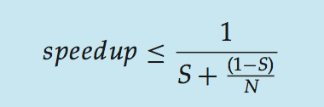
Amdahl’s Law
Identifies performance gains from adding additional cores to an application that has both serial and parallel components
S is serial portion
N processing cores
That is, if application is 75% parallel / 25% serial, moving from 1 to 2 cores results in speedup of 1.6 times
As N approaches infinity, speedup approaches 1 / S

Slide 54
User Threads and Kernel Threads
User threads - management done by user-level threads library
Three primary thread libraries:
POSIX Pthreads
Windows threads
Java threads
Kernel threads - Supported by the Kernel

Slide 55
Multithreading Models
Many-to-One
One-to-One
Many-to-Many

Slide 56
Many-to-One
Many user-level threads mapped to single kernel thread
One thread blocking causes all to block
Multiple threads may not run in parallel on muticore system because only one may be in kernel at a time
Few systems currently use this model
Examples:
Solaris Green Threads
GNU Portable Threads

Slide 57
One-to-One
Each user-level thread maps to a kernel thread
Creating a user-level thread creates a kernel thread
More concurrency than many-to-one
Number of threads per process sometimes restricted due to overhead
Examples
Windows
Linux
Solaris 9 and later

Slide 58
Many-to-Many Model
Allows many user level threads to be mapped to many kernel threads
Allows the operating system to create a sufficient number of kernel threads
Examples:
Solaris prior to version 9
Windows with the ThreadFiber package

Slide 59
Two-level Model
Similar to M:M, except that it allows a user thread to be bound to kernel thread
Examples
IRIX
HP-UX
Tru64 UNIX
Solaris 8 and earlier

Slide 60
Thread Libraries
Two primary ways of implementing
Library entirely in user space
Kernel-level library supported by the OS

Slide 61
Pthreads
May be provided either as user-level or kernel-level
A POSIX standard (IEEE 1003.1c) API for thread creation and synchronization
Specification, not implementation
Common in UNIX operating systems (Solaris, Linux, Mac OS X)

Slide 62
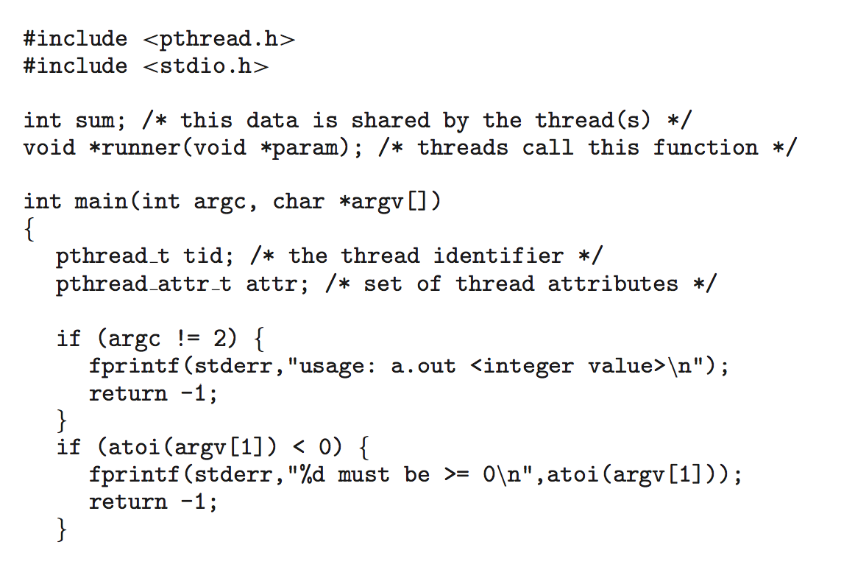
Pthreads Example

Slide 63
Pthreads Example (Cont.)

Slide 64
Implicit Threading
Creation and management of threads done by compilers and run-time libraries rather than programmers
Three methods explored
Thread Pools
OpenMP
Grand Central Dispatch

Slide 65
Thread Pools
Create a number of threads in a pool where they await work
Advantages:
Usually slightly faster to service a request with an existing thread than create a new thread
Allows the number of threads in the application(s) to be bound by the size of the pool
Separating task to be performed from mechanics of creating task allows different strategies for running task
Ex:Tasks could be scheduled to run periodically

Slide 66
OpenMP
Set of compiler directives and an API for C, C++, FORTRAN
Provides support for parallel programming in shared-memory environments
Identifies parallel regions – blocks of code that can run in parallel
#pragma omp parallel
Create as many threads as there are cores
#pragma omp parallel for for(i=0;i<N;i++) {
c[i] = a[i] + b[i];
}
Run for loop in parallel

Slide 67
Grand Central Dispatch
Apple technology for Mac OS X and iOS operating systems
Extensions to C, C++ languages, API, and run-time library
Allows identification of parallel sections
Manages most of the details of threading
Block is in “^{ }” - ˆ{ printf("I am a block"); }
Blocks placed in dispatch queue
Assigned to available thread in thread pool when removed from queue

Slide 68
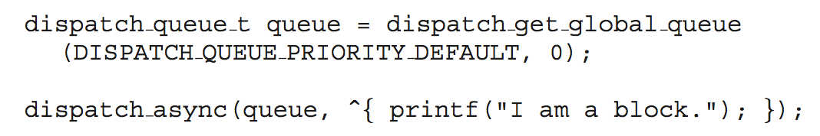
Grand Central Dispatch
Two types of dispatch queues:
serial – blocks removed in FIFO order, queue is per process, called main queue
Programmers can create additional serial queues within program
concurrent – removed in FIFO order but several may be removed at a time
Three system wide queues with priorities low, default, high

Slide 69
Semantics of fork() and exec()
Does fork()duplicate only the calling thread or all threads?
Some UNIXes have two versions of fork
exec() usually works as normal – replace the running process including all threads

Slide 70
Signal Handling
Signals are used in UNIX systems to notify a process that a particular event has occurred.
A signal handler is used to process signals
Signal is generated by a particular event
Signal is delivered to a process
Signal is handled by one of two signal handlers:
default
user-defined
Every signal has default handler that the kernel runs when handling the signal
User-defined signal handler can override default
For single-threaded, signal delivered to process

Slide 71
Signal Handling (Cont.)
Where should a signal be delivered for multi-threaded?
Deliver the signal to the thread to which the signal applies
Deliver the signal to every thread in the process
Deliver the signal to certain threads in the process
Assign a specific thread to receive all signals for the process

Slide 72
Thread Cancellation
Terminating a thread before it has finished
Thread to be canceled is target thread
Two general approaches:
Asynchronous cancellation terminates the target thread immediately
Deferred cancellation allows the target thread to periodically check if it should be cancelled

Slide 73
Thread Cancellation (Cont.)
Invoking thread cancellation requests cancellation, but actual cancellation depends on thread state
If thread has cancellation disabled, cancellation remains pending until thread enables it
Default type is deferred
Cancellation only occurs when thread reaches cancellation point
pthread_testcancel()
Then cleanup handler is invoked
On Linux systems, thread cancellation is handled through signals

Slide 74
Thread-Local Storage
Thread-local storage (TLS) allows each thread to have its own copy of data
Useful when you do not have control over the thread creation process (i.e., when using a thread pool)
Different from local variables
Local variables visible only during single function invocation
TLS visible across function invocations
Similar to static data
TLS is unique to each thread

Slide 75
Scheduler Activations
Both M:M and Two-level models require communication to maintain the appropriate number of kernel threads allocated to the application
Typically use an intermediate data structure between user and kernel threads – lightweight process (LWP)
Appears to be a virtual processor on which process can schedule user thread to run
Each LWP attached to kernel thread
How many LWPs to create?
Scheduler activations provide upcalls - a communication mechanism from the kernel to the upcall handler in the thread library
This communication allows an application to maintain the correct number of kernel threads

Slide 76
Windows Threads Data Structures
Notes:
The primary data structures of a thread include:
ETHREAD (executive thread block) – includes pointer to process to which thread belongs and to KTHREAD, in kernel space
KTHREAD (kernel thread block) – scheduling and synchronization info, kernel-mode stack, pointer to TEB, in kernel space
TEB (thread environment block) – thread id, user-mode stack, thread-local storage, in user space

Slide 77
Linux Threads
Linux refers to them as tasks rather than threads
Thread creation is done through clone() system call
clone() allows a child task to share the address space of the parent task (process)

