Slide 1

Week 4: CPU Scheduling
Sherif Khattab
http://www.cs.pitt.edu/~skhattab/cs1550
(Some slides are from Silberschatz, Galvin and Gagne ©2013)

Slide 2
Administrivia
Project 1 delayed for one week
Quiz 1 in recitations of this week
Open book, notes, and Internet
Online multiple-choice questions
Review the lab simulations!

Slide 3
Basic Concepts
Maximum CPU utilization obtained with multiprogramming
CPU–I/O Burst Cycle – Process execution consists of a cycle of CPU execution and I/O wait
CPU burst followed by I/O burst
CPU burst distribution is of main concern

Slide 4
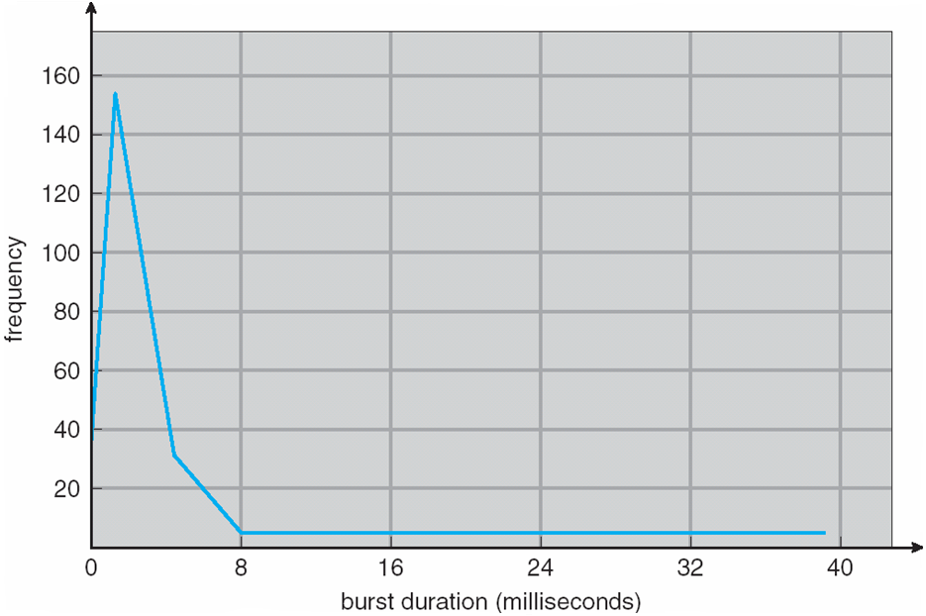
Histogram of CPU-burst Times

Slide 5
Scheduling Criteria
CPU utilization – keep the CPU as busy as possible
Throughput – # of processes that complete their execution per time unit
Turnaround time – amount of time to execute a particular process
Waiting time – amount of time a process has been waiting in the ready queue
Response time – amount of time it takes from when a request was submitted until the first response is produced, not output (for time-sharing environment)

Slide 6
First- Come, First-Served (FCFS) Scheduling
Process Burst Time
P₁ 24
P₂ 3
P₃ 3
Suppose that the processes arrive in the order: P₁ , P₂ , P₃ The Gantt Chart for the schedule is:
Waiting time for P₁ = 0; P₂ = 24; P₃ = 27
Average waiting time: (0 + 24 + 27)/3 = 17

Slide 7
Determining Length of Next CPU Burst
Can only estimate the length – should be similar to the previous one
Then pick process with shortest predicted next CPU burst
Can be done by using the length of previous CPU bursts, using exponential averaging
Commonly, α set to ½
Preemptive version called shortest-remaining-time-first

Slide 8
Prediction of the Length of the Next CPU Burst

Slide 9
Priority Scheduling
A priority number (integer) is associated with each process
The CPU is allocated to the process with the highest priority (smallest integer ≡ highest priority)
Preemptive
Nonpreemptive
SJF is priority scheduling where priority is the inverse of predicted next CPU burst time
Problem ≡ Starvation – low priority processes may never execute
Solution ≡ Aging – as time progresses increase the priority of the process

Slide 10
Round Robin (RR)
Each process gets a small unit of CPU time (time quantum q), usually 10-100 milliseconds. After this time has elapsed, the process is preempted and added to the end of the ready queue.
If there are n processes in the ready queue and the time quantum is q, then each process gets 1/n of the CPU time in chunks of at most q time units at once. No process waits more than (n-1)q time units.
Timer interrupts every quantum to schedule next process
Performance
q large ⇒ FIFO
q small ⇒ q must be large with respect to context switch, otherwise overhead is too high

Slide 11
Multilevel Queue
Ready queue is partitioned into separate queues, eg:
foreground (interactive)
background (batch)
Process permanently in a given queue
Each queue has its own scheduling algorithm:
foreground – RR
background – FCFS
Scheduling must be done between the queues:
Fixed priority scheduling; (i.e., serve all from foreground then from background). Possibility of starvation.
Time slice – each queue gets a certain amount of CPU time which it can schedule amongst its processes; i.e., 80% to foreground in RR
20% to background in FCFS

Slide 12
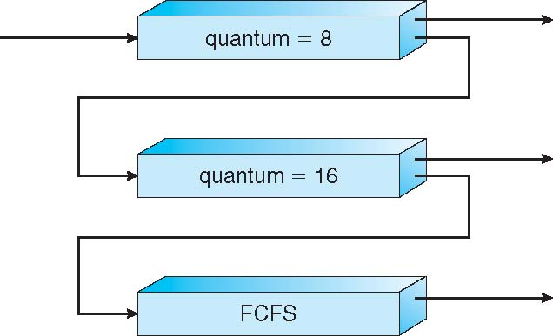
Example of Multilevel Feedback Queue
Three queues:
Q₀ – RR with time quantum 8 milliseconds
Q₁ – RR time quantum 16 milliseconds
Q₂ – FCFS
Scheduling
A new job enters queue Q₀ which is served FCFS
When it gains CPU, job receives 8 milliseconds
If it does not finish in 8 milliseconds, job is moved to queue Q₁
At Q₁ job is again served FCFS and receives 16 additional milliseconds
If it still does not complete, it is preempted and moved to queue Q₂

Slide 13
Pthread Scheduling API
#include <pthread.h>
#include <stdio.h>
#define NUM_THREADS 5
int main(int argc, char *argv[]) {
int i, scope; pthread_t tid[NUM THREADS];
pthread_attr_t attr;
/* get the default attributes */
pthread_attr_init(&attr);
/* first inquire on the current scope */ if (pthread_attr_getscope(&attr, &scope) != 0)
fprintf(stderr, "Unable to get scheduling scope\n");
else {
if (scope == PTHREAD_SCOPE_PROCESS)
printf("PTHREAD_SCOPE_PROCESS");
else if (scope == PTHREAD_SCOPE_SYSTEM)
printf("PTHREAD_SCOPE_SYSTEM");
else fprintf(stderr, "Illegal scope value.\n");
}

Slide 14
Pthread Scheduling API
/* set the scheduling algorithm to PCS or SCS */
pthread_attr_setscope(&attr, PTHREAD_SCOPE_SYSTEM);
/* create the threads */ for (i = 0; i < NUM_THREADS; i++)
pthread_create(&tid[i],&attr,runner,NULL);
/* now join on each thread */ for (i = 0; i < NUM_THREADS; i++)
pthread_join(tid[i], NULL);
}
/* Each thread will begin control in this function */
void *runner(void *param) {
/* do some work ... */
pthread_exit(0);
}

Slide 15
Multiple-Processor Scheduling
Symmetric multiprocessing (SMP) – each processor is self-scheduling, all processes in common ready queue, or each has its own private queue of ready processes
Currently, most common
Processor affinity – process has affinity for processor on which it is currently running
soft affinity
hard affinity
Variations including processor sets
Load balancing

Slide 16
NUMA and CPU Scheduling
Note that memory-placement algorithms can also consider affinity

Slide 17
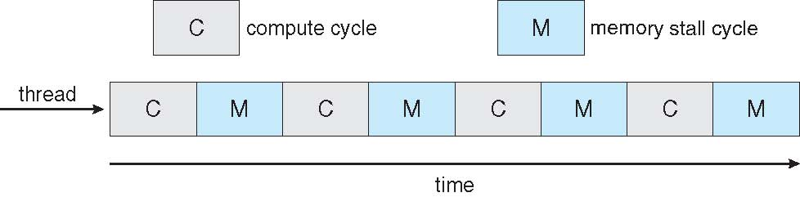

Multithreaded Multicore System

Slide 18
Real-Time CPU Scheduling
Conflict phase of dispatch latency:
Preemption of any process running in kernel mode
Release by low-priority process of resources needed by high-priority processes

Slide 19
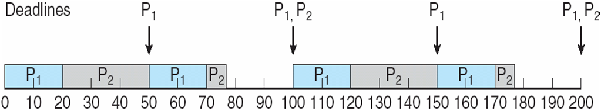
Rate Montonic Scheduling
A priority is assigned based on the inverse of its period
Shorter periods = higher priority;
Longer periods = lower priority
P₁ is assigned a higher priority than P₂.

Slide 20
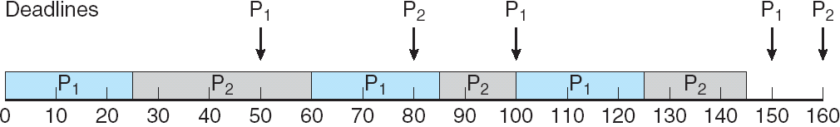
Earliest Deadline First Scheduling (EDF)
Priorities are assigned according to deadlines: the earlier the deadline, the higher the priority;
the later the deadline, the lower the priority

Slide 21
Operating System Examples
Linux scheduling
Windows scheduling

Slide 22
Linux Scheduling in Version 2.6.23 +
Completely Fair Scheduler (CFS)
Scheduling classes
Rather than quantum based on fixed time allotments, based on proportion of CPU time
Quantum calculated based on nice value from -20 to +19
Lower value is higher priority
Calculates target latency – interval of time during which task should run at least once
CFS scheduler maintains per task virtual run time in variable vruntime
Associated with decay factor based on priority of task – lower priority is higher decay rate
Normal default priority yields virtual run time = actual run time
To decide next task to run, scheduler picks task with lowest virtual run time

Slide 23
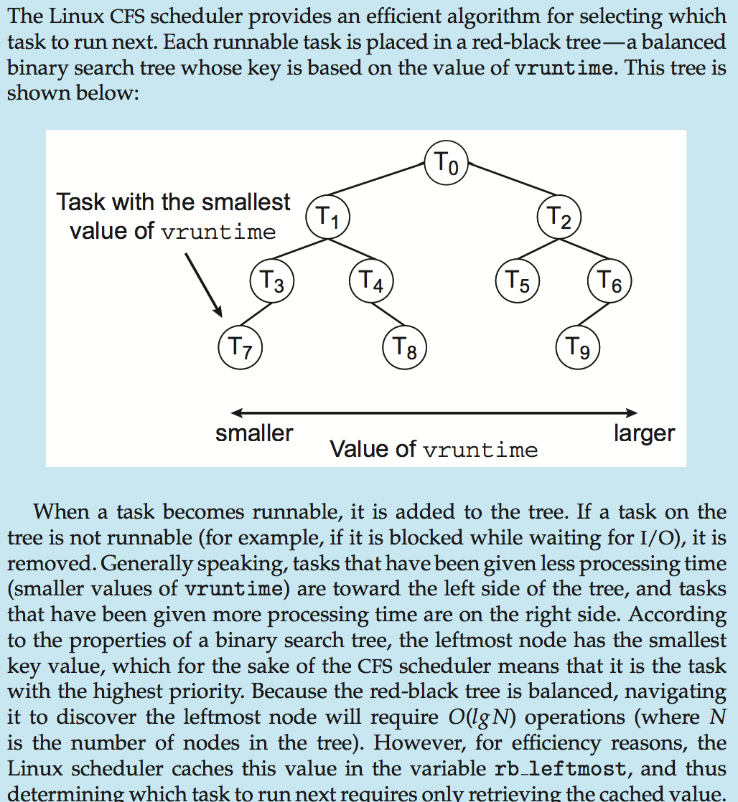
CFS Performance
Red-Black Binary Search Tree

Slide 24
Windows User Mode Scheduling
Windows 7 added user-mode scheduling (UMS)
Applications create and manage threads independent of kernel
For large number of threads, much more efficient
UMS schedulers come from programming language libraries like
C++ Concurrent Runtime (ConcRT) framework

Slide 25
Algorithm Evaluation
How to select CPU-scheduling algorithm for an OS?
at time 0:

Slide 26
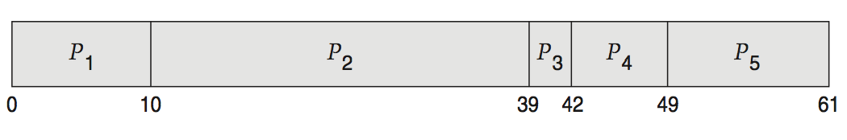
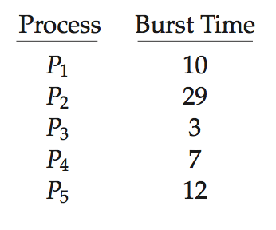
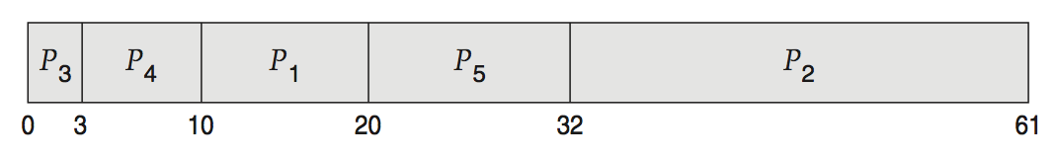
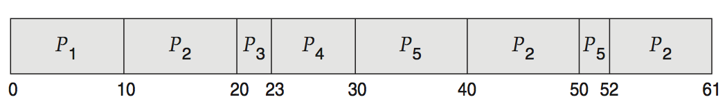
Deterministic Evaluation
For each algorithm, calculate minimum average waiting time
Simple and fast, but requires exact numbers for input, applies only to those inputs
FCS is 28ms:
Non-preemptive SFJ is 13ms:
RR is 23ms:

Slide 27
Queueing Models
Describes the arrival of processes, and CPU and I/O bursts probabilistically
Commonly exponential, and described by mean
Computes average throughput, utilization, waiting time, etc
Computer system described as network of servers, each with queue of waiting processes
Knowing arrival rates and service rates
Computes utilization, average queue length, average wait time, etc

Slide 28
Little’s Formula
n = average queue length
W = average waiting time in queue
λ = average arrival rate into queue
Little’s law – in steady state, processes leaving queue must equal processes arriving, thus: n = λ x W
Valid for any scheduling algorithm and arrival distribution
For example, if on average 7 processes arrive per second, and normally 14 processes in queue, then average wait time per process = 2 seconds

Slide 29
Simulations
Queueing models limited
Simulations more accurate
Programmed model of computer system
Clock is a variable
Gather statistics indicating algorithm performance
Data to drive simulation gathered via
Random number generator according to probabilities
Distributions defined mathematically or empirically
Trace tapes record sequences of real events in real systems

Slide 30
Implementation
Even simulations have limited accuracy
Just implement new scheduler and test in real systems
High cost, high risk
Environments vary
Most flexible schedulers can be modified per-site or per-system
Or APIs to modify priorities
But again environments vary

