Slide 1
Attack Name: Excessive Firewall Denies Across Multiple Hosts
IDS Sensors:
Source IP Address: a.b.c.d
Source Port: xxx
Destination Address: e.f.g.h
Destination Port: yyy
Reason For Escalation
------------------------
Reported on Mon Aug 10 13:43:50 GMT 2020, Offense ID 59650 was created when 202 event(s) occurred. Further offense details are available on the QRadar console.
How did IBM’s Network Intrusion Detection System QRadar detect this?
Machine Learning

Slide 2
Network Intrusion Detection Systems The Machine Learning Approach
by Mohammed Rahman
Site Reliability Engineer
MSC Industrial Supply Co.

Slide 3
Network Security Lab(NSL) Knowledge Discovery in Databases(KDD)
There are 125,973 records in the training dataset (85%) and 22,544 records in the test dataset (15%).
Made to train and evaluate intrusion detection models.
Can be used to identify network traffic pattern in NIDS.
Can be used develop NIDS algorithms that can detect and prevent cyber-attacks.
NSL-KDD is a dataset for network intrusion detection research.
Contains network traffic data generated by different types of attacks.
Contains 42 features for each connection record.
Includes a label for each record indicating whether it represents normal traffic or one of the attack types.

Slide 4
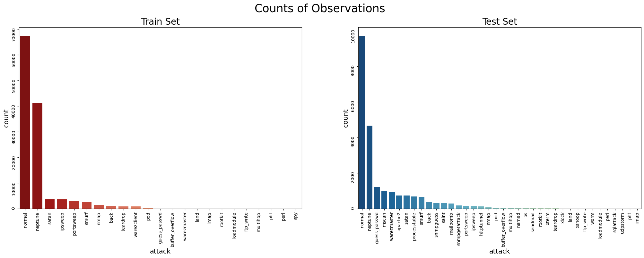
Challenge with the Dataset
The data is imbalanced in a major way. Most of the connections are either 'normal' or 'neptune' attack both in training and test dataset.

Slide 5
Challenge with the Dataset
There are 23 types of attack in the training dataset but 38 types of attack in the test dataset

Slide 6
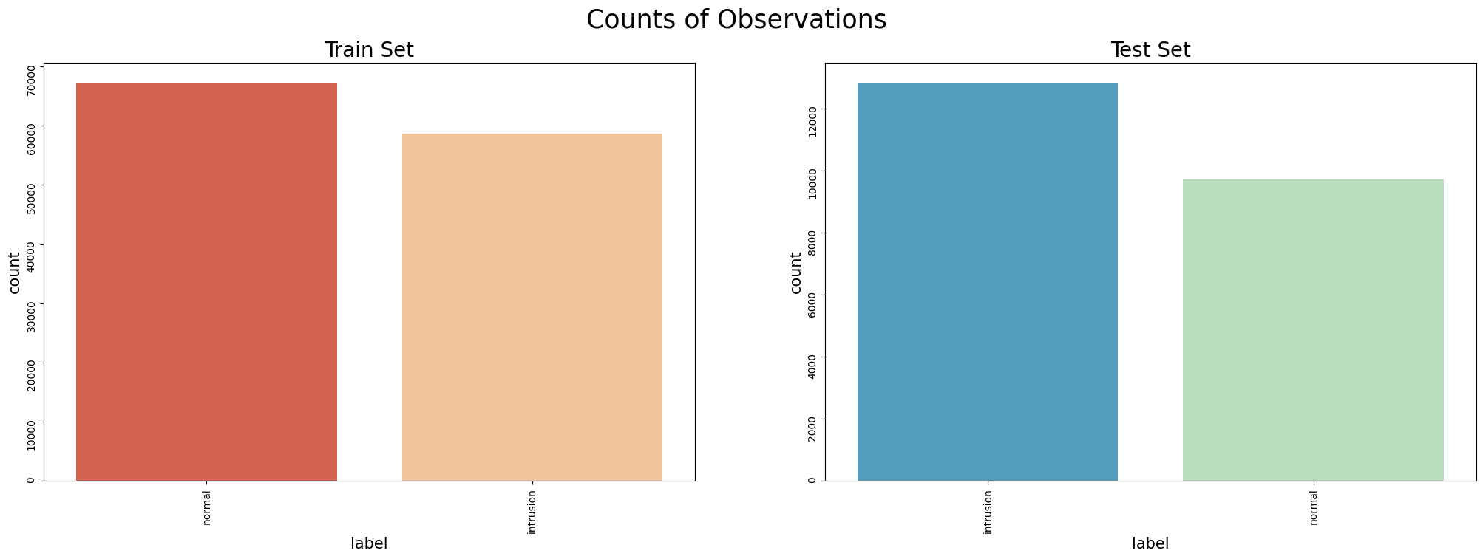
The Solution
Binary Classification
Convert all the attacks to one category called ‘intrusion’

Slide 7
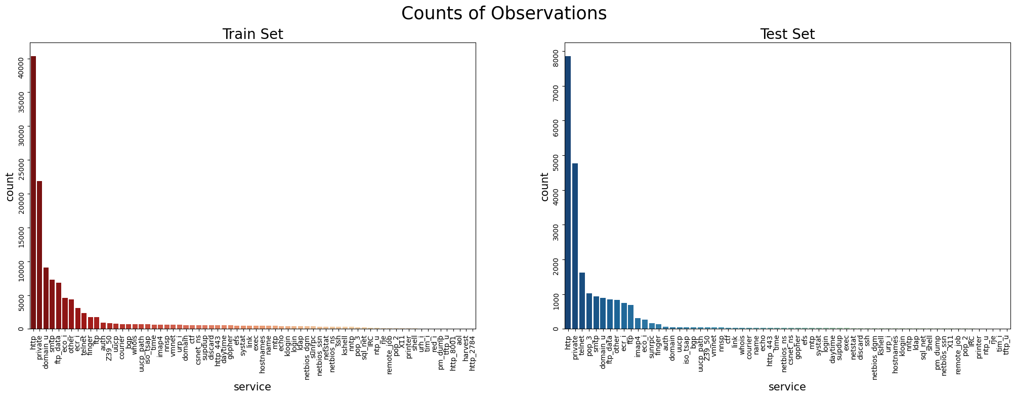
Challenge with the Dataset
There are 70 and 64 unique 'service' values in training and test dataset. This is a problem for both one-hot encoding and label encoding.

Slide 8
The Solution
Merge the training and test datasets, perform the string-to-number transformation (label encoding) on 'protocol_type', 'service', 'flag','label’ and then split them back into their original partitions.
df_train_copy = df_train.copy()
df_test_copy = df_test.copy()
df_train_copy['train']=1 df_test_copy['train']=0 joined_df = pd.concat([df_train_copy, df_test_copy]) le=preprocessing.LabelEncoder()
clm=['protocol_type', 'service', 'flag','label']
for x in clm:
joined_df[x]=le.fit_transform(joined_df[x])
df_train_copy = joined_df[joined_df['train']==1] df_test_copy = joined_df[joined_df['train']==0]
drop_cols = ['train'] df_train_copy.drop(drop_cols, axis=1, inplace=True) df_test_copy.drop(drop_cols, axis=1, inplace=True)
df_train=df_train_copy
df_test=df_test_copy

Slide 9
Data Transformation
Let’s apply MinMaxScaler on all the columns to transform the values between 0 and 1
x_train=df_train.drop('label',axis=1)
y_train=df_train["label"]
x_test=df_test.drop('label',axis=1)
y_test=df_test["label"]
scaler = MinMaxScaler()
x_train= scaler.fit_transform(x_train)
x_test= scaler.fit_transform(x_test)

Slide 10
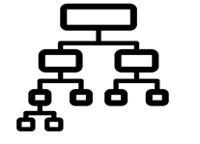
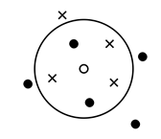

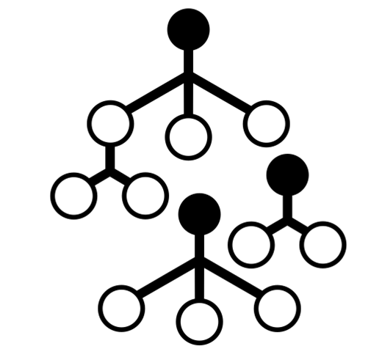
The Models
Logistic Regression
Decision Tree
Random Forest
K-Nearest Neighbor
Support Vector Machine Linear
Support Vector Machine Polynomial
Support Vector Machine RBF
Naive Bayes

Slide 11
The Results
 | Accuracy | Precision | Recall | Specificity | F1 | Confusion Matrix
Support Vector Machine RBF | 88.18 | 96.33 | 80.21 | 82.02 | 87.54 | [[10525, 2308], [356, 9355]]
Support Vector Machine Polynomial | 87.91 | 96.42 | 79.75 | 81.47 | 87.29 | [[10455, 2378], [348, 9363]]
Support Vector Machine Linear | 84.78 | 92.52 | 76.85 | 78.91 | 83.96 | [[10127, 2706], [726, 8985]]
Random Forest | 83.14 | 97.15 | 72.8 | 72.53 | 83.23 | [[9308, 3525], [277, 9434]]
Naive Bayes | 78.09 | 89.14 | 69.02 | 69.73 | 77.8 | [[8948, 3885], [1055, 8656]]
Logistic Regression | 85.18 | 92.5 | 77.47 | 79.64 | 84.32 | [[10220, 2613], [728, 8983]]
K-Nearest Neighbor | 81.09 | 97.64 | 70.15 | 68.56 | 81.64 | [[8798, 4035], [229, 9482]]
Decision Tree | 87.16 | 96.19 | 78.72 | 80.32 | 86.58 | [[10308, 2525], [370, 9341]]

Slide 12
Conclusion
While the overall accuracy is not excellent, it appears that Support Vector Machines (non-linear) performed better than the other models.
But Wait……..
Is it possible that the models did not perform that well due to a mismatch between the training and test dataset?

Slide 13
An Experiment
One approach to reduce the possibility of a mismatch between the training and test dataset is to combine them, shuffle the data, and then split them back into separate sets again.
df_combined = pd.concat([df_train, df_test])
df_combined = df_combined.sample(frac=1, random_state=42)
train_rows = 125973
df_train = df_combined[:train_rows]
df_test = df_combined[train_rows:]

Slide 14
The Results
 | Accuracy | Precision | Recall | Specificity | F1 | Confusion Matrix
Random Forest | 99.85 | 99.78 | 99.93 | 99.93 | 99.85 | [[10898, 8], [26, 11612]]
K-Nearest Neighbor | 99.53 | 99.35 | 99.75 | 99.73 | 99.55 | [[10877, 29], [76, 11562]]
Support Vector Machine Polynomial | 99.47 | 99.08 | 99.9 | 99.89 | 99.49 | [[10894, 12], [107, 11531]]
Support Vector Machine RBF | 99.45 | 98.99 | 99.93 | 99.93 | 99.46 | [[10898, 8], [117, 11521]]
Decision Tree | 99.3 | 98.9 | 99.75 | 99.73 | 99.32 | [[10877, 29], [128, 11510]]
Logistic Regression | 96.5 | 96.49 | 96.73 | 96.52 | 96.61 | [[10526, 380], [408, 11230]]
Support Vector Machine Linear | 96.33 | 96.38 | 96.51 | 96.28 | 96.44 | [[10500, 406], [421, 11217]]
Naive Bayes | 88.95 | 88.9 | 89.61 | 89.01 | 89.26 | [[9707, 1199], [1292, 10346]]

Slide 15
Conclusion
The performance metrics of the models, including accuracy and other relevant measures, showed a significant improvement.
The models are trained on a diverse range of data and tested on data that is representative of the real-world scenarios.
But Wait……..
What about multi-class Classification?

Slide 16

Let’s try a deep neuron network

Slide 17
Challenge with the Dataset
The data is imbalanced in a major way. Most of the connections are either 'normal' or 'neptune' attack both in training and test dataset.

Slide 18
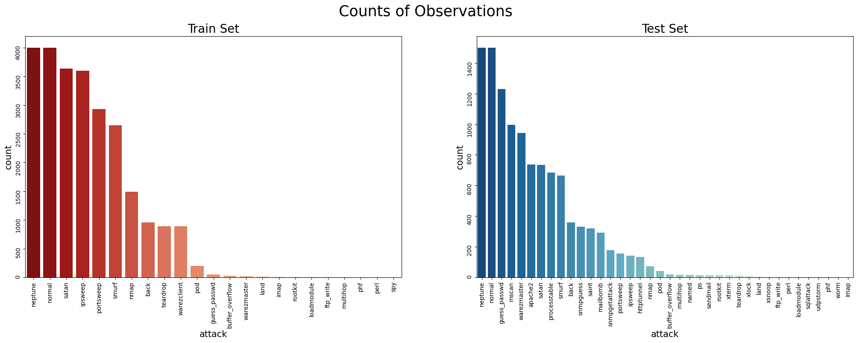
The Solution
Let's bring down 'normal; and 'neptune' data down to 4,000 records in the training set and 1500 records on the test set.

Slide 19
Challenge with the Dataset
There are 23 types of attack in the training dataset but 38 types of attack in the test dataset

Slide 20
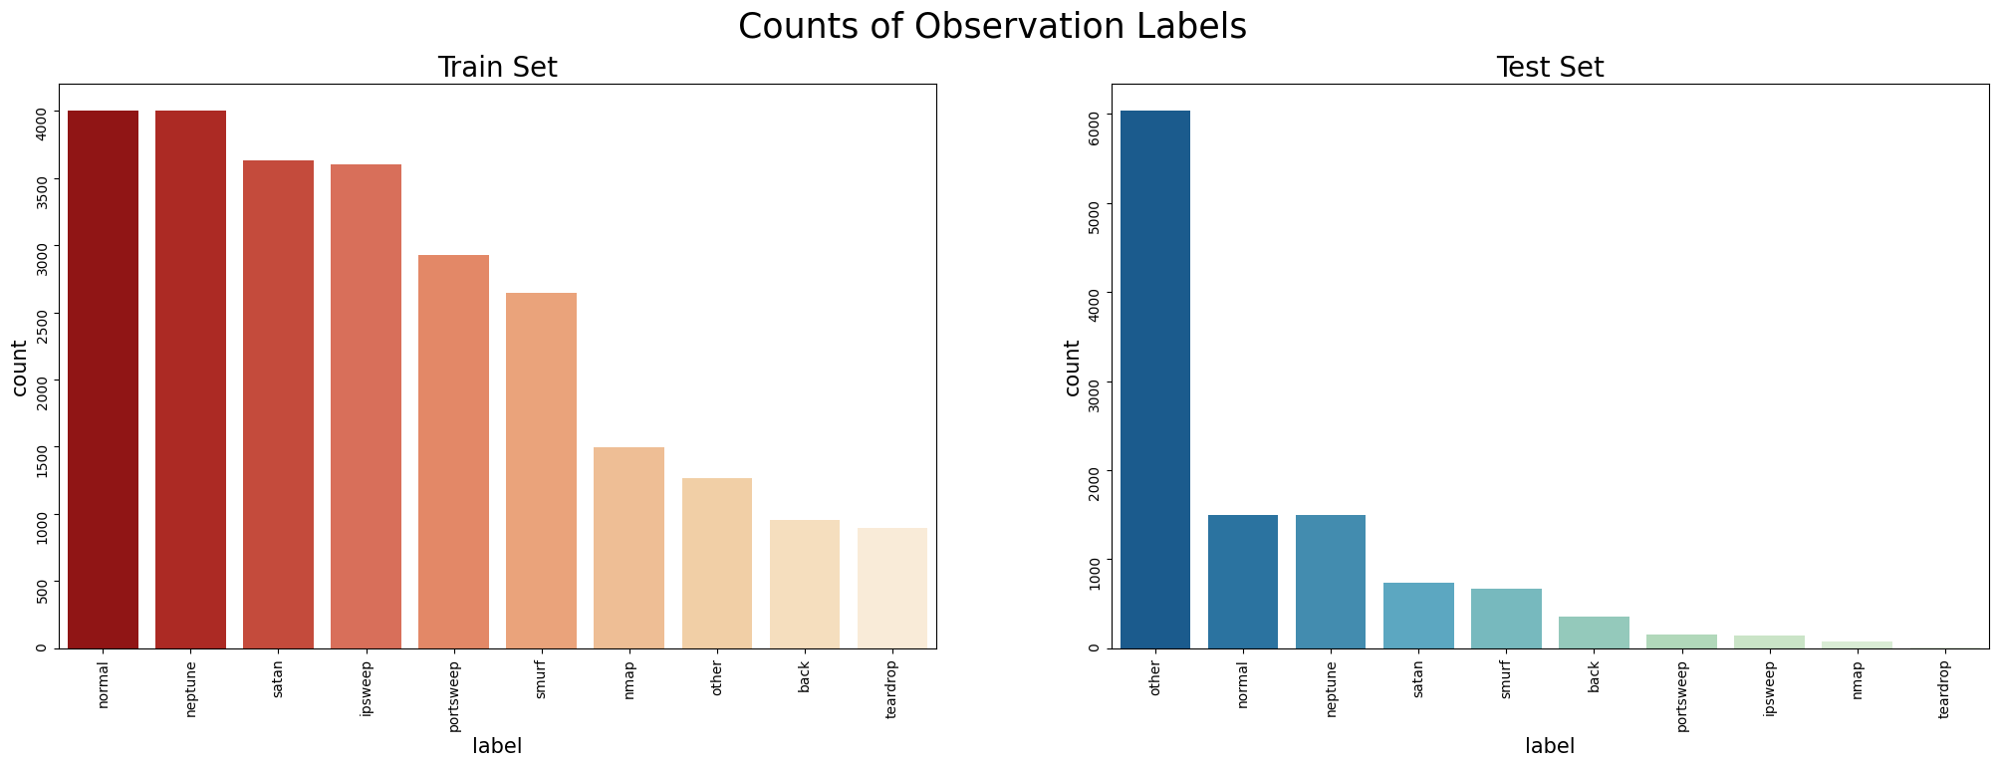
The Solution
Let’s keep the 9 specific attack types and assigning all other attack types to an 'other' category

Slide 21
The Challenge
We have too much data in the 'other' category on the test side

Slide 22
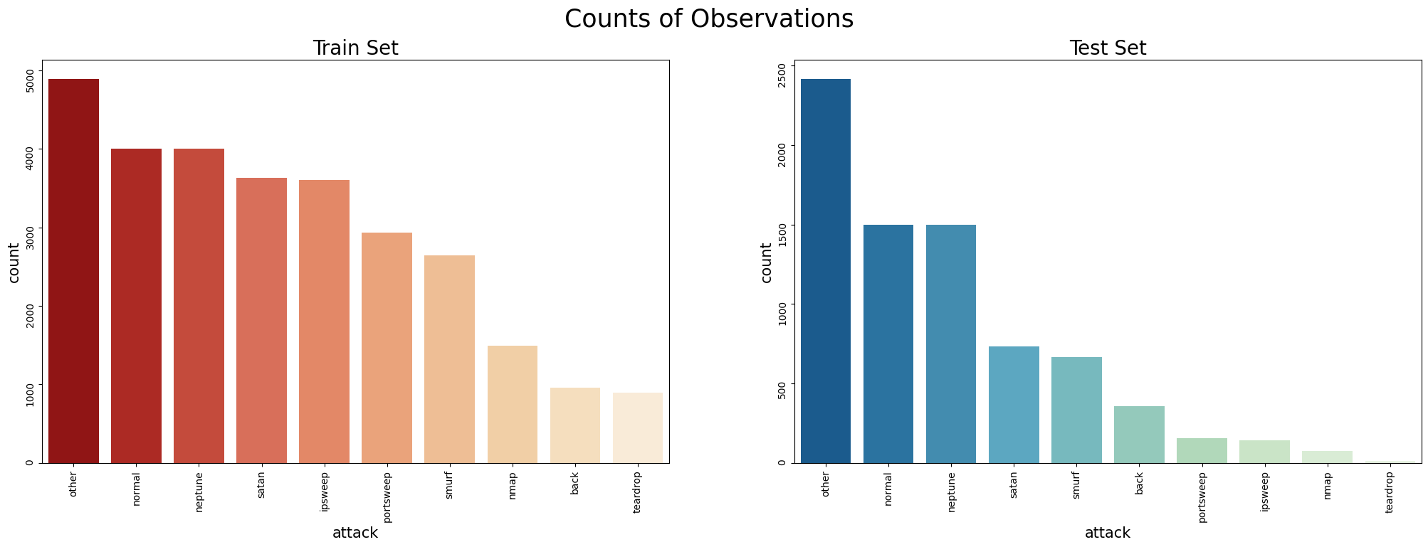
The Solution
Let's steal 60% of the other data from the test side and put them on the training side

Slide 23
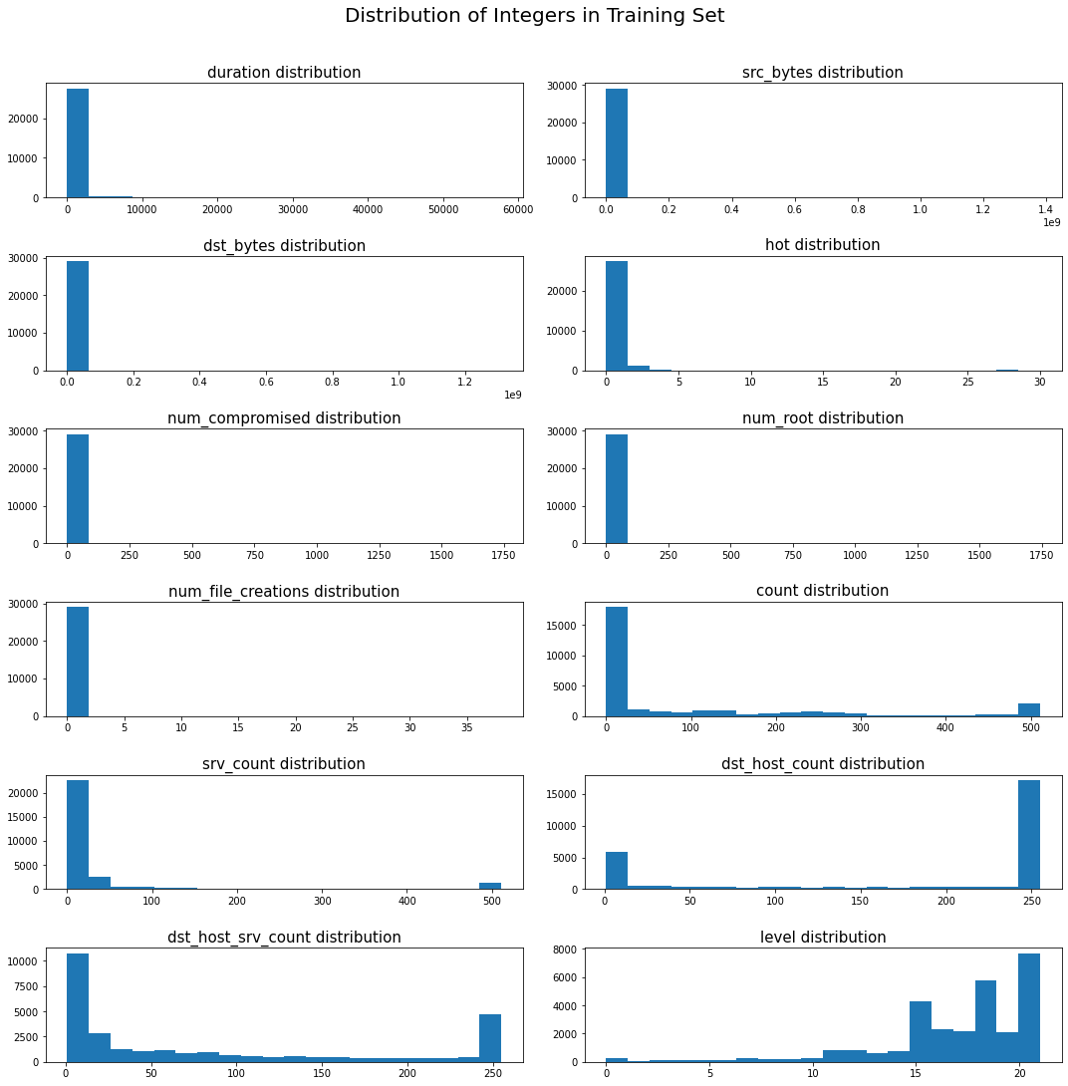
The Challenge
Most of the Integer data types are widespread in both sets

Slide 24
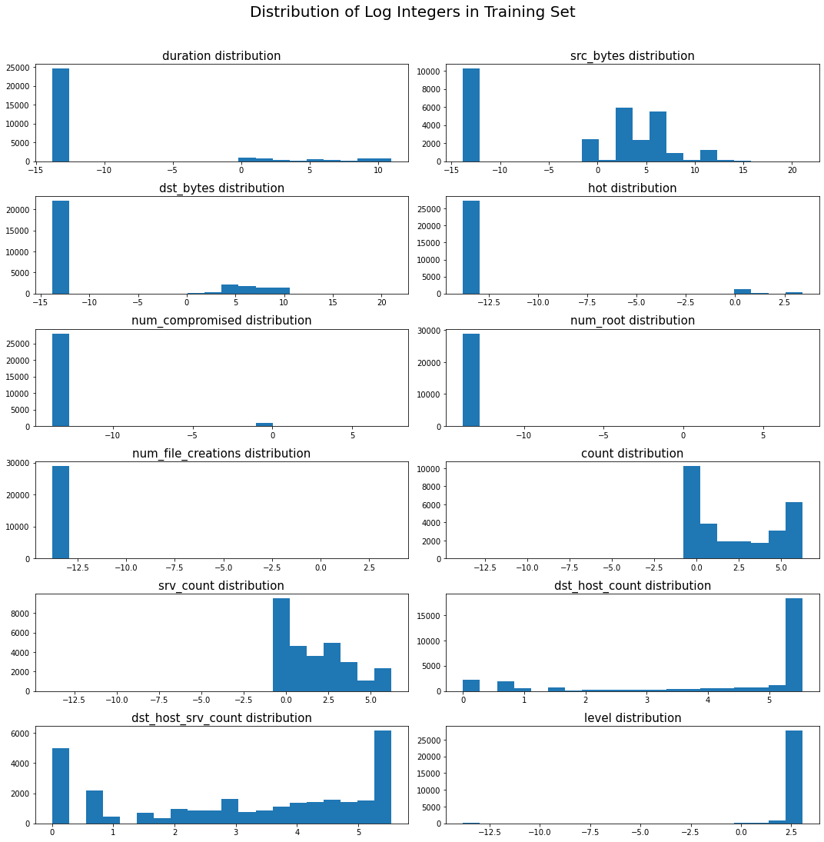
The Solution
Let's covert them to their log values for a smoother distribution set

Slide 25
The Challenge
There are string category values in the data
The Solution
Perform one-hot encoding on all of them

Slide 26
The Model
Deep Neuron Network with 3 hidden layers.
learning_rate=0.001
epochs = 25
batch_size = 2500

Slide 27
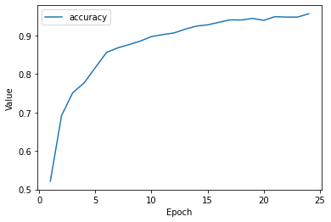
The Accuracy
Training Accuracy : 96.02%
Validation Accuracy : 95.51%
Testing Accuracy : 95.37%

Slide 28
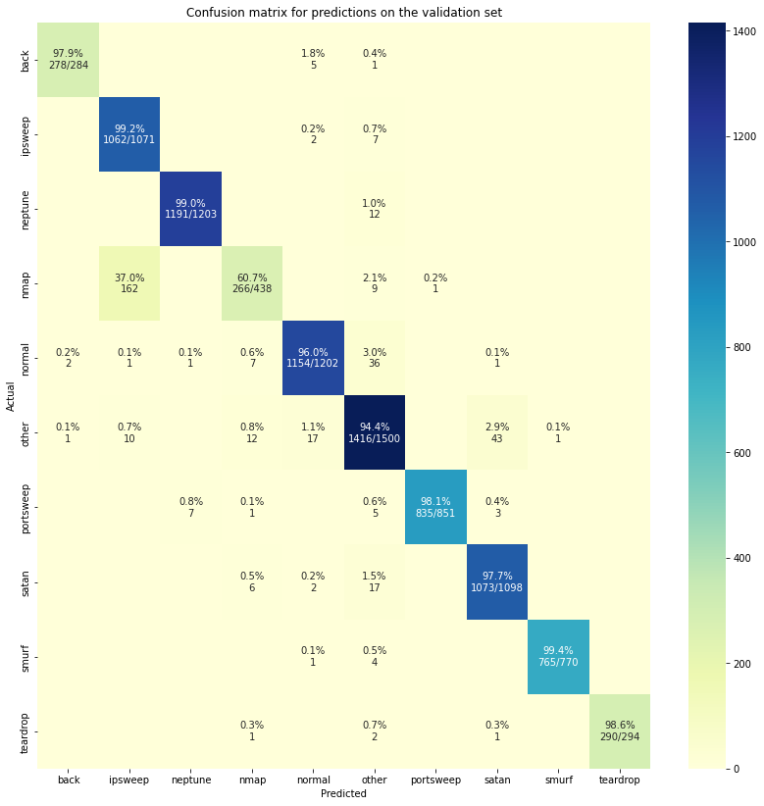
Confusion Matrix (Validation)

Slide 29
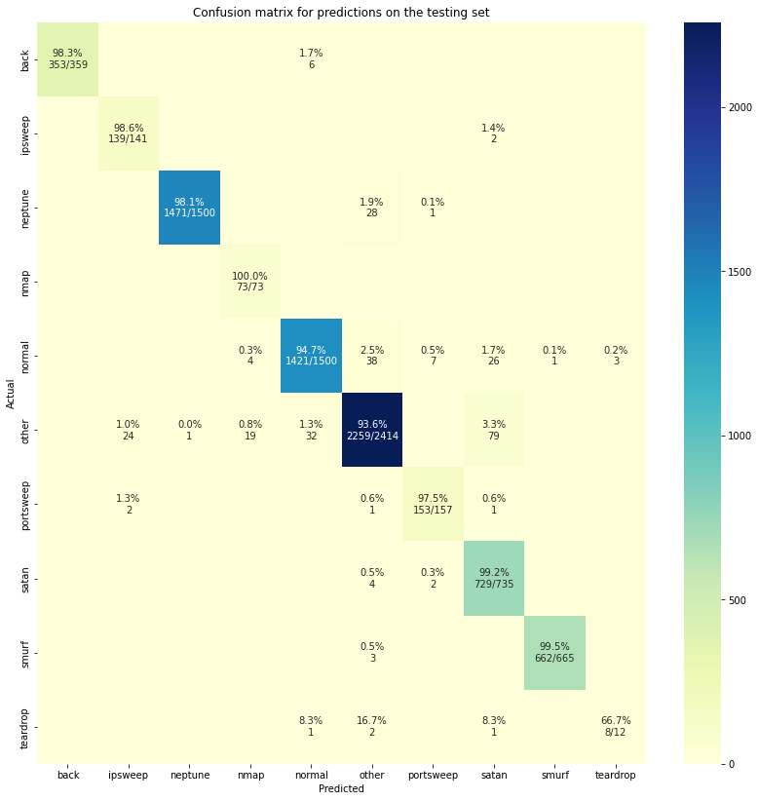
Confusion Matrix (Testing)

Slide 30
Conclusion
The model performed exceptionally well on all category predictions, except for the 'teardrop' category.
It's possible that the model struggled with the 'teardrop' category on the test dataset due to its limited representation in the dataset.
We can confidently say that we have a reliable and effective model since it performed just as well on the test dataset as it did on the training and validation datasets, indicating that the model is not over-fitted.

Slide 31
But Wait……..

Slide 32
Just kidding

Slide 33
Thank You

