Slide 1
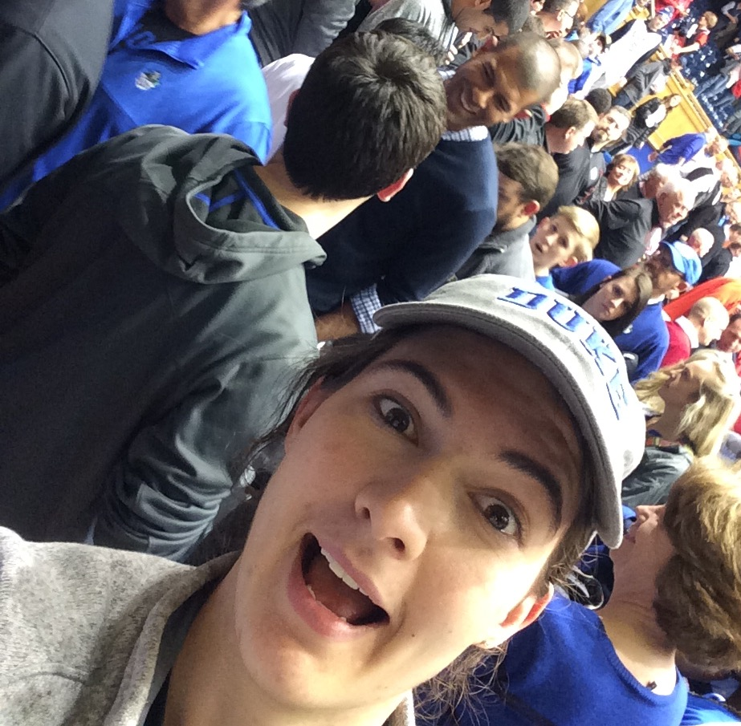
Predicting Runs
Nothing But Elastic Nets
Derek Owens-Fau, Federico Ferrari, Fan Bu, Megan Robertson

Slide 2
Defining an “exciting” run
Challenging part of the prompt
Impossible to incorporate every possible situation in the time frame
Determine a reasonable defintion
2
2

Slide 3
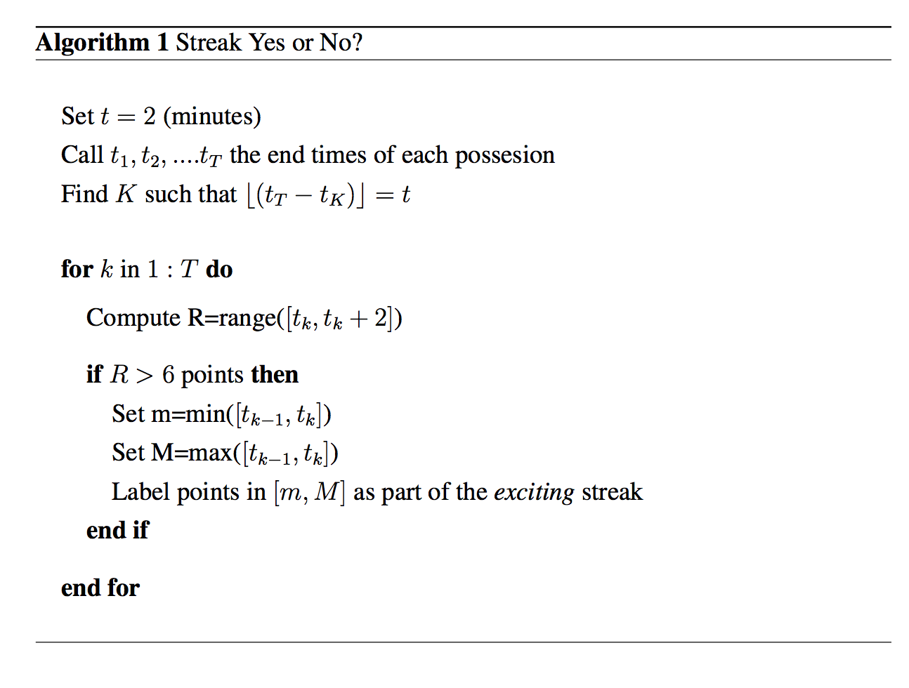
Defining an “exciting” run
ENGLISH
3
3

Slide 4
Defining an “exciting” run
Colorful plot
4
4

Slide 5
Feature Generation
Capturing the variability in defining a run
Measuring the pace – number of shots, number of rebounds
Accounting for player skill– how many all stars
Team – not all teams are created equal
5
5

Slide 6
Model
Subtitle
Bullet
Bullet
Visualization
6
6

Slide 7
Results
Subtitle
Bullet
Bullet
Visualization
7
7

Slide 8
Take Aways
Subtitle
Bullet
Bullet
Visualization
8
8

