Slide 1
DESIGN AND ANALYSIS OF ALGORITHMS
Dijkstra’s Algorithm
Finds the Cheapest Route
Single-source shortest paths · non-negative edge weights

Slide 2

THE PROBLEM
From a weighted graph to a shortest-path problem
Edge Types
Non‑negative weights labeled distance, time, or cost.
Given a source vertex s, find the minimum-cost path from s to every reachable vertex.
Shortest Distances
Computed d[v] values for all reachable vertices.
Predecessors
Edges carry non-negative weights: distance, time, cost, or another additive measure.
Return shortest distances, then reconstruct each path with predecessor pointers.
Predecessor pointers π[v] to reconstruct shortest paths.

Slide 3
THE GREEDY INVARIANT
The greedy choice makes one distance permanent
01
02
03
Maintain a tentative distance d[v] for every vertex. Start with d[s] = 0 and all others = ∞.
Choose the unvisited vertex with the smallest tentative distance.
Non-negative edges mean no later route can make that chosen distance smaller.
Estimate
Choose
Finalize
d[s] = 0; every other distance is ∞.
Take the smallest unsettled tentative distance.
That distance is now permanent.
Then relax its outgoing edges: d[v] ← min(d[v], d[u] + w(u,v))

Slide 4
WORKED TRACE
Step by step: settle, relax, repeat
ROUND 1 · SETTLE A
ROUND 2 · SETTLE C
ROUND 3 · SETTLE B
Start at A: d(A) = 0; all other distances are ∞.
Update B = 4, C = 1
C = 1
Improve B to 3; set D = 6
B = 3
Improve D to 5
FINAL PREDECESSORS
A
0
C
1
B
3
D
5
A→C · A→C→B · A→C→B→D
Settle D = 5; every chosen minimum is settled before the next one.

Slide 5
PSEUDOCODE
Initialize, extract, relax
THE TWO QUEUE OPERATIONS
EXTRACT-MIN
dist[s] ← 0
dist[v] ← ∞ for v ≠ s
Q ← all vertices in a min-priority queue
while Q is not empty:
u ← EXTRACT-MIN(Q)
for each edge (u, v):
if dist[v] > dist[u] + w(u,v):
dist[v] ← dist[u] + w(u,v)
parent[v] ← u
Removes the vertex with the smallest tentative distance and finalizes it.
DECREASE-KEY
Keeps a newly improved alternative near the front of the queue.
The queue determines how quickly the same algorithm runs.

Slide 6
IMPLEMENTATION CHOICE
The data structure changes the running time
ARRAY OR ADJACENCY MATRIX
BINARY HEAP + ADJACENCY LIST
O(V²)
O((V+E) log V)
Scan for the next minimum each round. A practical fit for dense graphs.
Extract and update priorities efficiently. A strong fit for sparse graphs.
Space: O(V+E) for the adjacency list, plus distances, parents, and the queue.

Slide 7
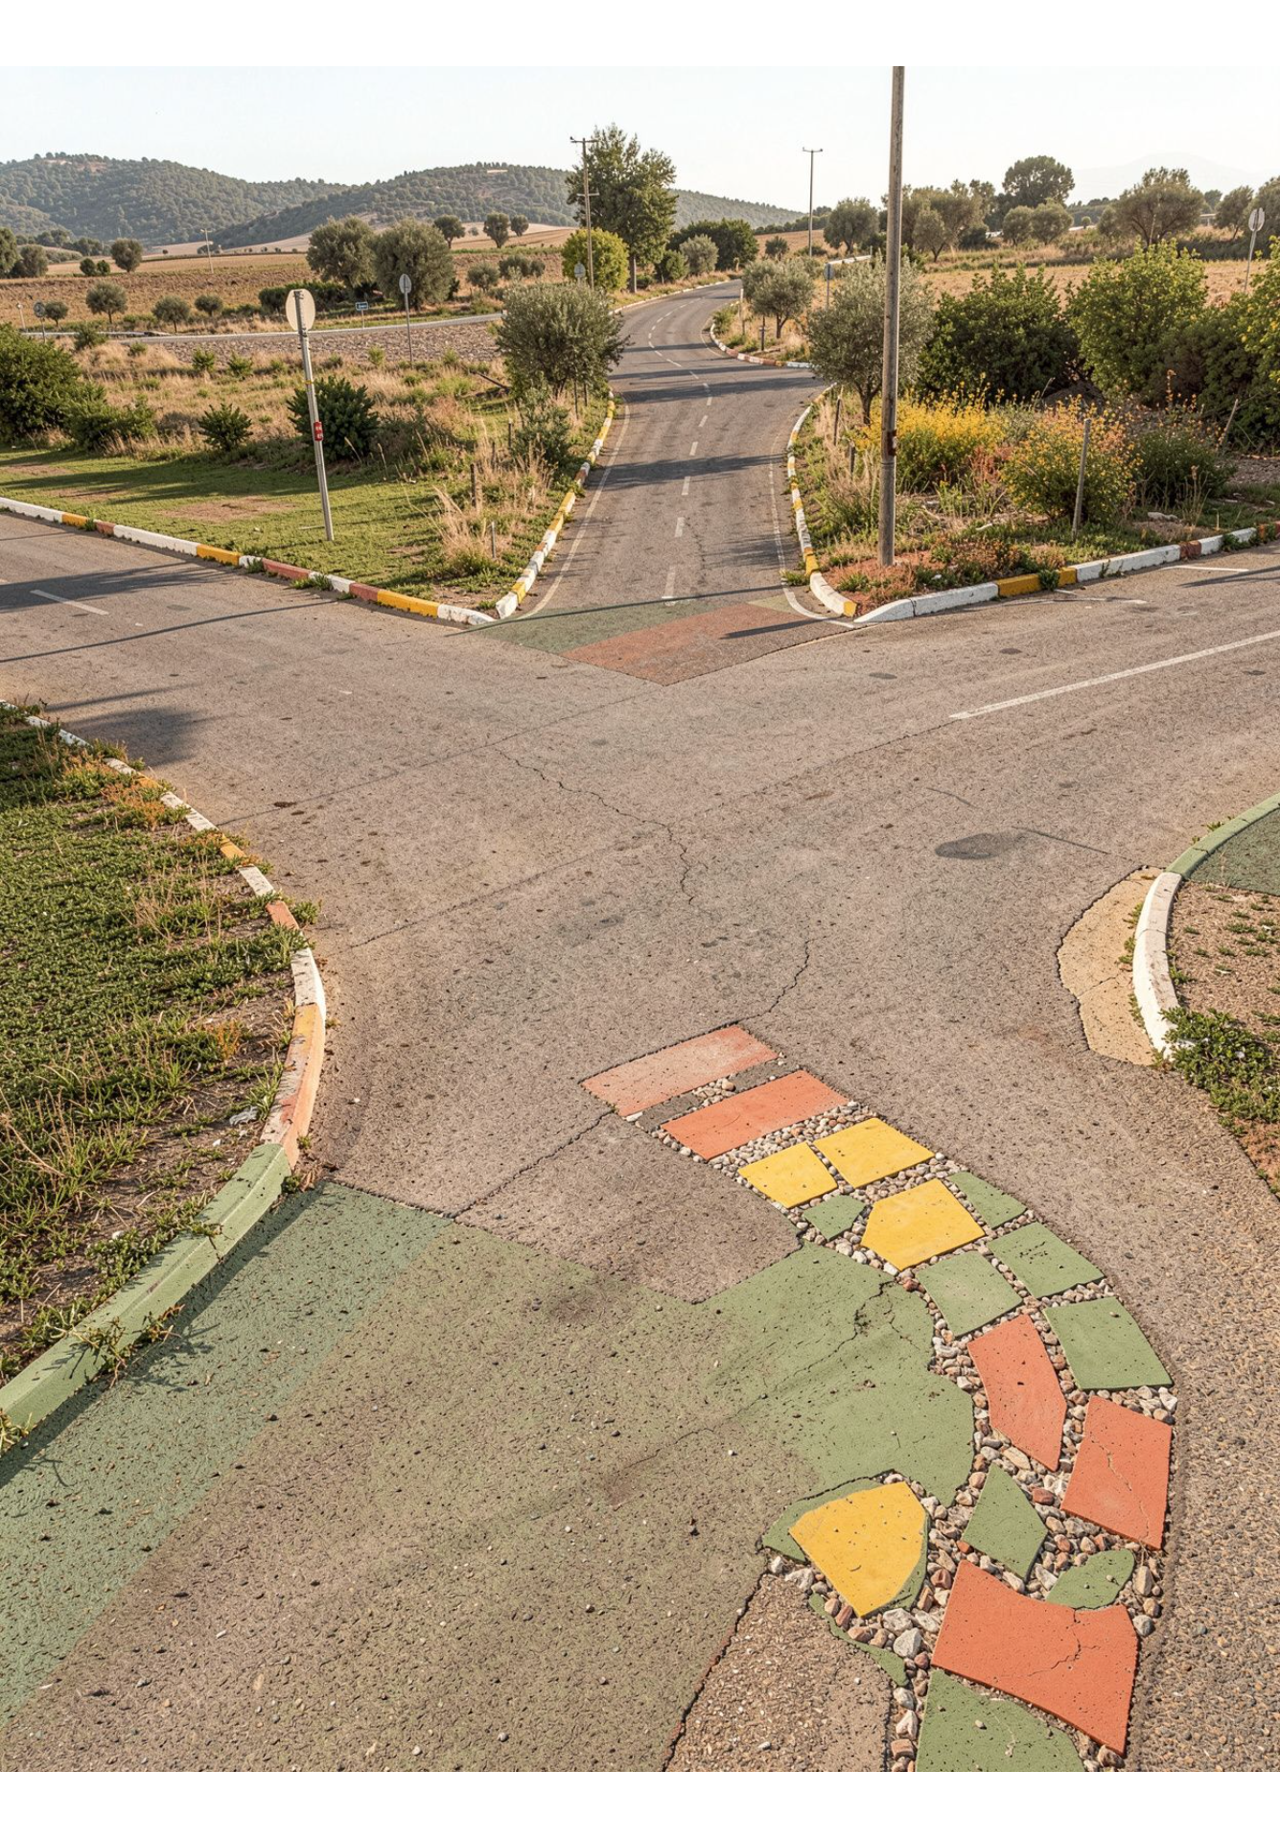
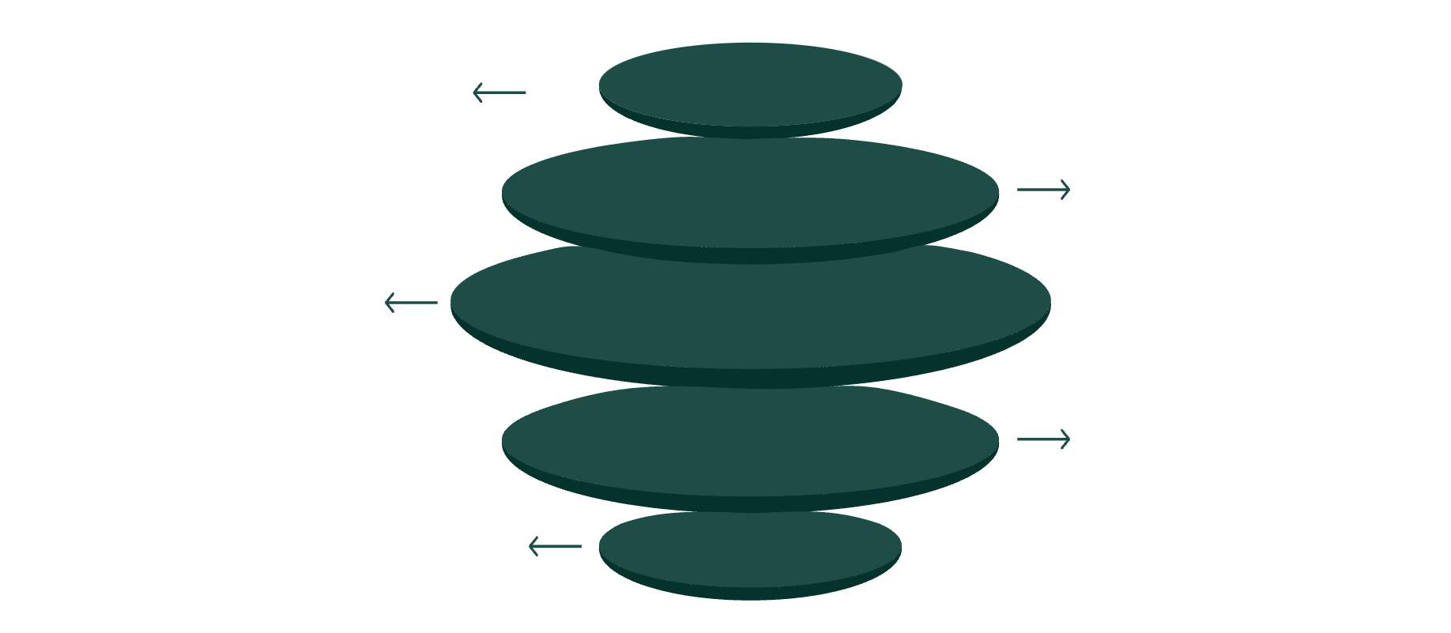
APPLICATIONS
When Dijkstra is the right tool
Use it when a route has additive cost and every edge weight is non-negative.
Core Cost
Non-negative route cost at center
Road Navigation
Distance and travel-time routing
Internet Routing
OSPF and IS-IS path selection
Robotics & Games
Low-cost movement planning
Network Design
Optimized routes for logistics
One pattern, many route systems.

Slide 8
TAKEAWAY
Remember the condition
and the pattern
01
02
Estimate
Choose
Start with tentative distances.
Take the smallest.
Dijkstra finds a shortest path from one source to every reachable vertex when edge weights are non-negative. Its greedy choice becomes globally correct when no edge can undo it.
03
04
Finalize
Relax
Make it permanent.
Improve neighbors.
Use Bellman–Ford when negative edges may exist. Use BFS when every edge has equal cost.

