Slide 1
Sexual Dimorphism in Drosophila prolongata

Slide 2
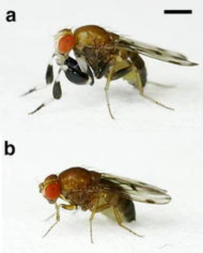
Model Species
In most species of Drosophila, females are larger than males
However, in D. prolongata, it is reversed
(a) Male and (b) female Drosophila prolongata adapted from Setoguchi et al. (2014)

Slide 3
Experiment
Treatment
27 species from D. melanogaster species group used
Our analysis just focuses on D. prolongata
Each group was exposed to increasing periods of starvation during larval development
Hypothesis
It was predicted that traits and species that were more sexually dimorphic would be more condition dependent than those that were less dimorphic

Slide 4
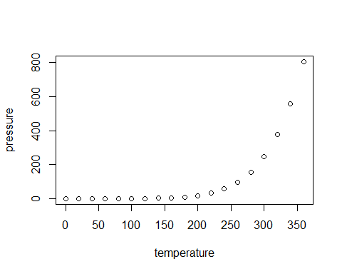
Data Analysis

