Slide 1
Sexual Dimorphism in Drosophila prolongata

Slide 2
Experiment
Treatment
27 species from D. melanogaster species group used
Our analysis just focuses on D. prolongata
Each group was exposed to increasing periods of starvation during larval development
(Pesevski, 2021)
Hypothesis
It was predicted that traits and species that were more sexually dimorphic would be more condition dependent than those that were less dimorphic

Slide 3
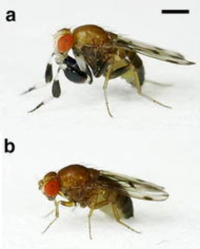
Model Species
In most species of Drosophila, females are larger than males
However, in D. prolongata, males are larger than females
Additionally, there is a particular distinction between their forelegs
This makes D. prolongata an excellent model for investigating how sexual dimorphism influences developmental growth
(a) Male and (b) female Drosophila prolongata adapted from Setoguchi et al. (2014)

Slide 4
Drosophila prolongata Initial Observations
D. prolongata has strong sexual dimorphism in tibia and tarsus size
despite this, they are only moderately condition dependent
all other species in the experiment exhibited moderate dimorphism and condition dependence
This leads us to a couple new hypotheses to investigate concerning D. prolongata
Starvation during larval development will decrease sexual dimorphism in forelegs
More sexually dimorphic traits (forelegs) will exhibit more condition dependence than less dimorphic traits (wings)

Slide 5
Proposed Analyses
Perform PCA analysis
allows us to investigate size without the influence of shape
log2 scaling
allows us to investigate proportional size differences instead of absolute
Multivariate Analysis
allows us to investigate each trait’s relationship to the others

Slide 6
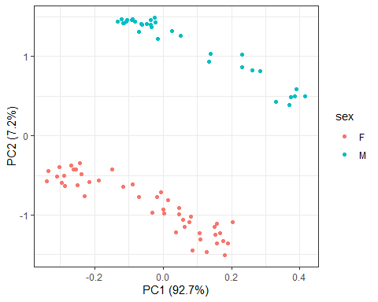
Principal Components Analysis
Trait | PC1 Loadings | PC2 Loadings
Tibia Length | 0.4987080 | -0.03130124
Tibia Width | 0.7313304 | 0.41634811
Tarsus Length | 0.4335791 | -0.33812703
Thorax Length | 0.1686874 | -0.84341247
PC1 accounts for most of the variation we see

Slide 7
Checking For Data Isometry
Since we are using a multivariate model on log-transformed data, we want to check that our loadings indicate isometry
This way, we can ensure that we have controlled for all non-size variation
Isometry is indicated when all PC1 loadings are equal to 1/√n (Jolicoeur, 1963)
Trait | PC1 Loadings
Tibia Length | 0.4987080
Tibia Width | 0.7313304
Tarsus Length | 0.4335791
Thorax Length | 0.1686874

Slide 8
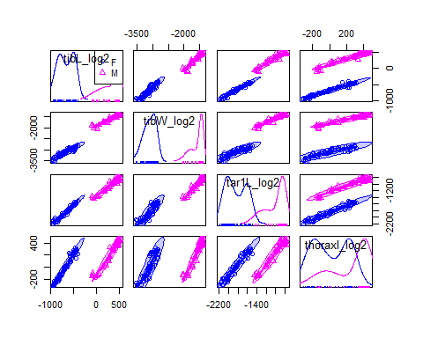
Multivariate Analysis: Why?

Slide 9
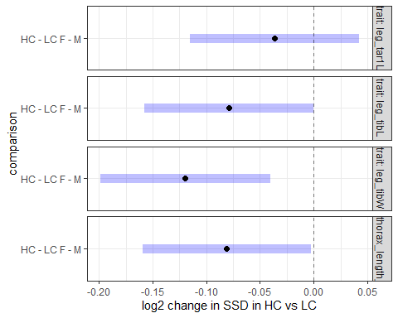
Multivariate Analysis

Slide 10
References
Jolicoeur, P. (1963). 193. Note: The Multivariate Generalization of the Allometry Equation. Biometrics, 19(3), 497–499. https://doi.org/10.2307/2527939
Pesevski, M. (2021). Influence of environmental variation on sexual dimorphism in Drosophila morphology among adaptively diverged populations and in an inter-specific comparative context. [Thesis]. https://macsphere.mcmaster.ca/handle/11375/26936
Setoguchi, S., Takamori, H., Aotsuka, T., Sese, J., & Matsuo, T. (2014). Sexual dimorphism and courtship behavior in Drosophila prolongata. Journal of Ethology, 32. https://doi.org/10.1007/s10164-014-0399-z\

