Slide 1
DAWG Spring 2019 session #1
Please download following software/programs:
QIIME1
In R, we will use the following packages:
BiocManager
ShortRead
devtools
dada2

Slide 2
DAWG (Data analysis Working Group)
Spring 2019
Microbiome Center
1-3 pm March 1st, March 29th, April 26th
Mara Cloutier
Sofia Roitman
Taejung Chung
Fabricio Vieira

Slide 3
Goals of DAWG
Provide a platform for Microbiome enthusiasts to share their bioinformatic expertise
Train students/post docs/ professors on bioinformatic software
Work through a dataset from start to finish

Slide 4
Next semester
Interested in being one of the group leaders?

Slide 5
DADA2
Machine learning algorithm that models the errors introduced during sequencing and uses the model to infer the TRUE sample composition
Has fewer spurious sequences
No singletons
Have exact sequences, rather than representative sequence
Easier to compare across studies

Slide 6
.sff to .fastq
What is an .sff? Standard flowgram format (SFF)
Flowgram file with info on sequence, quality, and signal strength
Need to convert .sff to .fna and .qual files
.fna = fasta nucleic acid, fasta format
.qual has the quality score (Phred score) information

Slide 7
Converting SFF to Fna & qual
QIIME1
conda create –n qiime1 python = 2.7 qiime matplotlib=1.4.3mock nose –c bioconda
source activate qiime1
print_qiime_config.py –t
cd ~/dawgfiles/
Process_sff.py –i ~/Directory

Slide 8
.fna & .qual to .fastq
QIIME1
convert_fastaqual_fastq.py -f /Users/admin/Downloads/IPQ6P9001.fna -q /Users/admin/Downloads/IPQ6P9001.qual -o /Users/admin//Downloads/fastq_file/
Contains sequences and a list of quality scores for each nucleotide

Slide 9
Demultiplex the fastq into 30 fastq files
QIIME1
split_libraries.py but produces .fasta files = no quality score information
www.mrdnafreesoftware.com has a ”Binning program” that is free to use

Slide 10
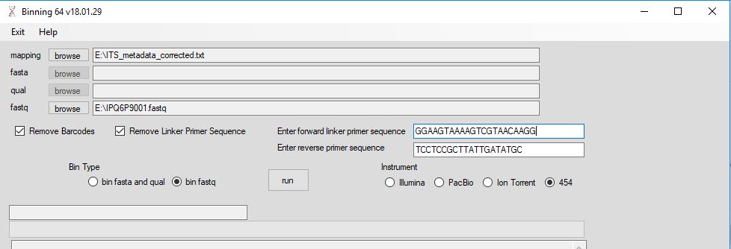
Binning program

Slide 11
MetaData file used for demultiplexing
Metadata files for demultiplexing samples need to have the barcodes that correspond to the individual samples
Create mapping file, save as .txt file
Validate_mapping_file.py –m /Berts_ITS_Data/ITS_Metadata.txt –o validate_mapping_file_output

Slide 12
Demultiplexing the fastq file
30 samples
1 fastq file
2 step process in qiime1
split_libraries.py –m /Users/admin/Downloads/mapping_output/ITS_metadata_corrected.txt -f /Users/admin/Downloads/IPQ6P9001.fna -q /Users/admin/Downloads/IPQ6P9001.qual -b 10 -o split_library_output
this removes the forward primer and barcode, but what about the reverse primer?

Slide 13
Removing reverse primer before demultiplexing
truncate_reverse_primer.py -f ~/Downloads/Berts_ITS_Data/split_library_output/seqs.fna -m ~/Downloads/Berts_ITS_Data/ITS_metadata_corrected.txt -o ~/Downloads/Berts_ITS_Data/FastaNoPrimers/

Slide 14
Demultiplex Samples fastX barcode splitter
split_sequence_file_on_sample_ids.py -i ~/Downloads/Berts_ITS_Data/FastaNoPrimers/seqs_rev_primer_truncated.fna -o ~/Downloads/Berts_ITS_Data/demultiplexed_new/

