Slide 1
Task 2 - Exploratory Data Analysis & Business Intelligence
MARADANA VINAY SAI
RAGHU ENGINEERING COLLEGE

Slide 2
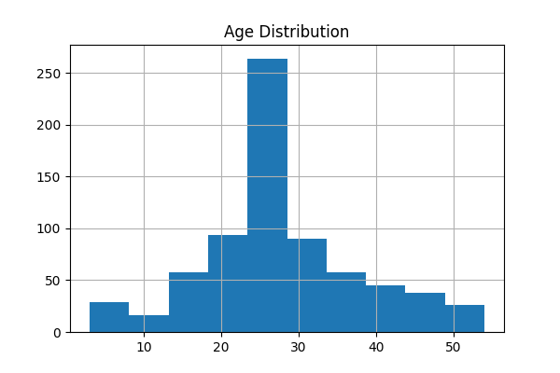
Age Distribution
Key Insight
Most passengers were between 20 and 35 years old. Young adults formed the largest segment.

Slide 3
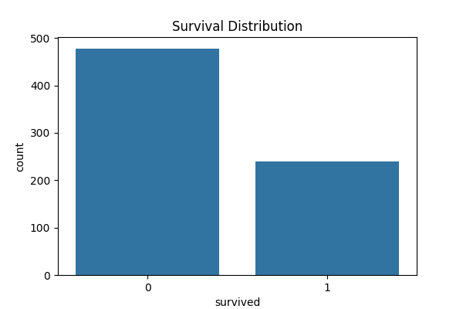
Survival Distribution
Key Insight
240 survived and 478 did not survive. Survival rate ≈ 33.4%.

Slide 4

Gender Distribution
Key Insight
489 males and 229 females. Male passengers dominated the dataset.

Slide 5
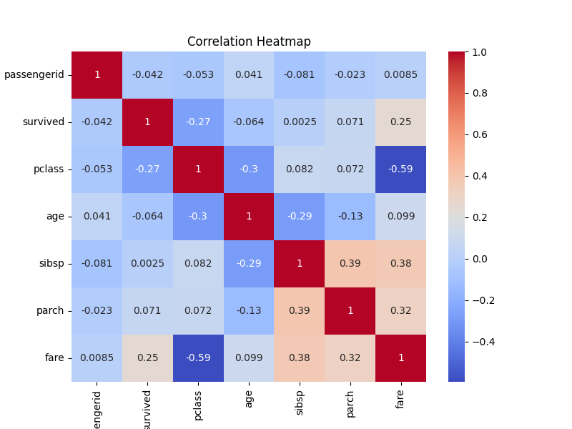
Correlation Heatmap
Key Insight
Fare has a strong negative relationship with passenger class. Survival is influenced by class.

Slide 6
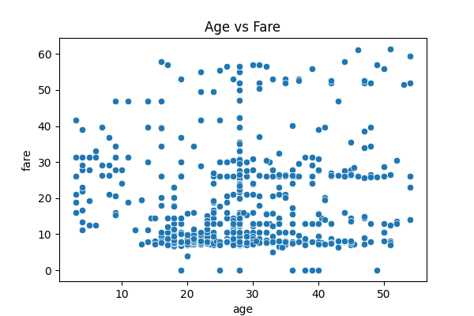
Age vs Fare Analysis
Key Insight
No strong age-fare correlation. Higher fares are spread across multiple age groups.

Slide 7

SQL Query Results

Slide 8
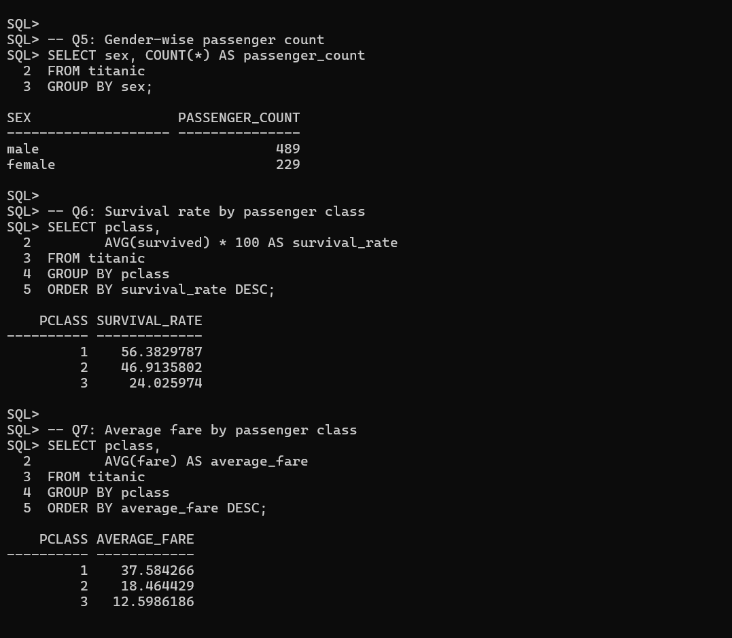
SQL Query Results (Continued)

Slide 9
Executive Dashboard Summary
Passengers
718
Survivors
240
Avg Age
28.08
Avg Fare
17.19

Slide 10
Conclusion
This analysis transformed raw Titanic passenger data into meaningful business insights. EDA revealed that passenger class, fare, and gender significantly influenced survival outcomes. The combination of Python visualizations, SQL-based business queries, and dashboard reporting provided a clear understanding of passenger demographics and survival patterns. This project demonstrates practical skills in Data Cleaning, Exploratory Data Analysis, SQL, Data Visualization, and Business Intelligence reporting.

