Slide 1
How did we fix DRM in Portugal (and so can you)
Marcos Marado
Paula Simões
https://ansol.org

Slide 2
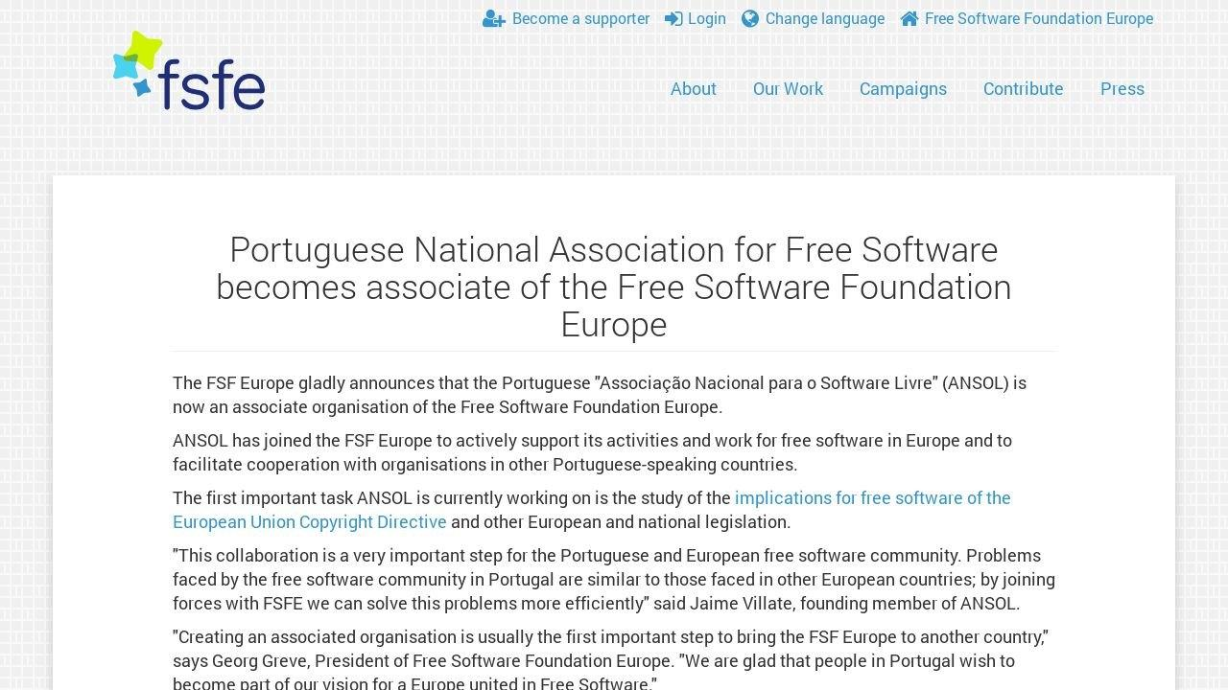

Slide 3
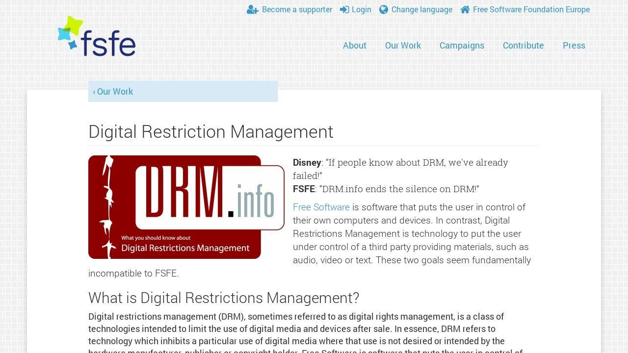

Slide 4
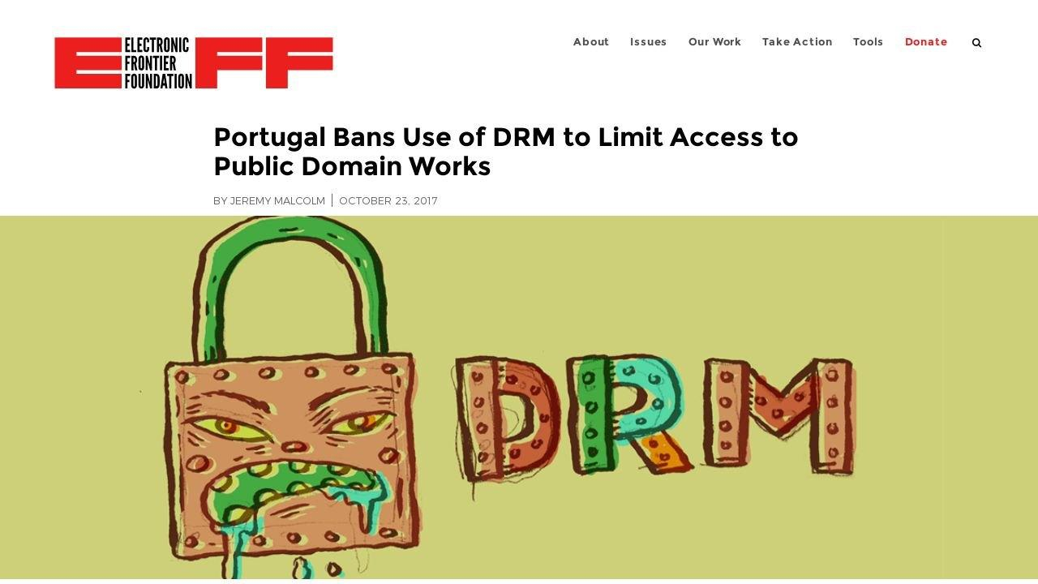

Slide 5
The new DRM law in Portugal in detail
extending DRM’s definition:
Article 217º […] the expression “technological measures” means any technology, device or component that, in the normal course of its operation, is designed to prevent or restrict acts, in respect of protected works, that are not exceptions to the copyright, provided in the nº 2 of the article 75º, in the article 81º, in the nº4 of the article 152º and in the nº1 of the article […]
making it clear: DRM cannot prevent the exercise of exceptions because the law does not consider it DRM

Slide 6
The new DRM law in Portugal in detail
extending DRM’s definition
making it clear
oh, BTW: it is not legal to apply DRM on public domain works
  which was actually already the case, since only creators (not rightholders) can decide that their work can have DRM, the “small victory” we managed to get during InfoSoc’s transposition
but since we had to make it clear, we also pushed it: you also can’t put DRM on works released by public entities or with public money

Slide 7
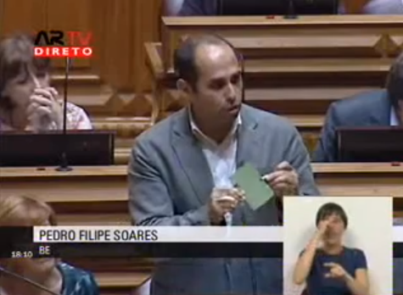
How did we manage it (and so can you)
Test the Law
Awareness & Education
Persistence
Work within the framework
Make the (apparent) opposition
talk
present your alternative

