Slide 1
rObotics
Marah Othman

Slide 2
problem
Due to the increase in the number of elderly people and the insufficient number of nurses in return.

Slide 3
ROBOTICS
a branch of engineering and science

Slide 4
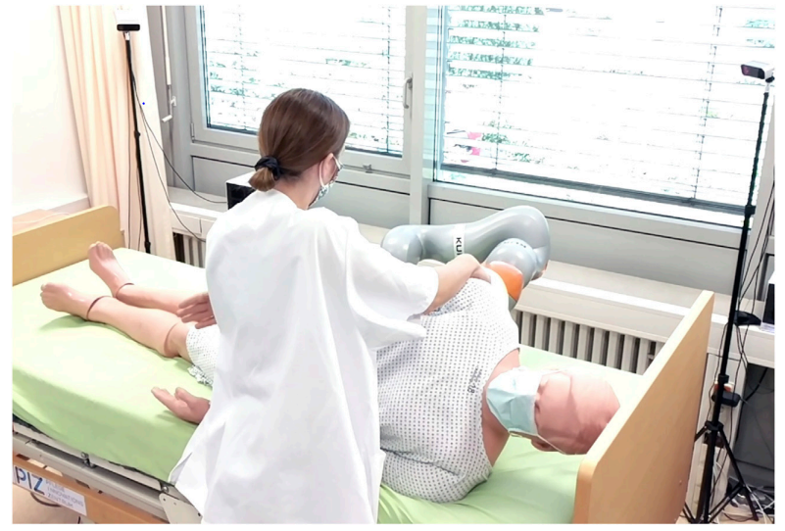

Slide 5
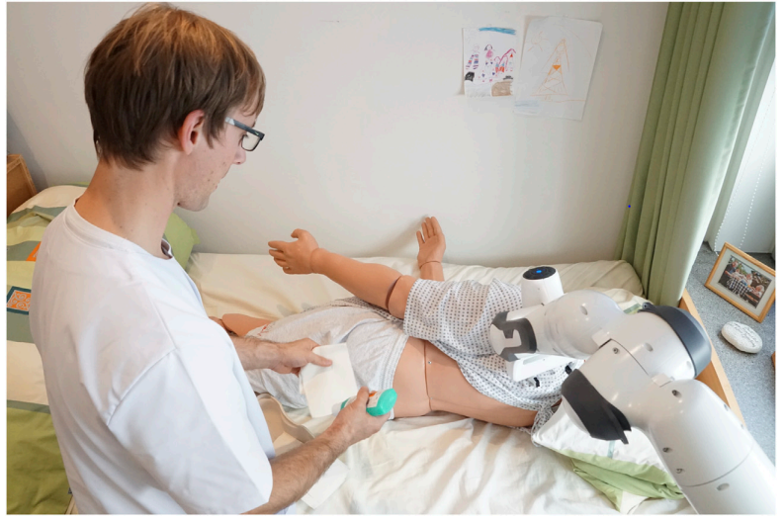

Slide 6
More Examples:
. Teaching :
Help children like the robot Kaspar.
. Logistics:
providing tools or information like the
Robot TUG
. Therapy support:
Increase mental activity for old people like the robot Mini .

Slide 7
pros
. Increase autonomy of the patient
. Lower cost
. Quick to train
. Easy to repair
. Protect human nurses
. Continuous monitoring
. High level of accuracy and constantly

Slide 8
cons
. Delays in ethical decision-making
. Concerns about safety and security
. Dignity and the happiness of the patients
. Discourage people from pursuing nursing careers
. Concern about privacy
. Accountability issues

Slide 9
SOLUTION
These cons highlight the need for a careful and balanced approach to integrating robotics into healthcare, ensuring that while they can offer efficiency and support, they do not replace the essential human elements of empathy, personal interaction, and ethical decision-making in patient care ,should put some constraints (taxes).

Slide 10
Green technologies
Using robots in energy-efficient ways, reducing waste, and supporting overall environmental goals.

Slide 11
What do you think ?

Slide 12
References
https://www.frontiersin.org/articles/10.3389/frobt.2022.832248/full
https://www.online-sciences.com/robotics/healthcare-robotics-nursing-care-robots-review-types-advantages-disadvantages-uses/#:~:text=Robot nurses are quicker to,to hazardous infections or chemicals
https://transitions2050.ademe.fr/en

Slide 13
THANK YOU

