Slide 1
Payroll
Payroll human
resources salary

Slide 2
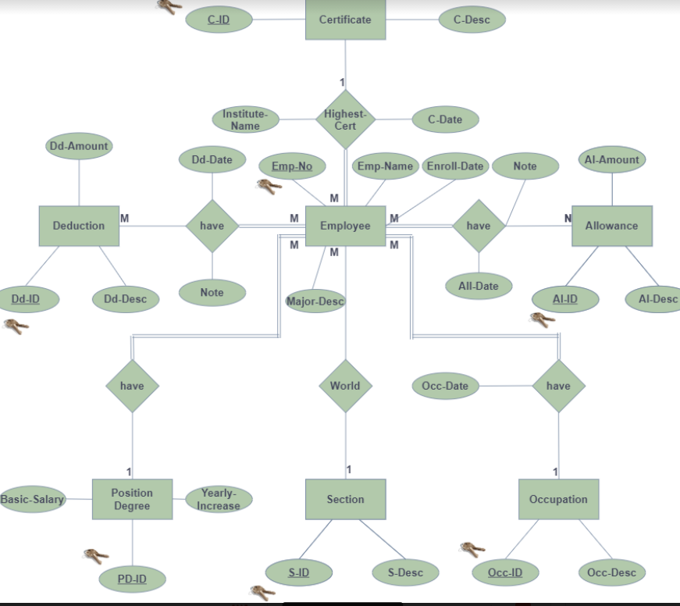

Slide 3

OverView Of Spark Company
Spark works in several fields, the most important of which is the study of companies’ projects and the construction and development of appropriate plans for them, as 20 employees work in a company in partnership with Al-Israa Company

Slide 4
The company consists of two Sections
Management Consulting Department
IT Department
which studies the following
market studies
business lines
various new projects
which contains three software
production management system
archiving management system
maintenance management system.

Slide 5
We are interested in creating a database that describes the employee’s data, especially the total salary for each month, according to their academic degrees and jobs
To begin with only an introduction to the company and the nature of the employees work in

Slide 6

The proposed project "Employee Database and Payroll Management System” for Spark company.
has been implemented. It was developed to overcome the problems encountered in the practice of the manual system. This program It is designed to eliminate and, in some cases, reduce the difficulties of the current system. Moreover, this system is designed to meet the company's special needs for its implementation operations in a smooth and efficient manner.

Slide 7
this project is in order to help the manager get rid of the paper system for employees' salaries and replace it with the electronic one through: The administrator is logged in with a valid username and password. The administrator can add a new employee, add new department, add new salary grade for employees. Administrator can set 'from' and 'to' date Work by an employee in a department with a specified salary grade. Administrator can create a file Automated monthly salary for the employee. Administrator can view all previous records of any file

Slide 8
The Equation…
Total_Salary = Basic_Salary+Allowances - Deductions

Slide 10
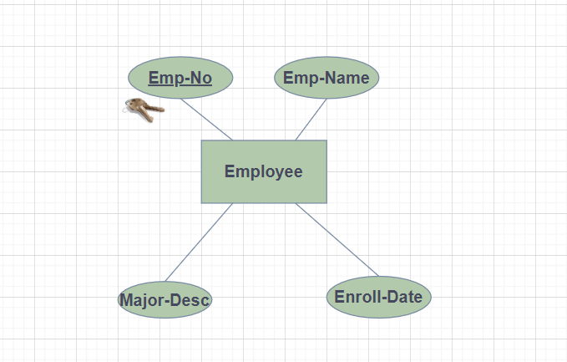

Slide 11
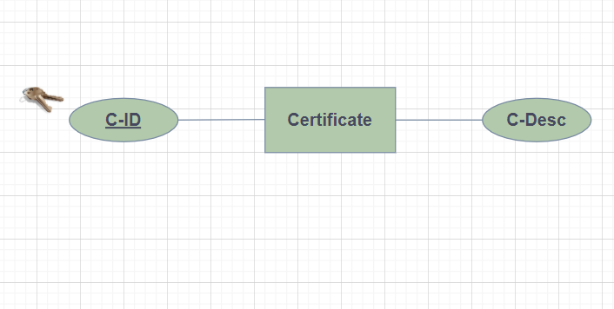

Slide 12
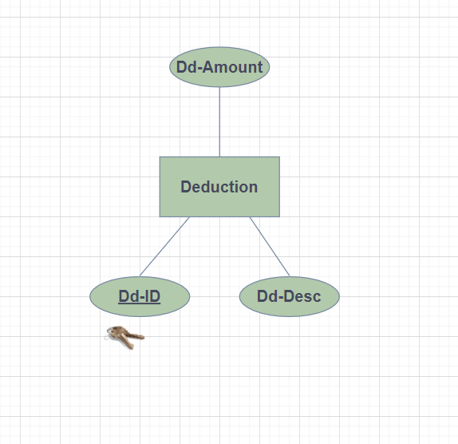

Slide 13
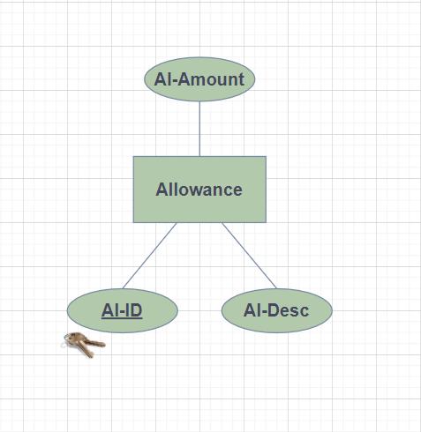

Slide 14
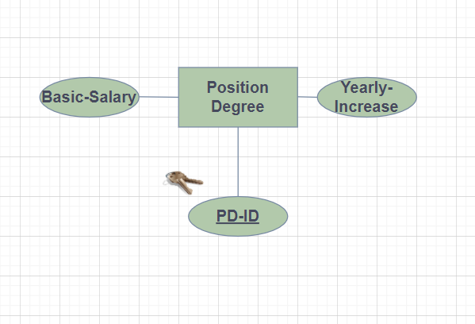

Slide 15
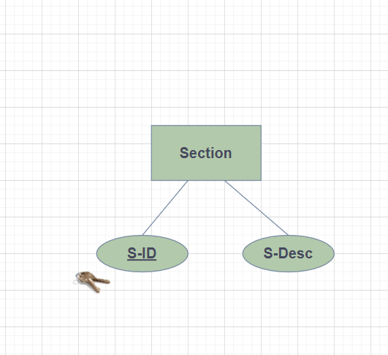

Slide 16
