Slide 1
Android Internals
Marakana
John Lombardo
John@Lombardos.org

Slide 2
Class introductions
name?
what do you do?
previous experiences relevant to the course?
Android app development?
Linux Kernel / Driver development?
C / C++?
Java?
what do you want to get out of the training?

Slide 3
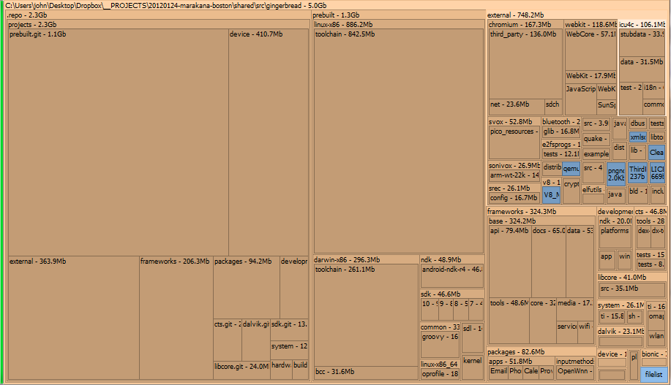
Why is the Android source so big?

Slide 4
Development Environment Setup
See
http://marakana.com/support/androidinternals_setup.html
Alternative 1
Install VMWare Player
Any 4.x version of player
You may need to register
Load “Marabuntu” VM
Alternative 2
Install Ubuntu 10.04
Configure as directed on the Android site.

Slide 5
Configure BIOS for Hardware Assisted Virtualization (HAV) PCs
http://goo.gl/5ZP3l
Although OEMs have been shipping hardware virtualization in PCs for three years, hardware virtualization is not available in all PCs—so even if your PC is new, it may not have hardware virtualization. Additionally, those PCs with hardware virtualization have it turned off by default, so you will need to turn on the hardware virtualization capability before you can use it.
Thanks, Mat!

Slide 6
Questions?

