Slide 1
Android Internals
Marakana
John Lombardo
John@Lombardos.org

Slide 2
Schedule
Day 1
Overview
Android Stack
Android Boot
Day 2 morning
Android JNI & NDK
Day 2 afternoon
NDK Sable APIs
Android Binder + AIDL
Building Android
Day 3 morning
Customizing Android
Day 3 afternoon
Customizing Android
Android Security

Slide 3
Class introductions
name?
what do you do?
previous experiences relevant to the course?
Android app development?
Linux Kernel / Driver development?
C / C++?
Java?
what do you want to get out of the training?

Slide 4
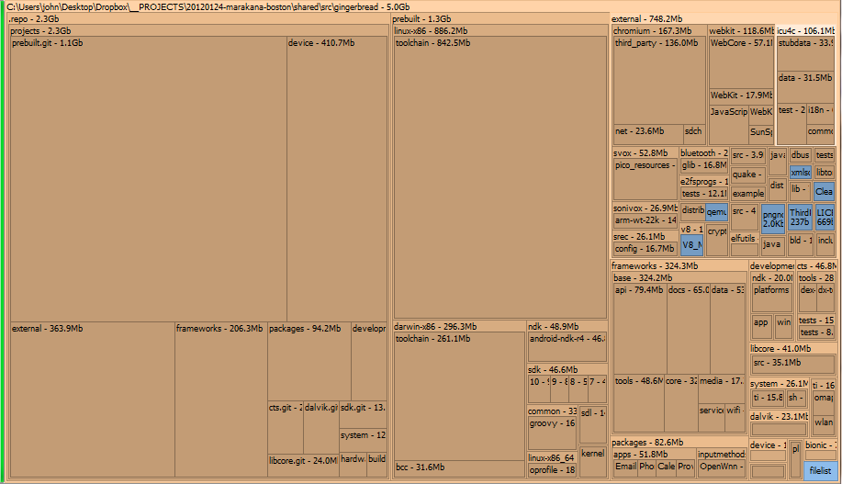
Why’s it so big?

Slide 5
Development Environment Setup
See
http://marakana.com/support/androidinternals_setup.html
Alternative 1
Install VMWare Player
Any 4.x version of player
You may need to register
Load “Marabuntu” VM
Alternative 2
Install Ubuntu 10.04
Configure as directed on the Android site.

Slide 6
Configure BIOS for Hardware Assisted Virtualization (HAV) PCs
http://goo.gl/5ZP3l
Although OEMs have been shipping hardware virtualization in PCs for three years, hardware virtualization is not available in all PCs—so even if your PC is new, it may not have hardware virtualization. Additionally, those PCs with hardware virtualization have it turned off by default, so you will need to turn on the hardware virtualization capability before you can use it.
Thanks, Mat!

Slide 7
Questions?

